Slide 1
LA County Crime rate trend prediction
Presented by:
Thant Thiri M. Kyi
(Springboard Data Science Career Track, July 2023 Cohort)

Slide 2
Understanding Top 5 Frequent Crime Patterns in Los Angeles: A Data-Driven Approach
Context
Los Angeles, known for its dynamic urban landscape, faces challenges with varying crime rates.Recognizing the need for a proactive approach to community safety.
Problem Definition
The persistent issue of crime necessitates innovative solutions.
Utilizing data analysis to uncover crime trends and predict future patterns.
Project Objective
To develop a predictive model that analyses historical crime data.
Aiming to provide insights that assist in informed decision-making for community welfare.
Impact
Highlighting the potential of data-driven strategies in enhancing public safety measures.
Empowering communities with knowledge for better preparedness and response.

Slide 3
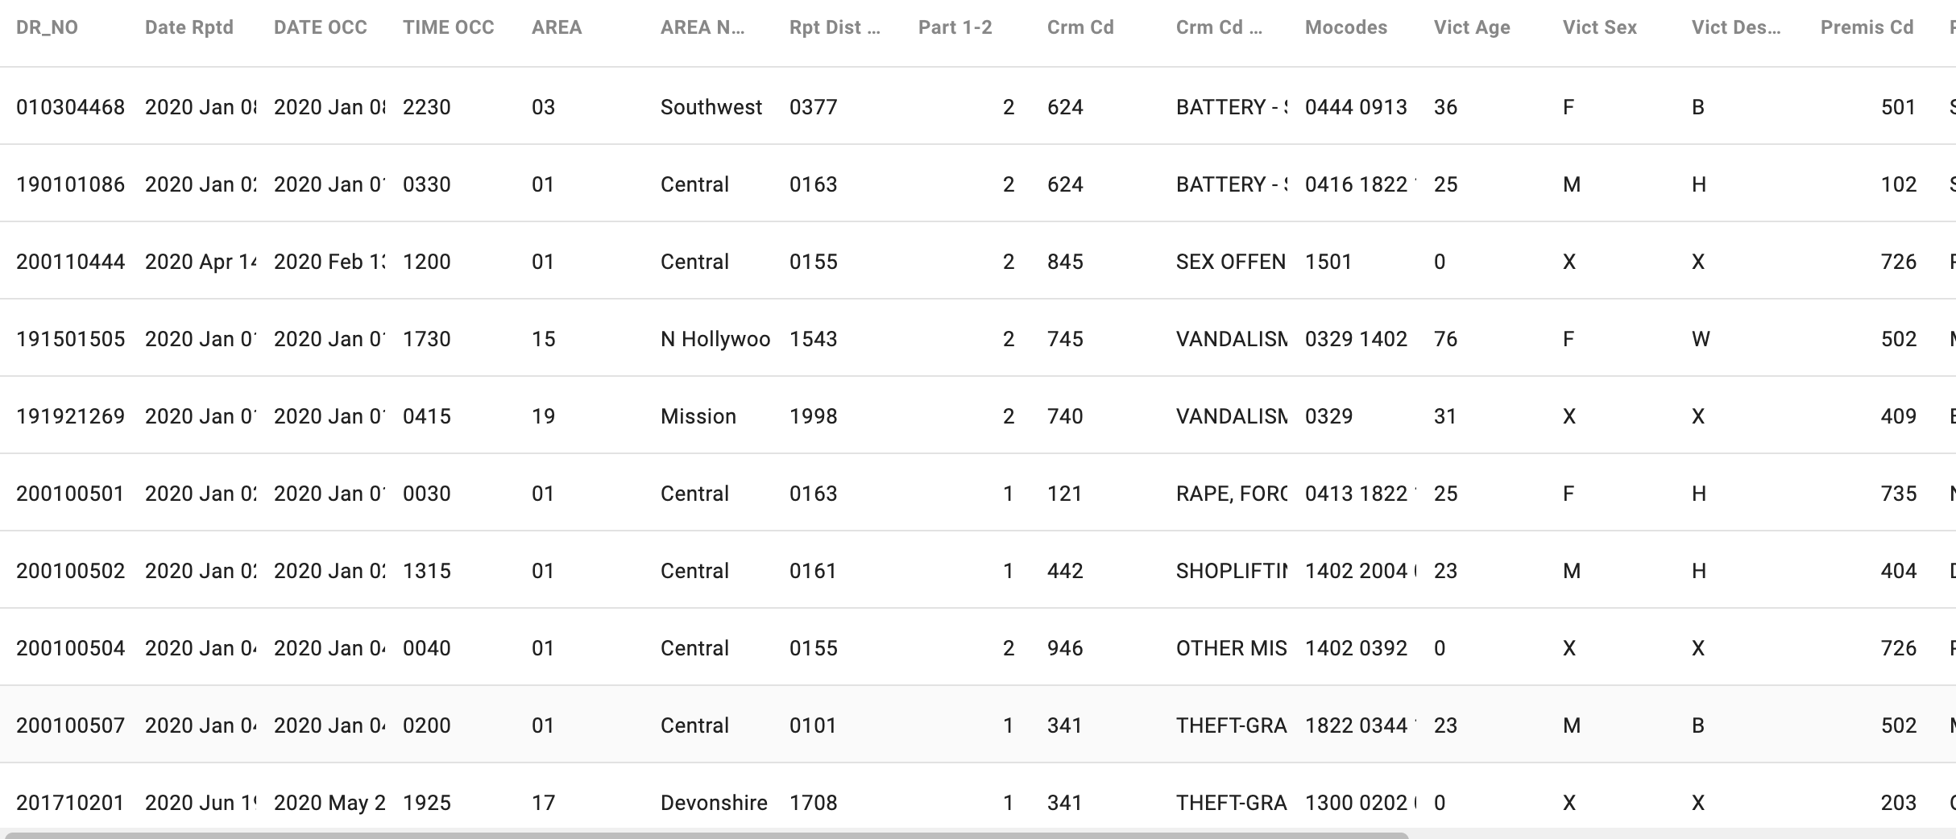
Data Acquisition
Data Source:
Los Angeles city public data website (https://data.lacity.org/Public-Safety/Crime-Data-from-2010-to-2019/63jg-8b9z/explore ,
https://data.lacity.org/Public-Safety/Crime-Data-from-2020-to-Present/2nrs-mtv8)
Time Range: 2012-2023
Record Count: ~3 million (2,993,433)
Key Variables:
Crime Codes, Modus Operandi, Victim's Age, Sex, Descent
Premise Type, Weapon Used, Case Status
Crime Severity (Crm Cd 1-4)
Location Details (Address, Latitude, Longitude)

Slide 4
Data Waggling
Initial Data Processing:
Merged two datasets (2010-2019, 2020-present)
Standardized column names
Filled missing values in key columns
Data Transformation:
Renamed 'LAT' and 'LON' to 'latitude' and 'longitude'
Derived date and time components from 'DATE_OCC'
Mapped codes to descriptions for better readability
Cleaning and Exploration:
Excluded incomplete year data (2023)
Dropped duplicates, sorted, and reindexed
Analysed crime frequency by area and weekdays
Final Data State:
Total Records: 2,707,190
Total Columns: 18
Output File: 'cleaned_crime_data.csv'

Slide 5
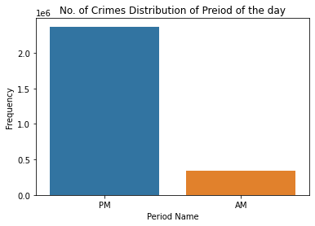
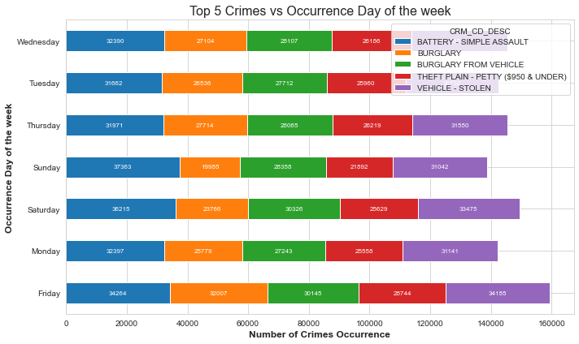
Time-Based Analysis - EDA
EDA Overview:
Dataset: 'cleaned_crime_data.csv' (2010-2022)
Focus: Timeframe, Weekdays, Crime Categories, Victim Characteristics, Area of Occurrence
Crime Occurrence by Time:
Weekdays: Higher incidents on Fridays and Saturdays, lowest on Sundays (Figure 1)
Time of Day: Evenings see the highest crime rates (Figure 2)

Slide 6
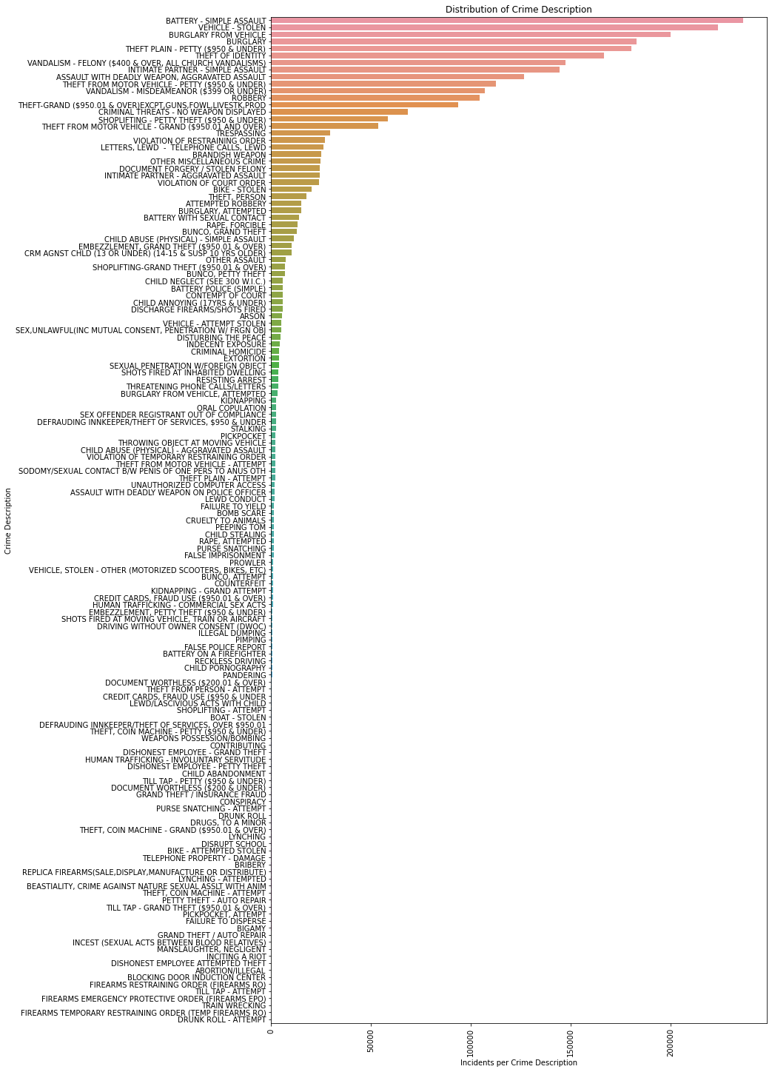
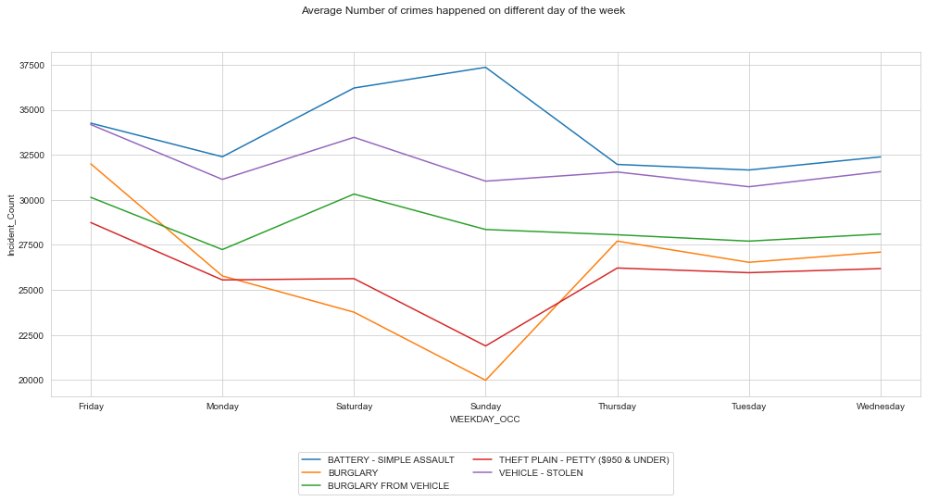
Crime Description Analysis:- EDA
Crime Description Analysis:
Common Crimes: Assault, Theft, Burglary
Trend Analysis: 'Battery - Simple Assault' highest but inconsistent; 'Assault with Deadly Weapon' on an upward trend.

Slide 7
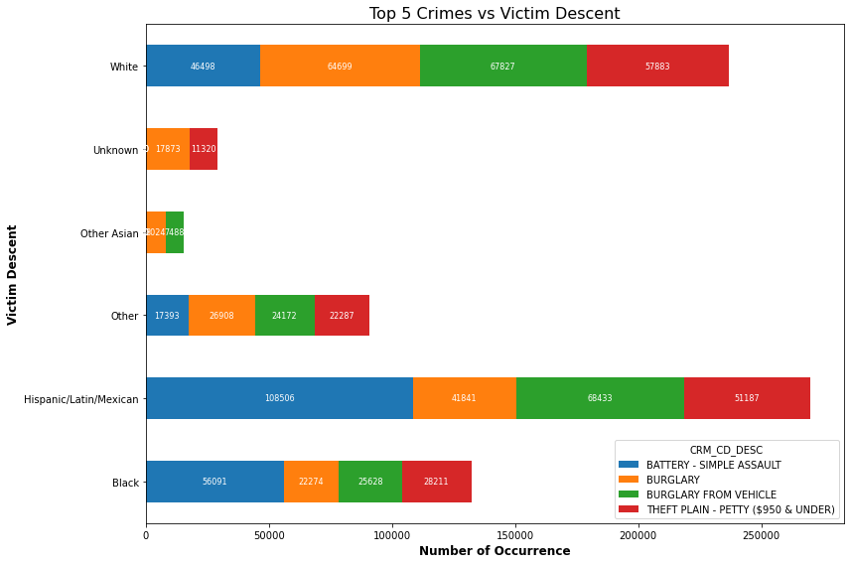
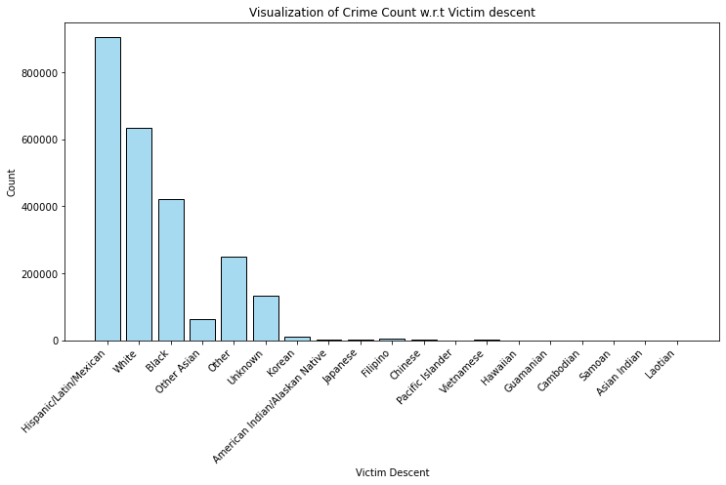
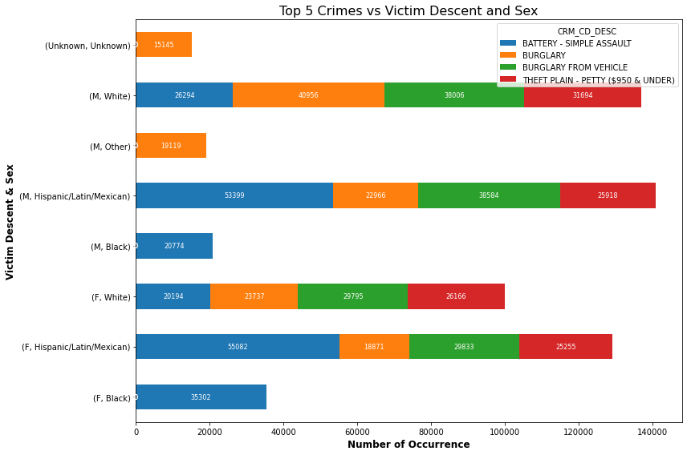
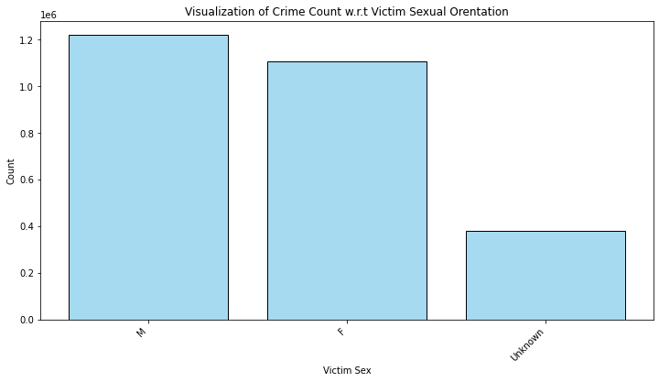
Victim Demographics - EDA
Victim Characteristics:
Age, Descent, Sex Analysis
Most victims: Hispanic/Latino/Mexican and Male

Slide 8
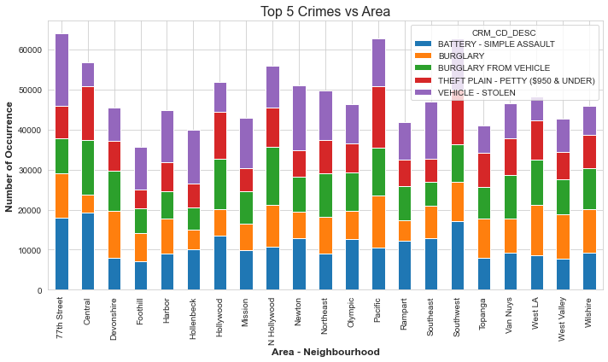
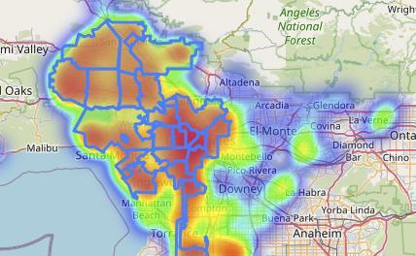
Area and Location Analysis - EDA
Highest Crime Rate: 77th Street, LA County
Geographic Distribution: Heatmaps and Point Maps

Slide 9
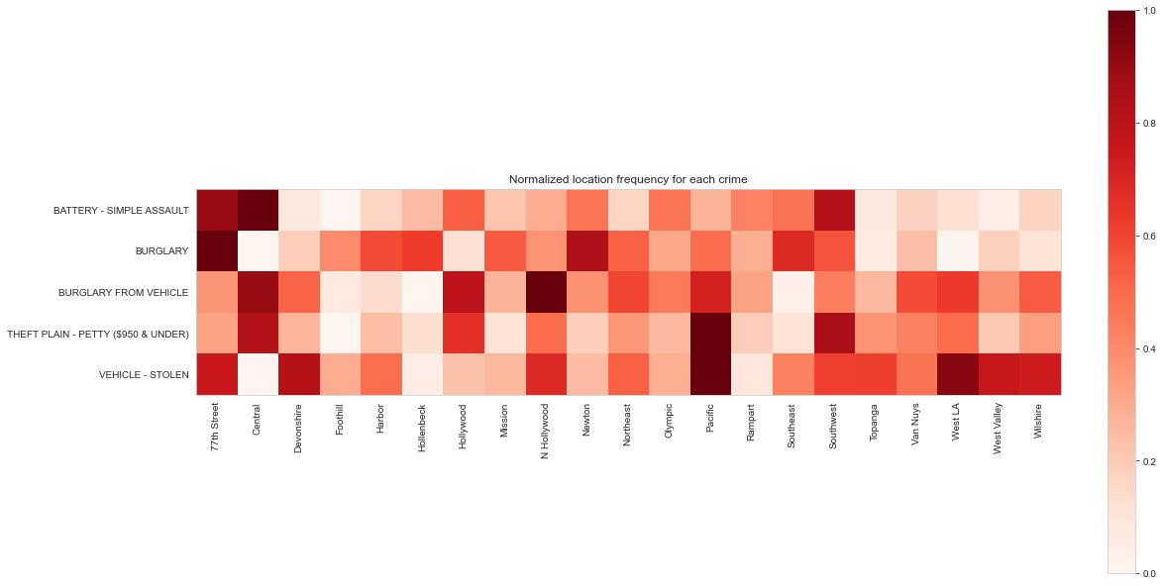
EDA Summary
Crime Trends: Mix of upward and downward trends in top 5 crimes over 12 years
Consistent High Crime Area: Downtown LA (77th Street)
Future Forecasting: Based on area, victim characteristics, and day of the week
Output File: 'top5_crime_data.csv'

Slide 10
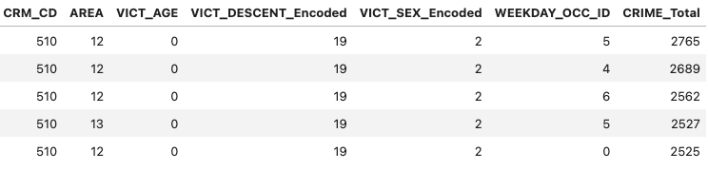
Building the Framework for Prediction – Feature Engineering
1. Data Pre-processing Steps
Data Preparation:
Loaded 'top 5 crime data' dataset
Removed irrelevant columns (e.g., 'ID')
Feature Engineering:
Categorical Encoding:
'VICT_SEX', 'VICT_DESCENT' via Label Encoding
One-hot Encoding for binary column transformation
Data Cleaning:
Duplicates removed post-encoding
Feature Scaling:
Standardization using StandardScaler
2. Data Preparation for Modelling and Training
Dataset Segmentation for Modelling:
Large dataset necessitated creation of smaller, focused datasets:
Crime category prediction dataset with key features
Crime count prediction/forecasting dataset
Model Data Setup:
Data split into features (X) and targets (y)
Training and Testing Sets:
Typical split ratio applied
Training set for model building
Testing set for model evaluation
Data Saving:
Processed data saved in 'train_test_split.pkl'
Preprocessed data for modelling saved in 'top5_crime_pre.csv'

Slide 11

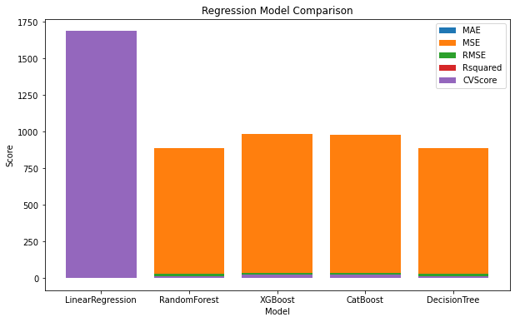
Model Training and Evaluation
Model Building:
Models: Linear Regression, Random Forest, XGBoost, CatBoost, Decision Tree
Metrics: MSE, RMSE, MAE, R-squared, and Cross-Validation Scores
Performance Analysis:
Linear Regression: High errors, negative R-squared (poor performance)
Random Forest: Low errors, high R-squared (good performance)
XGBoost: Moderate errors, negative R-squared (average to below-average performance)
CatBoost: High errors, negative R-squared (poor performance)
Decision Tree: Moderate errors, high R-squared (good performance)
Initial Conclusion:
Best Performers: Random Forest and Decision Tree
Random Forest has the lowest MAE and highest R-squared
Decision Tree has a slightly lower RMSE and the same R-squared as Random Forest

Slide 12
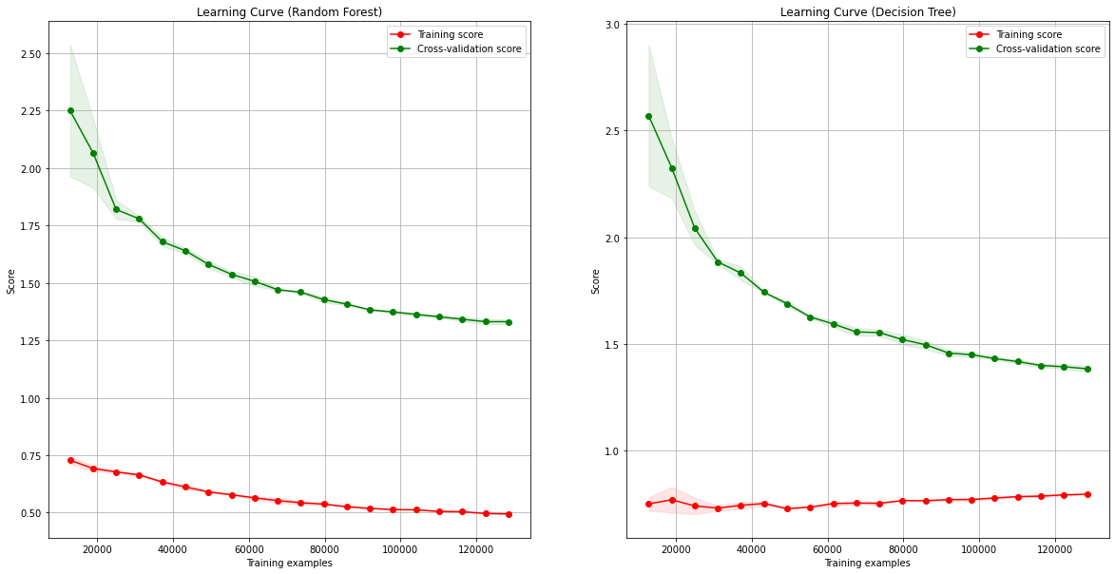
Model Validation and Final Choice
Overfitting and Underfitting Analysis:
Learning curves are used to evaluate model generalization
Random Forest Analysis:Learning Curve: Training and CV scores are consistent, suggesting no overfitting
Decision Tree Analysis:Learning Curve: High initial training score (potential overfitting) but improves with more data, indicating good generalization
Final Model Selection:
Decision Tree is selected based on its improving cross-validation score and ability to generalize with more data

Slide 13
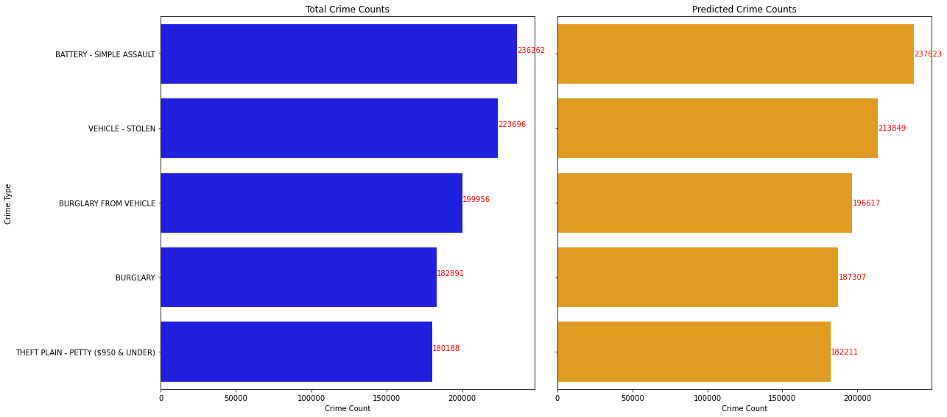
Final Model Fitting and Feature Importance
Feature Importance:
Key Predictive Features: Victim descent and crime type
High Importance: Indicating these features greatly influence crime rate predictions
Model Prediction Accuracy by Crime Type:
Battery - Simple Assault: Predictions slightly higher than actual rates
Burglary: Predictions slightly higher than actual
Burglary from Vehicle: Predictions slightly lower than actual
Theft Plain - Petty: Predictions slightly higher than actual
Vehicle - Stolen: Predictions significantly lower, indicating an area for improvement

Slide 14
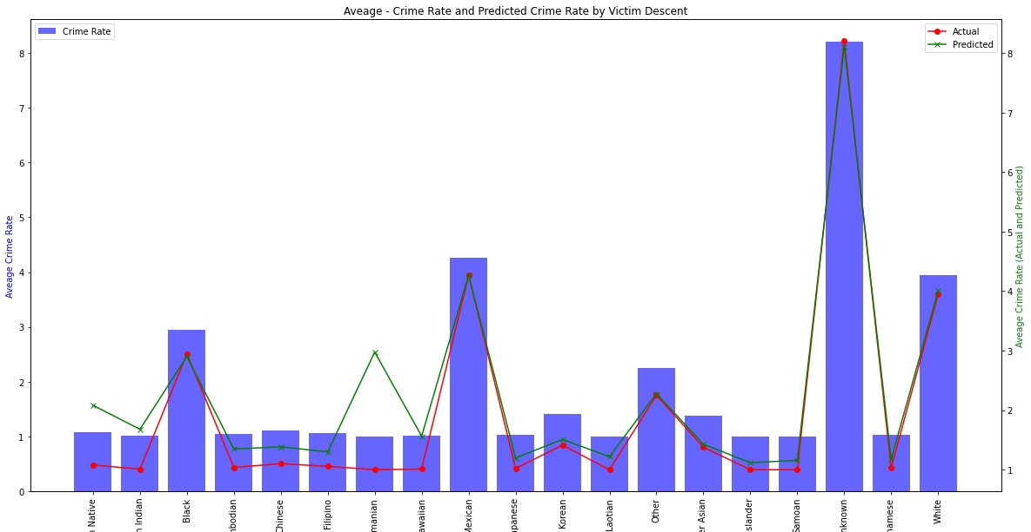
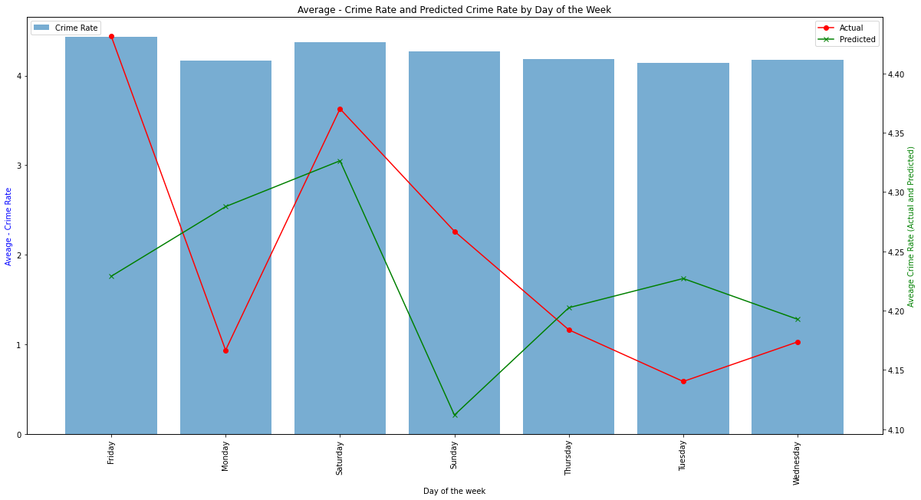
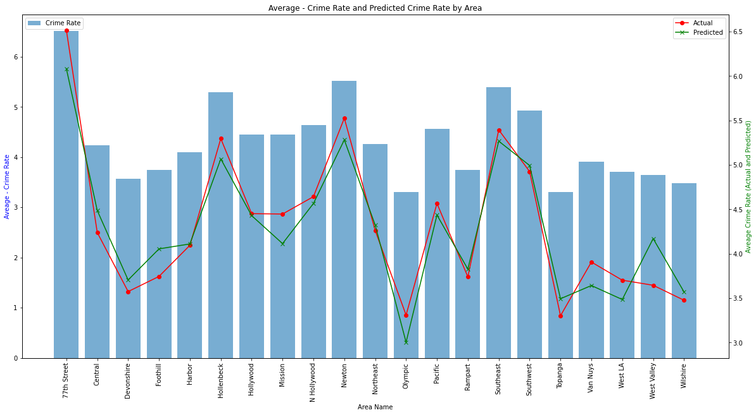
Predictive Performance by Descent, Area, and Day of the Week
Accuracy Across Descent Groups:
Overestimations: American Indian/Alaskan Native, Asian Indian, Guamanian
Close Predictions: Hispanic/Latin/Mexican
Underestimation: "Unknown" descent group
Actual vs. Predicted Crime Rates by Area:
Higher Actual Rates: 77th Street, Hollenbeck, Mission, Newton, Van Nuys
Higher Predicted Rates: Central, Foothill, Olympic, West Valley
Prediction Variance by Day of the Week:
Higher Actual Weekend Rates: Fridays and Sundays
Alternating Over and Under Predictions: During weekdays

Slide 15
General Trends and Future Improvements
Model trends to overpredict for certain descent groups
Notable underprediction for "Unknown" descent and Vehicle Theft
Hispanic/Latin/Mexican descent group consistently targeted
Limitations: Insufficient RAM, leading to data underutilization
Suggestion: Investment in computational resources for better performance

Slide 16
Thank you
Q & A

