Slide 1
Project proposal: Early & accessible CVD risk prediction
Group 15:
eake191
awns132
qwan621
thil124
zden973
zfan700
Notes:
TOM

Slide 2
Background & Motivation
Cardiovascular disease (CVD) is the cause of a quarter of all deaths every year (McNamara et al., 2019).
CVD is incurable, however intervention at early stages (such as medication) can slow its progression and extend life.
Identification of those at risk before symptoms become severe allows the best chance at a successful intervention
Many ML studies have been done in this area, however most risk models rely on clinical metrics (e.g., blood pressure), reducing practicality and accessibility.
Mc Namara, K., Alzubaidi, H., & Jackson, J. K. (2019). Cardiovascular disease as a leading cause of death: how are pharmacists getting involved? Integr Pharm Res Pract, 8. 1–11. doi: 10.2147/IPRP.S133088.
Notes:
TOM
Mcnamara: https://pubmed.ncbi.nlm.nih.gov/30788283/
CVD -> high death rate that is increasing, incurable BUT early intervention can help The earlier we can detect signs, the better.
ML approaches have become more popular, but these use harder to access clinical data. We aim to use easily accessible data. We will aim to make CVD detection easy, using non clinical data that can easily be measured. This is even more relevant today as wearable devices make data collection easier and cheaper
We will aim to find out if we can get accurate prediction without clinical data

Slide 3
Lit review
There are over 300 articles published in online journals that use ML to predict CVD risk (Krittanawong et al., 2020). However, most of them use prevalent data and rely on clinical factors.
Dritsas et al. (2022) performed the most similar analysis, however included clinical factors like cholesterol and blood pressure. They also used prevalent data, limiting clinical applicability.
Our dataset was sourced from Weng et al. (2017), which we will be using to construct our project.
Improvements:
Removing clinical factors
Using a wider range of ML models
Dritsas, E., Alexiou, S., & Moustakas, K. (2022). Cardiovascular disease risk prediction with supervised machine learning techniques. In *Proceedings of the 8th International Conference on Information and Communication Technologies for Ageing Well and e-Health (ICT4AWE 2022)* (pp. 315–321). DOI: 10.5220/0011088300003188
Krittanawong C, Rogers AJ, Johnson KW, Wang Z, Turakhia MP, Halperin JL, Narayan SM. Integration of novel monitoring devices with machine learning technology for scalable cardiovascular management. Nat Rev Cardiol,18. 75–91 doi: 10.1038/s41569-020-00445-9
Weng, S. F., Reps, J., Kai, J., Garibaldi, J. M. & Qureshi, N. (2017). Can machine-learning improve cardiovascular risk prediction using routine clinical data? Stephen. PLoS ONE 12, 1–14. doi.org/10.1371/journal.pone.0174944
Notes:
EMMA
Weng: https://journals.plos.org/plosone/article?id=10.1371/journal.pone.0174944&source=post_page-----9cb5c78ee582----------------------
Krittanawong: https://www.nature.com/articles/s41598-020-72685-1
Dritsas: https://www.scitepress.org/Papers/2022/110883/110883.pdf
Lit review
There are over 300 articles published in online journals that use ML to predict CVD risk. However, most of them use prevalent data and rely on clinical factors.
Prevalent data: people who were already diagnosed with the disease at baseline, meaning there are no measurements taken before the diagnosis happened.
Why this is less useful: because it is less useful to have the feature profile of someone who already has the disease. It is much more useful and clinically applicable to use incident data, which is where the patient was diagnosed after baseline measurements were taken, because rather than saying ‘you are X amount likely to have CVD now’, we are saying: ‘you are X amount likely to have CVD in 10 years’, or whatever our time frame is, so that lifestyle factors can actively be changed to mitigate the risk.
Clinical factors: In our case, refers to data that you would need to see a healthcare professional to get, such as blood pressure, or cholesterol levels. This means that often in practice, only people who are visiting a specialist would be able to benefit from models like this.
Dristas et al:
used naive bayes, support vector machines, logistic regression, and random forest on a dataset of 70,000 people
Used prevalent data, meaning no longitudinal analysis - only info on what a current case’s feature profile looks like.
Used clinical factors, limiting accessibility
Weng et al:
Where we are getting our data from
Used random forest, logistic regression, lightGBM, and neural networks on a dataset of 300,000 people.
10 year incidence study, meaning measurements were taken 10 years before diagnosis, so we get the feature profile of what someone who will get CVD in 10 years looks like
Improvements:
Our main improvement is the removal of the clinical features, in order to maintain accessibility of the model.
We will also aim to use a wider range of ML models if time allows.

Slide 4
Objectives of research
Objective: Develop a model that uses readily available characteristics (e.g., diet, lifestyle, medical history) to predict whether a user is at risk for CVD without requiring specialised medical tests (e.g., blood pressure, LDL levels).
Approach:
Train and evaluate multiple ML models to identify the most accurate predictor.
Compare feature profiles of CVD cases vs. controls to highlight key risk indicators.
Outcome: If your feature profile aligns more closely with (eventual) CVD cases, consider consulting a primary care provider for further evaluation.
Notes:
BERNADETTE
Building on what Emma shared about the limitations of existing CVD prediction research, especially their reliance on clinical data like blood pressure or cholesterol levels, our group has defined clear objectives to address these limitations.
Our core objective is to develop a CVD risk prediction model that uses only readily available characteristics, such as diet, lifestyle habits, and basic medical history — with no need for specialized medical tests. This shifts from "clinic-bound" screening to accessible and proactive assessment.
To achieve this, we’ll take two key steps:
First, we’ll train and evaluate multiple models across traditional statistical, machine learning, and deep learning approaches, including logistic regression, Random Forest（RF）, MLP, among others, then we aim to find the most accurate predictor. The specific methodology for this process will be presented later.
Second, we’ll compare the feature profiles of those who developed CVD versus those who didn’t, for example, quantifying how specific dietary habits or lifestyle patterns correlate with incident CVD, then we want to highlight key risk indicators that anyone can monitor in daily life.
What outcome are we aiming for? A tool that doesn’t just predict risk, but empowers early intervention: if someone’s lifestyle or feature profile aligns more closely with those who developed CVD, it will encourage early consultation with a primary care provider for further evaluation.

Slide 5
Dataset
308,854 UK-based participants
Cases: 24,971 10-year incident cases
Controls: 283,883 controls
17 baseline features:
Lifestyle: general health (1-5), exercise (y/n), weight, BMI, smoking (y/n), alcohol (0-30/week), fruit consumption (0-120/week), vegetable consumption (0-128), fried potato consumption (0-128)
Demographic: sex (m/f), age, height
Medical: skin cancer (y/n), other cancer (y/n), depression (y/n), diabetes (y/n), arthritis (y/n)
Notes:
EMMA
We will have to explain what an incident case is

Slide 6
Methodology
Preprocessing: Remove irrelevant features, create participant IDs, etc.
Data Splitting: Split the data into 90% training and 10% test sets, stratified by case/controls.
Class Imbalance: Address imbalance using SMOTE on the training set, most likely via undersampling controls.
Model Tuning: Perform hyperparameter optimization via 5-fold cross-validation for all models: LightGBM, LR, RF, KNN, SVM, & MLP (if possible)
Evaluation: Assess the best model on the test set using:
AUROC
Precision, recall, sensitivity, specificity
Feature importance
Notes:
ZISHI

Slide 7
Risks & limitations
Different CVD types: CVD includes many diseases, and they might not all have the same risk factors.
Missing data: Trade-off between accuracy and accessibility - the removal of clinical features will most likely degrade our accuracy metrics.
UK-only data: Since the dataset is from the UK-based, the results may be as applicable to other countries with other ethnic makeups.
Complex models: Since we plan to use multiple complex models, available time may become an issue.
Notes:
OLIVE
First, CVD is not just one single illness. It includes many conditions, and these conditions may have different risk factors. This makes the prediction task more complex.
Second, our dataset has missing values. If we remove some clinical features, the model becomes easier to apply in practice, but the trade-off is that we might lose some accuracy in prediction.
Third, our data is collected in the UK. Because of that, the population structure and ethnicity may limit how well the results apply to other countries or regions.
Finally, we plan to use several complex models. This can improve performance, but it will also require more time and resources for training and tuning.

Slide 8
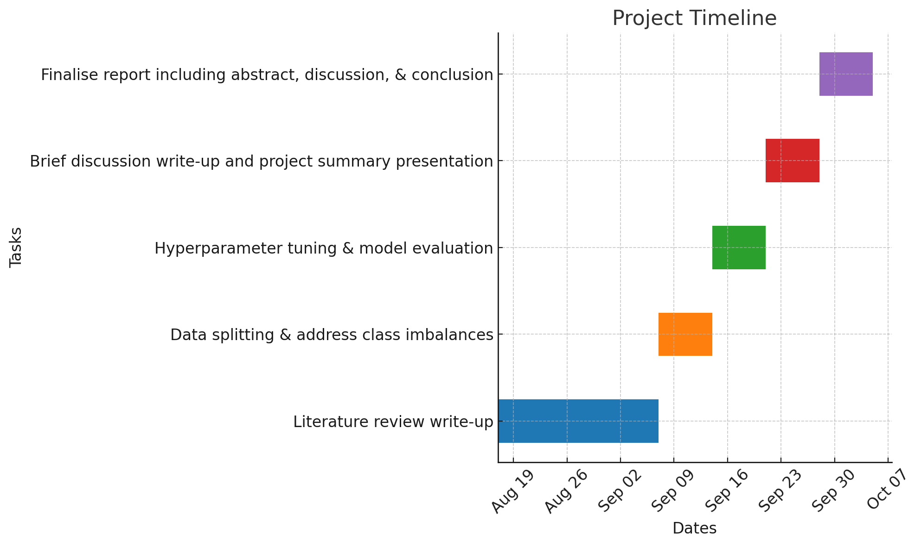
Timeline
Weeks 1-3: | Literature review write-up
Weeks 3-4: | Data splitting & address class imbalances
Weeks 5-6: | Hyperparameter tuning & model evaluation
Week 7: | Brief discussion write-up and project summary presentation
Weeks 8-9: | Finalise report including abstract, discussion, & conclusion.
Notes:
ZIHENG

Slide 9
Group contribution
Emma: | Write up, hyperparameter tuning, model evaluation.
Tom: | Write up, literature review, model evaluation
Qian: | Class imbalance investigation, write up
Siqi: | Preprocessing of data, splitting and preparing for evaluation.
Zishi: | Literature review, model evaluation
Ziheng: | Literature review, preprocessing of data
Notes:
ZIHENG

Slide 10
Q&A
Notes:
ZIHENG

