Slide 1
Project Update on Methodology & Results
Group 15:
eake191
awns132
qwan621
thil124
zden973
zfan700

Slide 2
Objectives of research
Objective: Develop a model that uses readily available characteristics (e.g., diet, lifestyle, medical history) to predict whether a user is at risk for CVD without requiring specialised medical tests (e.g., blood pressure, LDL levels).
Approach:
Train and evaluate multiple ML models to identify the most accurate predictor.
Compare feature profiles of CVD cases vs. controls to highlight key risk indicators.
Outcome: If your feature profile aligns more closely with (eventual) CVD cases, consider consulting a primary care provider for further evaluation.

Slide 3

Existing results
Author | Best Model: AUROC
DeGroat et al. [1] | SVM: 0.99
Baghdadi et al. [2] | Gradient Boosting: 0.93
Sajid et al. [3] | Random Forest: 0.85
Weng et al. [4] | Neural Network: 0.764
Dritsas and Trigka [5] | Stacking Ensemble: 0.98
Kakadiaris et al. [6] | SVM: 0.92
[1] W. DeGroat et al., "Discovering biomarkers associated and predicting cardiovascular disease with high accuracy using a novel nexus of machine learning techniques for precision medicine," Sci. Rep., vol. 14, no. 1, Jan. 2024, doi: 10.1038/s41598-023-50600-8.
[2] N. A. Baghdadi, S. M. F. Abdelaliem, A. Malki, M. H. Alkhursani, and H. M. Alzahrani, "Advanced machine learning techniques for cardiovascular disease early detection and diagnosis," J. Big Data, vol. 10, no. 1, p. 144, 2023, doi: 10.1186/s40537-023-00817-1.
[3] M. R. Sajid, N. Muhammad, R. Zakaria, S. A. A. Shah, and F. M. Alotaibi, "Nonclinical features in predictive modeling of cardiovascular diseases: a machine learning approach," Interdiscip. Sci. Comput. Life Sci., vol. 13, no. 2, pp. 201–211, Jun. 2021, doi: 10.1007/s12539-021-00423-w.
[4] S. F. Weng, J. Reps, J. Kai, J. M. Garibaldi, and N. Qureshi, "Can machine-learning improve cardiovascular risk prediction using routine clinical data?," PLoS ONE, vol. 12, no. 4, p. e0174944, Apr. 2017, doi: 10.1371/journal.pone.0174944.
[5] E. Dritsas and M. Trigka, "Efficient data-driven machine learning models for cardiovascular diseases risk prediction," Sensors, vol. 23, no. 3, p. 1161, Jan. 2023, doi: 10.3390/s23031161.
[6] I. A. Kakadiaris, M. Vrigkas, A. A. Yen, T. Kuznetsova, M. Budoff, and M. Naghavi, "Machine learning outperforms ACC/AHA CVD risk calculator in MESA," J. Amer. Heart Assoc., vol. 7, no. 22, p. e009476, Nov. 2018, doi: 10.1161/JAHA.118.009476.

Slide 4
Dataset
308,854 UK-based participants
Cases: 24,971 10-year incident cases
Controls: 283,883 controls
17 baseline features:
Lifestyle: general health (1-5), exercise (y/n), weight, BMI, smoking (y/n), alcohol (0-30/week), fruit consumption (0-120/week), vegetable consumption (0-128), fried potato consumption (0-128)
Demographic: sex (m/f), age, height
Medical: skin cancer (y/n), other cancer (y/n), depression (y/n), diabetes (y/n), arthritis (y/n)

Slide 5
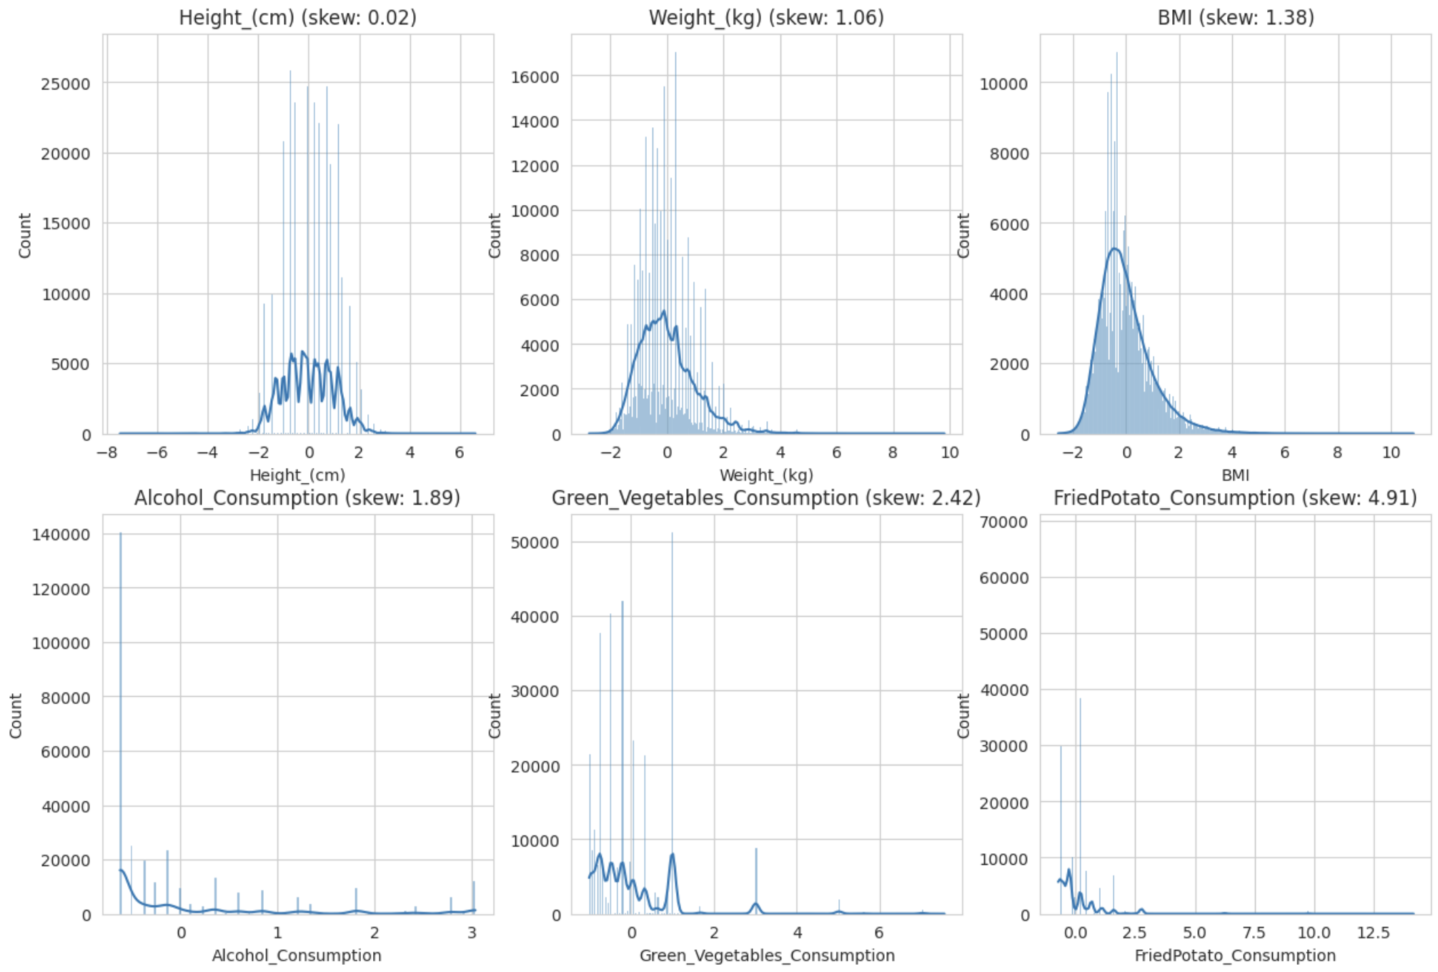
Preprocessing
Examined the data for missing values, transformed into categorical or numerical values, created participant ID
Standardised the data using StandardScaler()
Normalised numeric values with a skewness greater than 1
80:20 training/testing split due to class imbalance
Using CV throughout to eliminate the need for a validation set.

Slide 6
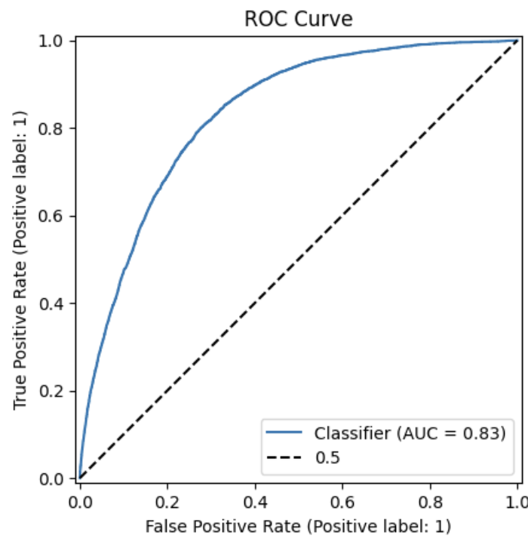
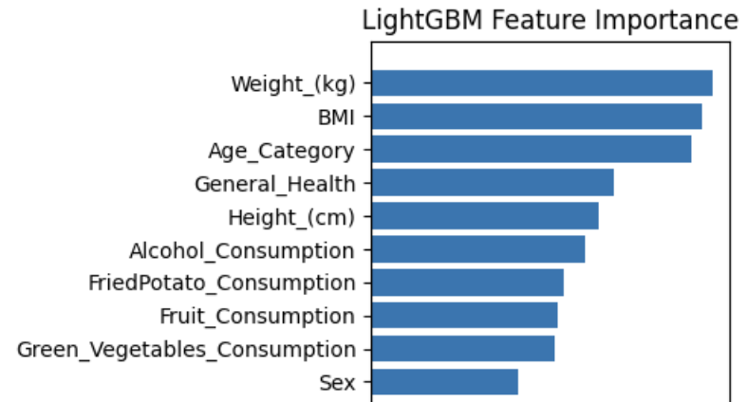
LightGBM
METHODS
RESULTS
Hyperparameter tuning:
Optuna framework
100 trials
5 fold CV
AUROC: 0.8336
Precision: 0.5533
Recall: 0.0384
TN: 56622 | FP: 155
FN: 4802 | TP: 192
Hyperparameter | Search range | Optimal
Number of trees | 50 - 500 | 199
Maximum number of bins | 128 - 1024 | 861
Learning rate of each tree | (log) 0.001 - 0.3 | 0.047
Maximum tree depth | 3 - 12 | 5
Maximum leaves per tree | 8 - 128 | 68
Fraction of data to use per tree | 0.5 - 1.0 | 0.78
Fraction of features to use per tree | 0.5 - 1.0 | 0.54
L2 regularisation term | (log) 0.001 - 1000 | 0.005
Min sum of instance weights per leaf | (log) 0.0001 - 1000 | 0.0002
Min number of data points per leaf | 10 - 5000 | 986
Notes:
Verbally:
FUTURE WORK: due to very poor recall and a lot of missed cases, we should experiment with class imbalance mitigation methods like SMOTE, for undersampling the majority class, or matching case to controls 1:10 via age and sex.

Slide 7
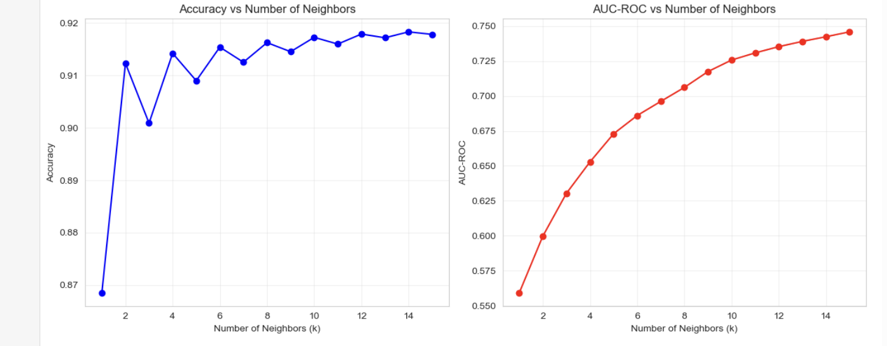
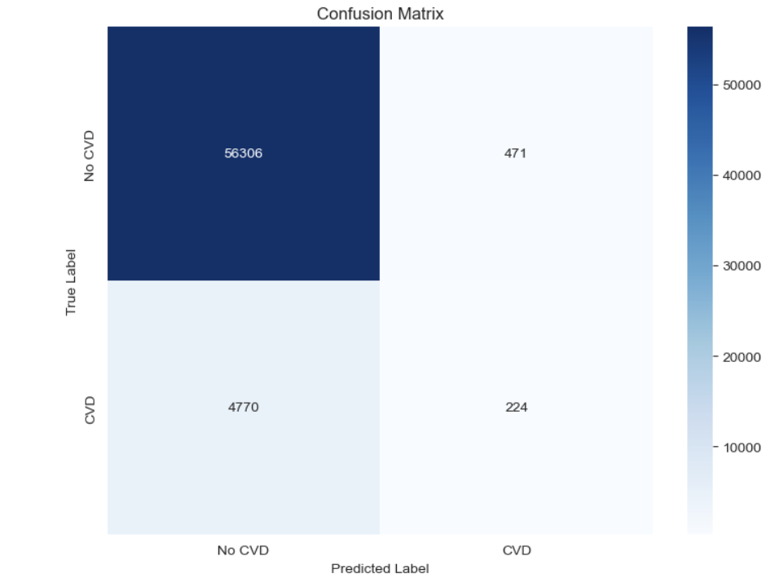
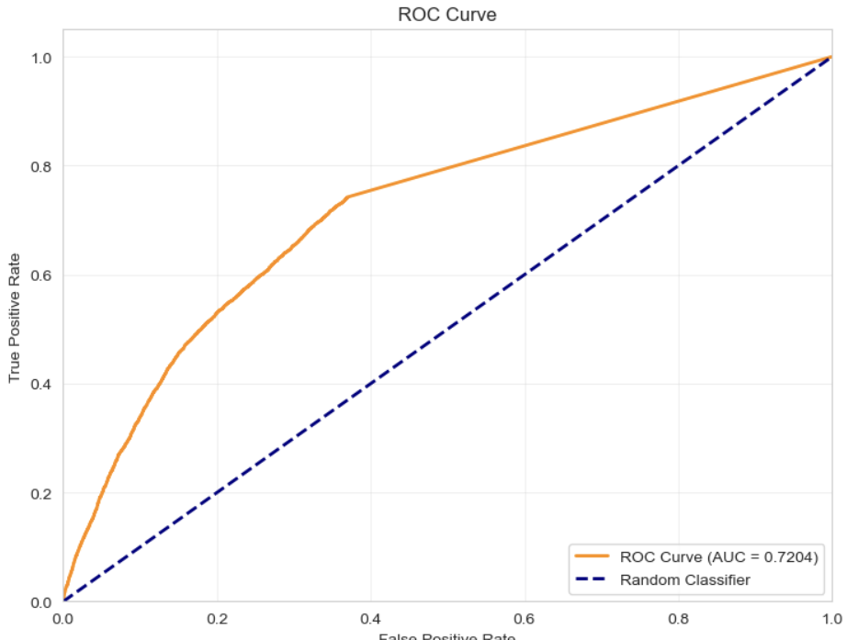
KNN (High-Specificity Model)
True Negative (TN): 56,306 (correctly identified healthy individuals)
False Positive (FP): 471 (healthy individuals misdiagnosed)
False Negative (FN): 4,770 (patients missed)
True Positive (TP): 224 (correctly identified patients)
1.Accuracy vs K-value
Trend: relatively stable with minimal fluctuation(0.87-0.92)
Peak: highest accuracy at K=2(~0.915)
2. AUC-ROC vs K-value
Trend: Extremely sensitive, steep decline. Plummet from 0.75 at K=2 to approximately 0.55 at K=14.
Peak: The AUC-ROC curve reaches its maximum value when K=2.
AUC > 0.7: The model demonstrates strong discriminatory capability
Curve shape: Maintains high true positive rate even at low false positive rates
Practical value: Suitable for use as a screening tool

Slide 8
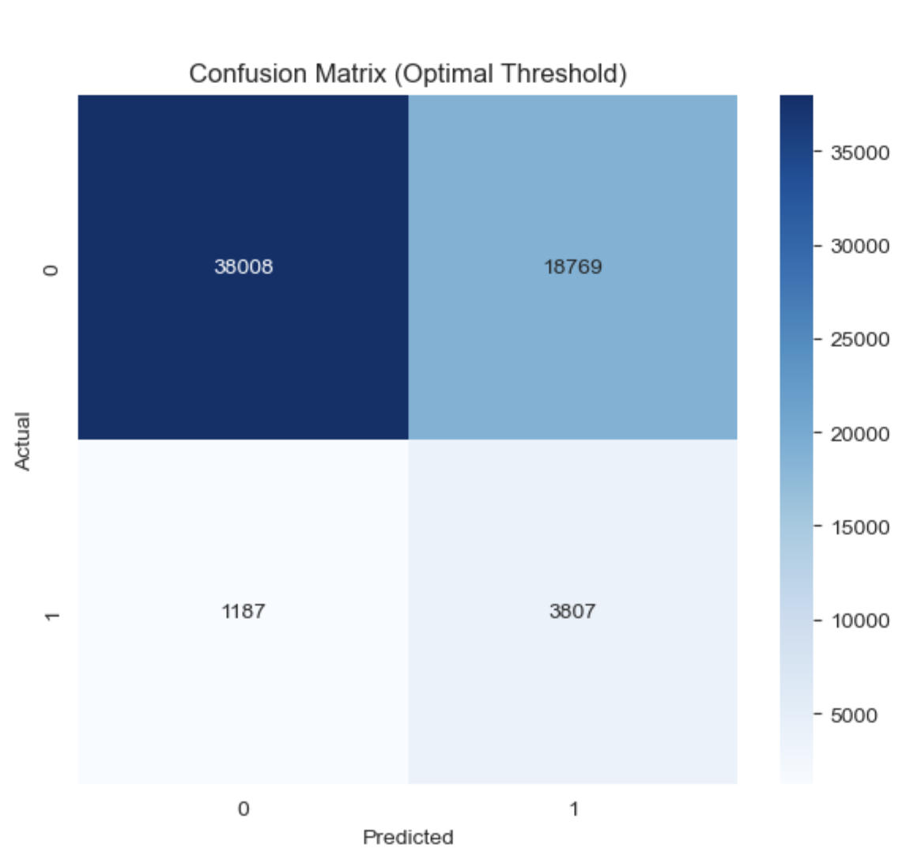
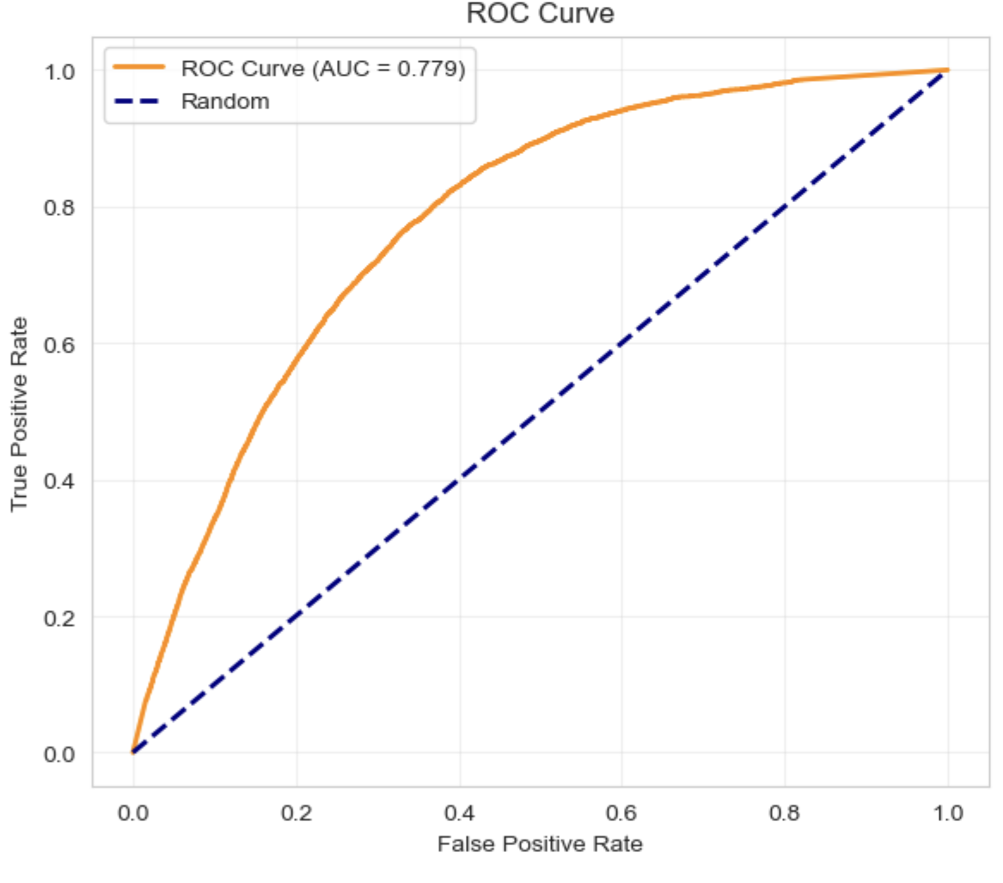
KNN (High-Sensitivity Model)
Before improvement: AUC ≈ 0.72–0.75
After improvement: AUC = 0.779
Improvement margin: Approximately 4–6% increase in AUC
True Negative (TN): 38,008
False Positive (FP): 18,769
False Negative (FN): 1,187
True Positive (TP): 3,807
AUC value: 0.779
Curve position: Significantly above the diagonal line
Performance level: Good discriminatory ability

Slide 9
k-Nearest Neighbors
Characteristic | High-Specificity Model | High-Sensitivity Model
Optimization Objective | Maximize Accuracy | Maximize Recall
Accuracy | 91.52% | 67.69%
Recall Rate | 4.49% | 76.23%
Precision | 32.23% | 16.86%
Detection Capability | Detects 4.5% of patients | Detects 76.2% of patients
False Positives | 473 people | 18769 people
Medical Risk | High missed diagnosis risk | High misdiagnosis risk

Slide 10
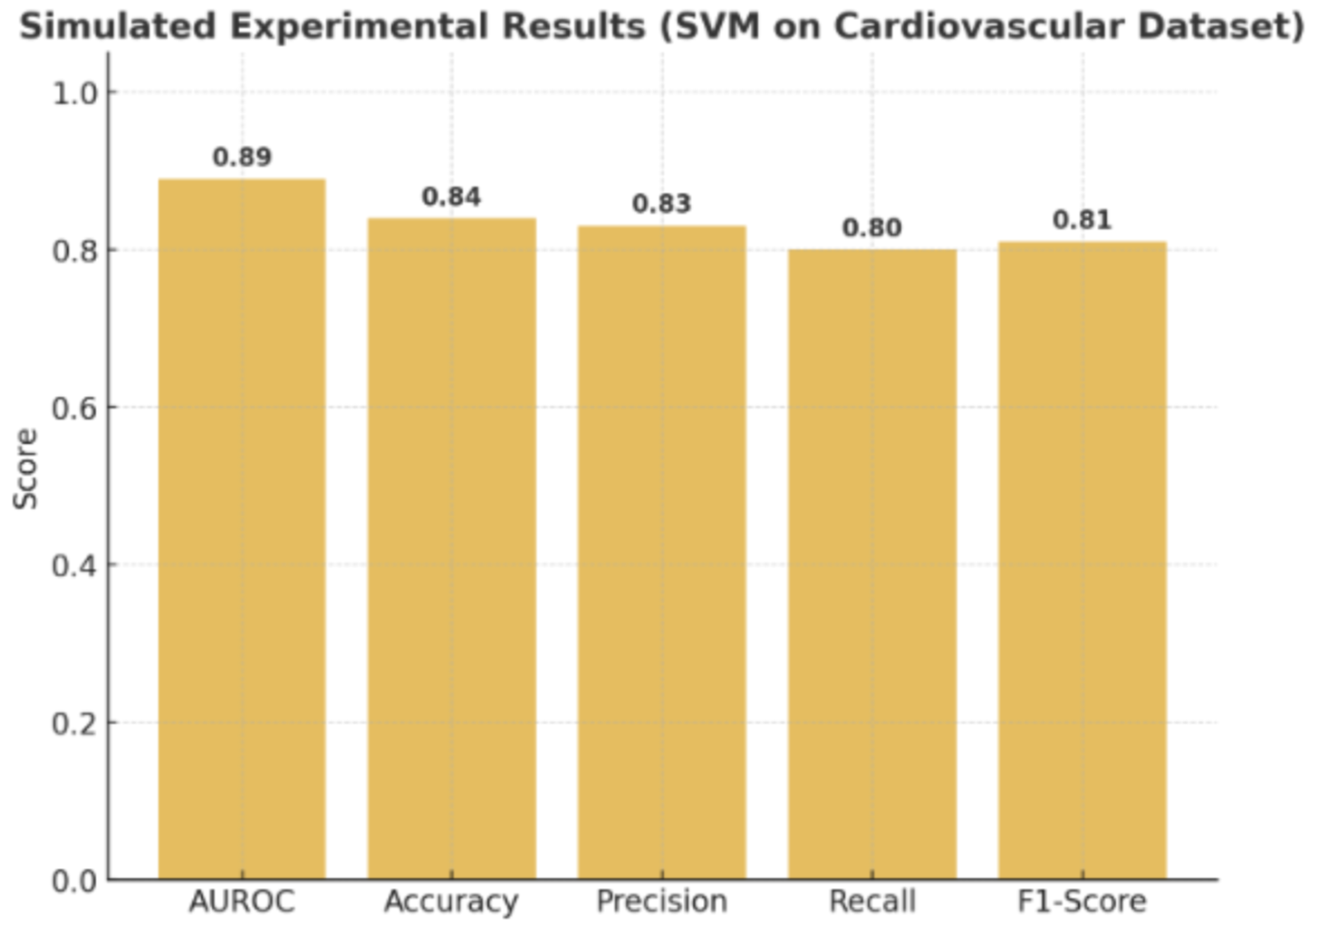
Support Vector Machine
Method
Model construction: Support Vector Machine (SVM) classifier
Hyperparameter optimization: Grid Search with 5-fold Stratified Cross-Validation for 100 iterations. Hyperparameters:
Reproducibility: Random seed setting to ensure consistent results
Visualization: ROC curve, confusion matrix heatmap, predicted probability distribution
Result
C | Degree | Gamma | Kernel

Slide 11
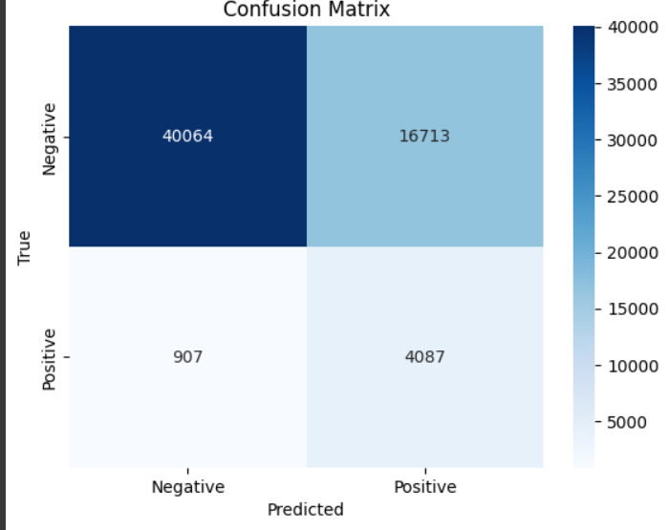
XGBoost
METHODS
RESULTS
Model Evaluation＆Hyperparameter Optimization:
50 trials
5 fold CV
Aim: Improve the predictive performance of the model through hyperparameter tuning, especially to achieve a balance between precision and recall.
Accuracy: 71.48%
Precision: 19.65%
Recall: 81.84%
F1-Score: 31.69%
AUROC: 0.8336
Hyperparameter | Optimal
subsample | 0.8
scale_pos_weight | 10
n_estimators | 1000
max_depth | 5
learning_rate | 0.01
colsample_bytree | 0.8

Slide 12
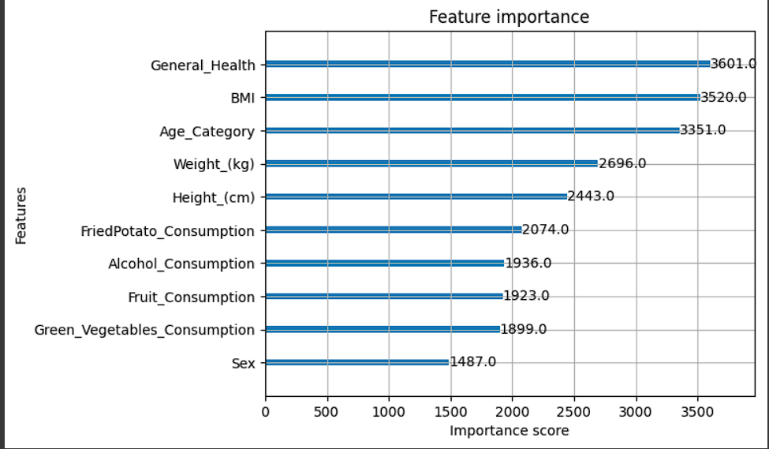
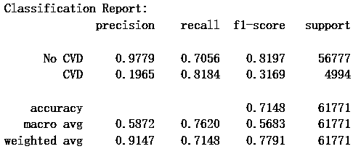
XGBoost
ziheng

Slide 13
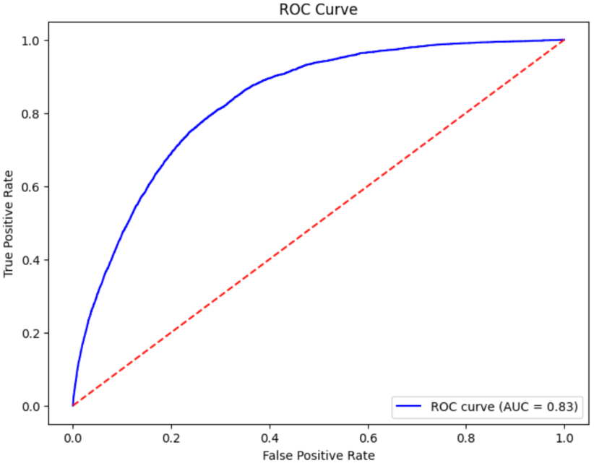
Random Forest
METHODS
RESULTS
Hyperparameter tuning:
Scikit framework
100 trials
5 fold CV
AUROC: 0.8313
Precision: 0.6000
Recall: 0.0102
TN: 56743 | FP: 34
FN: 4943 | TP: 51
Hyperparameter | Search range
Estimators | 100 - 1000
Max depth | 5 - 30
Min samples split | 2, 5 or 10
Min samples leaf | 1, 2 or 4
Max features | None, sqrt or log2
Bootstrap | True or false

Slide 14
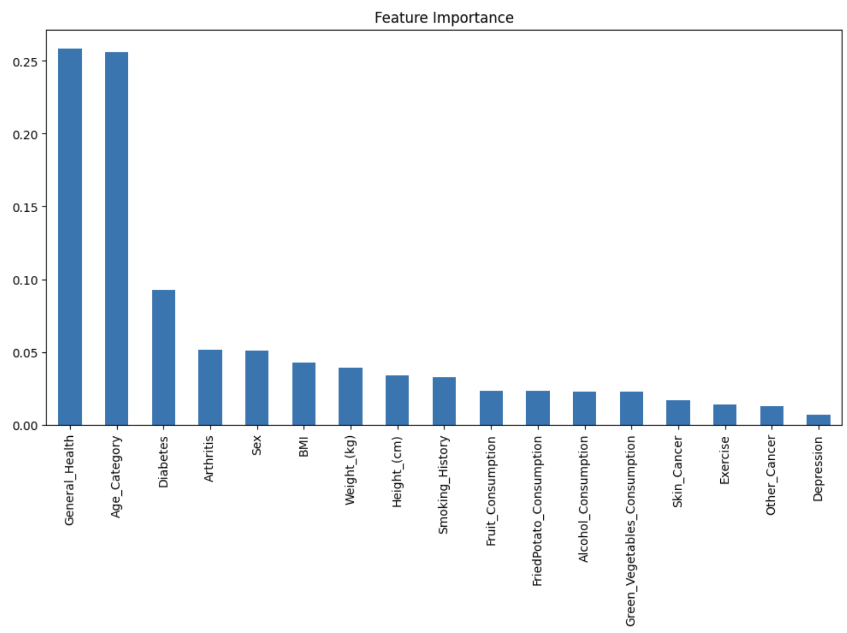
Random Forest
Classification Report (Per Class):
 | Precision | Recall | F1 Score | Support
No CVD | 0.92 | 1.00 | 0.96 | 56777
CVD | 0.60 | 0.01 | 0.02 | 4994
Accuracy |  |  | 0.02 | 61771
Macro avg | 0.76 | 0.50 | 0.49 | 61771
Weighted avg | 0.89 | 0.92 | 0.88 | 61771

Slide 15
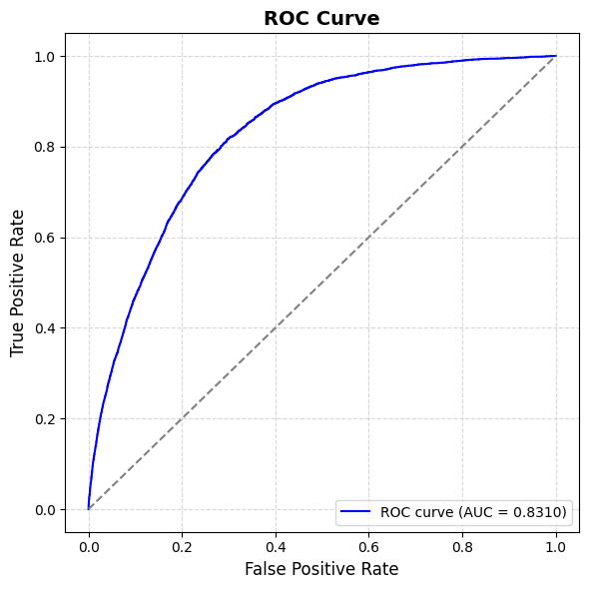
Logistic Regression
METHODS
RESULTS
Hyperparameter tuning:
100 trials
5 fold CV
AUROC: 0.8310
Accuracy: 0.7390
Recall (TPR): 0.7805
Weighted Precision: 0.9123
Macro F1: 0.5821
TN: 41752 | FP: 15025
FN: 1096 | TP: 3898
Hyperparameter | Search range | Optimal Value
Nclassifier__alpha | logspace(-5, 1, 7) | 0.0000
classifier__learning_rate | ['optimal', 'invscaling'] | invscaling
classifier__eta0 | [0.001, 0.01, 0.1] | 0.1
classifier__max_iter | [1000, 1500] | 1000
classifier__tol | [1e-4, 1e-3, 1e-2] | 0.0001

Slide 16
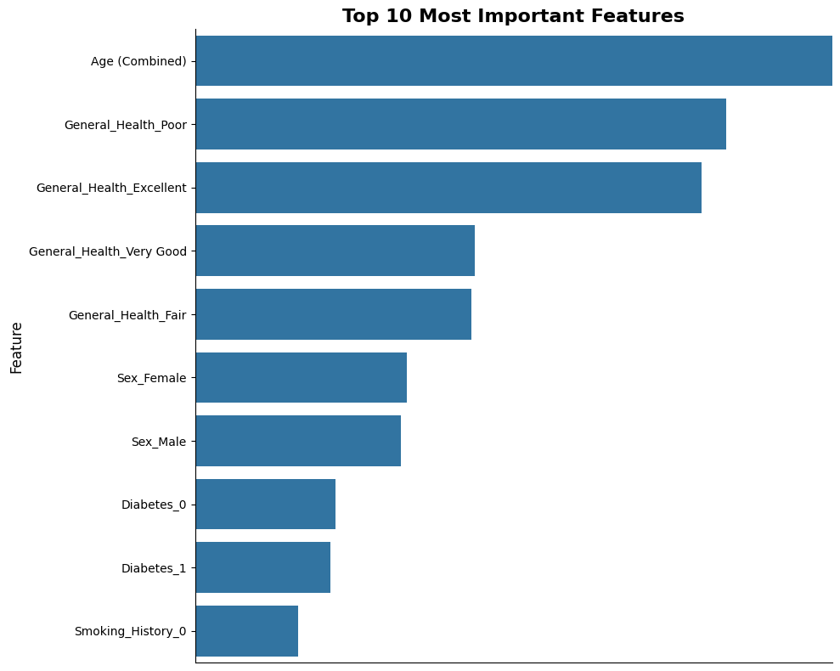
Logistic Regression
Classification Report (Per Class):
 | Precision | Recall | F1 Score | Support
Control | 0.97 | 0.74 | 0.84 | 56777
Case | 0.21 | 0.78 | 0.33 | 4994
Accuracy |  |  | 0.74 | 61771
Macro avg | 0.59 | 0.76 | 0.58 | 61771
Weighted avg | 0.91 | 0.74 | 0.80 | 61771

Slide 17
Next steps
Group contribution
Improved preprocessing steps for numeric variables
Include a deep learning via a neural network in the project
Test class imbalance mitigation techniques (eg, SMOTE) on all models
Choose best model and most effective class rebalancing technique
Uniform parameters (number of CV folds, number of iterations) across all models
Emma: | Preprocessing, LightGBM
Tom: | Random Forest, GitHub
Qian: | Logistic Regression
Siqi: | KNN
Zishi: | SVM
Ziheng: | XGBoost

Slide 18
Q&A
GitHub Repository: https://github.com/thil124/CVD_prediction

