Slide 1
AI-Powered
Task Management System
By
P.Saineelima
K.Thilak Sekhar

Slide 2
OBJECTIVE
The main goal of this project is to build an AI-based system that can automatically manage tasks. It uses NLP and Machine Learning to understand task details, classify them into categories, and predict their priority levels. The system also checks each person’s workload and deadlines to assign tasks in a fair and smart way. This helps teams save time, stay organized, and work more efficiently.

Slide 3
KEY FEATURES
Automatically classifies tasks using AI
Predicts task priority based on urgency and importance
Assigns tasks to the right person based on workload
Provides accurate and consistent task management

Slide 4
TECH STACK
Python– Main programming language
Pandas & NumPy– For data handling and analysis
Matplotlib & Seaborn– For visualizations
scikit-learn – For machine learning models
SentenceTransformers– For text embeddings
NLTK– For text cleaning and preprocessing

Slide 5
FLOW CHART
Data Collection
& EDA
NLP Preprocessing
Embedding Generation
Workload & Assignment Module
Priority Prediction Model
Task Classification Model

Slide 6
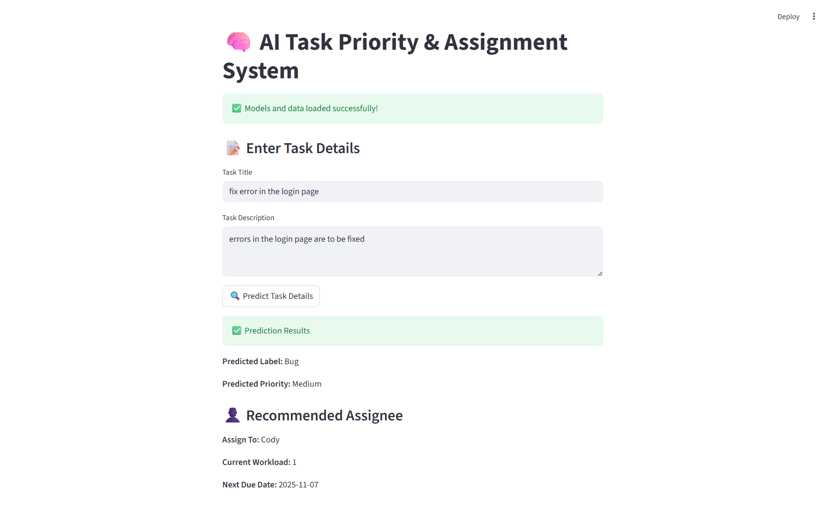

Slide 7
CONCLUSION
The AI-powered task management system effectively automates the process of classifying, prioritizing, and assigning tasks based on workload and deadlines. By integrating natural language processing and machine learning techniques, the system can analyze task details, predict their urgency, and assign them to the most suitable team members. This reduces manual effort, saves time, and ensures better workload distribution. Overall, the project demonstrates how artificial intelligence can simplify task management and improve team productivity.

Slide 8
THANK YOU

