Slide 1
Digital Portfolio
STUDENT NAME: THILAKAVATHI.T
REGISTER NO AND NMID: 24BIT124 AND asbruaz2426j1574
DEPARTMENT: BSC.INFORMATION TECHNOLOGY
COLLEGE: KPR COLLAGE ARTS SCIENCE AND RESREACH / BHARATHIYAR UNIVERSITY

Slide 2
PROJECT TITLE : AI POWERED MENTAL HEALTH SUPPORT CHATBOT PORTFOLIO

Slide 3
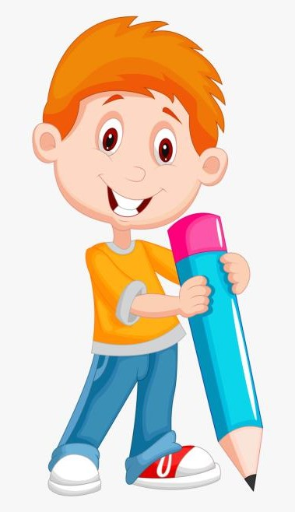

AGENDA
Problem Statement
Project Overview
End Users
Tools and Technologies
Portfolio design and Layout
Features and Functionality
Results and Screenshots
Conclusion
Github Link
3/21/2024 Annual Review

Slide 4

Mental health support is often limited due to lack of resources, accessibility issues, and social stigma. Many individuals hesitate to seek help from professionals, resulting in delayed treatment and worsening of conditions. There is a strong need for an AI-driven solution that can provide 24/7 confidential and accessible mental health support.
PROBLEM STATEMENT :

Slide 5

This project focuses on developing an AI-powered chatbot designed to provide mental health support through empathetic conversation, mental wellness tips, stress management techniques, and emergency guidance. The chatbot leverages Natural Language Processing (NLP) and sentiment analysis to understand user emotions and respond effectively.
PROJECT OVERVIEW

Slide 6

1. Students facing academic stress
2. Working professionals experiencing burnout
3. Individuals with anxiety, depression, or stress
4. Healthcare institutions offering mental wellness programs
5. General public seeking emotional support
WHO ARE THE END USERS ?

Slide 7

Frontend:HTML5,CSS3,JavaScript (ES6+) JavaScript Frameworks and Libraries:React.js,Node.js + Express CSS Tools/Versions:Tailwind CSS,Bootstrap 5,Modern CSS3 features. Deployment / Hosting: GitHub (for source code management and deployment) GitHub Pages (for frontend hosting and deployment)
TOOLS AND TECHNIQUES

Slide 8
PORTFOLIO DESIGN AND LAYOUT
The chatbot interface is designed to be minimalistic, user-friendly, and accessible on web and mobile platforms. The layout includes:
• Chat Window for user-AI interaction
• Emotion Detection indicator
• Quick Action Buttons (e.g., relaxation tips, connect to counselor)
• Dark & Light Mode for accessibility
8

Slide 9

Prototype chatbot successfully demonstrated:
• 24/7 availability for mental health support • Sentiment analysis to detect user’s emotional state • Data privacy and anonymity guaranteed • Option to escalate to professional help Accurate emotion detection (positive, neutral, negative)
• Effective conversation handling with empathy
• Real-time stress relief tips
• Screenshot placeholders can be added here showing chatbot conversation flow.
FEATURES AND FUNCTIONALITY
3/21/2024 Annual Review
9

Slide 10
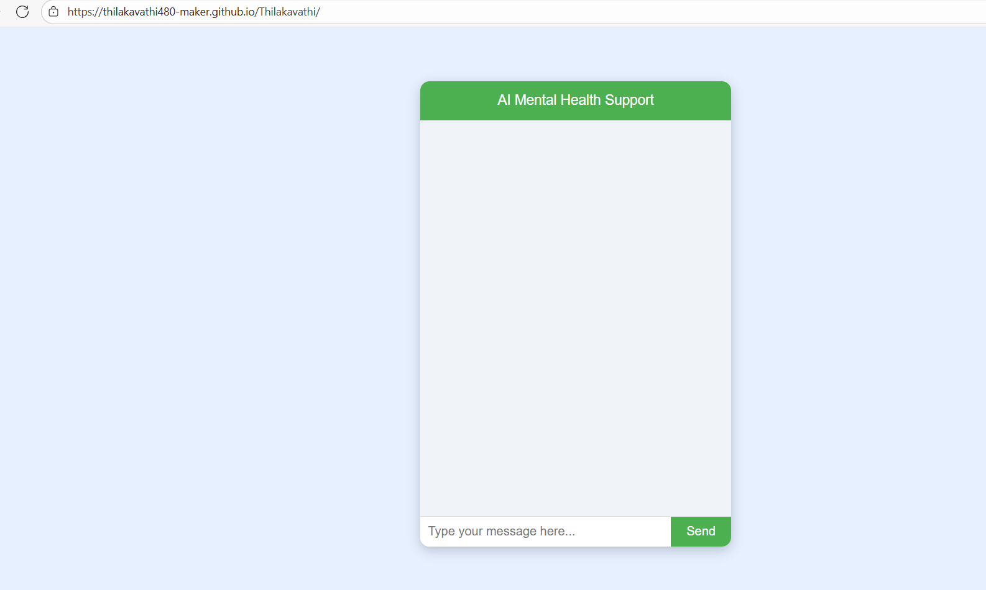
RESULT AND SCREENSHOT

Slide 11
The AI Powered Mental Health Support Chatbot provides an accessible, affordable, and stigma-free solution for mental health support. While it cannot replace professional therapy, it acts as a first line of support for individuals in need. Future improvements include integrating voice-based support, advanced emotion recognition, and seamless connection with certified therapists.
CONCLUSION
11

