Slide 1
AI-Powered Personalized Learning Path Generator
University Project
Review-1
Team number : CSE_192
Roll Number | Student Name
20231CSE3020 | THILAK M BHOSLE
20231CSE3084 | HARSHA HM
20231CSE3048 | VINOD KUMAR M
Under the Supervision of,
Mr. Vinayak Raju Kage
Assistant Professor
School of Computer Science and Engineering
Presidency University
Name of the Program : B.tech in computer science & engineering
Name of the HoD : Dr. Asif Mohamed HB
Name of the Program Project Coordinator : Muthuraju V.
Name of the School Project Coordinators : Dr. Sampath A K

Slide 2
Content
Problem Statement
Analysis of Problem Statement
Background and Related Work
System Architecture
Git-hub Link
Timeline of the Project
References

Slide 3
Problem Statement Number: SIH_25199
Organization: Ministry of Skill Development & Entrepreneurship (MSDE)
Category : AICTE
Problem Description:
The challenge is to develop an AI system capable of :
Analyzing learners’ profiles (academic background, prior skills, socio-economic context, learning pace, and aspirations).
Mapping career aspirations with industry-driven skill requirements and NSQF-aligned programs.
Generating adaptive, personalized training pathways including courses, micro-credentials, certifications, and on-the-job training opportunities.
Continuously updating recommendations as learners progress or as job market trends evolve

Slide 4
Analysis of Problem Statement
Key Challenges in Existing Systems:
Fixed learning paths for all students
Poor personalization
Manual selection of courses by students
No real-time performance tracking
Limited feedback mechanisms
No AI-based prediction of student needs

Slide 5
Background & Related Work
Traditional Learning Management Systems (LMS).
AI-based recommendation systems.
Adaptive learning models.
Student performance analytics.
Personalized education frameworks.
Machine learning in education (EdTech AI).

Slide 6
System Architecture (Suggested)
Data Collection Module.
AI/ML Engine.
Learning Recommendation Module.
Progress Tracking Module.
Feedback & Analytics Module.

Slide 7
Github Link
Project Code: https://github.com/thilakbhosle/AI_Personalized_Learning_Path
Includes:
Source Code
Datasets
Documentation
Model Training Scripts

Slide 8
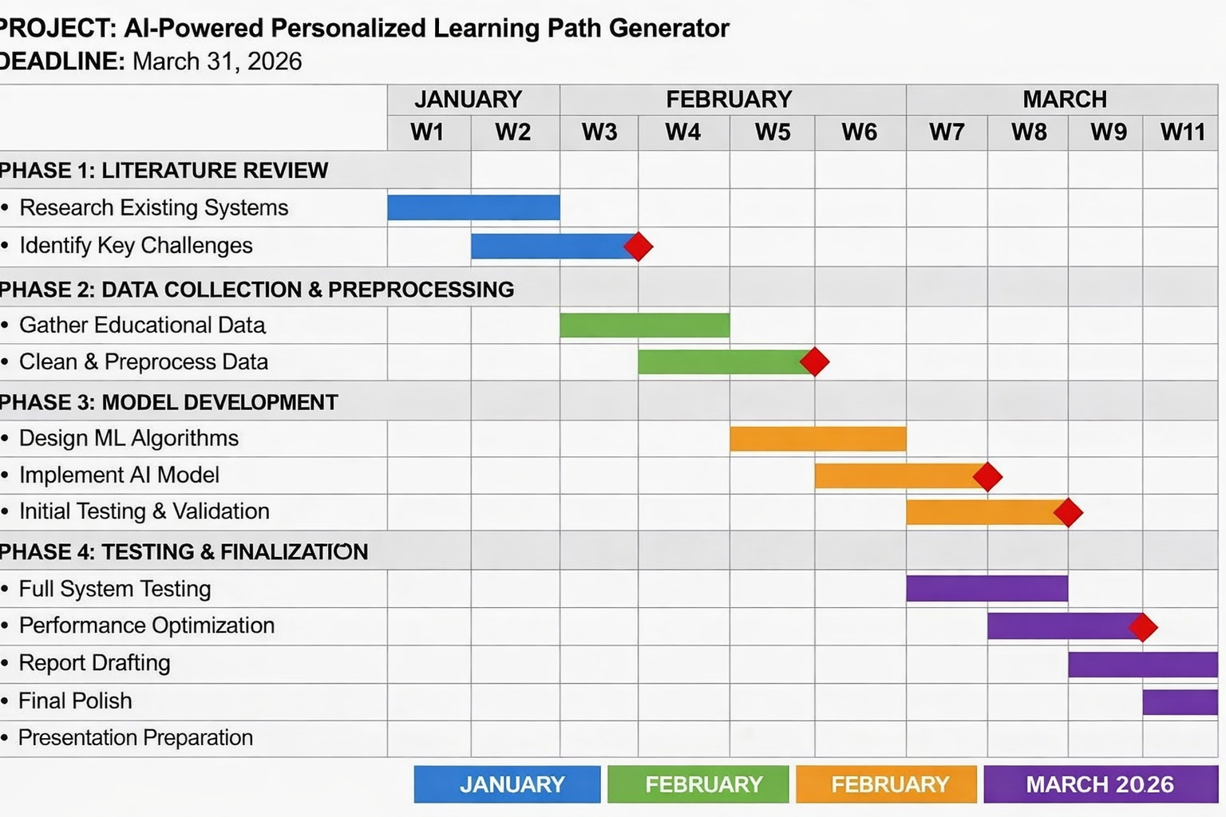
Timeline of the Project (Gantt Chart)

Slide 9
References (IEEE Paper format)
[1]. Zhou, X., Zhang, L., & Wang, K. (2018). Full-path learning recommendation model based on clustering for e-learning. Education and Information Technologies, 23(4), 1781–1795.
[2]. Ahmed, A., Khan, S., & Roy, P. (2023). Human-centric safe path recommendation in smart cities using deep reinforcement learning. IEEE Internet of Things Journal, 10(1), 112–124.
[3] Gupta, R., Kumar, P., & Singh, U. (2024). Indoor personalized navigation using context-aware deep reinforcement learning. Sensors, 24(5), 1843–1858.

Slide 10


