Slide 1
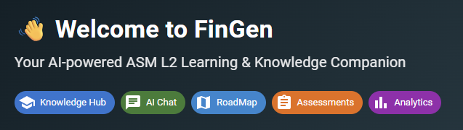
FINGEN – AI Companion for Level2 Production Support Engineer

Slide 2
FinGen AI – Intelligent Knowledge & Operations Assistant
Key Business Challenges:
Knowledge Fragmentation in Operations: Production support engineers must refer to multiple documents, runbooks, and internal systems to understand custody banking workflows, slowing down troubleshooting and learning.
Slow Incident Diagnosis: Identifying the root cause of failures in custody operations such as NAV calculation errors, trade settlement failures, or pricing discrepancies requires manual investigation across logs and monitoring tools.
Dependence on Subject Matter Experts: Critical operational knowledge often resides with experienced engineers, making onboarding and knowledge transfer difficult for new team members.
Lack of Structured Learning Paths: Support engineers lack a guided roadmap to systematically learn custody banking workflows, operational procedures, and troubleshooting practices
Centralized Knowledge Hub
Provides a unified repository of operational knowledge including custody workflows, pricing, and trade processing documentation.
AI-Powered Knowledge Companion Uses Retrieval-Augmented Generation (RAG) to provide contextual answers strictly based on internal knowledge documents.
Interactive Learning RoadMap A structured roadmap provides engineers with a guided learning path. It allows engineers to track their learning progress and understand operational workflows systematically.
2
3
1
2
3

Slide 3
Technology Rationale
FastAPI (Backend Framework) FastAPI is used to build high-performance REST APIs for the FinGen AI platform.It enables fast communication between the frontend, AI engine, and knowledge storage.Its automatic API documentation and asynchronous processing improve development efficiency. React.js (Frontend Framework)React.js powers the interactive user interface of the platform.It allows modular components such as Chatbot UI, Knowledge Hub, and Assessment module.The component-based architecture ensures scalability and smooth user experience. Ollama + LLaMA 3.2 (AI Engine) Ollama runs the LLaMA 3.2 model locally to generate AI responses.The model supports question generation, chat assistance, and answer evaluation.Running the AI locally ensures privacy, faster responses, and enterprise security. Retrieval-Augmented Generation (RAG) RAG ensures that AI responses come from the uploaded knowledge base documents.The system retrieves relevant information before generating answers.This approach improves accuracy and reduces hallucinated AI responses. React Flow (Learning Roadmap Visualization) React Flow is used to build an interactive roadmap for banking knowledge topics.It enables zoom, pan, node connections, and dynamic topic navigation.This visual learning interface improves user understanding of complex workflows.
AI & Intelligent Processing Stack
Ollama with LLaMA 3.2 for local AI-powered reasoning and response generation
Retrieval-Augmented Generation (RAG) to retrieve answers directly from the Knowledge Hub
AI-driven Question Generation for dynamic knowledge-based assessments*
AI Evaluation Engine for scoring answers and generating feedback with expected key points
1

Slide 4
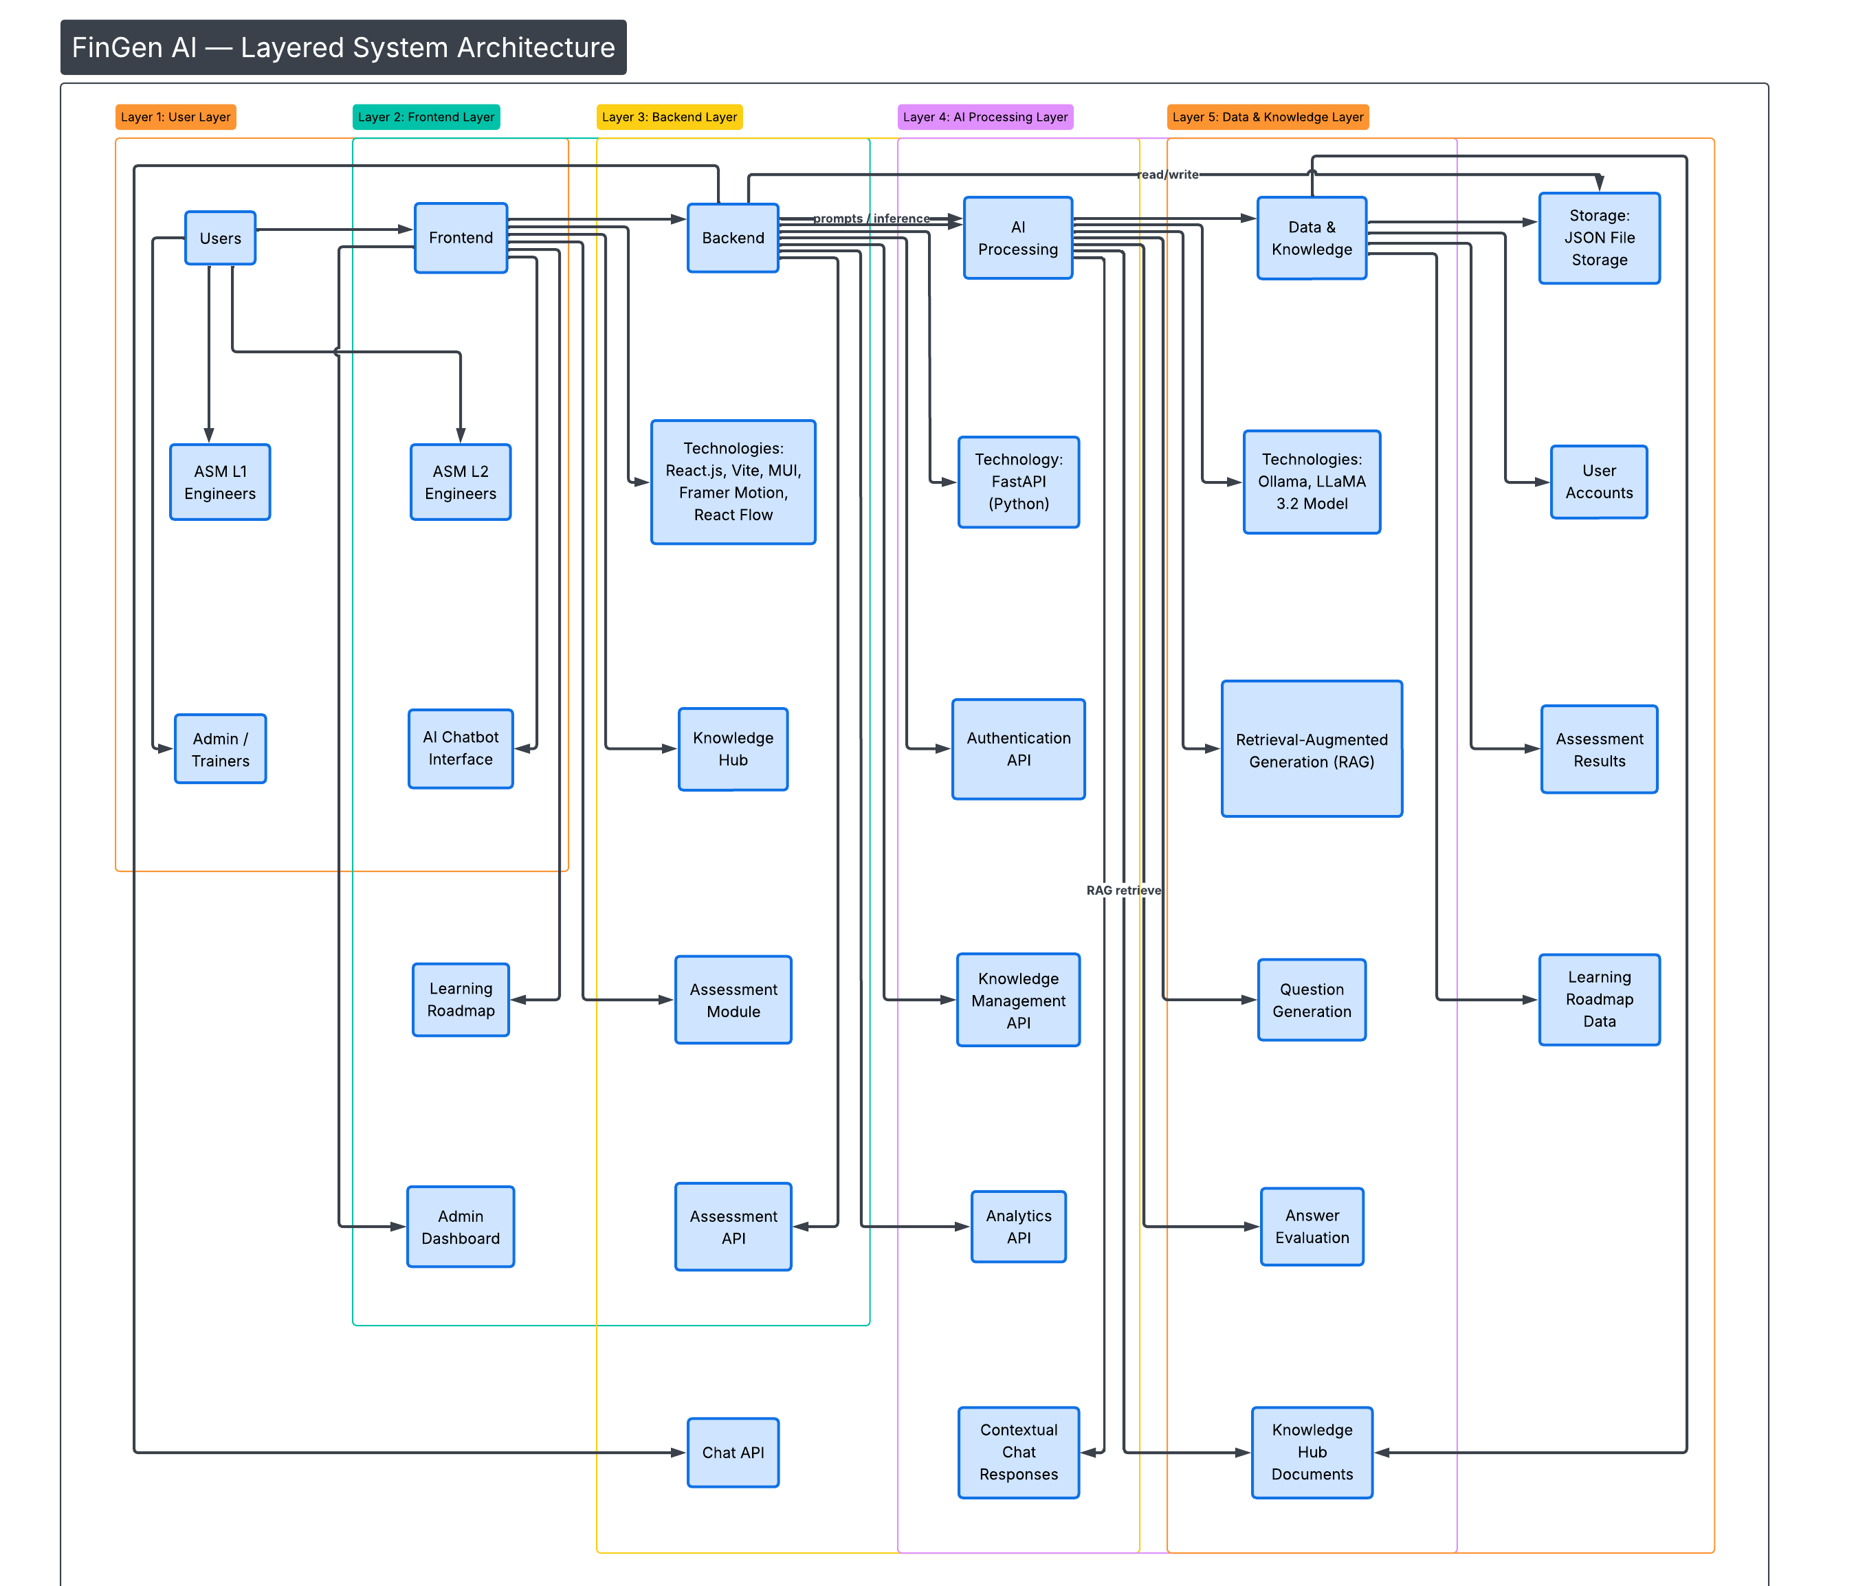

Slide 5
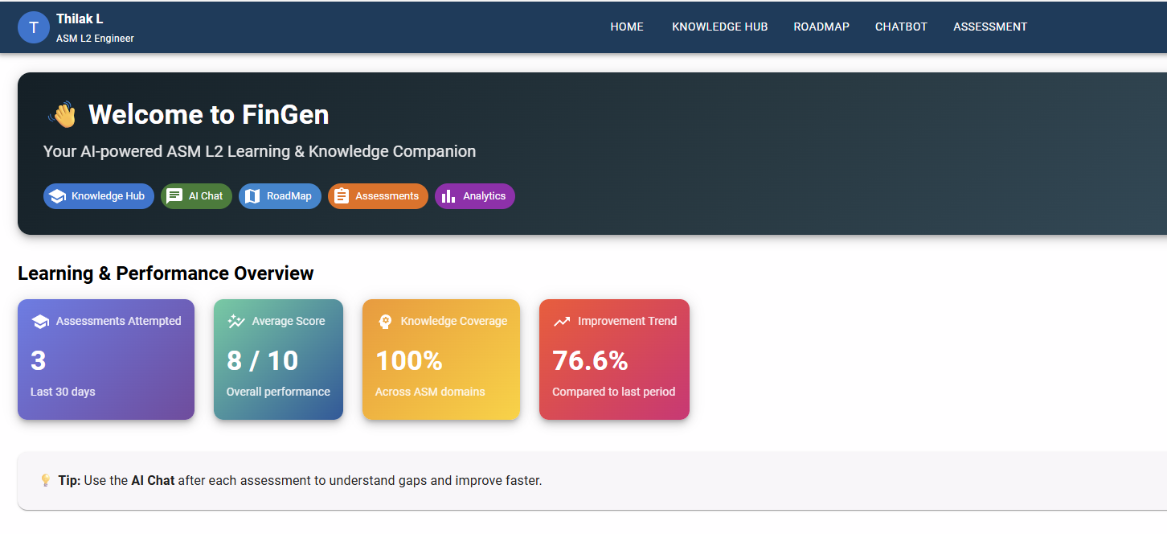
FINGEN –AI COMPANION (UI SNAPSHOTS)
Homepage:

Slide 6
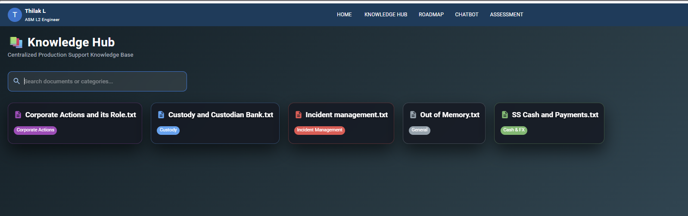
FINGEN –AI COMPANION (UI SNAPSHOTS)
Knowledge Hub:

Slide 7
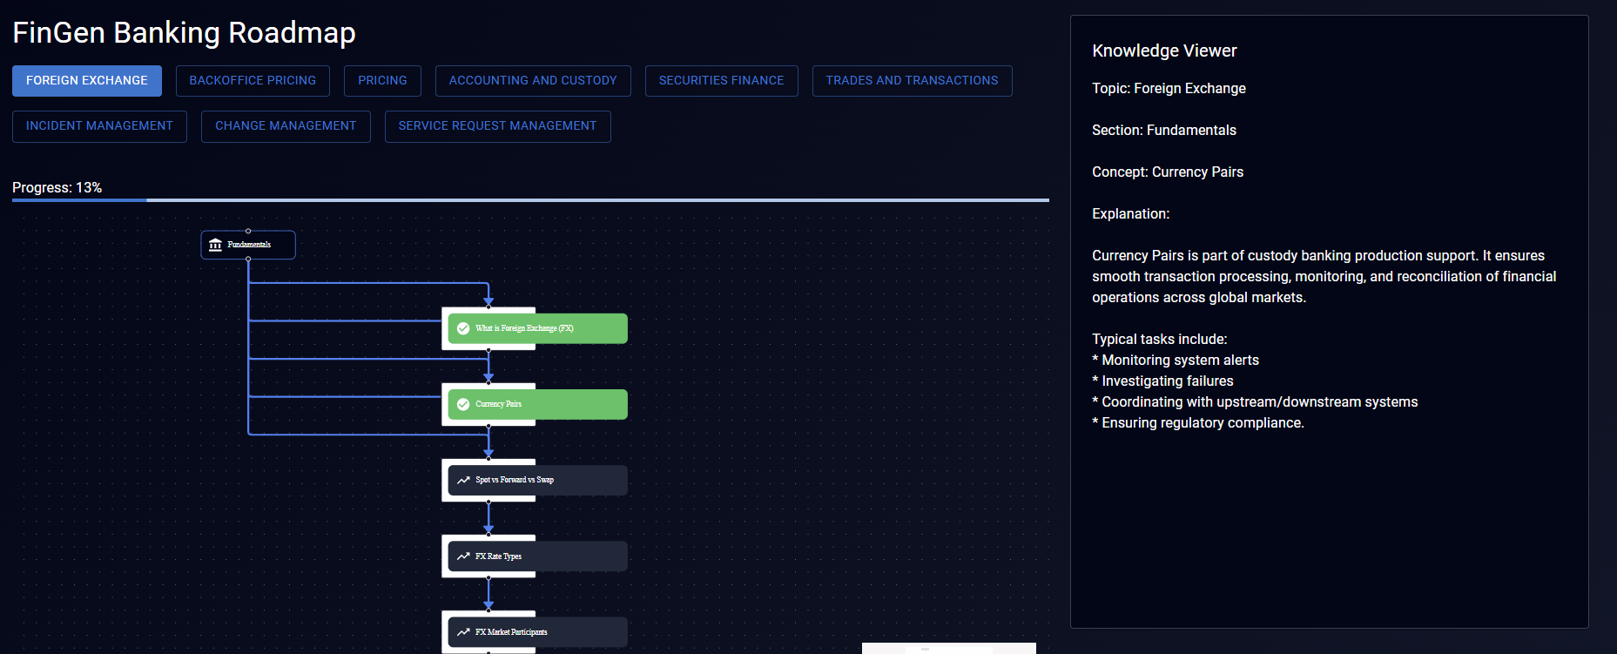
FINGEN –AI COMPANION (UI SNAPSHOTS)
RoadMap:

Slide 8
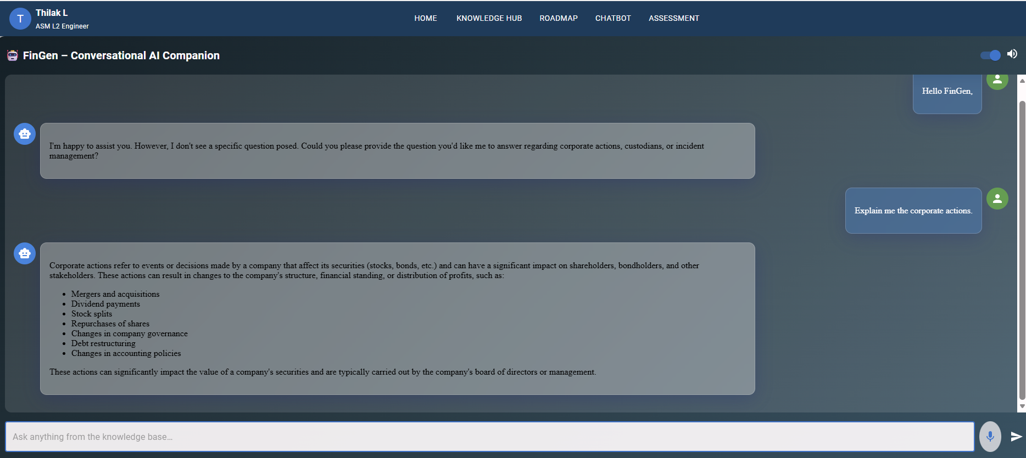
FINGEN –AI COMPANION (UI SNAPSHOTS)
AI Chatbot:

Slide 9
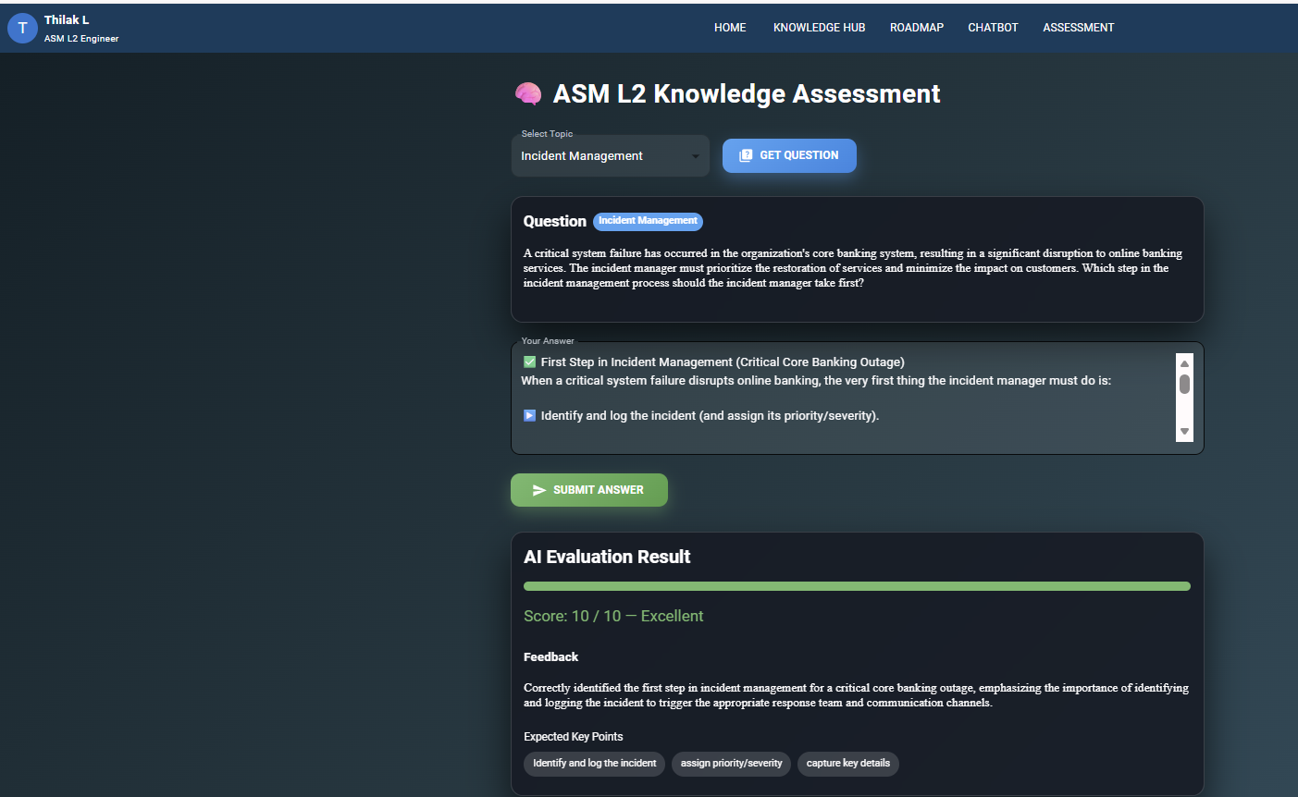
FINGEN –AI COMPANION (UI SNAPSHOTS)
Knowledge Assessment:

Slide 10
Thank You

