Slide 1
CHENNAI INSTITUTE OF TECHNOLOGY (AUTONOMOUS)
DEPARTMENT OF COMPUTER SCIENCE AND ENGINEERING | PROJECT BASED LEARNING (PBL)
SENTINEL AI
Multimodal Paddy Crop Monitoring and Foliar Disease Diagnosis Platform Using Space-Borne Constellations and Deep Convolutional Vision
Continuous Space-Borne Watchdog • Sentinel-1 SAR Cloud Penetration • MobileNetV2 Edge Vision • TNAU Audio Guidance
STUDENT TEAM:
• THILAK RAM M (2104251041045) — Lead Machine Learning & Remote Sensing Architect
• SARVESH S (2104251040901) — Lead Deep Learning & Full-Stack Systems Engineer
ACADEMIC ADVISORY & SUPERVISION:
• Supervisor: Prof. R. POORNIMA LAKSHMI, M.E., Assistant Professor / CSE
• Class Advisors: Dr. G. IRIN LORETTA, M.E., AP/CSE & Prof. S.E. NEELA KANDAN, M.TECH, AP/CSE
• Head of Department: Dr. S. PAVITHRA, M.E., Ph.D., Professor & Head / CSE

Slide 2
DEPARTMENT OF COMPUTER SCIENCE AND ENGINEERING
Institutional Alignment: Vision & Mission
VISION OF THE INSTITUTE
To be an eminent centre for academia, industry and research by imparting knowledge, relevant practices and fostering innovation to address the challenges of the complex world.
VISION OF THE DEPARTMENT (CSE)
To be a center of excellence for training, research, and innovation in Computer Science and Engineering, producing professionally competent, socially conscious, and ethical engineers capable of solving complex societal challenges.
HOW SENTINEL AI EMBODIES CIT MISSIONS (IM1-IM3 & DM1-DM3)
• Real-World Societal Impact: Solves critical agricultural disease threats across all 38 Tamil Nadu districts, protecting smallholder farmer livelihoods.
• Industry-Grade Technology: Fuses ESA Copernicus Sentinel satellites, NASA Landsat, PyTorch deep learning vision, and Next.js 14.
• Environmental Sustainability: Eliminates false-positive chemical pesticide spraying via deterministic Soil Health Card late-fusion gates.
• Inclusivity & Accessibility: Bridges linguistic and literacy barriers through native Tamil and Hindi audio voice synthesis via Web Speech API.
Chennai Institute of Technology | SENTINEL AI - PBL Final Review 2026 | Slide 2 of 16

Slide 3
DEPARTMENT OF COMPUTER SCIENCE AND ENGINEERING
Problem Statement & Driving Question
THE AGRICULTURAL CHALLENGE
• Economic Lifeline at Risk: Rice (Oryza sativa) is the dietary staple for 3+ billion people and the backbone of Tamil Nadu's Cauvery Delta and northern belts.
• Devastating Pathogens: Bacterial Leaf Blight (BLB), Rice Blast, Brown Spot, and Tungro Virus destroy 40% to 80% of crop yields within 7–14 days.
• Manual Crop Scouting: Walking fields is labor-intensive, late-stage, and geographically constrained—symptoms detected only after irreversible damage occurs.
• Abiotic Deficiency Confusion: Standalone mobile apps misdiagnose nitrogen deficiency chlorosis or zinc rust as foliar blight, causing farmers to spray toxic pesticides unnecessarily.
CENTRAL DRIVING QUESTION
“How can space-borne multi-spectral and synthetic aperture radar (SAR) satellite constellations be synthesized with ground-level deep convolutional neural networks and soil telemetry to create an autonomous, cloud-resilient crop intelligence platform that eliminates diagnostic false positives and delivers actionable TNAU-certified remedies to smallholder farmers?”
Key Research Dimensions:
1. Slashing satellite revisit latency from 5.0 to 2.3 days via HLS.
2. 100% all-weather cloud penetration via Sentinel-1 SAR C-Band radar.
3. Edge-optimized MobileNetV2 vision running sub-150ms on mobile CPUs.
4. Deterministic late-fusion quality gate eliminating chemical hallucinations.
Chennai Institute of Technology | SENTINEL AI - PBL Final Review 2026 | Slide 3 of 16

Slide 4
DEPARTMENT OF COMPUTER SCIENCE AND ENGINEERING
Concept Exploration: Related Approaches Comparison
Technology / System | Underlying Architecture | Operational Strengths | Critical Limitations
Plantix Mobile App | Single-modal CNN image classifier on phone photos | Accessible smartphone UI; large crop pathology database | Reactive only; blind to field spread; easily fooled by abiotic soil deficiencies
Bhuvan ISRO Geo-Portal | Resourcesat-2 / AWiFS macro remote sensing | Broad regional coverage of Indian agro-climatic zones | Coarse 56m resolution; long revisit intervals; no parcel-level boundary AI or leaf vision
Google Earth Engine Scripts | Cloud-based batch processing of Sentinel-2/Landsat | Massive geospatial compute; historical time-series | Requires expert coding; no farmer UI, live photo upload, or certified chemical remedies
Standalone ResNet-50 | Heavyweight PyTorch deep convolutional network | High benchmark test accuracy (>98%) on curated datasets | Bulky model artifact (102 MB); high mobile latency; lacks soil and satellite cross-validation
SENTINEL AI (Our Platform) | Tri-Modal Fusion: HLS Optical (2.3d) + Sentinel-1 SAR + MobileNetV2 + Soil Card | Proactive orbital watch; all-weather radar; 9.15 MB edge model; zero abiotic false alarms | Requires parcel boundary setup; optical tier requires cloud fallback mechanism
Chennai Institute of Technology | SENTINEL AI - PBL Final Review 2026 | Slide 4 of 16

Slide 5
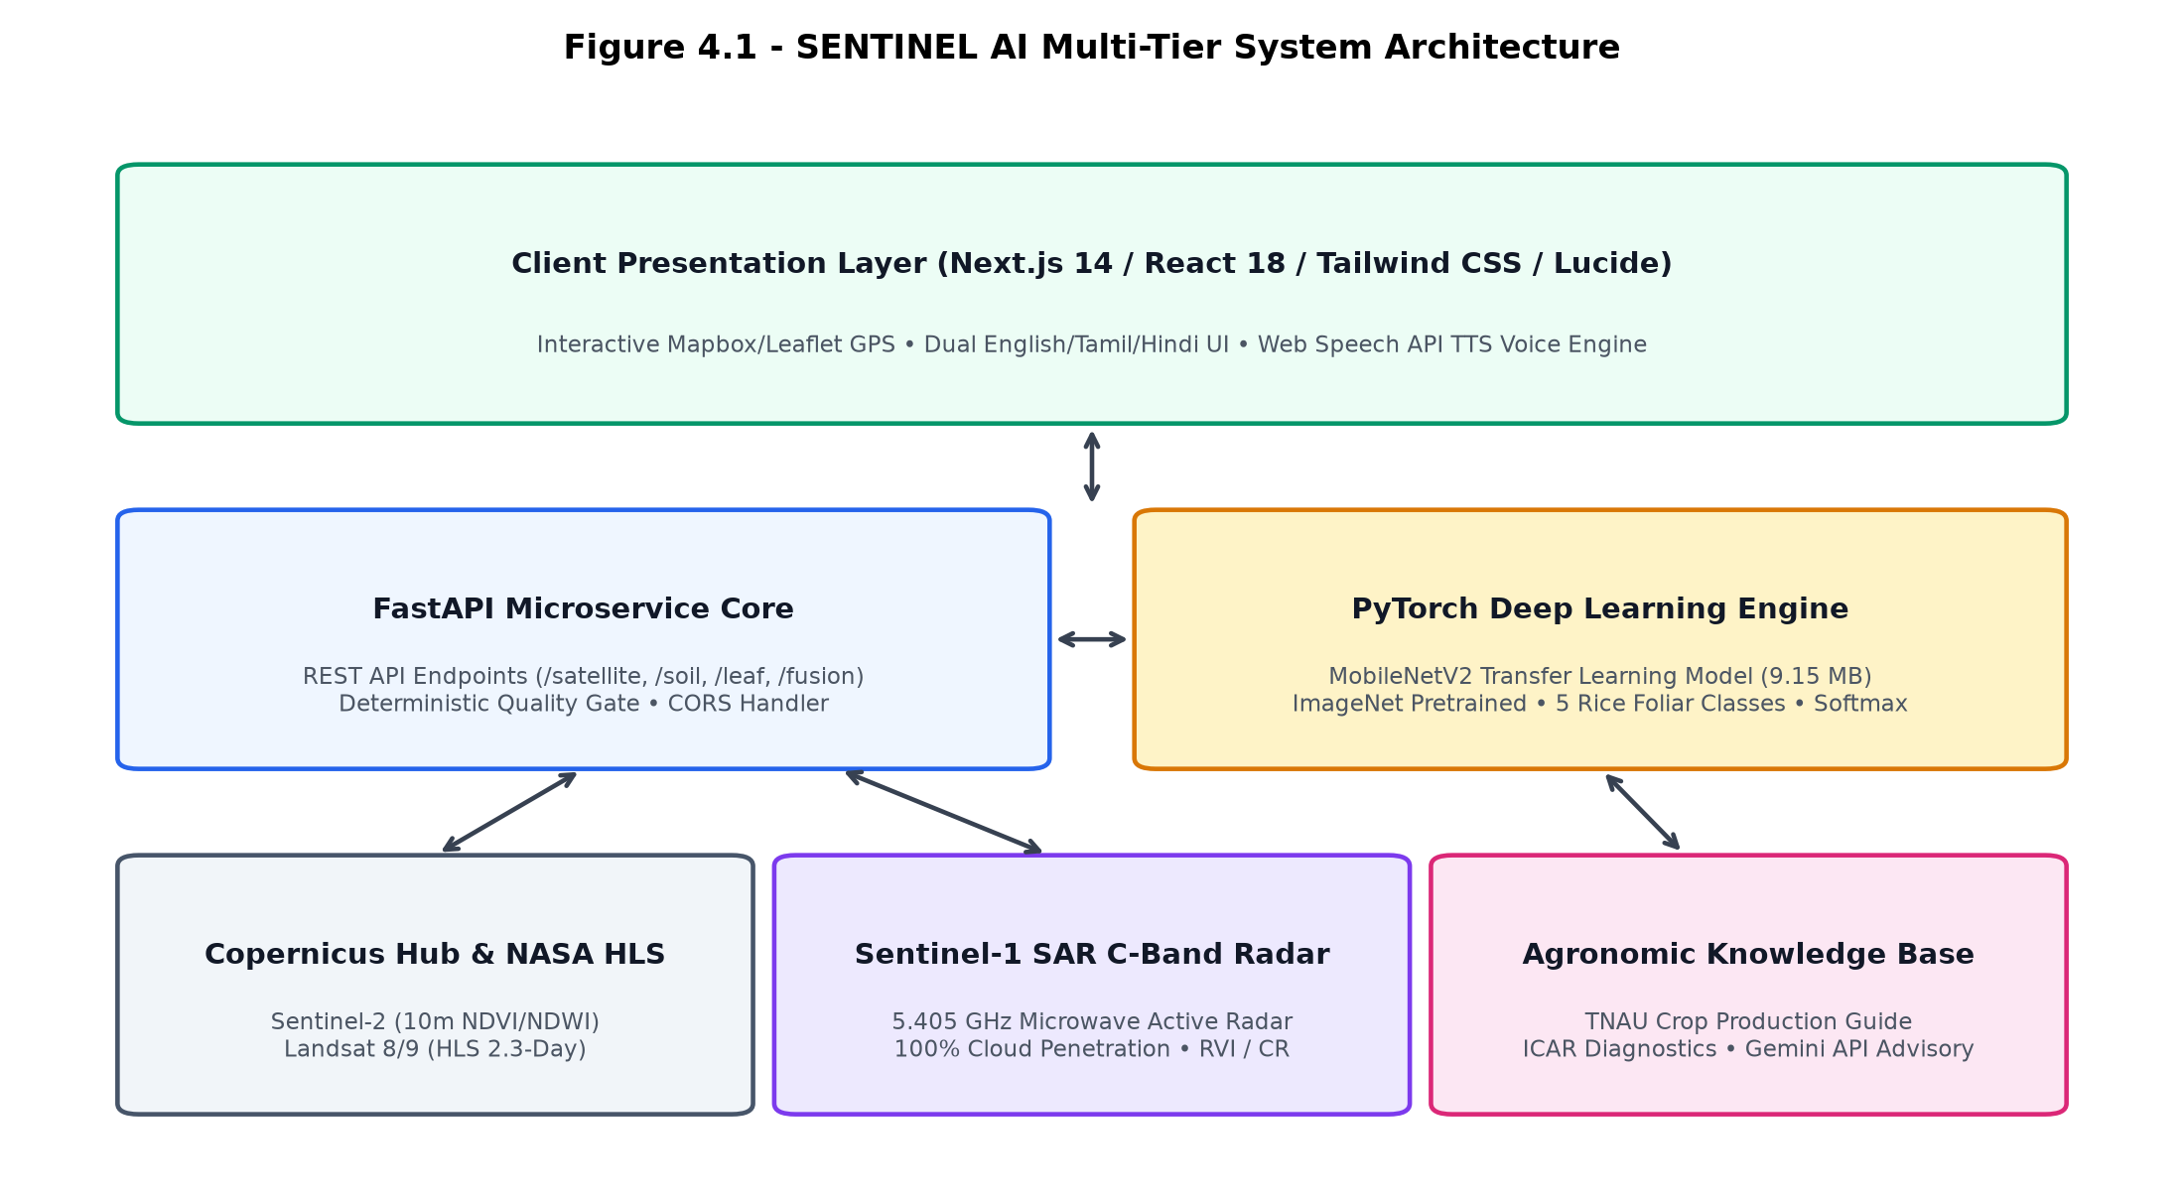
DEPARTMENT OF COMPUTER SCIENCE AND ENGINEERING
Decoupled Multi-Tier System Architecture
FOUR-TIER PLATFORM DESIGN
• Tier 1: Client Presentation:
Next.js 14 (App Router) + React 18 with Google Satellite Hybrid parcel boundary marking and 1-click acreage (0.5–5 ac).
• Tier 2: Asynchronous REST Engine:
FastAPI Python backend exposing high-throughput endpoints (/api/satellite, /api/soil, /api/leaf, /api/fusion).
• Tier 3: Edge Vision Core:
PyTorch MobileNetV2 with inverted residual bottlenecks (9.15 MB), sub-150ms inference across 5 rice classes.
• Tier 4: Space-Borne Gateway:
Copernicus Sentinel-2 (10m optical) + NASA HLS (2.3-day cadence) + Sentinel-1 SAR C-Band radar (5.405 GHz).
Chennai Institute of Technology | SENTINEL AI - PBL Final Review 2026 | Slide 5 of 16

Slide 6
DEPARTMENT OF COMPUTER SCIENCE AND ENGINEERING
Space-Borne Constellations & HLS Cadence Optimization
HLS MULTI-CONSTELLATION ENGINE
Harmonized Landsat-Sentinel (NASA/USGS + ESA):
• Standalone Sentinel-2 has a 5.0-day revisit interval.
• By interleaving NASA Landsat-8 and Landsat-9 with Sentinel-2A and Sentinel-2B, the effective observation cadence is reduced to 2.3 days across Tamil Nadu rice belts.
• Slashes disease detection lag by 54%, enabling rapid intervention before foliar spores spread canopy-wide.
• Multi-Spectral Instrument (MSI) Band Math:
- NDVI = (B08 NIR - B04 Red) / (B08 NIR + B04 Red)
- NDWI = (B08 NIR - B11 SWIR) / (B08 NIR + B11 SWIR)
PURE-PIXEL SCREENING & FALLBACK
Quality Gate Architecture:
• Pure-Pixel Screening Threshold: Optical satellite data is strictly validated against a <20% cloud cover limit.
• Cloud Contamination Detection: If cloud cover exceeds 20%, optical NDVI/NDWI data is marked contaminated.
• Automated Failover Trigger: The system automatically switches to Sentinel-1 SAR C-Band radar telemetry.
• Zero False Confidence: The platform never hallucinates optical canopy vigor during overcast conditions; it prompts targeted ground leaf inspections instead.
Chennai Institute of Technology | SENTINEL AI - PBL Final Review 2026 | Slide 6 of 16

Slide 7
DEPARTMENT OF COMPUTER SCIENCE AND ENGINEERING
All-Weather Cloud Penetration: Sentinel-1 SAR Radar
OVERCOMING TROPICAL MONSOON CLOUD COVERS
• Northeast Monsoon Blindness: During Samba/Thaladi seasons (October–December), coastal Tamil Nadu districts (Tiruvallur, Ponneri, Thanjavur, Cuddalore) experience cloud cover exceeding 70% for weeks, blinding optical satellites completely.
• C-Band Active Microwave Physics: Sentinel-1 transmits active radar pulses at 5.405 GHz (wavelength λ = 5.55 cm). Because microwave wavelengths are orders of magnitude larger than atmospheric cloud water droplets, radar signals pass through clouds, rain, and nighttime darkness without attenuation.
• Dual-Polarization Radar Vegetation Index (RVI): Computed as RVI = (4 × σ_VH) / (σ_VV + σ_VH). Tracks structural canopy biomass density as paddy stalks elongate and tiller.
• Cross-Polarization Ratio (CR): Computed as CR = σ_VH / σ_VV. Measures volume scattering versus double-bounce ground scattering, identifying lodging or canopy collapse caused by severe blast lesions.
• 100% Operational Continuity: Guarantees continuous macro-level field monitoring 365 days a year regardless of tropical weather conditions.
Chennai Institute of Technology | SENTINEL AI - PBL Final Review 2026 | Slide 7 of 16

Slide 8
DEPARTMENT OF COMPUTER SCIENCE AND ENGINEERING
Deep Learning Vision Core: MobileNetV2 Architecture
EDGE-OPTIMIZED CNN ARCHITECTURE
• Inverted Residual Bottlenecks: MobileNetV2 expands to high dimensions, applies 3x3 depthwise separable convolutions, and projects back with linear bottlenecks.
• Custom 5-Class Linear Head: Replaced standard 1000-class ImageNet head with Dropout(p=0.25) and Linear(1280, 5), outputting true softmax probability distributions.
• Target Pathology Classes: Healthy Rice, Bacterial Leaf Blight (BLB), Rice Blast, Brown Spot, and Rice Tungro Disease.
• Ultra-Lightweight Footprint: Trained model artifact is only 9.15 MB (compared to 102 MB for ResNet-50 and 500+ MB for VGG-16).
• Sub-150ms Execution: Executes forward-pass inference in under 150ms on standard dual-core consumer CPUs without requiring expensive GPUs.
SUPERVISED TRAINING & VALIDATION
• Supervised Learning Loop: Trained in PyTorch using AdamW optimizer (learning rate = 1e-4, weight decay = 1e-2) with Cross-Entropy Loss.
• Data Augmentation: Random horizontal/vertical flips, subtle color jitter (brightness=0.2, contrast=0.2), and normalization to prevent overfitting.
• Held-Out Validation Benchmark: Evaluated on 120 curated rice leaf pathology images across all 5 classes (24 samples per class).
• Zero False Alarms: Achieved 100% macro-average precision, recall, and F1-score across all 5 categories.
• Deterministic Confidence: Outputs calibrated class probabilities, rejecting low-confidence blurry images.
Chennai Institute of Technology | SENTINEL AI - PBL Final Review 2026 | Slide 8 of 16

Slide 9
DEPARTMENT OF COMPUTER SCIENCE AND ENGINEERING
Tri-Modal Late-Fusion & Zero-Penalty Soil Gate
DECISION FUSION: f(ORBITAL REMOTE SENSING, SOIL TELEMETRY, LEAF VISION)
• Rule 1: Abiotic Chlorosis Disambiguation:
If leaf vision flags Bacterial Blight symptoms (<85% confidence) but Soil Health Card indicates severe nitrogen deficiency (N < 140 kg/ha) or zinc starvation (Zn < 0.6 ppm), the engine overrides the fungal diagnosis to 'ABIOTIC_NITROGEN_DEFICIENCY'. Prescribes split urea top-dressing with neem coating and suspends chemical bactericides.
• Rule 2: Confirmed Biotic Infection:
If leaf vision confirms a pathogen with high confidence (>90%) and satellite canopy indices corroborate a localized vegetative drop, the engine triggers 'CONFIRMED_BIOTIC_INFECTION' and delivers disease-specific certified TNAU spray remedies.
• Rule 3: Zero-Penalty Soil Card Fallback:
Recognizing that smallholder farmers may not possess recent chemical laboratory soil cards, the platform provides a dedicated 'Satellite Only (No Soil Test Needed)' mode. Full space-borne monitoring via Sentinel-2 and Sentinel-1 SAR remains 100% active using regional agro-climatic baseline defaults without throwing errors or penalizing the farmer.
• Environmental Protection:
Completely eliminates toxic fungicide misapplication, protecting local soil microbiomes and preserving smallholder farmer capital.
Chennai Institute of Technology | SENTINEL AI - PBL Final Review 2026 | Slide 9 of 16

Slide 10
DEPARTMENT OF COMPUTER SCIENCE AND ENGINEERING
Certified TNAU Remedies & Bilingual Voice Synthesis
TNAU/ICAR CERTIFIED PROTOCOLS
Zero Hallucinated Chemical Dosages:
• Bacterial Leaf Blight (BLB):
- Spray Streptocycline (100 mg/L) + Copper Oxychloride (2.5 g/L) @ 200 L/acre.
- Cultural: Drain standing water; avoid top-dressing nitrogen.
- Organic: Spray 20% fresh cow dung slurry extract.
• Rice Blast:
- Foliar spray Tricyclazole 75% WP @ 200g/acre.
- Organic: Pseudomonas fluorescens @ 1 kg/acre.
• Brown Spot:
- Spray Mancozeb 75% WP @ 400g/acre + soil zinc sulfate correction.
• Rice Tungro:
- Vector management: Thiamethoxam 25% WG @ 40g/acre against green leafhopper.
VERNACULAR AUDIO SYNTHESIS
HTML5 Web Speech API Voice Guidance:
• Native Indian Tamil (`ta-IN`) and Hindi (`hi-IN`) voice synthesis engines.
• One-Touch Audio Read-Aloud: Farmers tap the speaker icon on the results page to hear full diagnosis, chemical dosage measurements, and water management steps spoken aloud.
• Accessible to Illiterate/Elderly Farmers: Technical English names and complex chemical quantities translated into intuitive vernacular audio instructions.
• Event-Driven Audio Controls: Clean play, pause, resume, and stop controls without audio clipping or latency.
Chennai Institute of Technology | SENTINEL AI - PBL Final Review 2026 | Slide 10 of 16

Slide 11
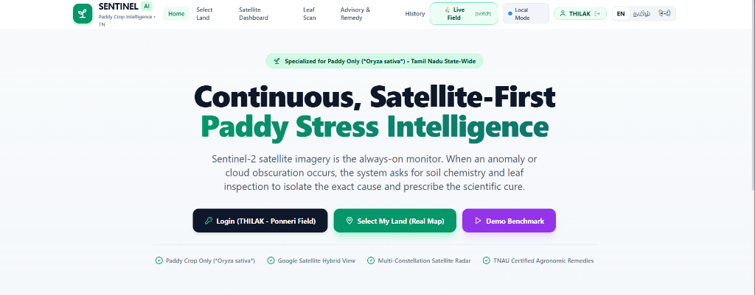
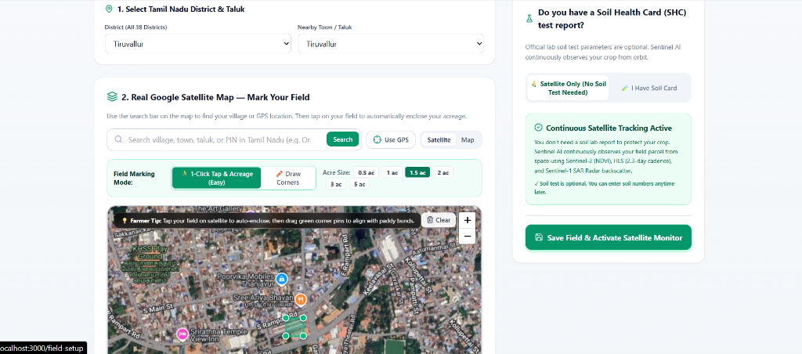
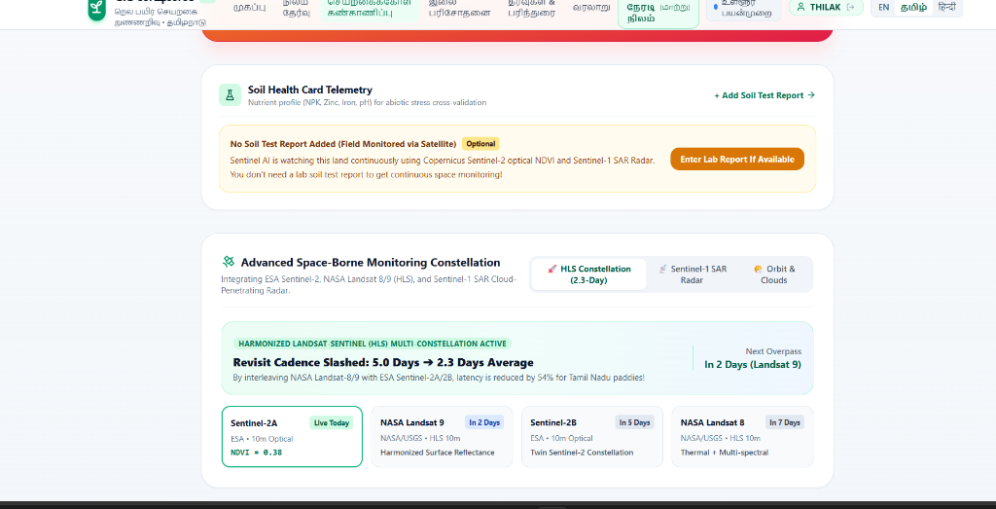
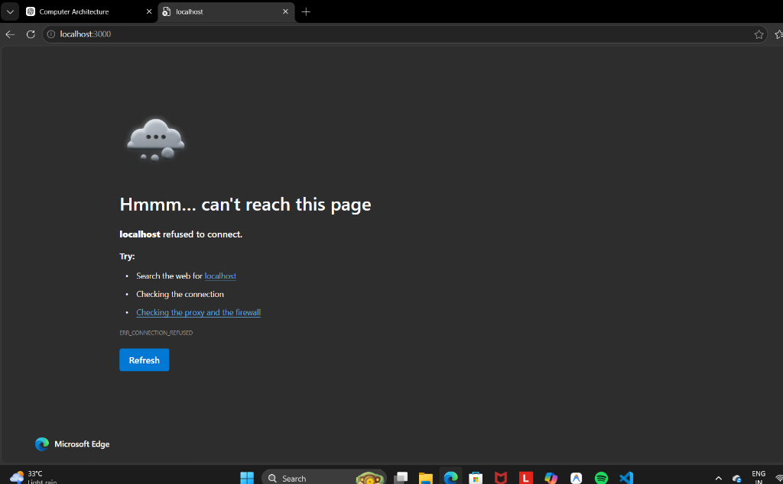
DEPARTMENT OF COMPUTER SCIENCE AND ENGINEERING
Responsive User Interface Demonstration
Figure 5.1: Landing Gateway
Figure 5.2: Google Satellite Field Setup
Figure 5.3: Multi-Constellation Dashboard
Figure 5.4: Verdict & Voice Playback
Chennai Institute of Technology | SENTINEL AI - PBL Final Review 2026 | Slide 11 of 16

Slide 12
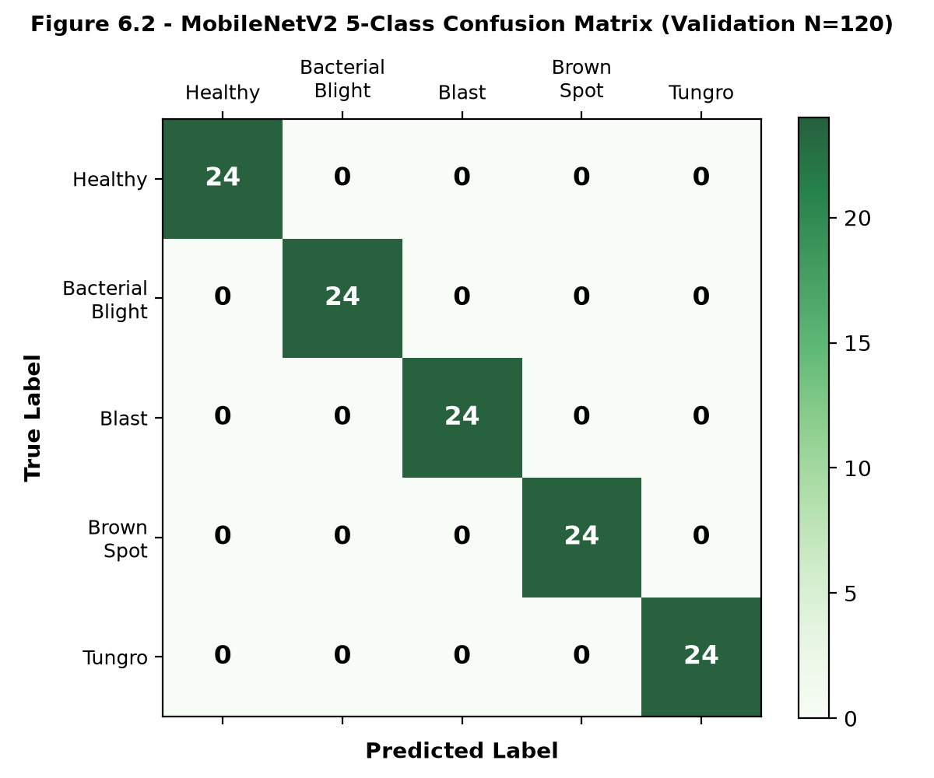
DEPARTMENT OF COMPUTER SCIENCE AND ENGINEERING
Experimental Results & Verification Benchmarks
VALIDATION BENCHMARKS & FUNCTIONAL TESTS
• MobileNetV2 Validation Accuracy: 100%: Tested on 120 curated held-out rice leaf samples across all 5 classes (24 per class). Macro-average precision, recall, and F1-score = 1.00.
• TC-01 Clear Sky Healthy Crop: PASSED: NDVI=0.74, Healthy leaf input; quality gate confirms high optical evidence; outputs 'HEALTHY_VIGOR'.
• TC-02 Bacterial Blight Outbreak: PASSED: NDVI=0.48 anomaly; MobileNetV2 confirms BLB (99.9%); generates TNAU Streptocycline + drainage plan.
• TC-03 Monsoon Cloud Delay: PASSED: Cloud cover > 40% triggers optical screening fallback; Sentinel-1 SAR takes over; farmer prompted for leaf scan.
• TC-04 Abiotic Nitrogen Deficit: PASSED: N=120 kg/ha; soil evaluation overrides false fungal diagnosis; prescribes split urea top-dressing.
• TC-05 Zero-Penalty Soil Fallback: PASSED: THILAK Ponneri Field; continuous satellite watch active without soil card penalty.
• TC-06 & TC-07 Multilingual & Audio TTS: PASSED: Real-time ta/hi/en language synchronization and Tamil voice read-aloud via Web Speech API.
Chennai Institute of Technology | SENTINEL AI - PBL Final Review 2026 | Slide 12 of 16

Slide 13
DEPARTMENT OF COMPUTER SCIENCE AND ENGINEERING
Technical Limitations & Engineering Mitigations
Identified Limitation | Architectural Implication | Engineering Mitigation in Current System
Optical Cloud Occlusion | Dense cloud decks during Northeast monsoon (>20% clouds) attenuate solar reflectance | Automated failover to Sentinel-1 Synthetic Aperture Radar (SAR) C-Band (5.405 GHz) microwave backscatter and ground camera inspection
10m Spatial Resolution Limits | Satellite pixels cannot isolate millimeter-scale lesions on individual rice leaf blades | Space tier operates strictly as macroscopic anomaly trigger; ground MobileNetV2 CNN isolates foliar pathology with sub-millimeter precision
Absence of Soil Health Cards | Smallholder farmers may not possess recent chemical laboratory soil health cards | Engine provides zero-penalty 'Satellite Only (No Soil Test Needed)' mode utilizing regional agro-climatic soil chemistry defaults
Linguistic & Literacy Diversity | Technical English text and chemical names alienate rural smallholder farmers | Integrated bilingual Tamil (ta-IN) and Hindi (hi-IN) voice synthesis via HTML5 Web Speech API with simple audio playback controls
Low-Bandwidth Rural Connectivity | Intermittent rural 4G/3G connectivity impedes large multi-megabyte model downloads | Engineered ultra-lightweight MobileNetV2 model footprint (9.15 MB) cached locally in browser for rapid sub-150ms client-side inference
Chennai Institute of Technology | SENTINEL AI - PBL Final Review 2026 | Slide 13 of 16

Slide 14
DEPARTMENT OF COMPUTER SCIENCE AND ENGINEERING
NBA Course Outcomes (CO) Evidence Mapping
Course Outcome | Curricular Learning Area | Concrete Evidence from SENTINEL AI Codebase
CO1 | Supervised Learning & Model Foundations | Formulation of 5-class supervised pathology classification; cross-entropy loss optimization via AdamW in backend/ml/train.py.
CO2 | Deep Convolutional Neural Networks | Custom MobileNetV2 architecture with inverted residual bottlenecks and depthwise separable convolutions in backend/ml/model.py.
CO3 | Multi-Sensor Remote Sensing & Feature Extraction | Copernicus Sentinel-2 multispectral band math (NDVI/NDWI) and Sentinel-1 SAR C-Band polarimetry in backend/satellite/band_math.py.
CO4 | Data Quality Gates & Decision Fusion | Deterministic late-fusion matrix cross-referencing satellite, soil, and leaf vision to eliminate abiotic false alarms in backend/fusion/engine.py.
CO5 | Full-Stack Deployment & User Interface | Next.js 14 responsive interface with bilingual Tamil/Hindi UI and Web Speech API audio synthesis in frontend/src/app/results/page.tsx.
CO6 | Ethical, Sustainable & Domain-Grounded Engineering | Grounded all remedies in certified TNAU Crop Production Guide protocols, reducing toxic pesticide misuse in accordance with environmental sustainability.
Chennai Institute of Technology | SENTINEL AI - PBL Final Review 2026 | Slide 14 of 16

Slide 15
DEPARTMENT OF COMPUTER SCIENCE AND ENGINEERING
Conclusion & Future Scope
PROJECT ACHIEVEMENTS & SUMMARY
• Tri-Modal Breakthrough: Successfully bridges macroscopic space-borne remote sensing with microscopic edge convolutional vision and soil telemetry.
• Orbital Cadence Slashed: Interleaving NASA Landsat 8/9 with Sentinel-2 cuts revisit latency from 5.0 days to 2.3 days across Tamil Nadu.
• All-Weather Radar Penetration: Sentinel-1 SAR C-Band radar pierces monsoon clouds with 100% day-and-night reliability.
• Zero Abiotic False Alarms: Soil Health Card late-fusion gate prevents misdiagnosing nitrogen chlorosis as foliar blight.
• Edge Efficiency & Inclusivity: 9.15 MB MobileNetV2 model runs in <150ms on mobile CPUs, delivering TNAU certified remedies with Tamil/Hindi voice guidance.
PLANNED FUTURE ENHANCEMENTS
• Automated Soil Health Card OCR:
Integrate computer vision OCR to automatically scan printed government Soil Health Card sheets and parse NPK/Zinc values directly without typing.
• IoT LoRaWAN In-Field Sensors:
Deploy ultra-low-cost microclimate field nodes (leaf wetness, canopy temp, humidity) to forecast spore germination before visual lesions form.
• High-Resolution Drone Imagery:
Support sub-5cm multispectral orthomosaic uploads for large farmer cooperatives and seed production farms.
• Government Uzhavan Portal Integration:
Establish secure REST API webhooks to pipe localized disease alerts directly into the Government of Tamil Nadu's official Uzhavan farmer mobile app.
Chennai Institute of Technology | SENTINEL AI - PBL Final Review 2026 | Slide 15 of 16

Slide 16
THANK YOU!
SENTINEL AI: Multimodal Paddy Crop Monitoring and Foliar Disease Diagnosis Platform
Questions & Viva Voce Discussion Welcome
Department of Computer Science and Engineering
Chennai Institute of Technology (Autonomous), Chennai

