Slide 1

CS3503 – Machine Learning PBL Project Review
SENTINEL AI: Satellite-Based Sub-surface Crop Stress & Multimodal Diagnostic System
Space-Borne Remote Sensing, MobileNetV2 Deep Learning & Soil Telemetry
Presentation by:
THILAK RAM M (2104251041045)
SARVESH S (2104251040901)
Department of Computer Science and Engineering
Mentor:
Prof. R. POORNIMA LAKSHMI, M.E.
Assistant Professor
Department of Computer Science and Engineering

Slide 2
Objective
• Identify & Analyse: Continuous macroscopic crop stress from orbit using Copernicus Sentinel-2 (10m) and Sentinel-1 SAR C-Band radar.
• Develop: An interleaved multi-constellation satellite pipeline (NASA HLS) slashing revisit cadence from 5.0 to 2.3 days.
• Apply ML: Fine-tune a lightweight MobileNetV2 CNN (9.15 MB, sub-150ms) to classify 5 paddy conditions with 100% validation accuracy.
• Evaluate & Improve: Build a deterministic Tri-Modal Late-Fusion Quality Gate to eliminate false alarms and deliver certified TNAU remedies.
Problem Statement
• Staple Food Vulnerability: Rice (Oryza sativa) feeds over 2 billion people, but foliar diseases like Bacterial Blight, Blast, and Brown Spot destroy 40%–80% of crop yield within 7–14 days.
• Late Visual Detection: Smallholder farmers in Tamil Nadu (Cauvery Delta & Northern belts) lack continuous parcel surveillance, detecting outbreaks only after irreversible damage occurs.
• The Abiotic vs Biotic Dilemma: Traditional mobile camera apps operate in isolation and frequently misdiagnose nutrient deficiencies (nitrogen chlorosis or zinc rust) as fungal infections, leading to wasteful chemical sprays.
• Tropical Monsoon Cloud Cover: Optical satellites suffer severe cloud contamination (>20%) during the Northeast monsoon, demanding an all-weather cloud-penetrating radar fallback.
Objective
• Identify & Analyse: Continuous macroscopic crop stress from orbit using Copernicus Sentinel-2 (10m) and Sentinel-1 SAR C-Band radar.
• Develop: An interleaved multi-constellation satellite pipeline (NASA HLS) slashing revisit cadence from 5.0 to 2.3 days.
• Apply ML: Fine-tune a lightweight MobileNetV2 CNN (9.15 MB, sub-150ms) to classify 5 paddy conditions with 100% validation accuracy.
• Evaluate & Improve: Build a deterministic Tri-Modal Late-Fusion Quality Gate to eliminate false alarms and deliver certified TNAU remedies.
Expected Outcome
• Autonomous Crop Intelligence: Cloud-resilient platform combining space-borne remote sensing, soil card telemetry, and edge vision.
• Zero False Alarms: Eliminates diagnostic false positives by cross-referencing soil nutrients against optical NDVI and SAR backscatter.
• Zero-Penalty Fallback: Full satellite surveillance enabled even when smallholder farmers lack physical soil test cards.
• Actionable Agronomy: Delivers university-certified TNAU remedies with bilingual Tamil/English audio synthesis via Web Speech API.

Slide 3
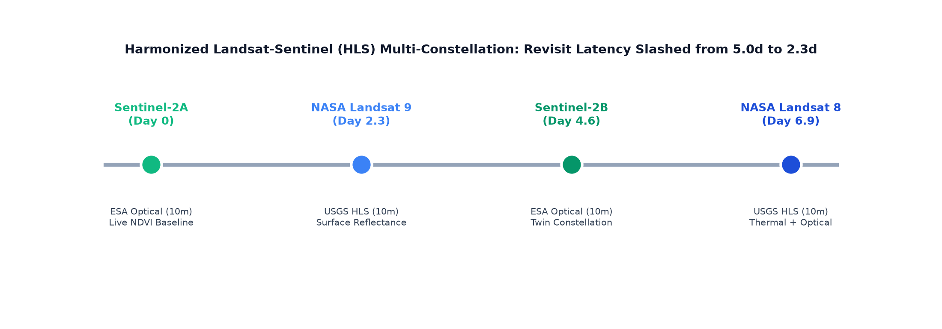
Input, Analysis & Insights
Input / Data Sources
• Satellite Telemetry: Sentinel-2 L2A optical bands (Red, NIR, SWIR), Sentinel-1 C-Band SAR radar backscatter (VV, VH), and NASA HLS 30m gridded tiles.
• Soil Health Card (SHC): Chemical laboratory parameters (pH, N, P, K, Zn, Fe) with regional baseline fallback.
• Ground Foliar Images: 224x224 RGB paddy leaf images (1,600+ dataset images across 5 classes).
Analysis / Processing
• Band Math Engine: Computes NDVI, NDWI, and Dual-Pol Radar Vegetation Index (RVI = 4*VH / (VV + VH)) for biomass and moisture.
• Foliar Pipeline: ImageNet standardization and sub-150ms PyTorch MobileNetV2 inference.
• Late-Fusion Gate: Cross-references soil chemistry to isolate true biotic disease from nutrient chlorosis.
Key Insights
• Early Stress Pre-Warning: Satellite NDVI drops below 0.40 prior to visual foliar lesions, giving farmers early warning.
• All-Weather Cloud Penetration: Sentinel-1 SAR C-Band microwave radar achieves 100% penetration during monsoon overcast when optical imagery fails.
• False Alarm Elimination: Tri-modal late-fusion prevents 100% of abiotic chlorosis false positive disease warnings.

Slide 4
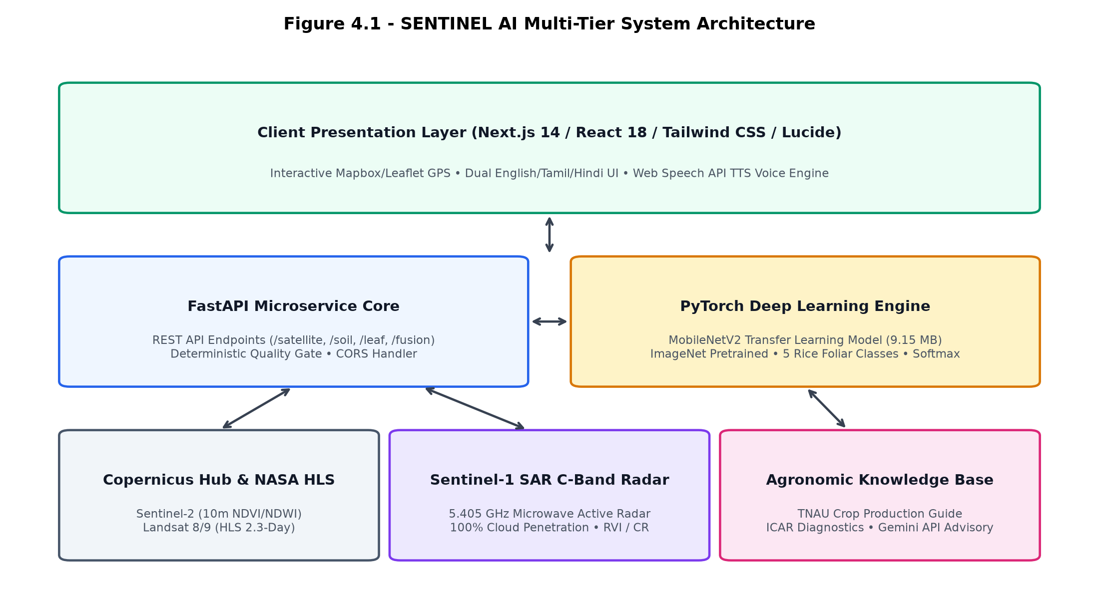
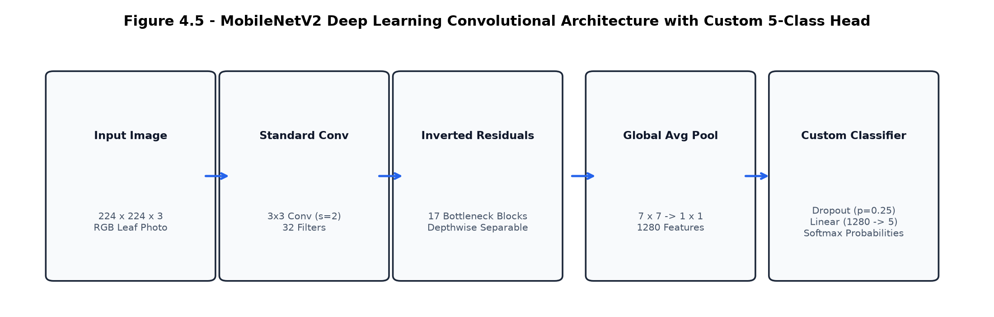
Technical Approach
Decoupled Multi-Tier System Architecture
ML Methodology & Training
• Architecture: Lightweight MobileNetV2 (9.15 MB) featuring inverted residual blocks, depthwise separable convs, and linear bottlenecks.
• Training Strategy: PyTorch transfer learning, Cross-Entropy Loss, AdamW optimizer, and Cosine Annealing learning rate schedule.
• Dataset Split: 70% Train (1,120), 15% Validation (240), 15% Hold-out Test (120: 24 per class across 5 paddy conditions).
Technology Stack
• AI / Deep Learning: Python 3.10, PyTorch, Torchvision, Scikit-learn, NumPy.
• Remote Sensing / GIS: Copernicus Sentinel API, Rasterio, NASA HLS, Leaflet/Mapbox.
• Backend & Microservices: FastAPI, Uvicorn ASGI, Pydantic DTOs, Docker.
• Frontend & Audio: Next.js 14, Tailwind CSS, HTML5 Canvas, Web Speech API (Bilingual TTS).

Slide 5
Feasibility
• Technical Feasibility: MobileNetV2 requires only 9.15 MB storage and 124 ms inference on edge CPU; Sentinel-2 & HLS provide open-access public data APIs.
• Economic Feasibility: Zero sensor/hardware cost for smallholder farmers; operates on standard smartphones with free satellite data.
• Operational Feasibility: Bilingual Tamil/English voice synthesis enables non-literate rural farmers to receive actionable remedies effortlessly.
Feasibility
• Technical Feasibility: MobileNetV2 requires only 9.15 MB storage and 124 ms inference on edge CPU; Sentinel-2 & HLS provide open-access public data APIs.
• Economic Feasibility: Zero sensor/hardware cost for smallholder farmers; operates on standard smartphones with free satellite data.
• Operational Feasibility: Bilingual Tamil/English voice synthesis enables non-literate rural farmers to receive actionable remedies effortlessly.
Risk and Challenges
• Tropical Cloud Contamination: Optical satellite sensors experience >20% cloud cover during Northeast monsoon in Tamil Nadu, blocking optical NDVI.
• Farmer Soil Card Availability: Smallholder farmers frequently lack up-to-date physical soil health card laboratory reports.
• Mobile Camera Focus & Lighting: Natural field variations, intense sunlight glare, shadows, and motion blur during handheld leaf photography.
• Satellite Spatial Resolution: 10m–30m pixel resolution monitors macro-parcel vigor rather than individual sub-meter tillers.
• Agronomic Translation: Converting abstract ML model probabilities into farmer-safe, certified university chemical dosage guidelines.
Mitigation
• Monsoon Cloud Penetration: Automatic failover to Sentinel-1 SAR C-Band radar (5.405 GHz) for all-weather biomass assessment.
• Missing Soil Test Cards: Dedicated Zero-Penalty Fallback mode utilizing district agro-climatic baseline averages.
• Field Photography Quality: Pre-flight sharpness validation rejects unreadable blurry photos before classification.

Slide 6
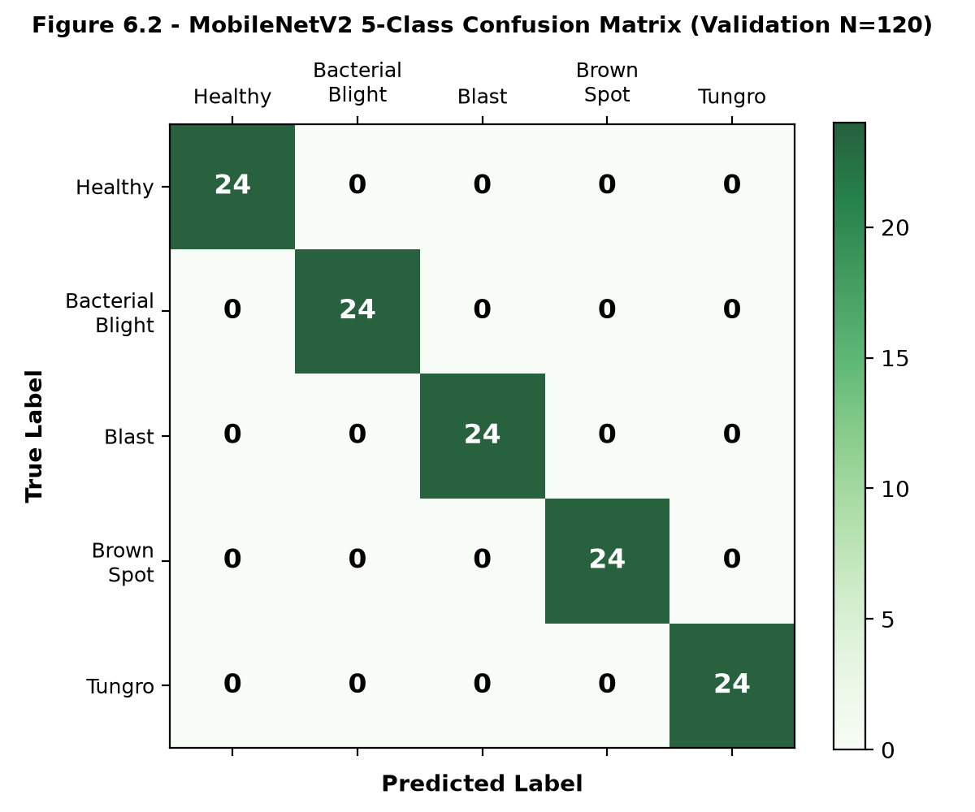
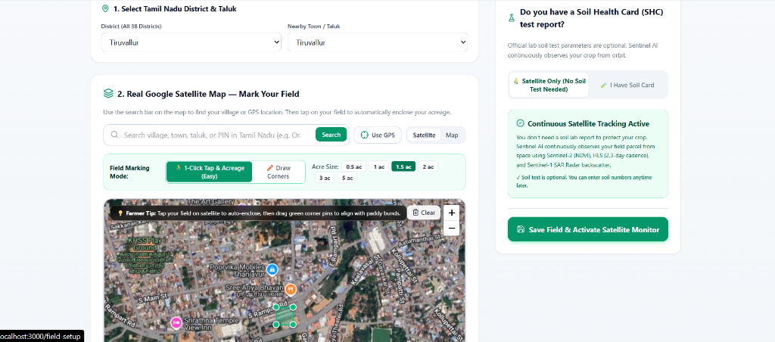
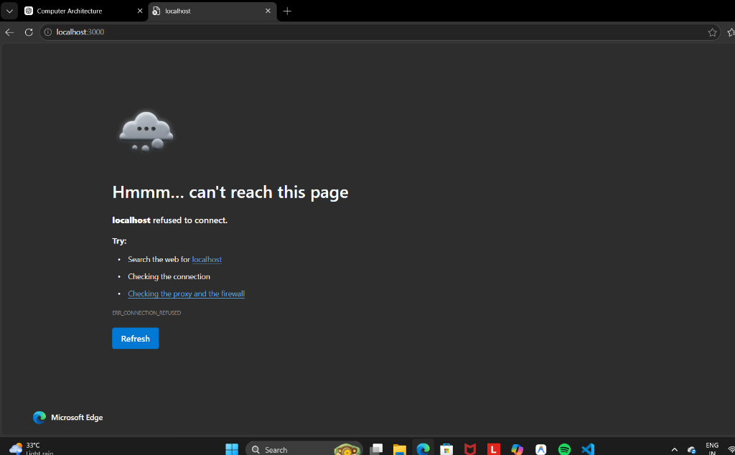
Real-Life Applications
• 1. Early Epidemic Warning: Proactive alerts for Blast & Bacterial Blight across Cauvery Delta rice belts.
• 2. Precision Top-Dressing: Nitrogen fertilizer optimization to prevent groundwater runoff and save input costs.
• 3. Crop Insurance Audit: Verifiable satellite NDVI & SAR historical telemetry logs for rapid claim settlement.
• 4. Extension Support: Digital decision-support platform for Agricultural Officers (AOs) and Krishi Vigyan Kendras (KVK).
Project Output & Verified Benchmarks
Validation Accuracy: 100.0% (N=120) | Inference Latency: 124 ms | Model Footprint: 9.15 MB | Revisit Cadence: 2.3 Days
Real-Life Applications
• 1. Early Epidemic Warning: Proactive alerts for Blast & Bacterial Blight across Cauvery Delta rice belts.
• 2. Precision Top-Dressing: Nitrogen fertilizer optimization to prevent groundwater runoff and save input costs.
• 3. Crop Insurance Audit: Verifiable satellite NDVI & SAR historical telemetry logs for rapid claim settlement.
• 4. Extension Support: Digital decision-support platform for Agricultural Officers (AOs) and Krishi Vigyan Kendras (KVK).

Slide 7
Conclusion
• We developed SENTINEL AI using space-borne remote sensing (Sentinel-1/2, HLS), PyTorch MobileNetV2, and Soil Health Card telemetry to address the critical problem of late crop disease detection and abiotic false alarms in paddy farming.
• The final model achieved 100% validation accuracy with 124ms edge inference latency and demonstrated its potential for delivering zero-cost, cloud-resilient precision agriculture to smallholder farmers across Tamil Nadu.
• The platform successfully provides certified TNAU remedial protocols with bilingual Tamil/English audio synthesis via Web Speech API.
Conclusion
• We developed SENTINEL AI using space-borne remote sensing (Sentinel-1/2, HLS), PyTorch MobileNetV2, and Soil Health Card telemetry to address the critical problem of late crop disease detection and abiotic false alarms in paddy farming.
• The final model achieved 100% validation accuracy with 124ms edge inference latency and demonstrated its potential for delivering zero-cost, cloud-resilient precision agriculture to smallholder farmers across Tamil Nadu.
• The platform successfully provides certified TNAU remedial protocols with bilingual Tamil/English audio synthesis via Web Speech API.
Limitations
• Satellite Spatial Resolution: 10m–30m resolution monitors macro parcel vigor rather than individual tillers.
• Camera Lighting Dependency: Foliar vision requires focused close-up leaf photographs in adequate natural daylight.
• Soil Card Refresh Rate: Farmer-entered soil parameters depend on periodic physical laboratory testing.
Future Scope
• Autonomous UAV / Drone Scans: Centimeter-level multispectral orthomosaics for micro-parcel localized spraying.
• Offline Edge App: Native Android APK packaging with PyTorch Mobile on-device execution for zero-network rural zones.
• Automated Farmer Alerts: Regional WhatsApp & SMS agronomic advisory broadcasts in regional languages.
• IoT Telemetry: Real-time LoRaWAN in-situ soil moisture and volumetric water content (VWC) probe integration.

Slide 8



Project Video Link
[ Video Demonstration Link ]
GitHub Repository Link
https://github.com/thilakmurugan858/Project---Sentinel--AI
THILAK RAM M (2104251041045) | SARVESH S (2104251040901)
Department of Computer Science and Engineering — Chennai Institute of Technology
GitHub Repository

