Slide 1
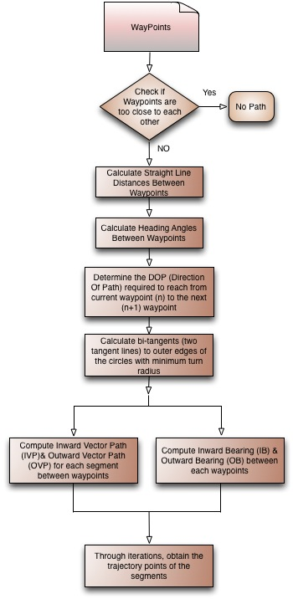
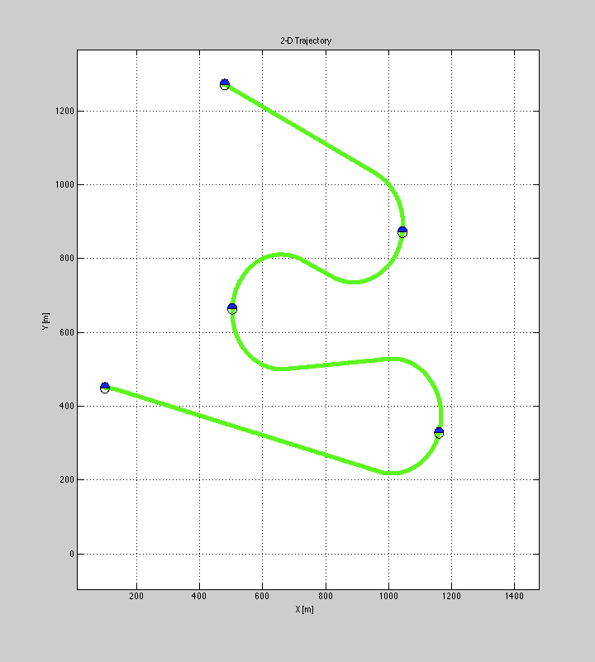
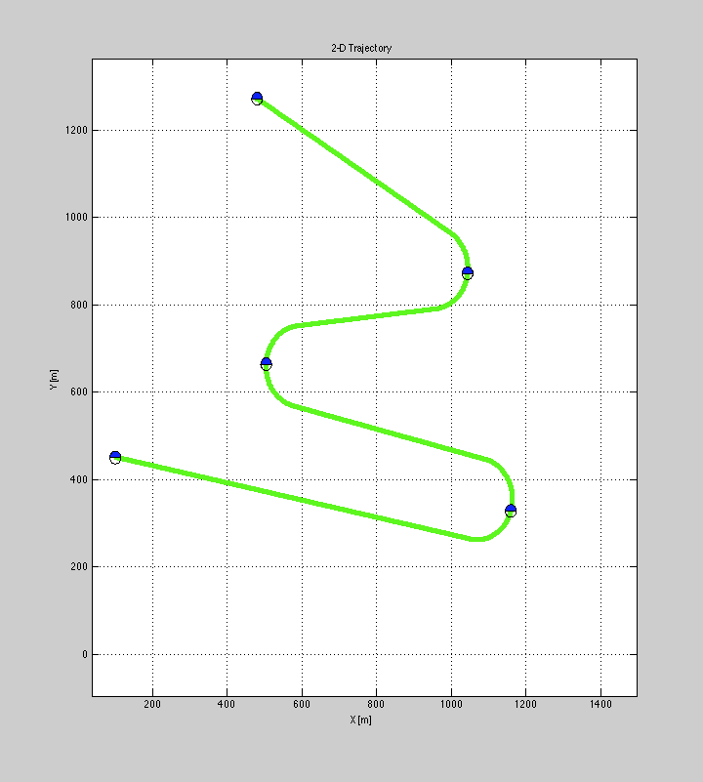
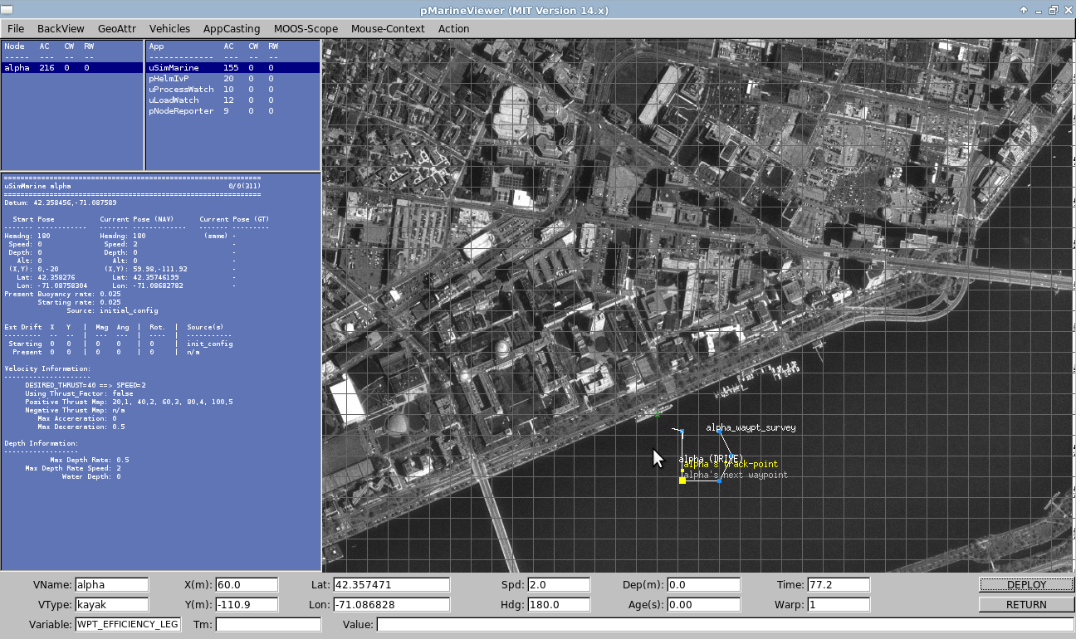
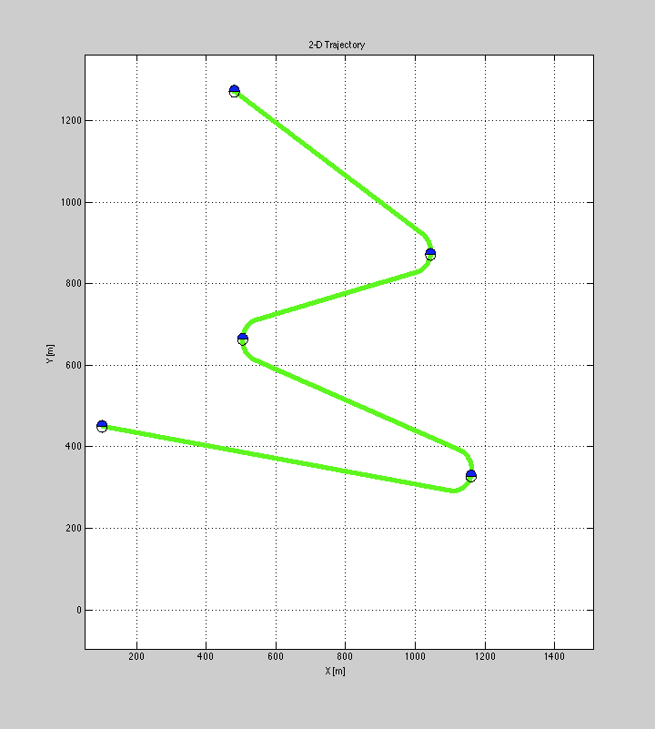

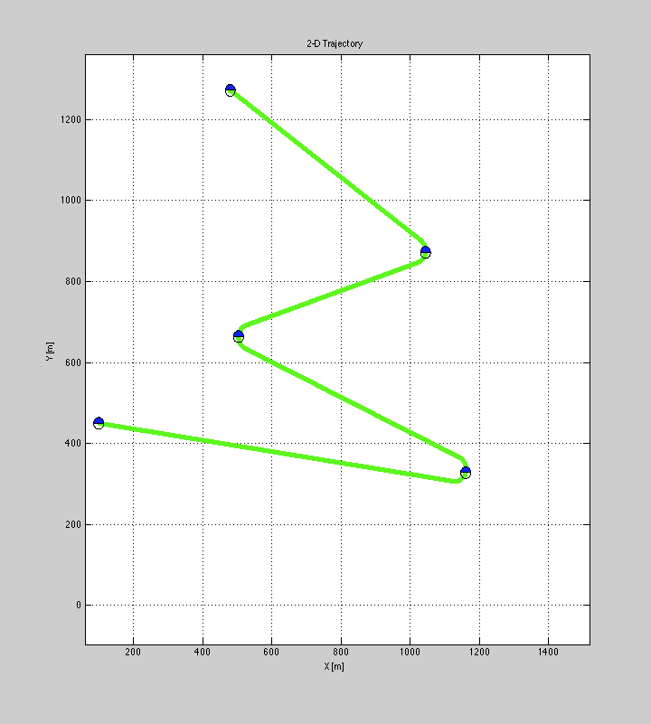

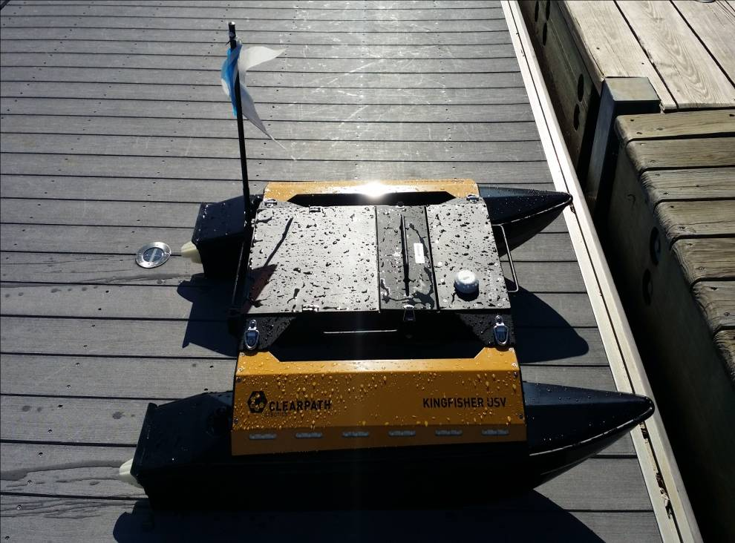
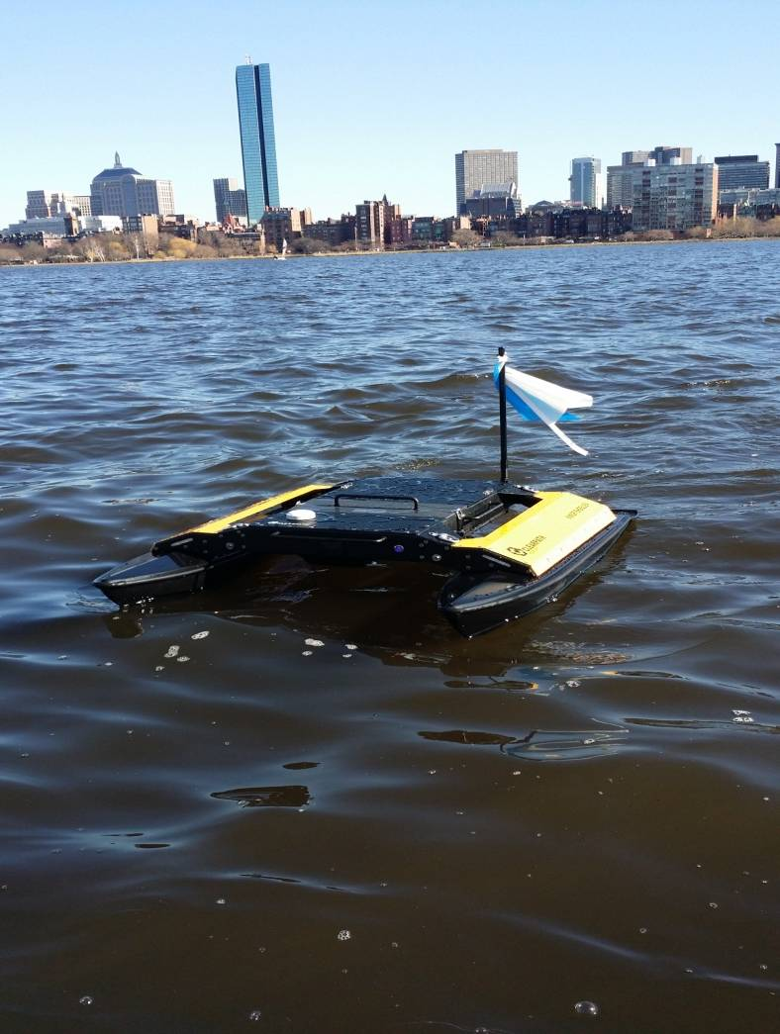
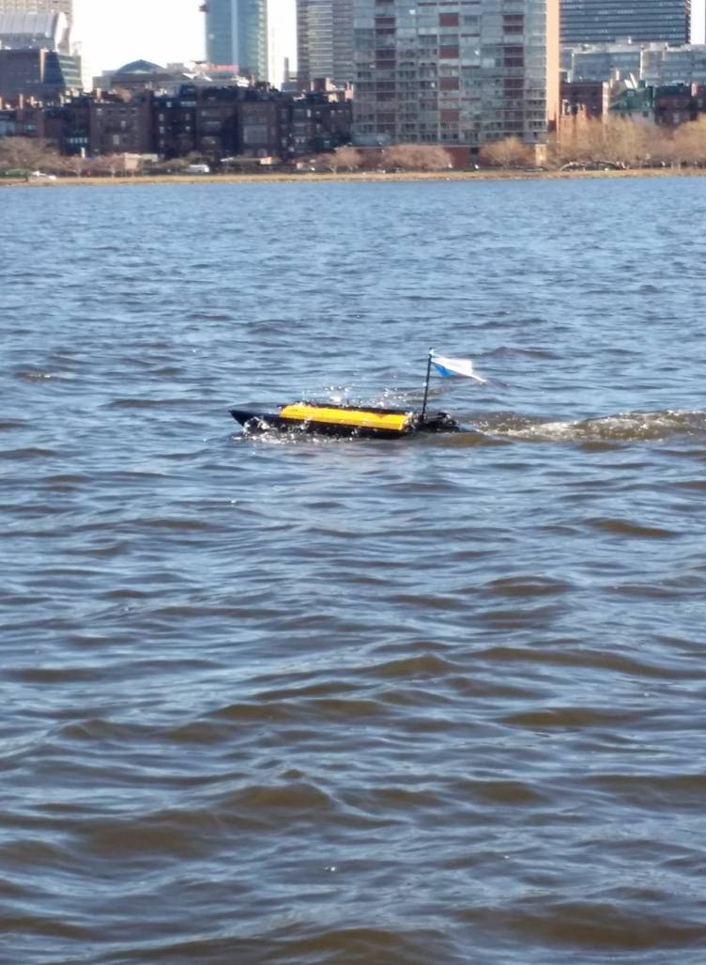
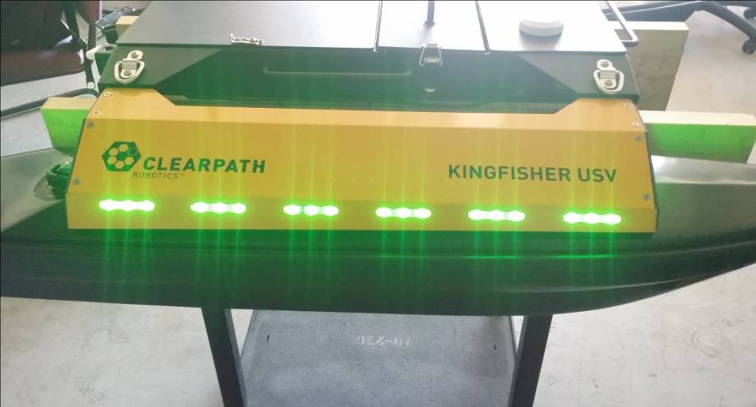
Efficient Maneuvering Path Planner
Thilanka Munasinghe¹, Dr. Arjuna Balasuriya², Dr. Michael Benjamin², Alon Yaar²
Dr. Marjorie Darrah¹, Dr. Eddie Fuller¹.
Department of Mathematics, West Virginia University¹
Department of Mechanical Engineering, MOOS-IvP Group, MIT².
Objective
High Level Overview
  Goal of this planning algorithm is to obtain a smooth trajectory points for a autonomous vehicle to conduct efficient maneuvers in an underwater environment using MOOS-IvP open source software.
Path Planning
  This path planner has a capability of developing vehicle path trajectory over determined waypoints. In order to visit a desired waypoint as much as efficiently on its way to next waypoint, vehicle must enter to the capture radius of the waypoint in a manner, which optimize the length of the course. In order to optimize the trajectory path, there are two conditions should act in accordance with to meet the overall optimization criteria in the algorithm.
  (I) Vehicle must enter to a waypoint with a specific trajectory that helps the vehicle to travel to the next waypoint (n+1) from the current waypoint (n) with a smooth transition as much as possible while obeying the maximum allowable turn radius.
  (II) Minimize the overshoot of the turning segment of the trajectory path over the area intersecting the capture radius.
Results
Simulation
Test Case 1
Test Case 2
Test Case 3
Test Case 4
Deployment: Kingfisher USV
Test Case 5
Test Case 6

