Slide 1
2.2 Creating and Initializing Objects: Constructors

Slide 2
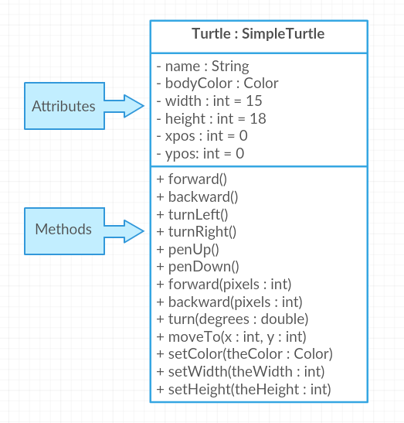

Slide 3

Among Us Characters
AmongUsCharacter : Blue
//Attributes
//Methods

Slide 4
Constructor
Method used to create an instance of a class.
// To create a new object and call a constructor write:
// ClassName variableName = new ClassName(parameters);
World habitat = new World(); // create a new World object
Turtle t = new Turtle(habitat); // create a new Turtle object
A new object is created with the new keyword followed by the class name (new Class())

Slide 5
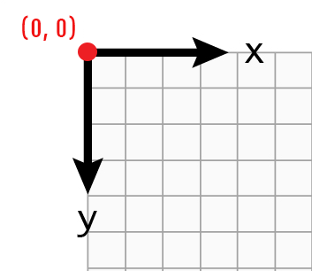
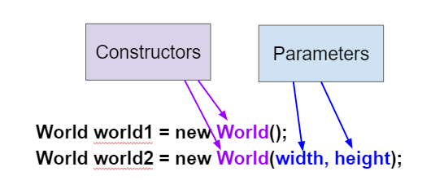
Overloading Constructors
There can be more than one constructor defined in a class. This is called overloading the constructor.

Slide 6
Dog
public class Dog {
public String breed;
public int age;
public String color;
public Dog() {
breed = “pug”;
age = 3;
color = “brown”;
}
public Dog(String a, int b, String c) {
breed = a;
age = b;
color = c;
}
}
Default constructors still need a value to be assigned to the instance variables
Parameter constructors still need a value to be assigned to the instance variables

Slide 7
World world1 = new World(); // creates a 640x480 world
World world2 = new World(300,400); // creates a 300x400 world
Turtle t1 = new Turtle(world1);
Turtle t2 = new Turtle(50, 100, world1);
Notice here that the order of parameters matters

Slide 8
Character constructor
public class AmongUsCharacter {
public String name;
public String color;
public boolean imposter;
public int size;
public AmongUsCharacter(String a, String b, boolean c, int d){
name = a;
Color = b;
Imposter =c;
Size = 3;
}
}
//In a different method
AmongUsCharacter Blue = new AmongUsCharacter();

Slide 9
You can declare an object variable and initialize it to null
World world1 = new World();
Turtle t1 = null;
t1 = new Turtle(world1);
// declare and initialize t2
Turtle t2 = new Turtle(world1);

Slide 10
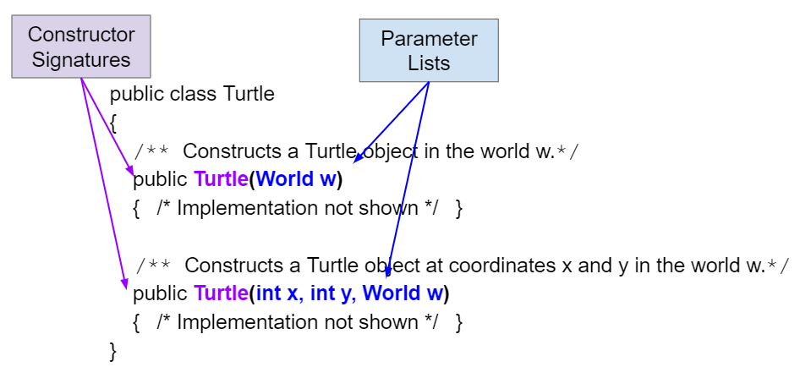
Constructor Signatures

Slide 11
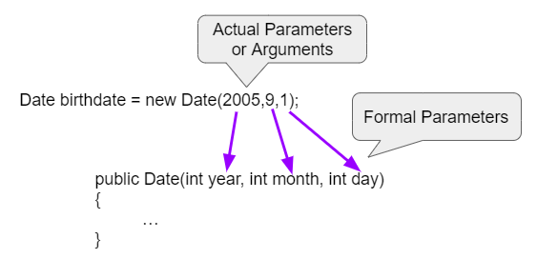
Formal and Actual Parameters
Date(2005,9,1) - This is call by value which means that copies of the actual parameter values are passed to the constructor. These values are used to initialize the object’s attributes.

Slide 12
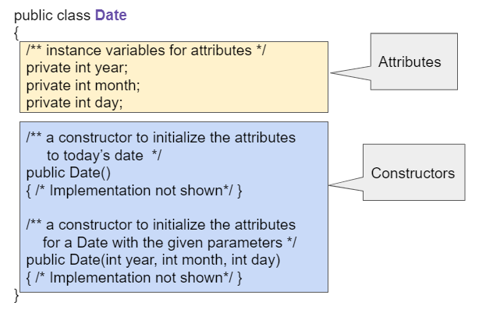

Slide 13
Student
public class Student {
public String name;
public int gradeLevel;
public double gpa;
public Student(String n, int gl, double g) {
name = n;
gradelevel = gl;
gpa = g;
}
}
// It’s a good idea to use a single
// letter from the fields you are
// initializing in the constructor.
// It keeps things simple.
What would you add to this constructor?
Can you think of some situations where you would want to leave out some of the fields?

Slide 14
AP Example 1
public class Cat
{
private String color;
private String breed;
private boolean isHungry;
public Cat()
{
color = "unknown";
breed = "unknown";
isHungry = false;
}
public Cat(String c, String b, boolean h)
{
color = c;
breed = b;
isHungry = h;
}
}
I. Cat a = new Cat();
II. Cat b = new Cat("Shorthair", true);
III. String color = "orange";
boolean hungry = false;
Cat c = new Cat(color, "Tabby", hungry);

Slide 15
AP Example 2
public class Movie
{
private String title;
private String director;
private double rating;
private boolean inTheaters;
public Movie(String t, String d, double r)
{
title = t;
director = d;
rating = r;
inTheaters = false;}
public Movie(String t)
{
title = t;
director = "unknown";
rating = 0.0;
inTheaters = false;
}
}
Which of the following code segments will construct a Movie object m with a title of “Lion King” and rating of 8.0?
A. Movie m = new Movie(8.0, "Lion King");
B. Movie m = Movie("Lion King", 8.0);
C. Movie m = new Movie();
D. Movie m = new Movie("Lion King", "Disney", 8.0);
E. Movie m = new Movie("Lion King");

