Slide 1
2.5: Calling Methods That Return Values

Slide 2
Return Value
Methods can take inputs (“arguments” or “parameters”), and they can also spit out a single output (“return value”)
public double distance2D(double x1, double y1, double x2, double y2)
x1
distance2D method
y1
return value
x2
y2
Methods are like functions… what is the difference between a function and a method?

Slide 3
Methods vs. Functions
A method represents an action supported by some class of object in Object-Oriented Programming (OOP). Java is an OOP language.
Some programming languages have functions. Some have methods. Some have functions and methods!
In Java, there are only methods, but you can use methods to model functions like mathematical functions (Math.sin, Math.cos are static methods of the Math class)

Slide 4
Return Value
Methods that don’t return anything have a void return type
public void printGreeting(String name) { System.out.println("Hello " + name + "!"); }

Slide 5
Return Value
The type of the return value must match what is declared in the method declaration
Right: public int getNumberTimesThree(int value) { return 3 * value; }
Wrong (why?): public int getNumberTimesThree(int value) { return 3.0 * value; }
Q: Java only lets you return one value from a method. How might you return multiple pieces of data at once?

Slide 6
The return statement
The return statement specifies the return value of a method.
The return statement is one of Java's control flow statements. What do you think that means?

Slide 7
The return statement and control flow
Basic program of the Java virtual machine (and any CPU, really)
Control flow statements may jump to somewhere else other than the next instruction.
The return statement exits your method immediately with the specified return value; all other statements are skipped.
FETCH INSTRUCTION
EXECUTE INSTRUCTION
GO TO NEXT INSTRUCTION

Slide 8
The return statement in void methods
If your method is other than void return type, it MUST use return
You can use return in a void method too, though. Just don't specify any return value, since the method has none:
return;
Why do you think you might use return in a void method?

Slide 9
Getter and Setter Methods
In Java, you’ll commonly find that classes declare getXYZ and setXYZ methods for their properties (instance variables).
public class TurtleTestGetSet { public static void main(String[] args) { World world = new World(300,300); Turtle yertle = new Turtle(world); System.out.println("Yertle's width is: " + yertle.getWidth()); // Yertle's width is: 15 (this is the default width) yertle.setWidth(200); yertle.setHeight(200); System.out.println("Yertle's width is: " + yertle.getWidth()); // Yertle's width is: 200 (this is the width after we’ve set it to 200 2 lines above yertle.turnRight(); world.show(true); } }
This is considered a best practice. Q: Why do you think that is?

Slide 10
toString Methods
In Java, all objects can be represented in String form by defining a toString method.
This can be useful for programmers to get a visual or textual representation of an otherwise abstract object.
How can we make the toString method to the right more descriptive?
What gets printed if you don't define a toString method?
class Student { private String name; private int age;
Student(String name, int age) { this.name = name; this.age = age; } public String toString(){ return name; } } class HelloWorld { public static void main( String args[] ) { Student s = new Student("Jane",16); System.out.println(s.toString()); //”Jane” System.out.println(s); //Also ”Jane” } }

Slide 11
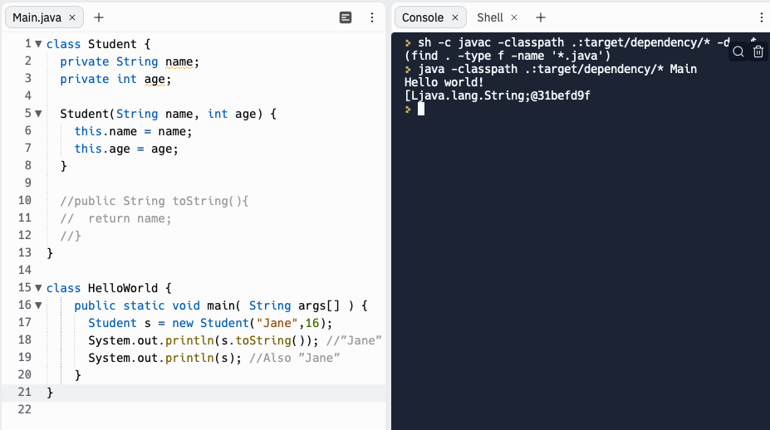
Object.toString

Slide 12
this??
The code on the right says this.name… what do you think this is?
class Student { private String name; private int age;
Student(String name, int age) { this.name = name; this.age = age; } public String toString(){ return name; } } class HelloWorld { public static void main( String args[] ) { Student s = new Student("Jane",16); System.out.println(s.toString()); //”Jane” System.out.println(s); //Also ”Jane” } }

Slide 13
this is a reference to the current object instance
class Student { private String name; private int age;
Student(String name, int age) { this.name = name; this.age = age; } public String toString(){ return name; } } class HelloWorld { public static void main( String args[] ) { Student s = new Student("Jane",16); System.out.println(s.toString()); //”Jane” System.out.println(s); //Also ”Jane” } }
Student s
Call Stack
VERY common
pattern.
"Jane"
name
s.toString()
16
age
this
Q: What's the difference here between name and this.name?
main(new String[]{})
args
new String[] {}
s
Q: What do you think the next thing on the call stack will be on top of main?

Slide 14
Exercise: What’s the output of this program?
class Liquid { private int boilingPoint = 100; private int freezingPoint = 0; private double currentTemp; private String name; public Liquid(String name) { currentTemp = 50; this.name = name; } public void lowerTemp() { currentTemp -= 10; } public double getTemp() { return currentTemp; } public boolean isFrozen() { return this.currentTemp <= this.freezingPoint; } public String toString() { return "Liquid | Name: " + this.name + " | Temp : " + this.currentTemp; } }
public class HelloWorld{ public static void main(String[] args){ Liquid myLiquid = new Liquid("Water"); System.out.println(myLiquid); myLiquid.lowerTemp(); System.out.println(myLiquid); System.out.println(myLiquid.isFrozen()); myLiquid.lowerTemp(); myLiquid.lowerTemp(); myLiquid.lowerTemp(); myLiquid.lowerTemp(); System.out.println(myLiquid.toString()); System.out.println(myLiquid.isFrozen()); } }

Slide 15
Your Turn!
http://tpcg.io/CBv7Yr6c

Slide 16
http://tpcg.io/CBv7Yr6c
Change the toString so that it displays whether or not the liquid is Frozen
Similar to lowerTemp, write a raiseTemp method that increases the temperature of the liquid by 10
Add code to your HelloWorld program so that you get the liquid to no longer be frozen
Implement a method isBoiling() that tells us whether or not the liquid is boiling
Change your toString to just tell us the liquid name and whether or not it’s boiling
Change your HelloWorld program to that you get the liquid to boil. Print out the object once it’s boiling!

