Slide 1
FRAUD DETECTION IN FINANCIAL TRANSACTIONS
Thilini Fernando Wijesekera

Slide 2

OBJECTIVE
is to predict whether a given financial transaction is fraud or not.
DATA SOURCE
Used the PaySim dataset from Kaggle.com
contains 6M+ financial transactions collected over a month in Africa

Slide 3

QUESTION HOPE TO ANSWER
Can we detect fraudulent credit card transactions?
WHY?
Fraudulent transactions are costing the financial industry a huge overhead and it is rising
Given the nature of our course work and my desire to find employment in the finance industry, I believe working on a similar project will be immensely helpful.

Slide 4


ROADBLOCKS
The biggest roadblock for the machine learning is the PaySim data is highly skewed towards being benign.
So in the training the dataset, I counted the number of benign transactions and over sampled the fraudulent transactions to match number of benign transactions.

Slide 5
EXPLORING DATA
I explored 4 different machine learning techniques but 5 different methodologies:
- Logisitc Regression
- SVM – Linear Kernel
- SVM – Gaussian Kernal
- XGBoost
- Random Forest
For each techniques, I tried different feature combinations. For Random Forest, I had to drop two categorical columns with more than 5 categories.

Slide 6
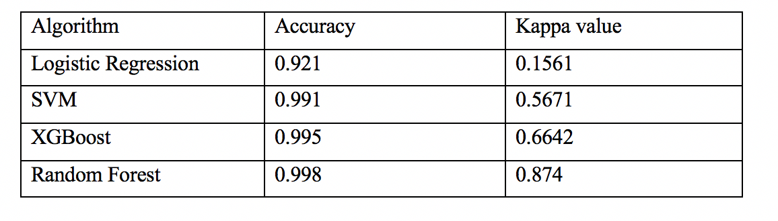
EXPLORING DATA

Slide 7
ANALYSIS OF THE PROJECT
- The entire data set of PaySim is 6M+ which was impossible to load and train the model. So I selected random 5000 data points and did the feature selection.
Given the highly skewed dataset, my main selection criteria was the biasness of the model. I used Kappa value to measure the biasness. Anything below 0.5 resembles a biasness.
Random Forest with 5 features produced the highest kappa value hence I selected Random Forest for the project.

Slide 8
Deployment
I used Python sklearn to implement Random Forest. A separate train module is embedded so that if there is no trained model, the code initiate a model.
I also used to one hot encoding to represent the categorical variable of payment type.
I used Python Flask to publish a rest API to call and detect whether a given transaction is fraudulent or not

Slide 9
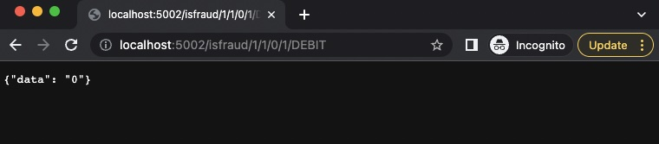
Deployment

Slide 10
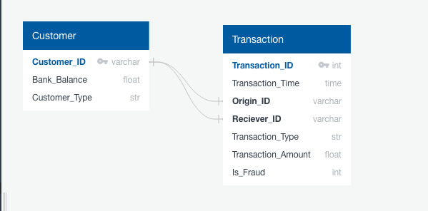
Database - ERD

Slide 11
Dashboard
I plan to use Tableau to visualize the distribution of the benign and fraudulent transaction.
I also plan to create a webpage that uses the rest API where users can enter the value and get a response whether it’s a fraud or not.

Slide 12

Try out different analysis to select proper features

