Slide 1
How I waste My Time
Project 1 Proposal

Slide 2
The average person lives approximately 672,000 hours.
How many of us take time to reflect on how we’ve spent those hours?
Do you “pass” or “spend” time?
Do you regret the time you’ve passed/spent on less productive activities, or was it worth it?

Slide 3
So how do I waste my time?
Long Answer: an unpredictable mix of passive web browsing, streaming, staring vacantly at a blank TV screen, etc.
Short Answer: a lot of things, but I’m choosing to focus on something readily quantifiable

Slide 4
Proposal
My gallery is a cross-section of one debatably non-productive use of my time: video games. This is compared, in contrast, to potential ways I could have used that time.
This is not just a gallery of how I waste my time, because millions of people spend a considerable amount of time gaming.
The collection is meant to ask the question of whether this time was truly wasted or is a justifiable use of free time in contrast to work and study.
This is most definitely an ongoing collection, seeing as I do still play games.

Slide 5
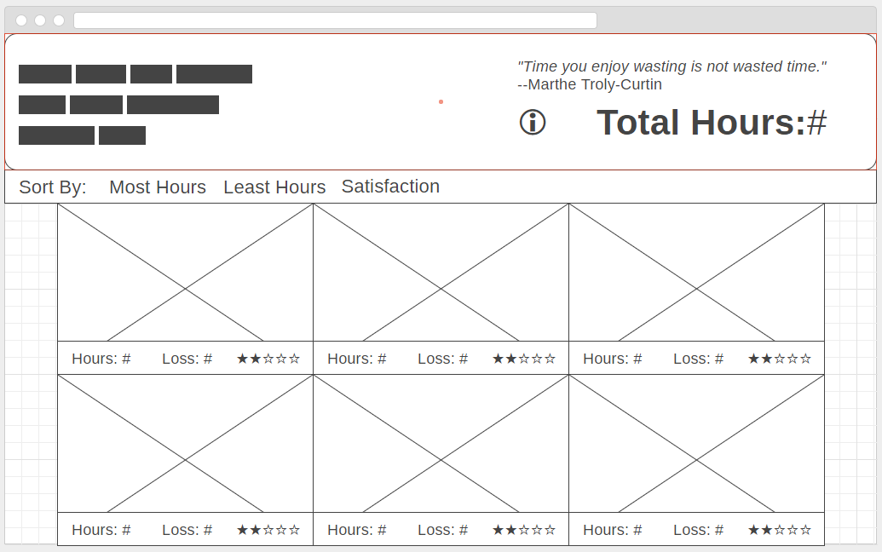
Home (main) Page
Info page link
Total hours spent on games (updates)
Dynamically loaded, interactive containers for each game

Slide 6
Container View
Image/screenshot from game
Satisfaction rating: was it worth my time?
Total Hours Spent (so far)
Approx. amount of potential new skills learned (hours / 20)

Slide 7
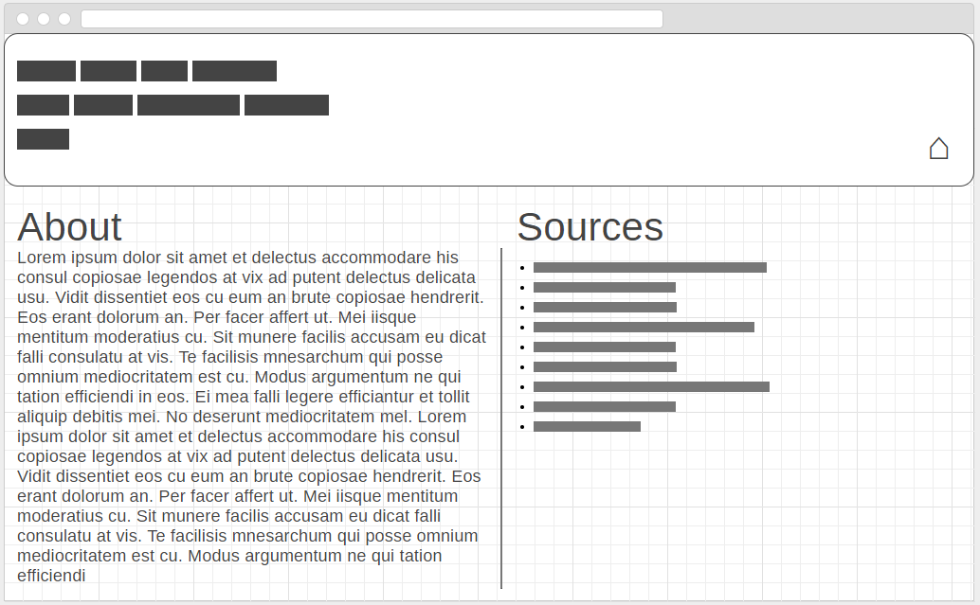
Info Page
Home Link
Sources for statistics
About the collection

Slide 8
Intended Effect
Not: to make people think that video games (or other non-productive uses of time) are a waste.
Yes: to encourage people to examine their leisure activities in a quantifiable way and ask themselves whether that was time well spent.

Slide 9
Collections like this
The Time You Have (in jelly beans) -- https://www.youtube.com/watch?v=BOksW_NabEk
Your Life in Weeks (Tim Urban) -- https://waitbutwhy.com/2014/05/life-weeks.html

