Slide 1
Automated Weld Path Generation Using Random Sample Consensus and Iterative Closest Point Workpiece Localization – DETC90082
Tristan Hill
Tennessee Technological University
Stephen Canfield
Tennessee Technological
University
Robert Shelton
Tennessee Technological
University

Slide 2
Overview
Applications:
Background – Robotics and Automated Welding
Method – Workpiece Localization
Results - Simulated and Experimental
Conclusions – Applications and Future Work

Slide 3
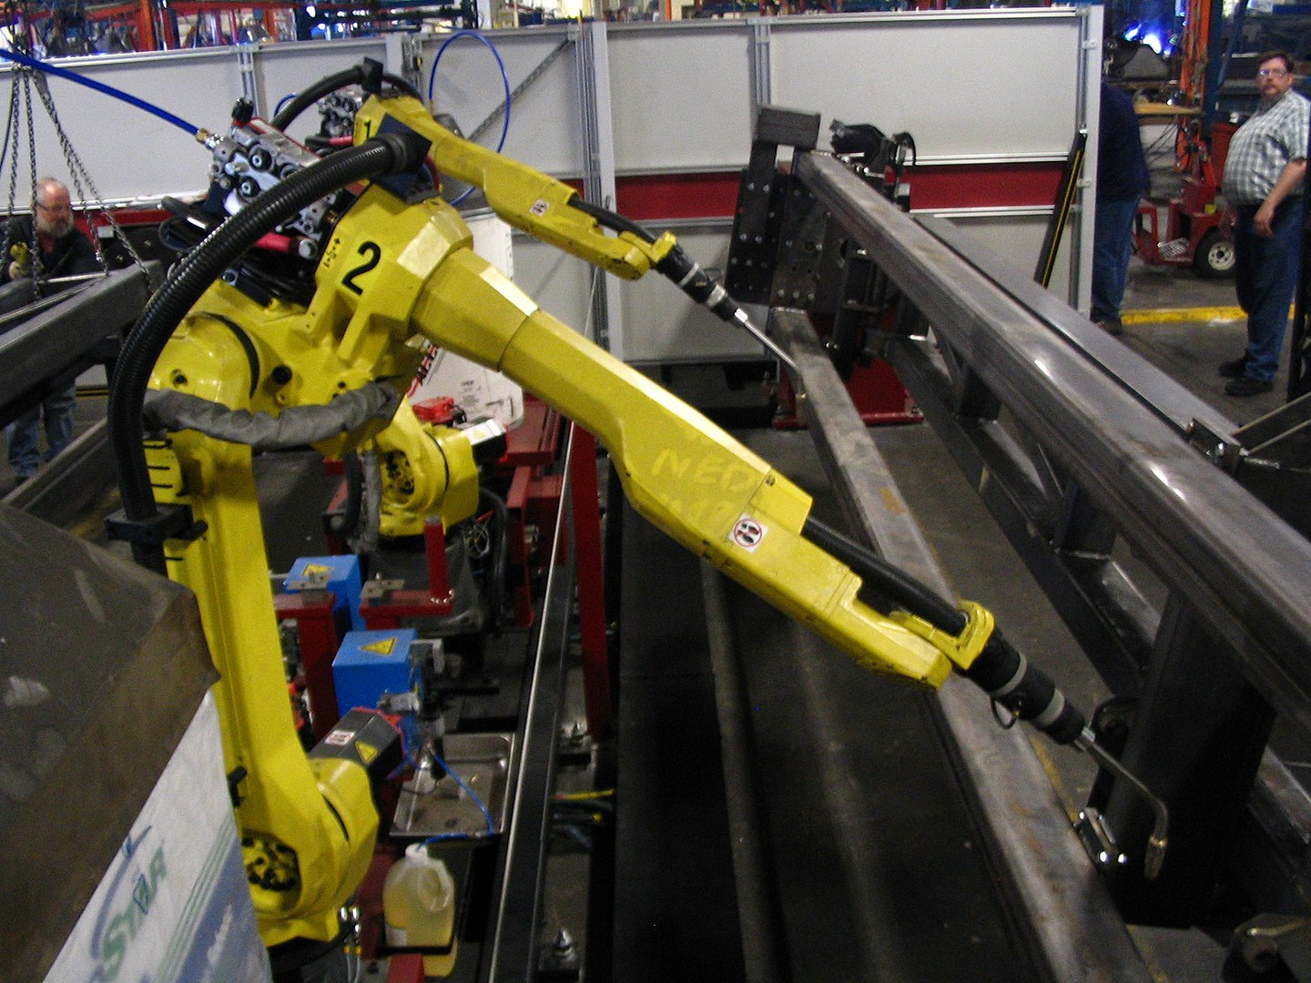
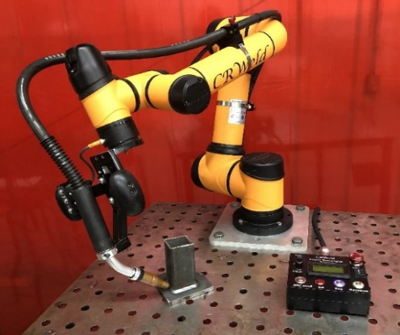
Robotics in Manufacturing
Applications:
Welding
Painting
Applying Glue
Additive Manufacturing
Technologies:
Serial Manipulators
Parallel Manipulators
Mobile Robots
Vision and Sensing
Cobots and Safety Systems
Source: Wikipedia, Industrial Robot
Benefits and Tradeoffs:
Efficiencies
Safety
Employment ?
Source: RTT, C.R. Weld

Slide 4
Automated Welding and Tool Path Generation
Automation requires control of tool pose typically achieved using a kinematic model and joint level control.
A spatial description of the desired task is required.
Manual programming
Teaching with Pendant or Hand
Computer Modeling
The transformation from the manipulator base frame to the start point on the workpiece must be known.
Fixtures or Jigs
Vision and Sensing
Teaching

Slide 5
Literature Review
Automation of welding has been a focus of robotics research for many years
Seam Tracking
Start Point Determination
Workpiece Localization
Image registration is a fundamental problem in computer vision and has been studied thoroughly. This field is changing rapidly with technological developments.
Sensing and Data Storage
Computational Abilities
Algorithms and Machine Learning

Slide 6
Contribution
A process is shown which uses RANSAC and ICP for workpiece localization from a point cloud data containing outliers for a robotic welding application.

Slide 7
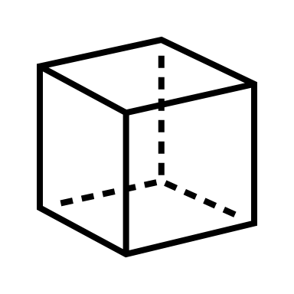



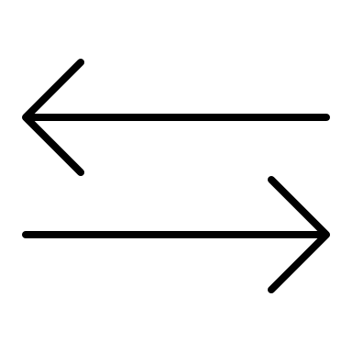

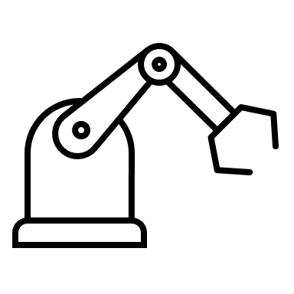
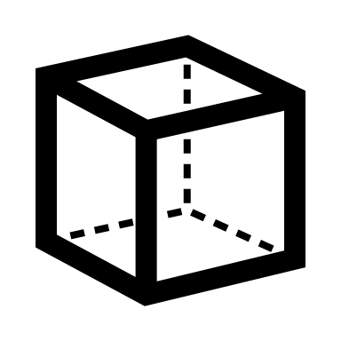
Overview of Approach
The process consists of multiple stages.
1- Model Preparation
2 - Workspace Sensing
3 - Workpiece Localization
4 - Path Generation
Model Preparation
Workpiece CAD
Model Generation
Workpiece Localization
Conversion to
Pointcloud
PassThrough + Voxel Filtering
RANSAC
Segmentation
ICP
Registration
Workspace Sensing
Collection of
2D LiDAR Scans
Conversion to
Pointcloud
Path Generation
Weld Path Construction with LSPB
Projection to workpiece frame

Slide 8
Model Preparation
Workspace Sensing
the geometry of the workspace and the workpiece is defined based on the prescribed application. An ideal model of the workpiece is generated using CAD.
Part models are first generated of the individual workpiece components which are then assembled to represent the workpiece.
Conversion to Point Cloud
The 3D models are generated using standard CAD software can be convered to point clouds through uniform sampling and exported as .ply or other standard file formats
The point cloud associated with the CAD model is known as the source point cloud.

Slide 9
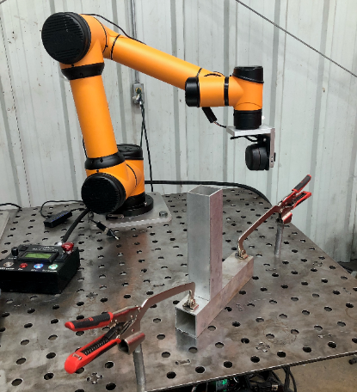
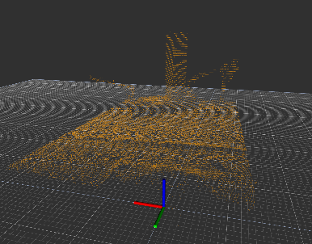
Workspace Sensing
Collection of 2D LiDAR Scans
the workpiece is placed in the robot workspace by the operator in the proper relative orientation to be joined by a weldment.
a sweeping motion of the arm is performed, and the workpiece and environment are scanned with the 2D LiDAR mounted on link 5 of the robot.
Conversion to Point Cloud
data are transformed from the sensor frame link 5 to the base frame link 0 through the known robot kinematics and accumulated into a 3D point cloud with respect to the base frame.
The point cloud associated with the LiDAR scan is known as the reference or target cloud.

Slide 10
Workpiece Localization
PassThrough + Voxel Filtering
The filtering process remove data points outside of the useable workspace
RANSAC Segmentation
The segmentation process removes points inside the workspace that are not part of the workpiece
This process must be adjusted for the specific workpiece geometry
ICP Registration
the source point cloud derived from the CAD model is compared to the reduced reference cloud acquired from lidar in the sensing stage
transformation between source and reference clouds is found using the iterative closest point algorithm (ICP), this transformation is interpreted as the pose of the workpiece.
Iterative Closest Point relies on correspondence between points between data sets therefore it fails or converges slowly in the presence of outliers.

Slide 11
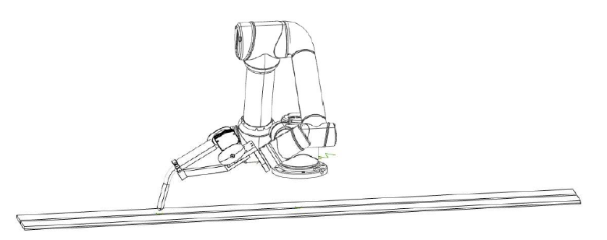
Path Generation
Path construction with LSPB
Projection to workpiece frame
Orientation of the Torch
P_{i}
O_{i,i+1}
P_{i+2}
O_{1+1,i+2}
P_{i+1}
θ_{T}
RP
y’, y’’
z_{WP}, z’
θ_{w}
t
z_{T}
z₀
x_{T}
x_{WP}
θ_{w}
θ_{R}
x’
n
y₀
θ_{T}
x₀

Slide 12
Implementation with ROS + PCL
This research has been implemented in ROS on Ubuntu Linux
multi-threaded and distributed software framework for robotics applications.
The combination of 2D LiDAR scans into 3D point clouds was done using a custom ROS package scan2cloud based on ROS laser_geometry (https://github.com/thillRobot/scan2cloud.git)
The primary approach was implemented in a custom ROS package seam_detection that uses PCL for filtering, RANSAC, and (https://github.com/thillRobot/seam_detection.git)
Email: thill@tntech.edu for questions about code

Slide 13
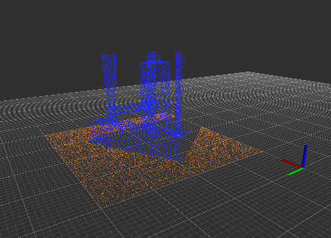
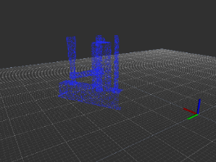
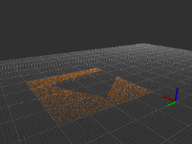
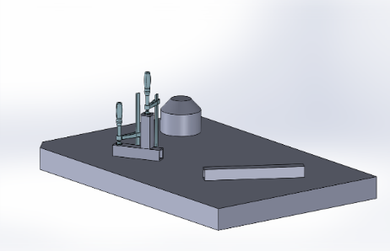
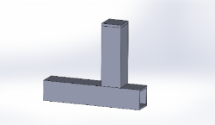
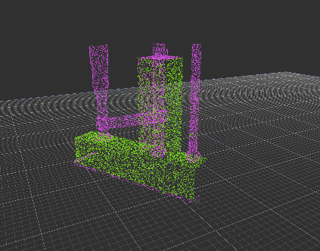
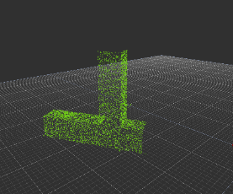
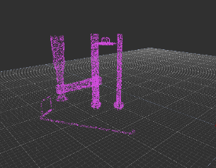
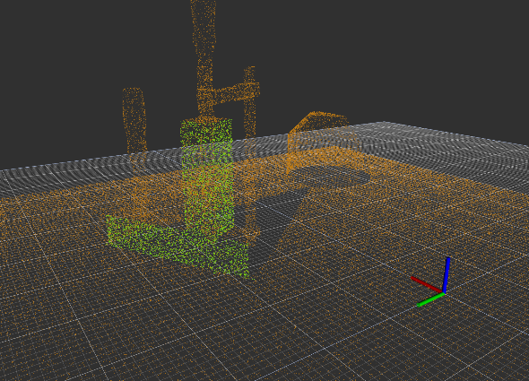
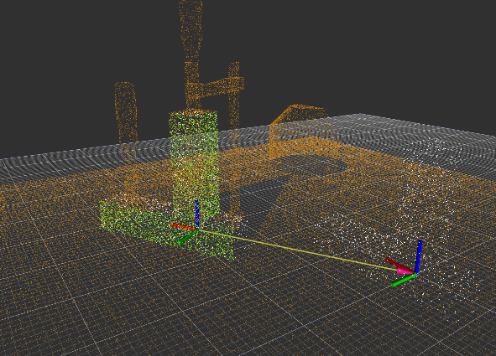
Simulation Results
FIGURE 4: SEGMENTATION TO REMOVE TABLE
The process was first completed on synthetic data. The source and reference clouds were both generated from CAD.
FIGURE 5: SEGMENTATION TO REMOVE CLAMPS
TABLE 1: SIMULATION RESULTS – EXAMPLE APPLICATION
 | X | Y | Z
Expected Translation | 0.25 | 0.2 | 0.025
Measured Translation | 0.251347 | 0.19923 | 0.02436
Difference | -0.00134 | 0.00077 | 0.00064
 | Roll | Pitch | Yaw
Expected Rotation | 0.0 | 0.0 | 0.52360
Measured Rotation | -0.00918 | -0.00681 | 0.52759
Difference | 0.00918 | 0.00680 | -0.00399
FIGURE 6: SIMULATED APPLICATION – WORKPIECE REGISTRATION

Slide 14
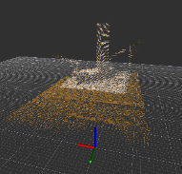
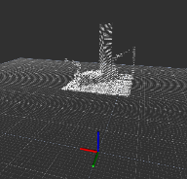
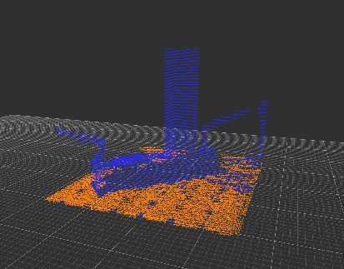
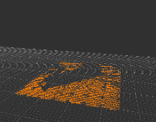
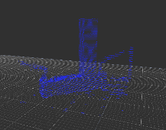
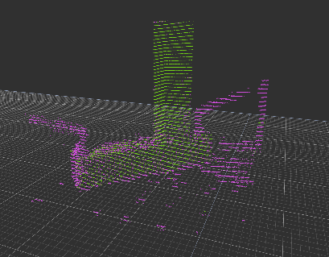
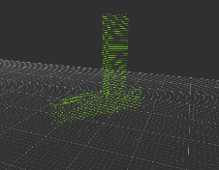
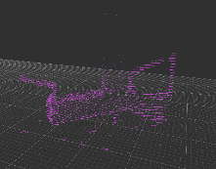
Experimental Results
The approach was tested using a Aubo i5 cobot and an RPLiDAR A2 on a welding table courtesy of RTT – Robotic Technologies of Tennessee and Stephen Zuccaro.
FIGURE 3: BOUNDING BOX
FIGURE 4: SEGMENTATION TO REMOVE TABLE
FIGURE 10: EXPERIMENTAL EXAMPLE APPLICATION
FIGURE 5: SEGMENTATION TO REMOVE CLAMPS

Slide 15
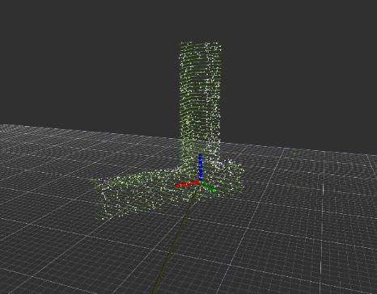
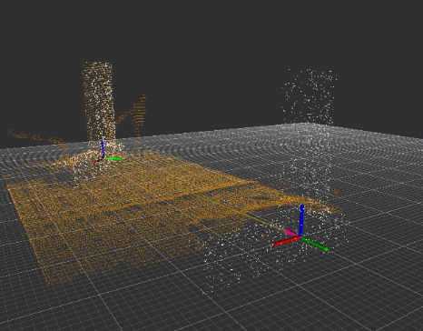
Experimental Results
TABLE 2: EXPERIMENTAL RESULTS – LIDAR CALIBRATION
 | X (m) | Y (m) | Z (m)
Expected Translation | 0.0 | -0.60960 | 0.02540
Measured Translation | 0.00893 | -0.60874 | 0.02003
Difference | -0.00893 | -0.00086 | 0.00537
 | Roll (rad) | Pitch (rad) | Yaw (rad)
Expected Rotation | 0.0 | 0.0 | 0.0
Measured Rotation | -0.00493 | -0.00071 | 0.019938
Difference | 0.00493 | 0.00071 | -0.00071
TABLE 3: EXPERIMENTAL RESULTS - EXAMPLE APPLICATION
 | X (m) | Y (m) | Z (m)
Expected Translation | 0.10160 | -0.60960 | 0.02540
Measured Translation | 0.10840 | -0.61096 | 0.02034
Difference | -0.00680 | 0.00136 | 0.00506
 | Roll (rad) | Pitch (rad) | Yaw (rad)
Expected Rotation | 0.0 | 0.0 | 0.785
Measured Rotation | -0.00457 | 0.02186 | 0.79461
Difference | 0.00457 | -0.02186 | -0.00921293
FIGURE 14: EXAMPLE APPLICATION – WORKPIECE REGISTRATION

Slide 16
Conclusion
asdfazsdf
sfghsfghsfgh

