Slide 1
BMI prediction using face images

Slide 2
OBJECTIVE
BENEFITS
Built a model to predict the BMI (body mass index) of a person from an image of their face.
Non-Invasive Nature of the Model
Large-Scale Screening for Health Risks
Personalized Health Assessments
Fitness Tracking and Monitoring
Potential for Automation
Implications for Healthcare

Slide 3
introduction
BMI prediction using face images by CNN is an important topic as accurate BMI prediction is crucial for assessing and managing individual and population health.
The objectives of the presentation may include discussing the concept of BMI, limitations of BMI, the use of CNNs for image-based BMI prediction, and the data collection and preprocessing techniques used for this task.

Slide 4
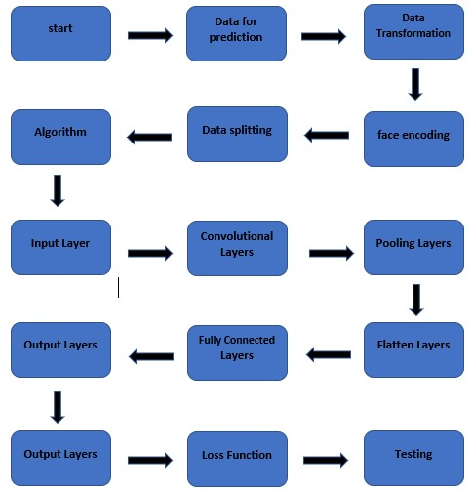
Architecture

Slide 5
What is BMI?
BMI is a measure of body fat based on a person's weight and height.
It is calculated by dividing a person's weight in kilograms by the square of their height in meters.
BMI is used to determine if a person is underweight, normal weight, overweight or obese, and can be an indicator of health risks associated with excessive body fat.

Slide 6
Introduction to Convolutional Neural Network
CNNs are a deep learning model used in image classification and recognition tasks.
They are designed to recognize patterns and features in images through the use of convolutional layers and pooling layers.
CNNs are particularly useful for image-based BMI prediction as they can learn and extract features from the face images that are related to body fat.

Slide 7
Data Collection
Face images for BMI prediction were collected using various methods such as self-reported height and weight or manual measurements.
Challenges in data collection may include ensuring that the images are diverse and representative of the population being studied.
Having a large and diverse dataset is important for training accurate CNN models.

Slide 8
Data Preprocessing
Data preprocessing involves preparing the face images for analysis and training by cleaning, resizing, and normalizing them.
Techniques such as data augmentation may also be used to increase the size of the dataset and improve model performance.
Proper data preprocessing can improve the accuracy of the CNN model for BMI prediction.

Slide 9
Model Architecture
The CNN model architecture used for BMI prediction may include several convolutional layers and pooling layers, followed by fully connected layers for classification.
The number of layers and parameters may vary depending on the dataset and task.
The model was trained and optimized using techniques
adam and relu.

Slide 10
Model Performance Evaluation
The model's performance can be compared to other BMI prediction methods, such as traditional regression models or other deep learning models.
The results of the model's accuracy and other metrics can be presented and analyzed to assess its effectiveness.

Slide 11
Applications and Limitations
Potential applications of CNN-based BMI prediction include personalized health assessments, fitness tracking, and obesity prevention programs.
Limitations of the method may include biases in data collection, lack of diversity in datasets, and potential privacy concerns.
Future research directions may include improving the accuracy and generalizability of the method, as well as exploring applications in related fields such as facial recognition and biometric authentication.

Slide 12
Conclusion
The presentation summarizes the importance of accurate BMI prediction and the potential benefits of using CNNs for image-based BMI prediction.
The limitations and potential future developments in the field are discussed.
The conclusion emphasizes the potential applications and impact of the method, as well as the need for continued research and development in this area.

Slide 13
Thank you

