Slide 1
Java EE Spring Web MVC Framework
Markus Veijola September 2015

Slide 2
Introduction
Spring MVC is the web component of Spring’s framework. It provides a rich functionality for building robust (stable) Web Applications.
Spring framework was initially written by Rod Johnson and was first released under the Apache 2.0 license in June 2003.
The Spring MVC Framework is highly configurable.
Integrate effortlessly with other popular Web Frameworks like Java Server Faces.
Integration with other View technologies like, Excel or Pdf is also possible.
Spring’s data binding is highly flexible.

Slide 3
Introduction
This material assumes that you have installed next components in your computer to make the examples:
Java SDK 8.0 latest release.
Netbeans IDE 8.x.x version with Glassfish and Tomcat server (you can use also other application servers if you want).
MySQL server.

Slide 4
What is MVC framework?
Model-view-controller (MVC) is a well known design pattern for designing UI based applications. It mainly decouples business logic from UIs by separating the roles of model, view, and controller in an application.
Models are responsible for encapsulating application data for views to present. Usually models are bind to database tables or documents in document based databases.
Views should only present this data, without including any business logic.
Controllers are responsible for receiving requests from users and invoking back-end services (manager or dao) for business logic processing. After processing, back-end services may return some data for views to present.

Slide 5
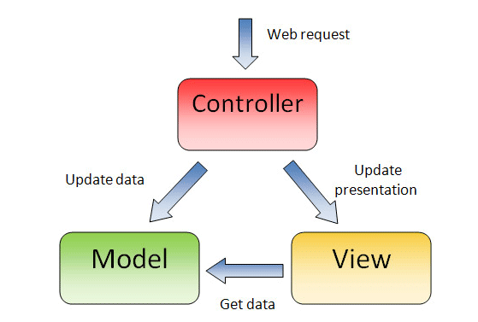
What is MVC framework?

Slide 6
Spring Web MVC
Spring’s web MVC framework is, like many other web MVC frameworks is request-driven, designed around a central servlet that dispatches requests to controllers, called DispatcherServlet.
DispatcherServlet is the only servlet you need to configure in a Java web deployment descriptor (i.e., the web.xml file). A Spring MVC controller—often referred to as a Dispatcher Servlet implements front controller design pattern and every web request must go through it so that it can manage the entire request life cycle.

Slide 7
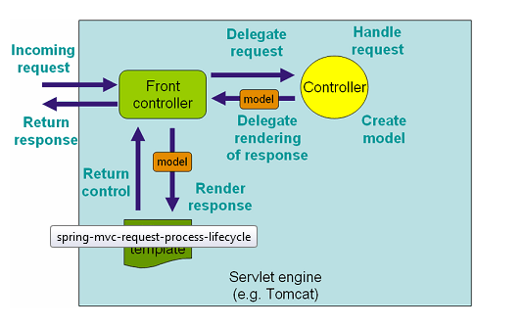
Spring Web MVC

Slide 8
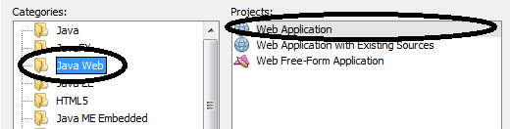
Creating Spring Web MVC project with NetBeans
Start NetBeans IDE (we assume version > 8)
From File menu select New Project.
From Categories select Java Web. From projects select Web application.

Slide 9
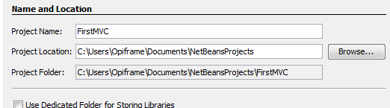
Creating Spring Web MVC project with NetBeans
From next dialog type in the project name and define the working directory.

Slide 10
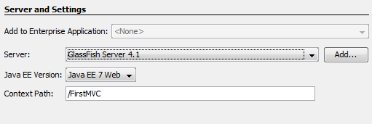
Creating Spring Web MVC project with NetBeans
From next dialog make sure that GlassFish or Tomcat server is selected. Make also sure that Java EE version is 7 or newer.

Slide 11
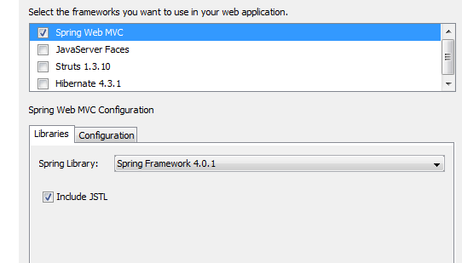
Creating Spring Web MVC project with NetBeans
From next dialog select Spring Web MVC framework. Make also sure that Spring library version is 4.1 or higer.

Slide 12
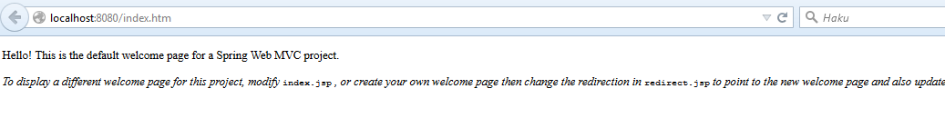
Creating Spring Web MVC project with NetBeans
To test that the project and JavaEE environment is working correctly press the green play button from netbeans toolbar. This should start the GlassFish application server and for a while the browser should be launched where yuo see next content:

Slide 13
Project Files
The template project contains next files:
index.jsp
applicationContext.xml
dispatcher-servlet.xml
glassfish-web.xml
web.xml
redirect.jsp
Also if you expand the Libraries folder you can see a bunch of spring-xxx libraries included in your project.

Slide 14
Web.xml
Web.xml file is part of any JavaEE application, not Spring. Our project wex.xml declares that our app will use an instance of class org.springframework.web.servlet.DispatcherServlet to handle all incoming HTTP(S) requests.
Servlet container as DispatcherServlet is , will be deployed in your application (when you hit the green play button) GlassFish server and it will manage all the communication infrastructure for you: it accepts connections, manages database connections(*) and will call upon your servlets to handle incoming requests. All this is done automatically, so you don’t have to worry about it.

Slide 15
applicationContext.xml
applicationContext.xml file stores all the configuration information about application wide functionality, like
Security
Persistence
Scheduled task
Etc…
The default template does notcontain any configuration info by default.

Slide 16
dispatcher-servlet.xml
By default DispatcherServlet will look for a name dispatcher-servlet.xml to load the Spring MVC configuration.
The default configuration defines the used view resolver class and a path to our .jsp files (in our case /WEB-INF/jsp/) and the default view and controller to be used which in our case is index.jsp.

Slide 17
glassfish-web.xml
This file contains configuration info for our application server. By default it only contains the information about Context Root.

Slide 18
.jsp files
These files are our views. By default we have only one view index.jsp in our project.

Slide 19
Model View Controller
The Spring Web model-view-controller (MVC) framework is designed around a DispatcherServlet that dispatches requests to handlers, with configurable handler mappings, view resolution, locale and theme resolution as well as support for uploading files. The default handler is based on the @Controller and @RequestMapping annotations, offering a wide range of flexible handling methods. With the introduction of Spring 3.0, the @Controller mechanism also allows you to create RESTful Web sites and applications, through the @PathVariable annotation and other features. (http://docs.spring.io/spring-framework/docs/3.0.x/reference/mvc.html)

Slide 20
Defining a Controller
Controllers acts a s routers in our Spring applications. Routers sets the models and launches the view depending of the user request.
Defining a router can be done in many ways´.In this material we are useing Annotations to do this.
To use annotations we need to tell that in our dispatcher-servlet.xml configuration file.

Slide 21
Defining a Controller
First make sure you have next RED lines in your dispatcher-servlet.xml file:
<beans xmlns="http://www.springframework.org/schema/beans"
xmlns:xsi="http://www.w3.org/2001/XMLSchema-instance"
xmlns:context="http://www.springframework.org/schema/context"
xmlns:p="http://www.springframework.org/schema/p"
xmlns:aop="http://www.springframework.org/schema/aop"
xmlns:tx="http://www.springframework.org/schema/tx"
xsi:schemaLocation="http://www.springframework.org/schema/beans http://www.springframework.org/schema/beans/spring-beans-4.0.xsd
http://www.springframework.org/schema/aop http://www.springframework.org/schema/aop/spring-aop-4.0.xsd
http://www.springframework.org/schema/tx http://www.springframework.org/schema/tx/spring-tx-4.0.xsd
http://www.springframework.org/schema/context http://www.springframework.org/schema/context/spring-context-4.0.xsd">
<bean class="org.springframework.web.servlet.mvc.support.ControllerClassNameHandlerMapping"/>
<context:annotation-config/>
<context:component-scan base-package="com.opiframe" />

Slide 22
Defining a Controller
The base-package attribute value com.opiframe is the ”root” name of the package where you place your controllers, models, beans etc…
You can set your own package name there but this material will use the package name com.opiframe.
Next we create a package for our controller under Source Packages folder in our project. We name it as com.opiframe.controllers (to do this right click over Source Packages folder and select New -> Java Package)

Slide 23
Defining a Controller
Next we add a new class to implement the controller functionality. Right click over the com.opiframe.controllers package and select New -> Java Class.
Give a name for the class i.e. HelloController and press Finish button.
Then use annotations as in next example to tell application server that this class implements Controller functionality.

Slide 24
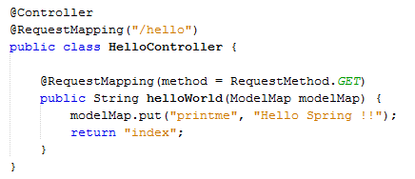
Defining a Controller
Annotation for controller
Thsi annotation defines the router path
For this class
This annotation defines that
helloWorld method handles GET
Request in path ”/hello”
The data for view
Name of the view variable
Name of the .jsp file to be rendered as response

Slide 25
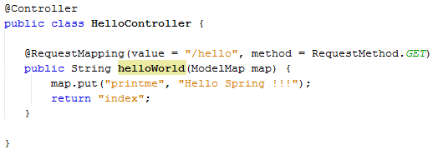
Defining a Controller
Another way to do the same thing…

Slide 26
Controller
@Controller annotation marks the class as spring bean which may handle different HTTP requests based on mapping specified on class or individual controller methods with @RequestMapping annotation as shown in previous examples.

Slide 27
Defining a View
We are using JSP templating in our examples. JSP stands for Java Server Pages.
JavaServer Pages (JSP) is a server-side programming technology that enables the creation of dynamic, platform-independent method for building Web-based applications. JSP have access to the entire family of Java APIs, including the JDBC API to access enterprise databases.
JavaServer Pages (JSP) is a technology for developing web pages that support dynamic content which helps developers insert java code in HTML pages by making use of special JSP tags, most of which start with <% and end with %>.

Slide 28
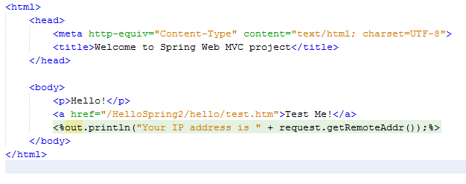
Example

Slide 29
Data Binding
You might remeber from our controller these code lines:
map.put("printme", "Hello Spring !!!");
return "index";
The first line defines an attribute with name printme the second argument string ”Hello Spring!!!” is the value where our attribute points.
Return statement return the name of the .jsp page to be generated to .hml file as response. As you remeber our /WEB_INF/jsp folder contains the index.jsp file.
The question is how we bind the attribute printme value to our view. The next example should illustrate this…

Slide 30
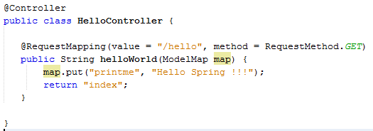


Data Binding
Index.jsp
HelloController.java

Slide 31
Data Binding
More complex data binding examples will follow later in this material.

Slide 32
Models
Models in MVC architecture contains or ”holds” the back end data. Models can contain data from database, file or any other source available.
Models can be also build using Java Persitence API (JPA) or Hibernate. Both of these technologies belongs to category of Object Relational Mapping (ORM).
The first example will simply use an build-in model that is not connected to database. You will see that kind of example later in this material.

Slide 33
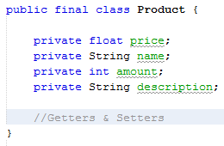
Model
Model is a simple POJO (Plain Old Java Object). Our models holds information of one product…

Slide 34
DAO (Data Access Object)
DAO objects holds usually a collections of models data. DAO object also communicates with database and makes the queries.
Our example creates a collections of Products objects (from our previous model) and defines a getter function for that collection.

Slide 35
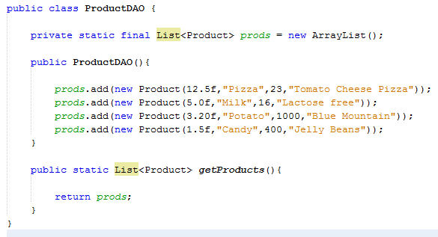
DAO

Slide 36
Controller
Controller handles the URL mapping and renders the wanted view with wanted data depending of the request. Our example passes the list of products to view called hello.jsp

Slide 37
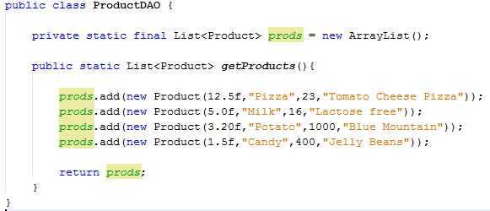
Controller

Slide 38
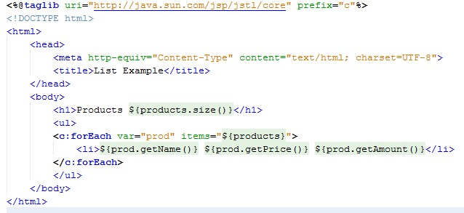
View
View renders the product data. It uses JSTL (Java Standard Tag Library) tags to create a dynamic web content.

Slide 39
Session Basics
Session management is one of essential parts for each web application.
As a framework for a web development, Spring has own tools and API for the interaction with sessions.
Normally if you do not have session handled in your web app the sequence of communication between client and server goes like:
Client send a request to server (a request can contain some data from client).
The server takes a request reads the data (if any) from it, makes possible database queries, makes a response and send it back. After this server DESTROYS the request and response objects and all the data related to those.
Client (usually a browser) gets the response, do something with it and possible make another request to server and we are back in step one.
Normally we want to keep the data BETWEEN the request response cycle. Here is where we need a concept of SESSIONS. Usually a session is an object in the server that holds some data for some client in the server side. The session objects are unique to every client. Usually framework takes the most of the work to handle sessions, you only define what data is stored.

Slide 40
Session Basics
Next simple example demonstrate the use of session in Spring web application.
It uses two new annotations for handling session data
@ModelAttribute
@SessionAttribute
In this case we create an empty Maven project, so you see how to use maven for handling projects. This is the usual way of creating large, dependency depending projects!

Slide 41
Session Basics (create a maven project)
There are many ways of creating Maven project. One of them is to use direct maven Artifact Id to create i.e. Spring web application that would create fully structured project structured ready to go.
In our case we create a project from scratch, so you see how to handle application dependencies using Maven project pom.xml file.
Note! If you already know how to use Maven, you can get the base project for Spring Web MVC with Maven from GitHub: https://github.com/maukka76/JavaEE/tree/master/SpringMVC/MavenBase

Slide 42
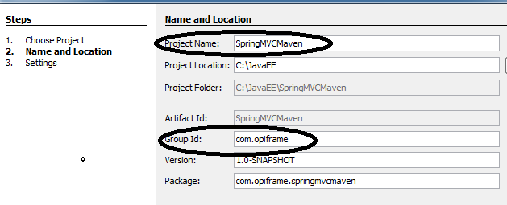
Session Basics (create a maven project)
First select File -> New Project
From categories select Maven. From the right hand project panel select Web Application. Press Next button.
Fill up the required information:

Slide 43
Session Basics (create a maven project)
Accept the setting in next page (the server and the Java EE version). Press finish and your Maven project is created.
The main project file pom.xml will contain all our project dependencies (and other configuration). When creating a Spring Web MVC project we of course need the Spring libraries (the .jar files) so we can use the framework. These libraries are defined in pom.xml in particular way i.e. :
<dependency>
<groupId>org.springframework</groupId>
<artifactId>spring-core</artifactId>
<version>${spring.version}</version>
</dependency>

Slide 44
Session Basics (create a maven project)
You can find these dependencies from maven repository: http://mvnrepository.com/
Open the pom.xml and append next dependencies and replace the correct version number to each dependency (you can find the most fresh one using the link above).
Note that it can take some time to load all the needed dependencies.

Slide 45
Session Basics (create a maven project)
<dependency>
<groupId>org.springframework</groupId>
<artifactId>spring-core</artifactId>
<version>${spring.version}</version>
</dependency>
<dependency>
<groupId>org.springframework</groupId>
<artifactId>spring-web</artifactId>
<version>${spring.version}</version>
</dependency>
<dependency>
<groupId>org.springframework</groupId>
<artifactId>spring-webmvc</artifactId>
<version>${spring.version}</version>
</dependency>
<dependency>
<groupId>javax.servlet</groupId>
<artifactId>javax.servlet-api</artifactId>
<version>${javax.servlet.version}</version>
<scope>provided</scope>
</dependency>
<dependency>
<groupId>jstl</groupId>
<artifactId>jstl</artifactId>
<version>${jstl.version}</version>
</dependency>

Slide 46
Configuration
In previous example the configuration was done using the .xml file (like dispatcher-servlet.xml) but this time we are making our configuration using Java objects and annotations.
Before that make next modification to project:
Remove index.html page (under Web Pages folder)
Create WEB-INF folder under Web Pages folder
Create jsp folder under WEB-INF folder
In the jsp folder create file index.jsp.
Create resources folder under WEB-INF folder
In the resources folder create a folder called js and a folder called css
Create a script.js under js folder and styles.css under css folder

Slide 47
Configuration
Create a package com.opiframe.config. Add next class to the package, that configures our application
@Configuration
@ComponentScan("com.opiframe.controller")
@EnableWebMvc
public class Config extends WebMvcConfigurerAdapter {
@Bean
public UrlBasedViewResolver setupViewResolver() {
UrlBasedViewResolver resolver = new UrlBasedViewResolver();
resolver.setPrefix("/WEB-INF/jsp/");
resolver.setSuffix(".jsp");
resolver.setViewClass(JstlView.class);
return resolver;
}
@Override
public void addResourceHandlers(ResourceHandlerRegistry registry) {
registry.addResourceHandler("/resources/**").addResourceLocations("/WEB-INF/resources/");
}
}

Slide 48
Configuration
Add next file also in com.opiframe.config package. This class mimics the web.xml file in our project.
public class WebInitializer implements WebApplicationInitializer {
@Override
public void onStartup(ServletContext servletContext) throws ServletException {
AnnotationConfigWebApplicationContext ctx = new AnnotationConfigWebApplicationContext();
ctx.register(Config.class);
ctx.setServletContext(servletContext);
Dynamic servlet = servletContext.addServlet("dispatcher", new DispatcherServlet(ctx));
servlet.addMapping("/");
servlet.setLoadOnStartup(1);
}
}

Slide 49
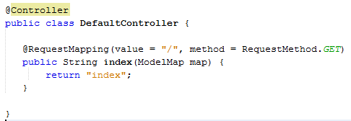
Controller
Finally create a com.opiframe.controller package. Under that package create a next controller class.

Slide 50
View
Next change the index.jsp page as follow…
<%@page contentType="text/html" pageEncoding="UTF-8"%>
<%@ taglib uri="http://java.sun.com/jsp/jstl/core" prefix="c" %>
<!DOCTYPE html>
<html>
<head>
<meta http-equiv="Content-Type" content="text/html; charset=UTF-8">
<link rel="stylesheet" type="text/css" href="resources/css/styles.css" />
<script src="resources/js/scripts.js"></script>
<title>JSP Page</title>
</head>
<body>
<h1 class="my_color">Hello World!</h1>
</body>
</html>

Slide 51
Sessions
To understand sessions we first make an application that is not handling session, see the problems what I causes and then fix it by using session.
First we create a view where user can pass form data to server. The view will implement an login functionality and the data passed are username (email) and password.
The server will check if user name and password are valid and depending of that render a particular view for user.

Slide 52
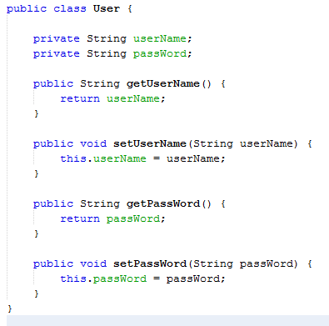
Model
We need a model to hold the user data. I create a next very simple User model under com.opiframe.model package.

Slide 53
Login View
Login view contains inputs for username and password. Note that the path attribute for inputs MUST match to the names of the attributes in class User we previously defined (userName and passWord).

Slide 54
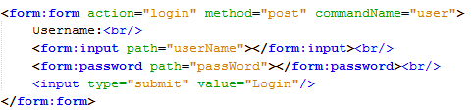
Login View

Slide 55
Controller
We need a new router for our controller. If you look the form we defined in our view the method in from was “post” and action was “login” so we need a router for that in our controller. We also need an annotation to map the form data to our User class. This is done with @ModelAttribute.

Slide 56
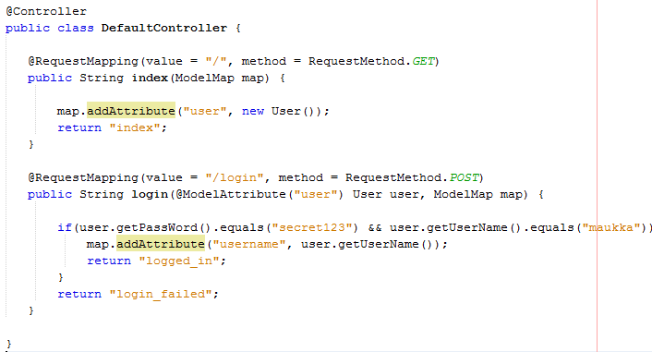
Controller

Slide 57
JSP pages
Finally the view where we go after login. If success login we render the logged_in.jsp page (return “logged_in”) and fail case renders the login_failed.jsp.

Slide 58
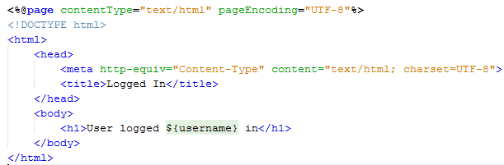
logged_in.jsp

Slide 59
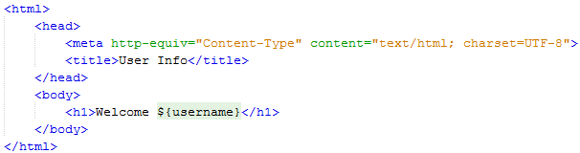
The problem
Everything seems to work OK at the first look. The problem arises when we try to pass some data to some other page. Let’s sat that we want to show the username information in page called userpage.jsp

Slide 60
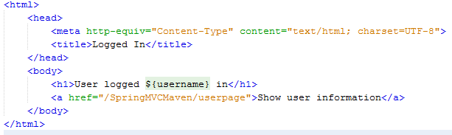
The problem
We make a link to that page from our logged_in.jsp page

Slide 61
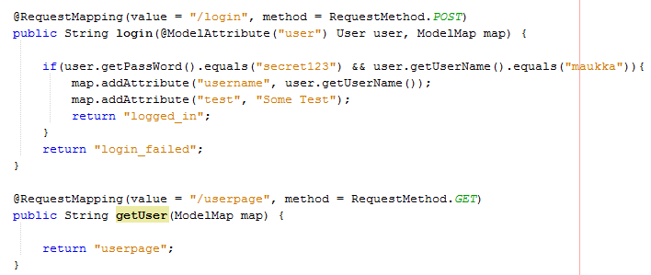
The problem
And last add the needed router to our controller…

Slide 62
The Problem
If you now test the application, you can notice that the username is not displayed in the userpage. This is because the attribute mapping for “username” is set in the login router. When the getUser router is called, the data is already destroyed.
This is where we need session. To keep some data alive during the request response cycle.
The easiest way to set data to session is to use @SessionAttributes annotation.

Slide 63
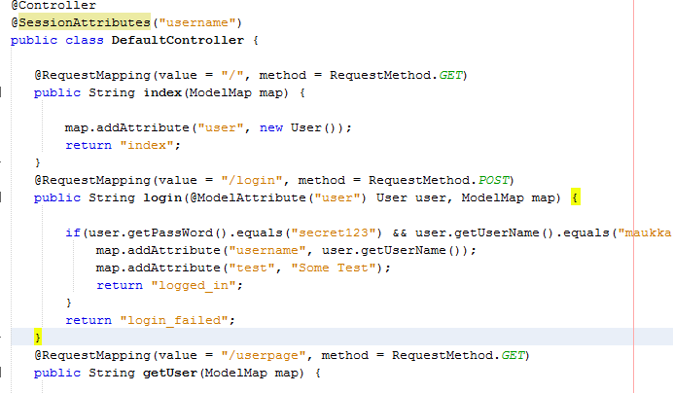
Problem Solved

Slide 64

Problem Solved/Destroy session
Now that the “username” is stored in session it is available until the session object is destroyed.
To make a logout functionality we append a new link to our userpage.jsp

Slide 65
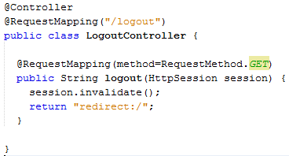
Problem Solved/Destroy session
Then make a new controller to com.opiframe.controller package for handling logout router

Slide 66
Data Validation
Sometimes there is need to validate the user input in your application. For example in our previous example it would be good idea to check that the user name and password fields are NOT empty, before actually checking if those are valid.
The validation can be done in two ways:
Using Validator interface
Using Annotations

Slide 67
Data Validation
You need to define these two dependencies in pom.xml file
<dependency>
<groupId>javax.validation</groupId>
<artifactId>validation-api</artifactId>
<version>1.1.0.Final</version>
</dependency>
<dependency>
<groupId>org.hibernate</groupId>
<artifactId>hibernate-validator</artifactId>
<version>5.2.2.Final</version>
</dependency>

Slide 68
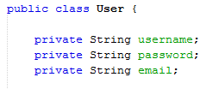
Data Validation Validation Interface
First example uses Validation interface. We make a validator for our user class:

Slide 69
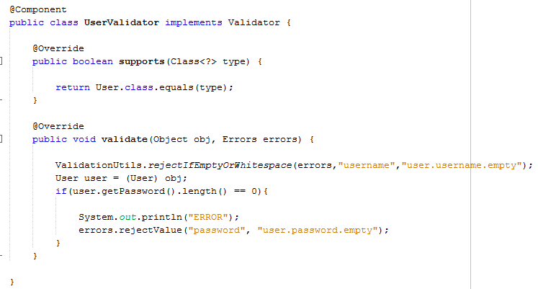
Data Validation Validation Interface
Then we need to make a validator for User class. Next class implements and the needed methods supports() and validate()

Slide 70

Data Validation Annotations
You need to add messages.properties file under resources folder with next content. This file will contain the error messages displayed if validation fails.

Slide 71
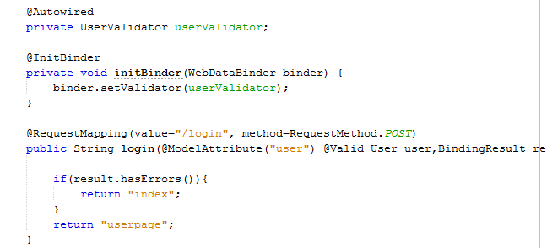
Data Validation Annotations
Then we need to make next changes in our controller. We autowire the UserValidator and the bind it to web data. Note also the @Valid annotation!

Slide 72
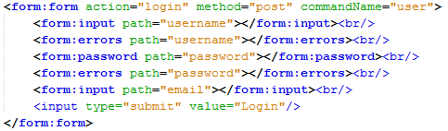
Changes in index.jsp
To show error messages in our login form we use <form:errors> tags as shoe below:

Slide 73
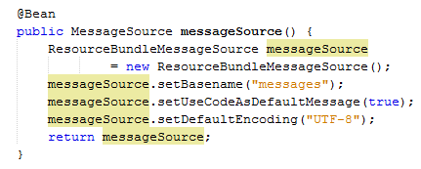
Changes to config
To load the messages.properties file for our application we need to make next change in our Config class to get it work. We append messageSource() function to load the resource:

Slide 74
Validation With Annotations
More easier way to make a validation is to use validation Annotations. Using annotation you don’t have to make so much code changes/new code to get it work.
You can find all validation annotations you can use from here:http://docs.jboss.org/hibernate/stable/validator/reference/en-US/html_single/#section-builtin-constraints

Slide 75
Validation With Annotations
To validate with annotations you define the those annotations in your models fields. In our application our model User conained three fields: username, password and email. To add validations annotations that does not allow:
Empty Strings
Null Strings
Invalid email address
You can do it as follow with annotations….

Slide 76
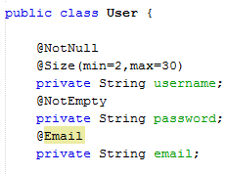
Validation With Annotations

Slide 77
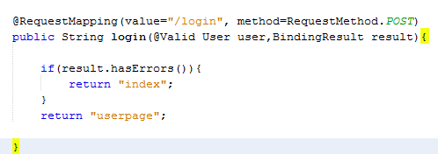
Validation With Annotations
We also have to change our controller code a bit:

Slide 78
Validation With Annotations
The previous example uses the default error messages. If you want to define your owns you can do it by following annotation syntax:
@Size(min=10, message="Phone number must be at least 10 characters")

Slide 79
Hibernate (ORM)
Object-relational mapping (ORM, O/RM, and O/R mapping) in a technique for converting data between incompatible type systems in object-oriented programming languages.
In other words ORM means converting relational database table to Java (in this case) object.
There is also concept of JPA (Java Persistence API) that is actually a specification how the above conversion should be implemented.
Hibernate is one of the JPA implementations (there are others also like EclipseLink, ActiveJPA etc.)
We use Hibernate because it the one most common used implementations out there.

Slide 80
Hibernate (ORM)
You need also an database that you want to model to objects.
In our example we use MySQL server and a database with 3 tables in it.
Note! If you use some other database solution it affects also in configuration that is explained in next slides!

Slide 81
Hibernate Configuration
Hibernate must be configured in your application. For example you must define what database you want to model.
Configuration can be done several ways:
Create Java Web application with Hibernate configuration using Netbeans project wizard. This basically sets all the needed stuff for you automatically.
You can configure all needed configurations in web.xml and applicationContext.xml file
You can use Annotations and built-in Java Classes to configure hibernate.
We use the Netbeans Wizard to help in this.

Slide 82
Spring MVC With Hibernate
Create a new project by selecting File->New Project
Select Java Web and Web Application.
Give name for the project and select the server etc. from next dialogs.
From frameworks dialog select both Spring Web MVC and Hibernate.
When you select hibernate checkbox you can see Database Connection and Database Dialect.
From database connection select jdbc:mysql://localhost:3306/xxxx
….where xxxx is the name of your database. Then press Finish.

Slide 83
Spring MVC With Hibernate
The project is similar to normal Spring Web MVC application, but with hibernate dependencies included.
Next we create needed classes to make object relational mapping to our database, define a UI where database is displayed and then make different kinds of queries to our database.
We start by generating the needed Java classes using the Netbeans project wizard.

Slide 84
Spring MVC With Hibernate
Create next packages under Source Packages
com.some_company.controller
com. some_company.model.dao
com. some_company.model.impl
com. some_company.util
Right click over Source Packages folder
Select New -> other
From Categories select Hibernate
From File Types select Hibernate Reverse Engineer Wizard
Press Next (leave the values as they are)
Press Next
Press Add all button (this selects all the database tables)
Press Finish
This creates a file named hibernate.reveng.xml file into project

Slide 85
Spring MVC With Hibernate
Next we create a Util class for database..
Right click over com.my_company.util package
Select New -> other
From categories select Hibernate from File Types select HibernateUtil.java
Press Next.
Name the class HibernateUtil. Press Finish.
This creates you a class HibernateUtil that contains the session object which is used to communicate to database.

Slide 86
Spring MVC With Hibernate
Next we create an object model from our database table. This is done with by completing next steps:
Select New -> other
From Categories select Hibernate. From File Types select Hibernate Mapping Files and POJO’s from database. Press Next.
From next dialog leave the values as they are and press Finish button.
This step creates a Java class model of your database tables.

Slide 87
Spring MVC With Hibernate
From generated xxxx.hbm.xml set this:
<hibernate-mapping auto-import="true">
Xxx is the name of the generated class.

Slide 88
Spring MVC With Hibernate
Next we create the data access object
Right click over com.my_company.dao package.
Select New -> Java Class
Name the class as xxxDao where xxx is the name of the model you previously created i.e. if you created a model Student from database table student the name this class as StudentDAO.
Make next implementation for this class….

Slide 89
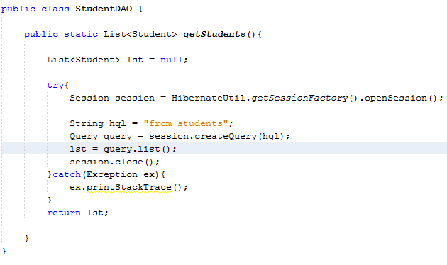
Spring MVC With Hibernate

Slide 90
Spring MVC With Hibernate
Next we create a controller and one router which will use the previously created DAO to get all the data from database and pass it to view, which generates an .htm page from it.
Right click com.my_company.controller and Select New -> Java Class
Name the class as xxxController where xxx represents the model name which this controller talks. In our case it is named as StudentController since this controller gives the user to access student table in our application.

Slide 91
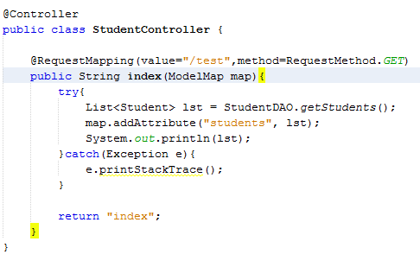
Spring MVC With Hibernate

Slide 92
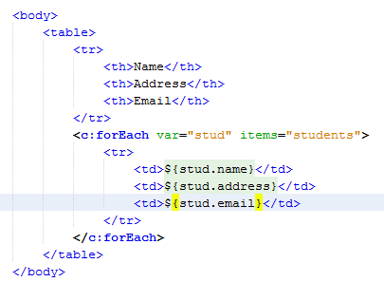
Spring MVC With Hibernate
Last thing is consume the data in view as is done in index.jsp file

Slide 93
Spring Boot
Spring-boot provides a quick way to create a Spring based application.
Simpler Dependency management using spring-boot starter projects.
The framework takes an opinionated approach to configuration, freeing developers from the need to define boilerplate configuration.
Makes it easy to define a REST based API with Spring.
Makes it easy to change/test different templating engines out there.

Slide 94
Spring Boot
You need next dependencies (see next slide and copy paste) for the boot template:

Slide 95
Spring Boot
<parent>
<groupId>org.springframework.boot</groupId>
<artifactId>spring-boot-starter-parent</artifactId>
<version>1.2.6.RELEASE</version>
</parent>
<properties>
<project.build.sourceEncoding>UTF-8</project.build.sourceEncoding>
<maven.compiler.source>1.7</maven.compiler.source>
<maven.compiler.target>1.7</maven.compiler.target>
</properties>
<dependencies>
<dependency>
<groupId>org.springframework.boot</groupId>
<artifactId>spring-boot-starter-web</artifactId>
</dependency>
</dependencies>
<build>
<plugins>
<plugin>
<groupId>org.springframework.boot</groupId>
<artifactId>spring-boot-maven-plugin</artifactId>
</plugin>
</plugins>
</build>
</project>

Slide 96
Basic Structure
To boostrap application you need following class in your project:
@SpringBootApplication
@ComponentScan(basePackages = "com.opiframe.controller")
public class Application {
public static void main(String[] args) {
SpringApplication.run(Application.class, args);
}
}

Slide 97
Basic Structure
Then the controller for REST api(s)
@RestController
public class GreetingController {
@RequestMapping("/")
@ResponseBody
String home() {
return "Hello World!";
}
@RequestMapping("/greeting")
@ResponseBody
String greeting() {
return "Greetings from finland!";
}
}

Slide 98
@ResponseBody & REST
@ResponseBody annotation marks the function to return something else than .html file.
You use this when you want that the REST function returns i.e. json, xml or data in some other than .html form.

Slide 99
JSON Example
For example of returning an Java object as an json representation will be done as follow. First we need a model class containing the data returned.

Slide 100
Model
public class Greeting {
private final long id;
private final String content;
public Greeting(long id, String content) {
this.id = id;
this.content = content;
}
public long getId() {
return id;
}
public String getContent() {
return content;
}
}

Slide 101
REST JSON
Then we need a controller containing REST api returning our model to client.
@RequestMapping(name="/test",method=RequestMethod.GET)
public @ResponseBody Greeting sayHello(@RequestParam(value="name", required=false, defaultValue="Stranger") String name) {
return new Greeting(counter.incrementAndGet(), String.format(template, name));
}

