Slide 1
Big Mountain Resort – Price Analysis
Thomas Turner – Data Scientist

Slide 2
The Challenge
Expanding Operations
- Adding a lift
Representative Price?
- Premium above market average
Justify an Increase?
- Decrease spending
- Generate Revenue

Slide 3
Recommendations
Baseline increase
- [$85.45, 106.26]*
Operational Expanse
- Additional $1.99
Operational Adjustment
- Additional $1.79

Slide 4
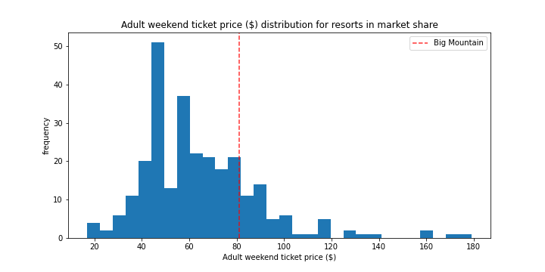
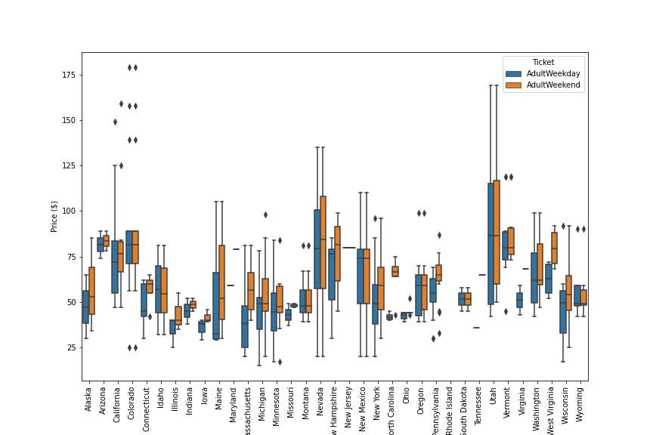
Modeling and Analysis
Weekend Ticket Price
Moderately high
Highest in Montana
*Weekend vs. Weekday
Weekend ~ 9.7% higher

Slide 5
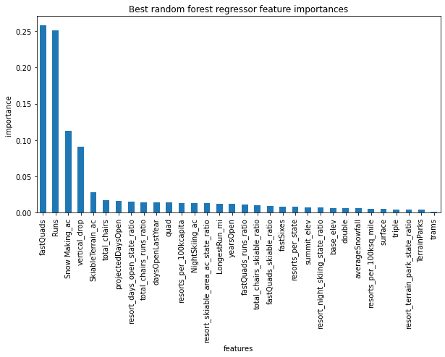
Modeling and Analysis
Strong Price correlation
- Vertical Drop
- Fast Quads
- Total Chairs
- Total Runs
- Snow Making acreage
Model Selection
- Matches observations
- Reduced variation

Slide 6
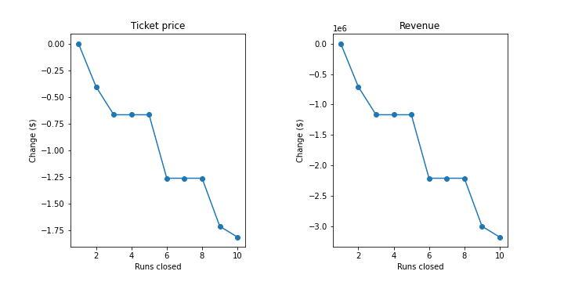
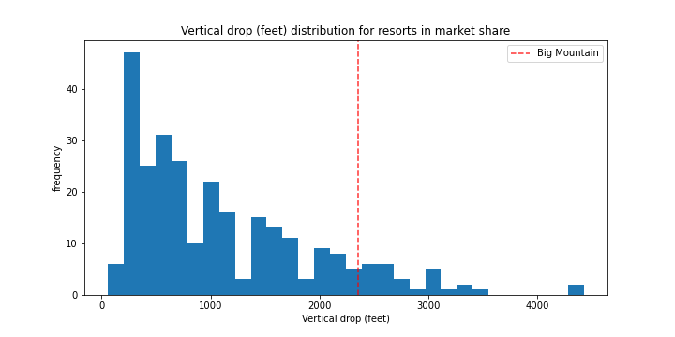
Modeling and Analysis
Reducing operations
- One is okay
- Quickly devalues tickets
Expanding operations
- More runs, more value
- Replace one for another
Testing change
- Easy

Slide 7
Conclusion
Support for increased price
- [$85.45, $106.26]*
- facility expansion covers added cost
Future consideration
- Forecast demand
- How would a price increase affect ridership?

