Slide 1

Summarization App:
Medical Documents
Thomas B. Turner

Slide 2

Motivation
Empower patients
  Advocacy
  Knowledge
Transfer Learning?

Slide 3
Data
MTSamples.com
  5000+ DI transcriptions
  Indications as summaries
  Findings and Impressions as documents

Slide 4
Data - Wrangling
Generating Structure
  Atypical NLP
  Extracting Entire sections
    “.,”
    Regex: (.*?)(?=\.\s[A-Z][A-Z]+|\Z)

Slide 5
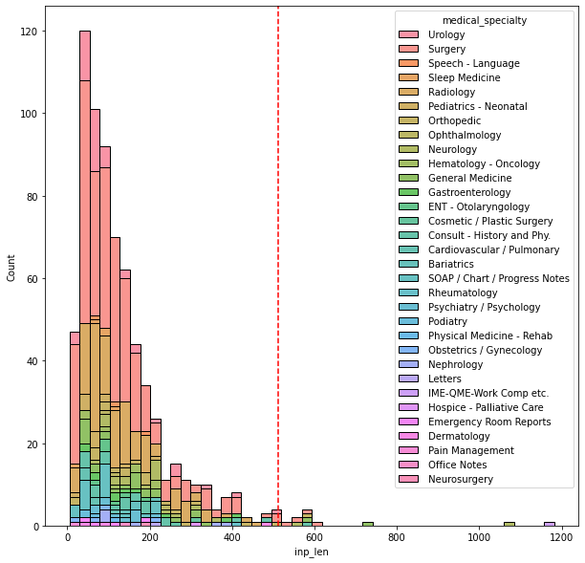
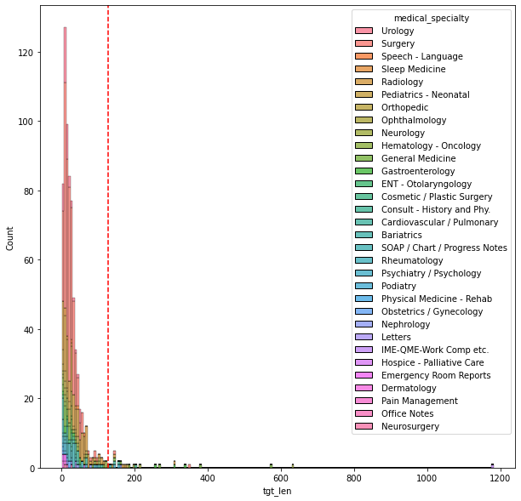
Data - EDA
Input
Target

Slide 6
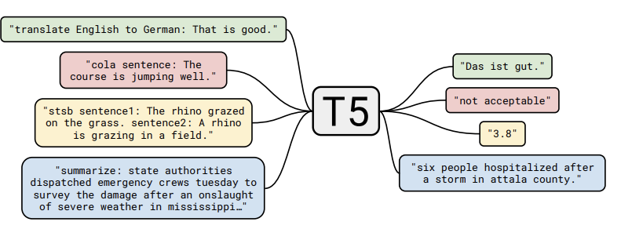
Model
Text-to-Text Transfer Transformer (T5)
T5 framework. Source: https://arxiv.org/pdf/1910.10683.pdf

Slide 7

Model - comparison
Baseline:
  Rouge-L: 16.38
  the lungs are clear of any abnormal airspace consolidation, pleural effusion or pneumothorax. limited images of the upper abdomen are unremarkable.
Fine-Tuned
  Rouge-L: 18.64
  No evidence for pulmonary arterial embolism. The lungs are clear of any abnormal airspace consolidation, pleural effusion, or pneumothorax. Limited images of the upper abdomen are unremarkable.

Slide 8
App Deployment
Backend API
  Paperspace
  Docker
  Model
Front End
  Streamlit

Slide 9
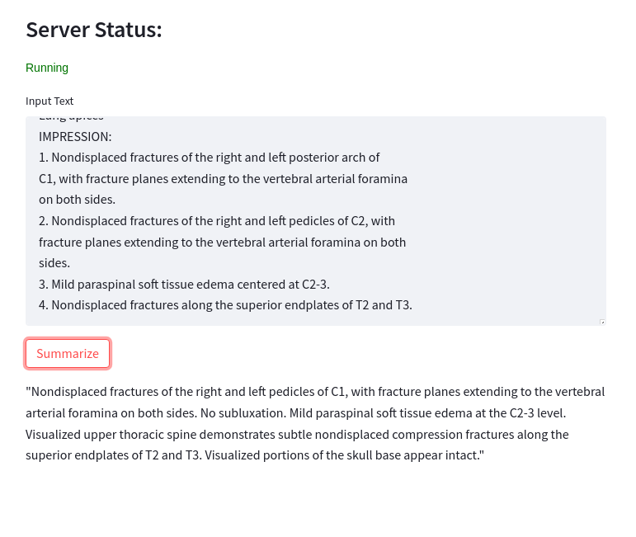
App - Demonstration
Simple Interface
  Copy and paste text
  Generates Summary

Slide 10
Summary
Improved performance
Deployed Model
Created Interface

Slide 11
Future Considerations
More Data
Larger Model
Longer Documents
Keyword Extraction
Sentence Extraction

Slide 12
Thank you, questions?

