Slide 1

Investigating relationship between GME stock price and WSB discourse
Thomas B. Turner

Slide 2

The Problem
GME Short Squeeze
Can we determine dicussion topics from WSB that correlate to GameStop stock prices?
Notes:
In January of 2021, the online community WallStreetBets successfully orchestrated a short squeeze of GameStop stocks. For many members of this community the impetus for this event was the belief that, for years, investment firms had been intentionally lowering and maintaining the price of GameStop's stocks to what they felt was an unfair value. Analysis of GameStop stocks indicated that around the time of the event the publicly held inventory was being short sold at a rate of 140%. This project seeks to better understand the nature of the public discourse amongst the members of this community starting from early 2016 and ending in February of 2021. What sort of topics has the community historically engaged in, and how did the discussion of these topics change--if at all--in the months leading up to the short squeeze event. In particular, this project addresses the question:
"Can we determine discussion topics from WSB that correlate to GameStop stock prices?"
Furthermore, considering that the discussions within this community happened in open channels begs the question if there were changes or unique events in community discourse in advance of these events, was could the event have been avoided?

Slide 3
Value
Losses over one week:
  $6Billion +
Notes:
With short selling being a risky yet potentially very profitable method of stock trading, there is no denying that online communities like WallStreetBets are a new variable that should be taken into consideration. Over the course of a few days, several US trading firms required cash infusions in excess of six-billion dollars to close their short options and cover their losses. With the resounding "success" of the GameStop short squeeze, it is safe to say that this will not be the last time WSB makes the headlines. Thus the understanding of the community discourse around certain topics and these changes over time could quite literally make the difference between massive gains or massive losses.

Slide 4
Findings – Key Findings
5 Topics
  - VWAP correlation
  - RSI correlation
  - 48 or 60 day leading
Causal?
  - Precedence established
Notes:
The key finding from the project was the identification of 5 topics that had an interesting correlation to GameStop stock prices at two distinct moments in the final year of data. However, going beyond correlation, causality tests between these five topics and GME stock price revealed precedence for a causal relationship. The strong leadership quality of these topics in advance of the two stock price events means that not only was there the potential for detecting the short squeeze event in advance, but these topics could also have served as independent variables for forecasting stock prices.

Slide 5

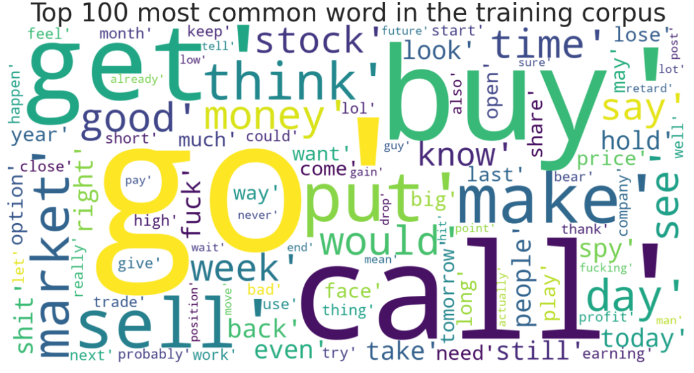
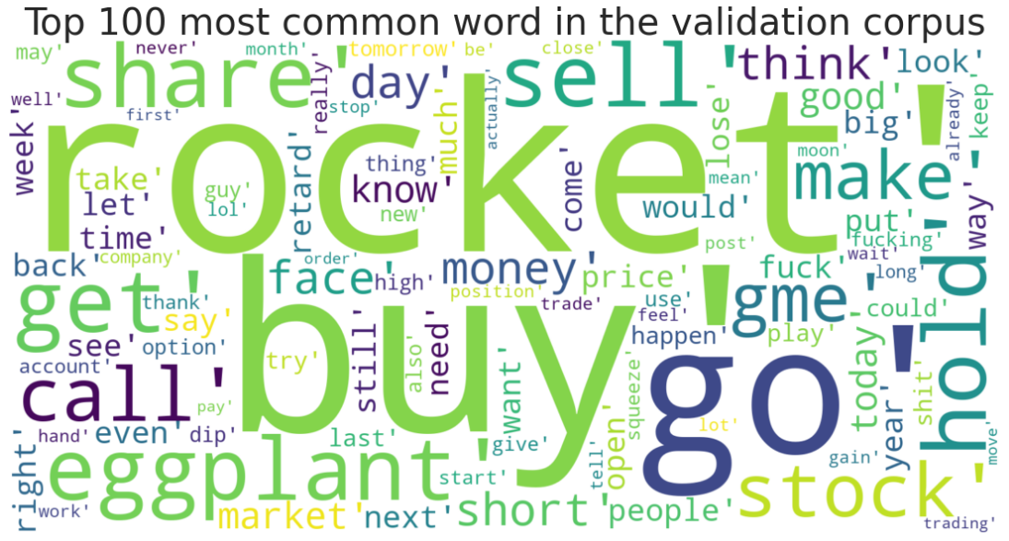
Findings – WSB Data
Before 2020-12-01
After 2021-02-01
Notes:
The dataset detailing the posts and comments on WallStreetBests between January 2016 and February 2021 was collected specifically for this project. The data was collected over a week from the Reddit API and stored in a local database to make analysis easier. Once assembled, the data was partitioned based on observations in the price history of GME stock prices and the assumption that any influence due to changes in community discourse would likely have happened at least one month in advance and the date of December 1, 2020, was chosen. Before this date, the most frequent words in the dataset relate to terms commonly used by stock traders and investors. After this date, the most frequent words are primarily unchanged; however, a distinct shift is observable with greater frequencies of words like hold and put moving to the top alongside blatantly obvious inclusions like GME. The observed differences highlight that community discourse varied before and after splitting date and is partly attributable to the rapid community growth at the onset of the short squeeze event in January.

Slide 6
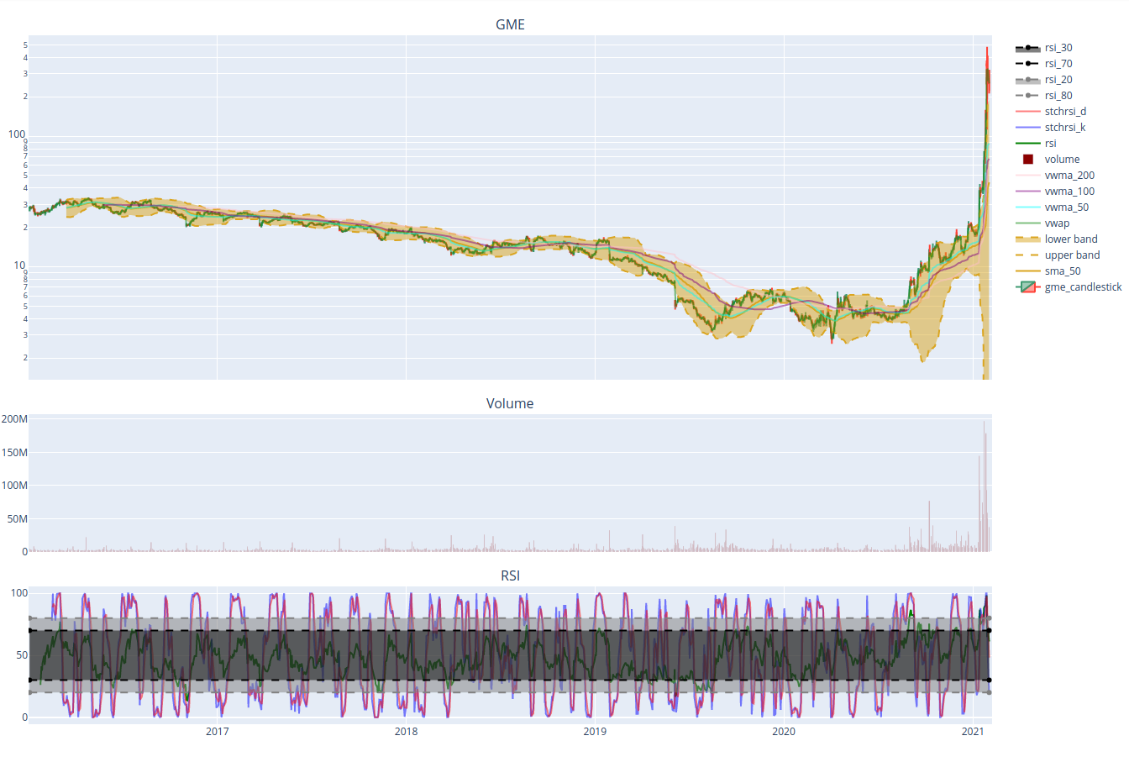
Findings – GME prices
Notes:
To avoid simply correlating topic frequencies with the price of GameStop stocks, I calculated two trading metrics to use instead: the Value Weighted Average Price and the Relative Strength Indicator. VWAP is what it sounds like, a weighted average of the price which accounts for the trading volume. The RSI is less clear but can signify trends not apparent in price, such as when a stock is overbought, oversold, or when a trend is reversing.

Slide 7
Findings - Topics
1: Buying gold | 2: AAPL | 4: NFLX | 6: Short Squeeze (?) | 7: Potential ROI | 8: Increase Price | 14: 2020 Election
18: Buy and Hold | 19: Oil Prices/ Robinhood | 26: Market Trending down | 27: Invest on post trends | 31: Market reversal | 35: Price has dropped | 38: Covid-19
Notes:
Modeling for this project was done using a probabilistic algorithm called latent Dirichlet allocation. Through testing various values, the optimal number for topics for the model was determined to be 40; however, of these 40, only 14 contained sufficient keyword combinations to infer a general category. Each document in the training and testing sets was assigned to one of the 40 topics determined by the model, but the final analysis only looked at these 14 topics: (refer to the topics)
I checked for correlations between these 14 identifiable topics and the GameStop price metrics. Using several techniques, I identified two periods where eight topics exhibited strong leadership characteristics towards the VWAP and RSI. In the first half of 2020, topics 14, 18, 26, 31 all displayed trends of leading interactions with VWAP and RSI roughly 48 days in advance. In the second half of 2020 and at the beginning of 2021, topics 8, 27, and 35 indicated strong leadership characteristics to both VWAP and RSI about 60 days in advance. Even more interesting is that topics 7 and 38 exhibited leading behavior in both situations. The latter two cases suggest possible changes in community discourse at the beginning of 2020 and the beginning of November of 2020 providing evidence of the events to come.
A final analysis into the relationship between five of these topics and the VWAP created precedence for causality. This finding implies that the community engagement on WSB with topics like Covid-19, Market analyses, and investment suggestions would likely have shown forecasted prices increasing.

Slide 8
Summary
Topid Modeling:
  - 5 topics
  - Causal precedence
  - Leading price shifts
Notes:
Talk about what you’ve already talked about!

Slide 9
Future Considerations
Topic evolution?
Entire set
Notes:
How far back do these topics go? Was there drift or evolution in the topics over time?
Due to hardware restrictions could only model on ~10% of the data, would like to do this on the entire set!

Slide 10
Thank you, questions?

