Slide 1

thingSoC
NEOLED Overview:
An Introduction to
WS2812 LEDs
By
@PatternAgents
Notes:
Hey Everybody!
I’m Tom Moxon, and
I’m very pleased to be speaking with you today-
I see some new faces in the audience as well as some old friends – welcome !

Slide 2
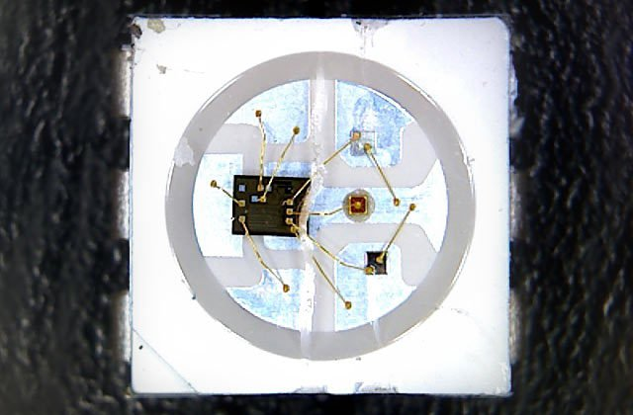
Addressable LEDs
WS2810/WS2812 (a.k.a. NEOPixels by Adafruit)
Integrates an LED driver chip with Red, Green, Blue LED's

Slide 3
WS2812 (SK6812) Color LEDs
Likely the most common addressable LED you'll find
(called NEOPixels when you buy them at Adafruit!)
They use a serial bit stream (UART like) protocol that
can be difficult for some microcontrollers or Linux single board computers (SBC) to drive directly (tight timing...)
It can also be difficult to drive and synchronize hundreds of WS2812 LEDs in multiple strings without hardware acceleration of some kind (special circuit, DMA, etc.)
Source : @PatternAgents

Slide 4
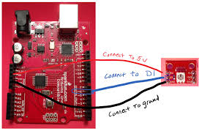
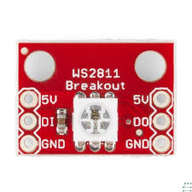
WS2812 Wiring
Needs 5.0 Volt Power
Needs 5.0 Volt Signal
Can draw AMPS of Power with many LEDs
Do NOT do this with more than a few LEDs, it can fry your Arduino boards...
Source : Sparkfun

Slide 5
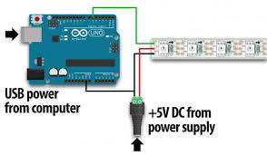
WS2812 Wiring
Best Practice is to power the LED strings separately:

Slide 6
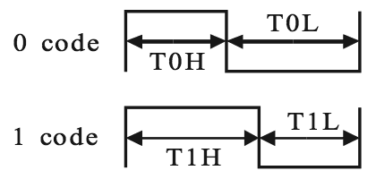
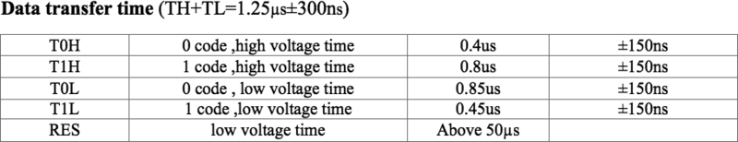
WS2812 Timing
The older WS2810 was a 400KHz serial data signal
The newer WS2811/WS2812 are now 800KHz data signals
Source : Adafruit

Slide 7
WS2812 LED Color Order
Eight (8) bits each for Green, Red, Blue
Different chips can use different color orders (beware!)
Some add White or Yellow LEDs for a 32 bit color pixel
Source : Adafruit

Slide 8
Arduino Libraries
Adafruit NeoPixel Library :
Well written, supports AVR, ESP8266, SAMD, etc.
FastLeds Library :
Optimized, with higher performance and update rates
Problems :
1) Can interfere with other functions, like audio, servos, etc.
2) Can use up a lot of the “scarce” memory resource
3) Doesn't work well with the Edison, Currie, Galileo, etc.
Source : Adafruit

Slide 9
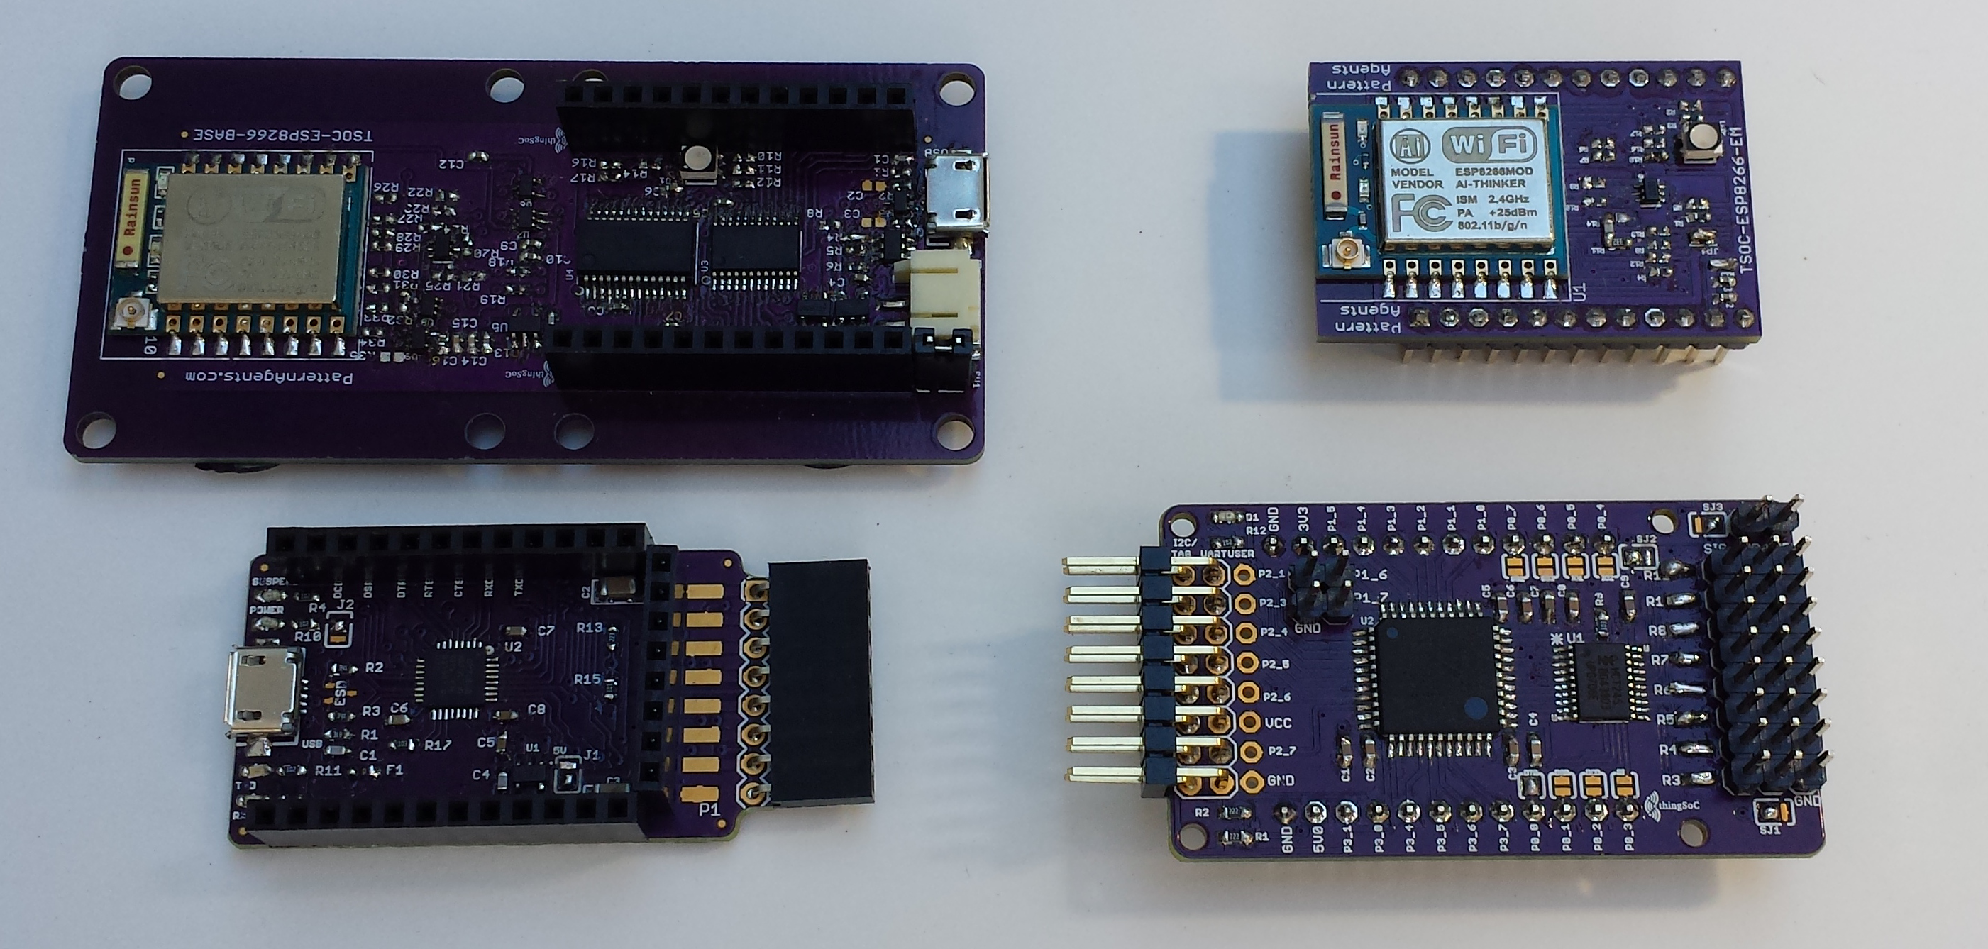
thingSoC is a OSHW Standard
Growing into a family of inter-operable products:
source: @PatternAgents

Slide 10
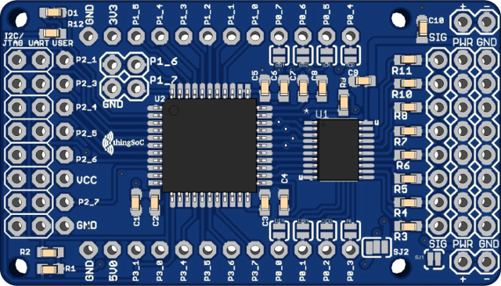
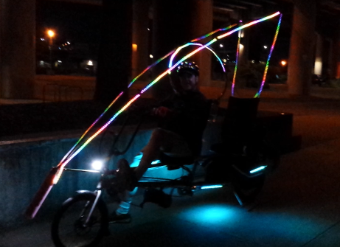
TSOC_NEOLED_EM
Eight (8) Channel RBG(Y) LED Driver Board (Embeddable Module)
Makes driving LED arrays as easy as writing to an I2C memory
Reprogrammable for other functions (servo motors, etc.)
Works with other thingSoC products
Coming soon to Crowd Supply here in Portland!
Source : @PatternAgents

Slide 11
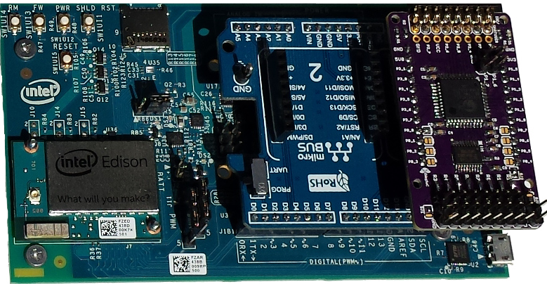
Driving WS2812 with Edison
source: @PatternAgents

Slide 12
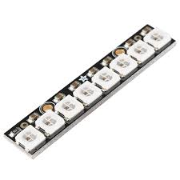
Driving WS2812 with Edison
While there are ways to drive WS2812 LEDs directly from the Edison (MRAA), they are not easy and have other problems.
Using the TSOC_NEOLED board eliminates the timing and voltage level translation issues for you.
The TSOC_NEOLED board looks like a simple I2C memory device to the Edison, simplifying your code.
Driving WS2812 with Edison
source: @PatternAgents

Slide 13
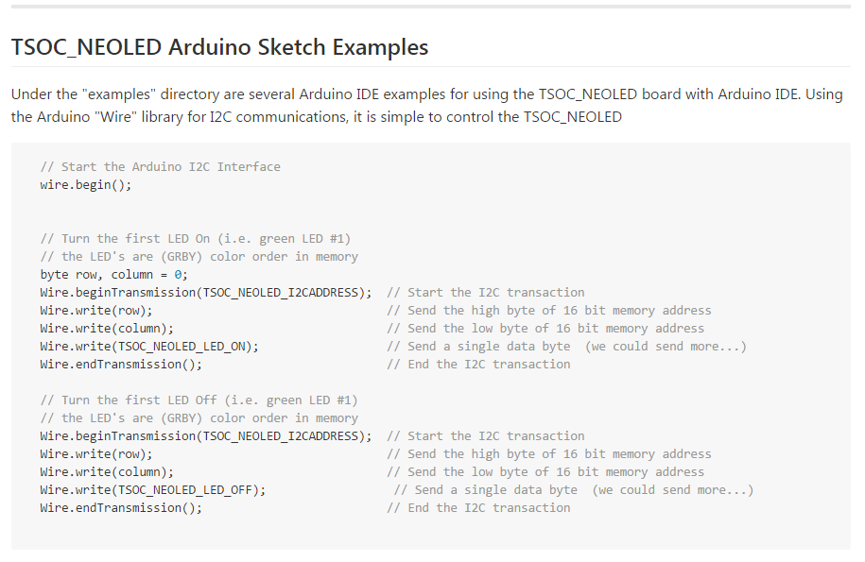
source: @PatternAgents

Slide 14
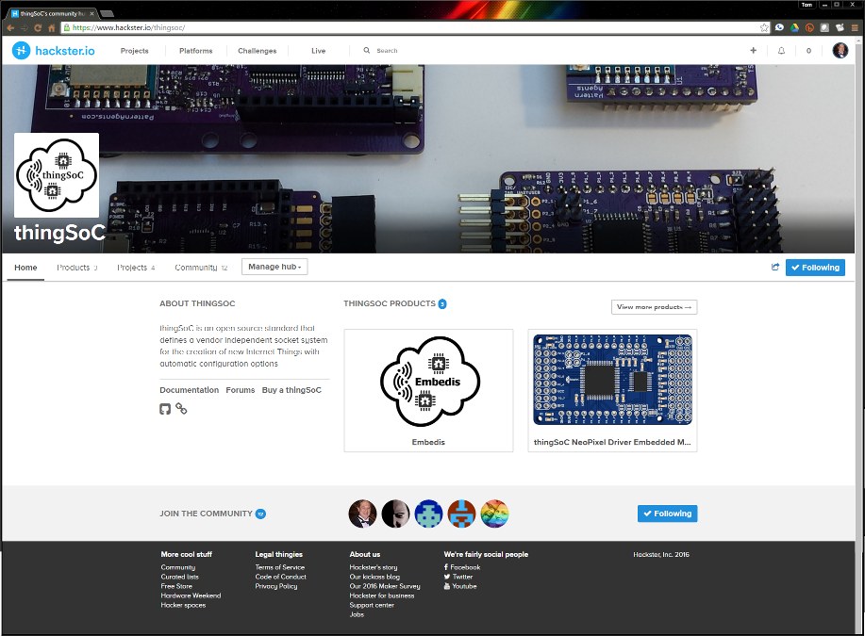
Hackster.io Platform
source: PatternAgents

Slide 15
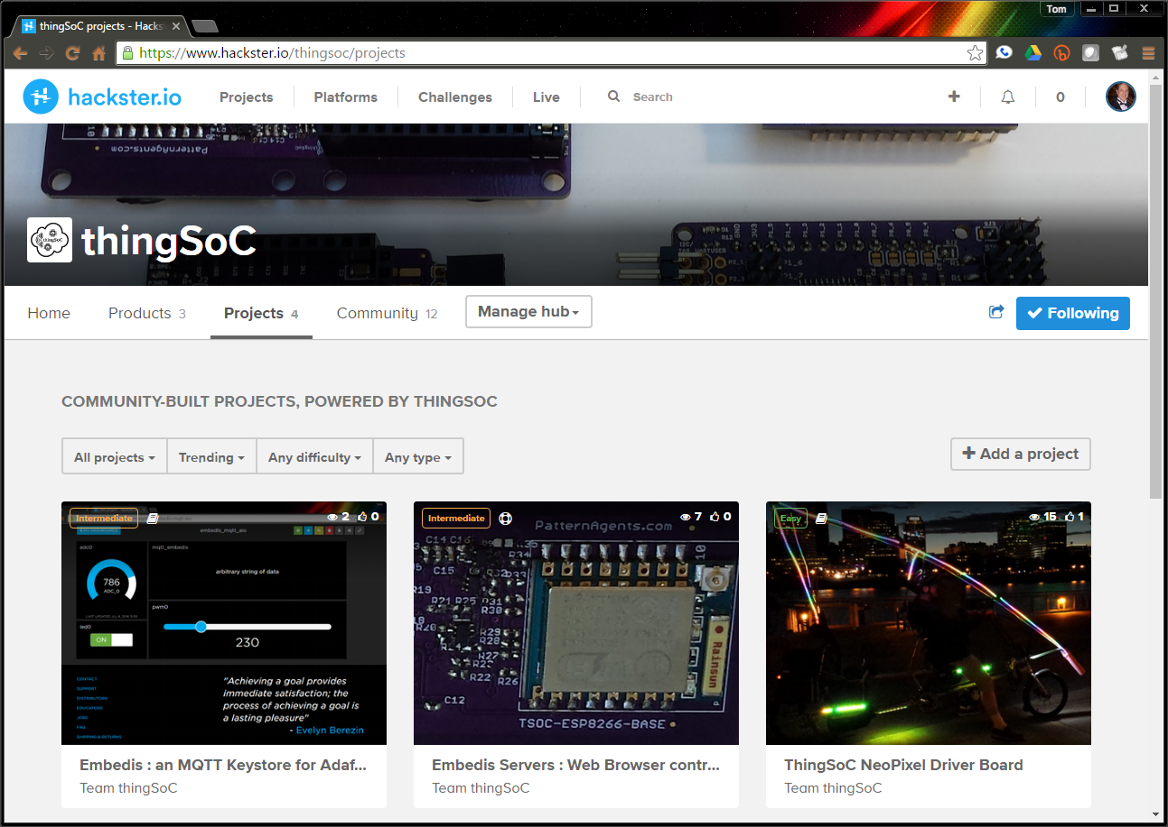
Hackster.io Projects
source: PatternAgents

Slide 16
If you would like to help...
Sign Up for Hackster.IO
Please go to :
https://www.hackster.io/thingsoc
and “Click” on the blue “Following” button
Look for our Crowd Supply campaign
coming soon!

Slide 17
Thank You !
Thank You!
Source : @PatternAgents

Slide 18
@Pattern Agents
PatternAgents supplies Open Source Design Patterns
for Hardware, Firmware, Software, and Applications.
A tailor or dressmaker is very familiar with the concept of a "pattern"; they select a “pattern” for the style of garment that they want to make, and then size that “pattern” for the customers individual measurements.
PatternAgents is doing the same thing for electronics,
in embedded systems for communications, robotics, metering and automation.

