Slide 1

Predicting on-time shipping with Machine Learning
FINC 514 Introduction to Data Science Spring 2021
Professor: Xiaodi Zhu
Students: Tiyanna Jenkins
Erika Leonida
Thi Diem My Nguyen
Anchal Patel

Slide 2
Outline
1. Introduction
2. Data summary
3. Data cleaning process
4. Methodology & Results
5. Model selection
6. Conclusion and future works
7. Q&A

Slide 3
1. Introduction
Project focused on how to apply Machine Learning to make predictions regarding shipping on-time, from an international e-commerce company to their customers.
Researched and tested several Machine Learning algorithms in order to select the one that maximizes the prediction accuracy score.
This algorithm introduces a prediction component to the output by giving an estimated on-time delivering to the customer for a shipment.

Slide 4

1. Introduction
Using Machine Learning to solve the business questions:
Discover key insights to figure which factors affected a product reaching on time
Using logistic regression and train/testing method to build 3 models
Select the one that maximizes the prediction accuracy score

Slide 5



1. Introduction
Motivation for doing this project
Ensuring on-time delivery to customer indicates:
The company is doing well in satisfying customers
The company has direct impact of increased revenues. It is a good starting point would be to have statistical analyses of inside every shipment success and predict accurately about the shipping time
Notes:
On time delivery has the direct impact of increased revenues, which affects the company, so a good starting point would be to have statistical analysis of inside every shipment success and predict accurately about the shipping time.

Slide 6
1. Introduction: The specific data science question we want to analyze
Which factor(s) significantly affect Reached on time?
Predict whether the product will deliver on-time or not?

Slide 7
Type of analysis and model that plan to use for each data science question
For the data science question:
'Which factor(s) significantly affect Reached on time' by using similar data for whether delivered on time.
Type of analysis: Regression Analysis
Model: A Logistic Regression Model
For the data science question:
'Predict whether the product will deliver on-time or not'
Type of analysis: use the training/testing method
Model: Logistic Regression, Decision Tree, and SVM; Run the model and pick the best model

Slide 8
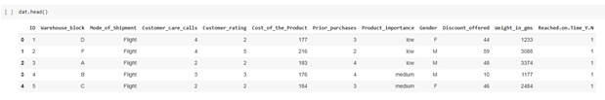
2. Data summary
a. Data source
Data saved in a CSV file covering a total of 10,999 observation shipments, called Train(2).csv
First five records from our dataset:
Notes:
On time delivery has the direct impact of increased revenues, which affects the company, so a good starting point would be to have statistical analysis of inside every shipment success and predict accurately about the shipping time.

Slide 9
2. Data summary
Target variable: Reached On Time (1/0)
Featured Variables:
Warehouse blocks
Mode of shipment
Cost of the product
Prior purchase
Product importance
Gender
Weight in grams.

Slide 10
2. Data summary
b. Statistical summary and Correlation matrix
Variable | Cost of the product | Discount offered | Weight in gms
Observation | 10,999 | 10,999 | 10,999
Mean | 210 | 13 | 3,634
Median | 214 | 7 | 4,149
Max | 310 | 65 | 7,846
Min | 96 | 1 | 1,001
Standard Deviation | 48 | 16 | 1,635
Notes:
On time delivery has the direct impact of increased revenues, which affects the company, so a good starting point would be to have statistical analysis of inside every shipment success and predict accurately about the shipping time.

Slide 11
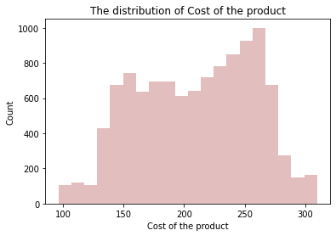

Slide 12
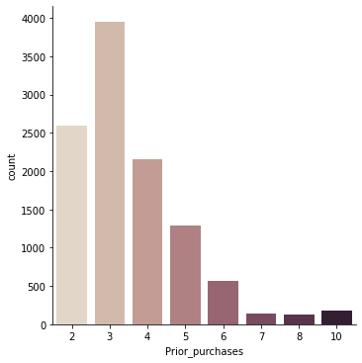

Slide 13
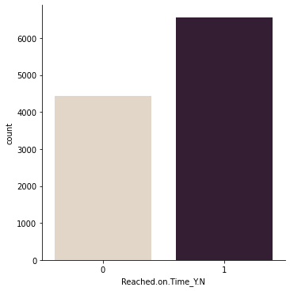

Slide 14
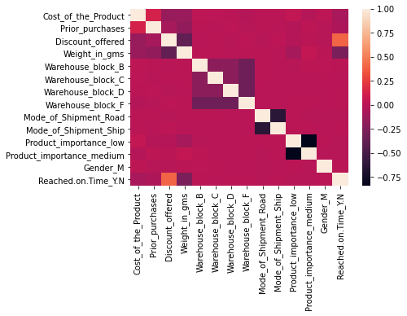
2. Data summary
Visualize the correlations using a heatmap
Notes:
On time delivery has the direct impact of increased revenues, which affects the company, so a good starting point would be to have statistical analysis of inside every shipment success and predict accurately about the shipping time.

Slide 15
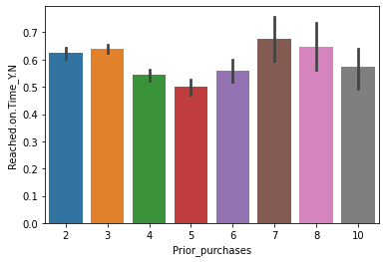
2. Data summary Relation between Prior purchases and Reached on time.

Slide 16
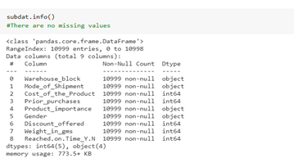
3. Data cleaning process
The data has no null value so we pass the cleaning process.

Slide 17

4. Methodology & Results
To answer the research question about which factor(s) significantly affect reach on-time:
Used Logistic Regression model
Reached on time as a dependent variable Y
Warehouse blocks, mode of shipment, cost of the product, prior purchases, product importance, gender, and weight in grams as independent variables X

Slide 18
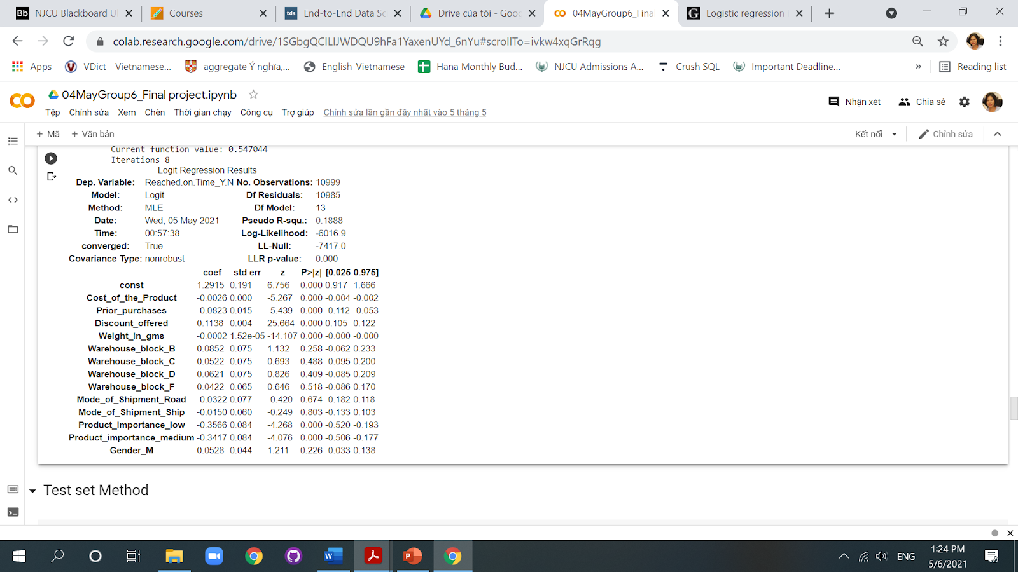
The outcome allows to estimate the parameters of the logistic regression model, the values of which are presented in table.
Notes:
This chart gives you the idea of the dataset based logistic regression model. This mentions the coef, z score, std error. z score ----negative value indicates it is below the mean. Lower z-score means closer to the meanwhile higher means more far away. The std error represents the average distance that the observed values fall from the regression line. Conveniently, it tells you how wrong the regression model is on average using the units of the response variable.
Coef-

Slide 19
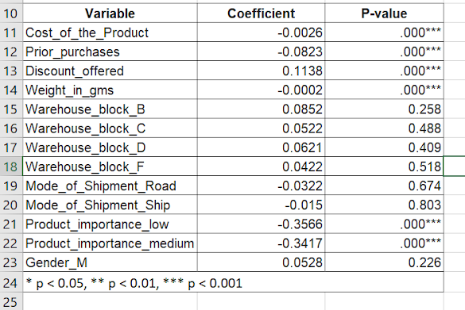

Slide 20
Parameters of the logistic regression model and their assessment:
+ Parameters turned out to be statistically significant:
Cost of the product
Prior purchase
Discount offered
Weight in gms
Product importance
+ Parameters didn’t turn out to be statistically significant:
Warehouse block
Mode of shipment
Gender

Slide 21
4. Methodology & Results
To answer the research question about how to use Machine Learning to predict whether a shipment will be delivered on-time or not
Apply the training/testing method with three models Logistic Regression, Decision Tree, and SVM
Pick the best model base on the accuracy score
Selected statistically significant variables to tie our model
Algorithms were trained and tested on the same training and test set so that we could compare their performance

Slide 22
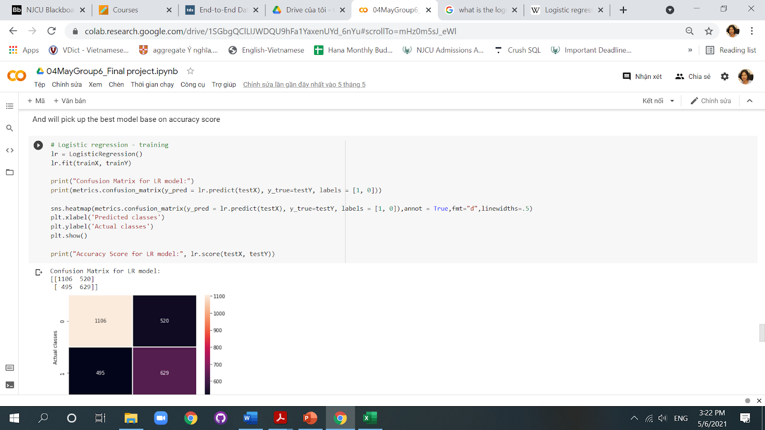
Apply Logistics regression model
Apply Logistics regression model
About logistic regression: Logistic regression is the appropriate regression analysis to conduct when the dependent variable is dichotomous (binary),
Logistic regression is used to describe data and to explain the relationship between one dependent binary variable and one or more nominal, ordinal, interval or ratio-level independent variables.
The code used to fit the model:

Slide 23
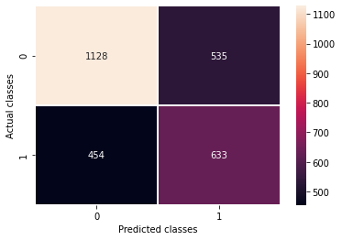
Apply Logistics regression model
Accuracy Score for LR model: 0.6403636363636364. The model makes 64% accuracy rate on testing dataset.

Slide 24
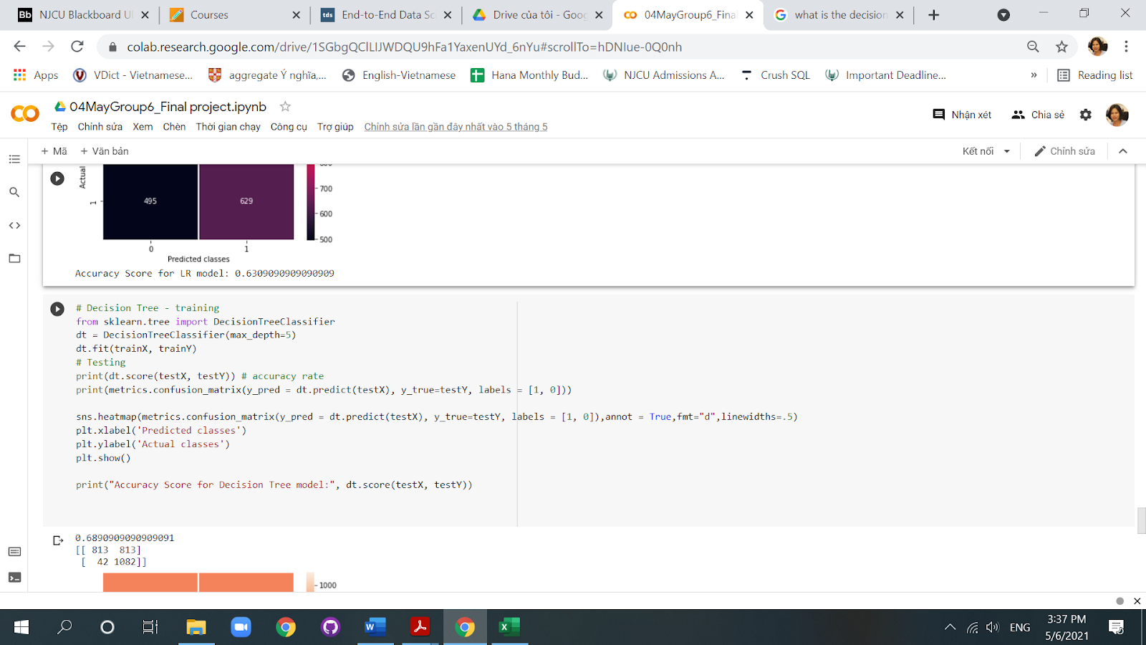
Apply Decision Tree model
A decision tree is a decision support tool that uses a tree-like model of decisions and their possible consequences including
Chance event outcomes
Resource costs
Utility
In our decision tree model, we have 5 classes with 6 input variables, and we use Reached on time as output variable. This is the code we use to fit the model.

Slide 25
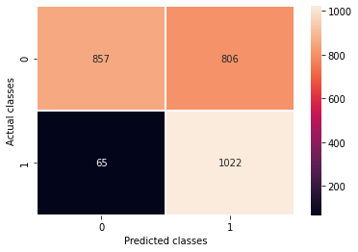
Accuracy Score for Decision Tree model: 0.6832727272727273

Slide 26
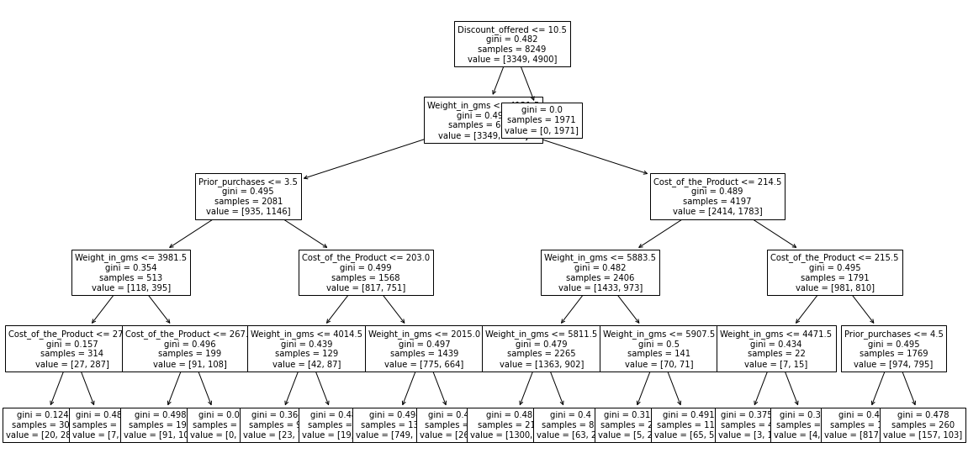
Plot of Decision Tree

Slide 27
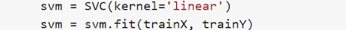
Apply SVM model
About SVM:
A support vector machine (SVM) is a supervised machine learning model that uses classification algorithms for two-group classification problems.
After giving an SVM model sets of labeled training data for each category, they’re able to categorize new text.
The code used to fit the model:

Slide 28
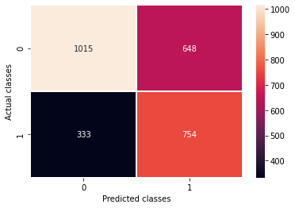
Accuracy Score for SVM model: 0.6432727272727272
The model makes 64% accuracy rate on testing dataset

Slide 29
5. Model selection
Model | Accuracy Score | Type I Error
Logistic Regression | 64% | 454
Decision Tree | 68% | 65
SVM | 64% | 333
Decision Tree model has the highest accuracy score and lowest type I error. We will choose this model to predict the on-time shipping on our dataset

Slide 30
6. Conclusion and future works
a. Results and Analysis:
Relationship between feature variables and target variable
Cost of the product, Prior purchases, Discount offered, Weight in grams and Product important function have significant influence on the model, specially Cost of the product and Prior purchases
Cost of the product has a negative influence on the prediction, higher cost of the product is correlated with a not on-time shipment, higher on cost of the product, less on not on-time shipment or heigher in on-time shipping

Slide 31
6. Conclusion and future works Results and Analysis
Predict on-time shipment:
Built the final prediction model with a Decision Tree algorithm as they result in the highest accuracy score (68%) and the least type I error (65), depending on the model segments.

Slide 32
6. Conclusion and future works
b. Limitations of our approach
It requires a lot of data in order to kick-start the analysis and modelling and the data should be at best great quality
A model demands analytics and coding skills
A project only supply a functioning tool, this means the company will have to work on the models in order to make them a part of their computing environment

Slide 33
6. Conclusion and future works
c. Potential future works
Limited our scope to electronic products but the same models developed for this purpose could be used for any products.
Insight of our study is that our approach could be applied to any shipping industry.
In the future, it would be worth investigating the possibility of including weather and customer's area patterns in the model as a way to improve its accuracy, if access to reliable data can be guaranteed.

Slide 34
7. Reference
Antoine Charles Jean Jonquais and Florian Krempl. “Predicting Shipping Time with Machine Learning.” The Program in Supply Chain management, May 10 2019.
Borucka, Anna. "Logistic regression in modeling and assessment of transport services." Open Engineering 10.1 (2020): 26-34.
Prachi Gopalani. “Product Shipment Delivered on time or not? To Meet E-Commerce Customer Demand.” https://www.kaggle.com/prachi13/customer-analytics, Feb 23 2021
Susan Li. “Building A Logistic Regression in Python, Step by Step.” https://towardsdatascience.com/building-a-logistic-regression-in-python-step-by-step-becd4d56c9c8, Sep 28, 2017.
De Gruyter. “Logistic regression in modeling and assessment of transport services”, Jan 31 2020.

Slide 35

Q&A

