Slide 1

STUDENT DROPOUT PREDICTION
FINC 530 Machine Learning for Business 1
Professor: J.D Jayaraman
Student: Thi Diem My Nguyen

Slide 2
Outline
1. Introduction
2. Data set and features
3. Exploratory Data Analysis - EDA
4. Data cleaning
5. Methodology and Results
6. Conclusion

Slide 3
1. Introduction
Dropping out of colleges is considered not just a serious educational problem but also a severe social problem. This project will aim to accurately predict the probability of a student dropping out from the college.
Measure prediction accuracy and analyze aspects of the students’ data so as to recognize the most important factors leading to high dropout rates. Implement several classification algorithms to find the best prediction model

Slide 4
2. Data set and features
The data was gathered from New Jersey City University undergraduate student from 2012 to 2017.
The data set contains three types of data:
Student Static Data: contains one record per student
Student Progress Data: reflecting each student’s activity for each term in each academic year
Student Financial Aid Data: each student for each academic year

Slide 5
2. Data set and features
Import and merge student static data: using rbind
StudentStaticData <- rbind(StaticFall2011,StaticFall2012,StaticFall2013,StaticFall2014,StaticFall2015,StaticFall2016,StaticSpring2012,StaticSpring2013,StaticSpring2014,StaticSpring2015,StaticSpring2016)

Slide 6
2. Data set and features
Import and merge student progress data: using rbind and group by
+ Import
+ Create a new column AcademicYearID
ProgressFall2011 <- mutate(ProgressFall2011, AcademicYearID = 1) ProgressSpring2012 <- mutate(ProgressSpring2012, AcademicYearID = 2)
…
ProgressSpring2017 <- mutate(ProgressSpring2017, AcademicYearID = 17) ProgressSum2017 <- mutate(ProgressSum2017, AcademicYearID = 18)
+ rbin
+ groupby by StudentID with the lastest AcademicYearID
ProgressData <- StudentProgressData1 %>% group_by(StudentID) %>% top_n(1, AcademicYearID)

Slide 7
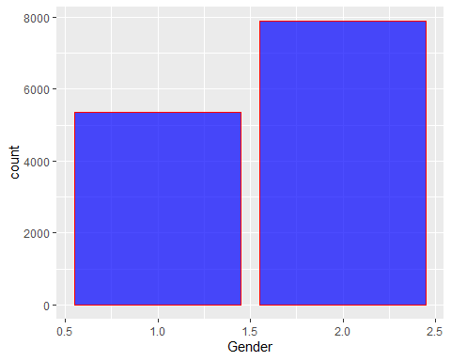
3. Exploratory Data Analysis - EDA
Student Static Data
summary(StudentStaticData)
Distribution of Gender, most students were female

Slide 8
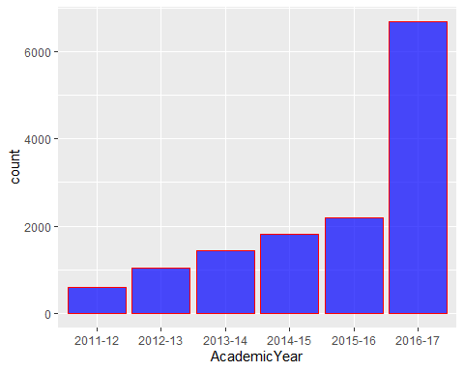
3. Exploratory Data Analysis - EDA
Student Progress Data
summary(StudentProgressData)
Distribution of Academic Year
most students were in the year 2016-2017

Slide 9
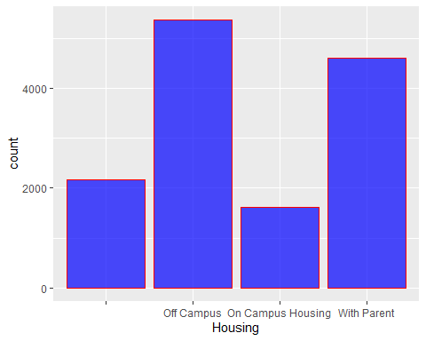
3. Exploratory Data Analysis - EDA
Student Financial Data
summary(FinancialAid)
Distribution of Housing
most students were living out of campus

Slide 10
4. Data cleaning
Data cleaning for Student Static Data
#Remove address columns because we won't use them for training and testing data: Address1, Address2, City, State, Zip, RegistrationDate #Remove columns because of missing most values: Campus, HSDipYr HSGPAWtd, FirstGen, DualHSSummerEnroll, CumLoanAtEntry, StudentStatic <- StudentStaticData[-c(4, 5, 6, 7, 8, 9, 10, 22, 24, 25, 26, 30)] #Replace value = -1 in Hispanic, AmericanIndian, Asian, Black, NativeHawaiian, White, TwoOrMoreRace = 0 StudentStatic["Hispanic"][StudentStatic["Hispanic"] == -1] <- 0 StudentStatic["AmericanIndian"][StudentStatic["AmericanIndian"] == -1] <- 0 StudentStatic["Asian"][StudentStatic["Asian"] == -1] <- 0 StudentStatic["Black"][StudentStatic["Black"] == -1] <- 0 StudentStatic["NativeHawaiian"][StudentStatic["NativeHawaiian"] == -1] <- 0 StudentStatic["White"][StudentStatic["White"] == -1] <- 0 StudentStatic["TwoOrMoreRace"][StudentStatic["TwoOrMoreRace"] == -1] <- 0

Slide 11
4. Data cleaning
Data cleaning for Financial Aid Data
# Most of students are single, so fill the empty values of Marital Status column with Single. FinancialAid["MaritalStatus"][FinancialAid["MaritalStatus"] == ""] <- "Single" # Most of students live Off campus, so fill the empty values of Housing column with Off Campus. FinancialAid["Housing"][FinancialAid["Housing"] == ""] <- "Off Campus" # Fill the empty values of parent's Highest Grade level with 'Unknown'. FinancialAid["FathersHighestGradeLevel"][FinancialAid["FathersHighestGradeLevel"] == ""] <- "Unknown" FinancialAid["MotherHighestGradeLevel"][FinancialAid["MotherHighestGradeLevel"] == ""] <- "Unknown" # Replace all other missing values by 0 FinancialAid <- na_replace(FinancialAid, 0)StudentStatic["TwoOrMoreRace"][StudentStatic["TwoOrMoreRace"] == -1] <- 0

Slide 12
5. Methodology and results
The data set was split in 75% train and 25% test, training the models using grid search and cross-validation on the training set and evaluating them on the test set.
library(caret) intrain <- createDataPartition(DataTrain$Dropout,p=0.75,list = FALSE)
train1 <- DataTrain[intrain,]
test1 <- DataTrain[-intrain,]
#Create cross validation trctrl <- trainControl(method = "cv", number = 5)

Slide 13
5. Methodology and results
Fit the classification tree model
model1 <- train(Dropout ~., data = train1, method = "rpart", trControl=trctrl) predictions1 <- predict(model1, newdata = test1) confusionMatrix(predictions1,test1$Dropout)
## Confusion Matrix and Statistics ## ## Reference ## Prediction 0 1 ## 0 1845 93 ## 1 36 1090 ## ## Accuracy : 0.9579 ## 95% CI : (0.9502, 0.9647) ## No Information Rate : 0.6139 ## P-Value [Acc > NIR] : < 2.2e-16 ##

Slide 14
5. Methodology and results
Fit the Logistic Regression Model
model2 <- train(Dropout ~., data = train1, method = "glm", trControl=trctrl) predictions2 <- predict(model2, newdata = test1) confusionMatrix(predictions2,test1$Dropout)
## Confusion Matrix and Statistics ## ## Reference ## Prediction 0 1 ## 0 1832 90 ## 1 49 1093 ## ## Accuracy : 0.9546 ## 95% CI : (0.9467, 0.9617) ## No Information Rate : 0.6139 ## P-Value [Acc > NIR] : < 2.2e-16 ##

Slide 15
5. Methodology and results
Fit the Bagging Model
model3 <- train(Dropout ~., data = train1, method = "treebag", trControl=trctrl) predictions3 <- predict(model3, newdata = test1) confusionMatrix(predictions3,test1$Dropout)
## Confusion Matrix and Statistics ## ## Reference ## Prediction 0 1 ## 0 1846 78 ## 1 35 1105 ## ## Accuracy : 0.9631 ## 95% CI : (0.9558, 0.9695) ## No Information Rate : 0.6139 ## P-Value [Acc > NIR] : < 2.2e-16 ##

Slide 16
5. Methodology and results
Fit the SVM Radial Model
model4 <- train(Dropout ~., data = train1, method = "svmRadial", trControl=trctrl) predictions4 <- predict(model4, newdata = test1) confusionMatrix(predictions4,test1$Dropout)
## Confusion Matrix and Statistics ## ## Reference ## Prediction 0 1 ## 0 1860 120 ## 1 21 1063 ## ## Accuracy : 0.954 ## 95% CI : (0.946, 0.9611) ## No Information Rate : 0.6139 ## P-Value [Acc > NIR] : < 2.2e-16 ##

Slide 17
5. Methodology and results
Stacking using Random Forest
# Construct data frame with predictions library(caret) predDF <- data.frame(predictions1, predictions2, predictions3, predictions4, class = test1$Dropout) predDF$class <- as.factor(predDF$class) #Combine models using random forest combModFit.rf <- train(class ~ ., method = "rf", data = predDF, distribution = 'multinomial') combPred.rf <- predict(combModFit.rf, predDF) confusionMatrix(combPred.rf, predDF$class)$overall[1]
## Accuracy ## 0.9631201

Slide 18
5. Methodology and results
Compare the accuracy of each model
The performance of the classifiers is assessed using the standard measure of accuracy.
Model Accuracy Score
Classification tree 95.79%
Logistic Regression 95.46%
Bagging 96.31%
SVM Radial 95.4%
Stacking with Random Forest 96.31%

Slide 19
6. Conclusion
These models achieves high predictive power with accuracy score over 96%.
The result was that the Bagging and Stacking with Random Forest performed the best, followed by the Classification Tree, Logistic Regression and SVM.
Some improvements that can be made to the experiment include a more advanced solution dealing with missing values rather than replacing missing values to 0 or the majority value.
Demands analytics and coding skills.

Slide 20
Issues
Data wrangling: spent more than 80% time.
Storage memories:
+ Increase memory size:
memory.size()
memory.limit()
memory.limit(size=500000)
+ Remove unused data
Rm() and gc()
Taking time to run the code:
Using R Markdown instead of R Studio

Slide 21

Question and Answer

