Slide 1
Course Management System
Lecturer : Đặng minh thắng
Implementers : lê Tiến thịnh -51600082
Lê NGUYỄN THIỆN tín -51600090

Slide 2
### Course Management :
Add, remove, manage courses in data warehouse
Statistics courses available
Information management and account security of customers

Slide 3
### Functions of System :
Log in or register as a member
View cart information, course
Personality information management, course management
Purchase, receive and process orders

Slide 4
### The object joins the system :
1 / Customer: is the person who purchases directly from the system or via website. Customers can feedback on system management if any errors occur.
2 / Administration: Work online on website. The person who receives and processes the course for the customer. As well as people who knows the situation of sales and purchase of the system, customer management

Slide 5
### Identify the USE CASE :
1/ Customer :
- Registration
- Log in/ out
- View courses
- View cart
- Purchase courses
- Add, remove courses in cart
2/ Administration :
- Log in/ out
- Course management
- Customer management
- Course management of customer
- Proccess order

Slide 6
### Customer UC specification:
Author: Customer
Description: UC allows customers to manage the products they need to purchase and information on the sales system
Event :
- View products
- Log in
- Add product to cart
- Add or remove products and quantities in the cart
- Buy and pay

Slide 7
### Commodity UC Specification:
Agent: Management
Description: Product statistics and customer information management
Event :
- Log in
- Inventory of products that are in and out of stock
- Manage information of members
-UC ended

Slide 8
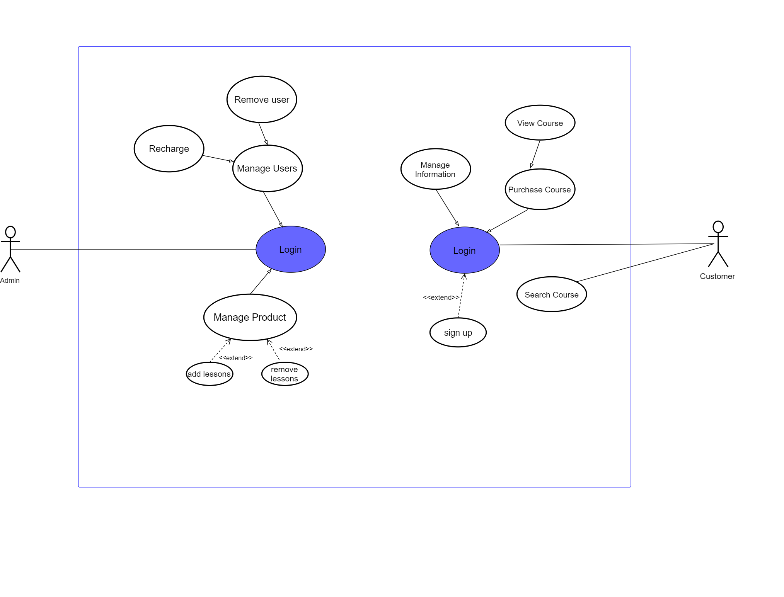
Build Use case diagram

Slide 9
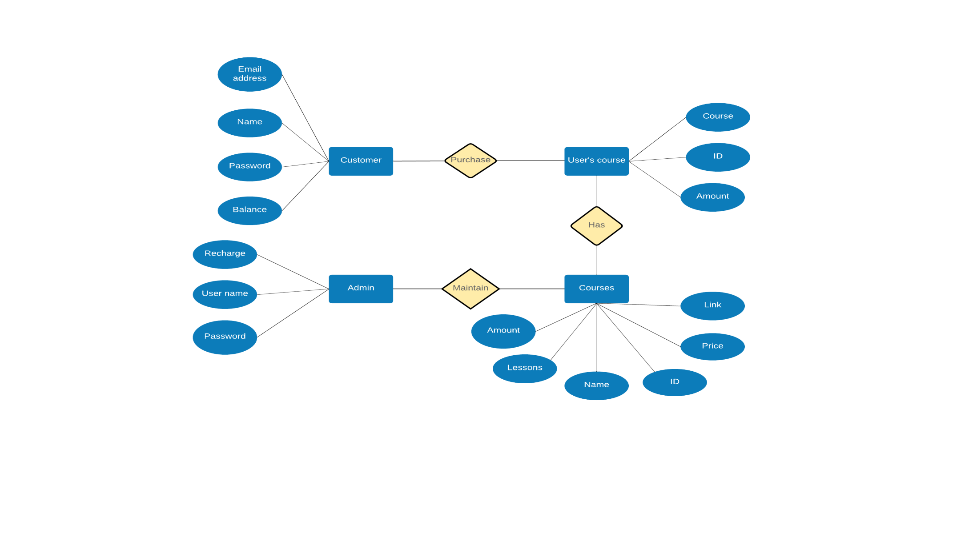
###Entity relational diagram

Slide 10
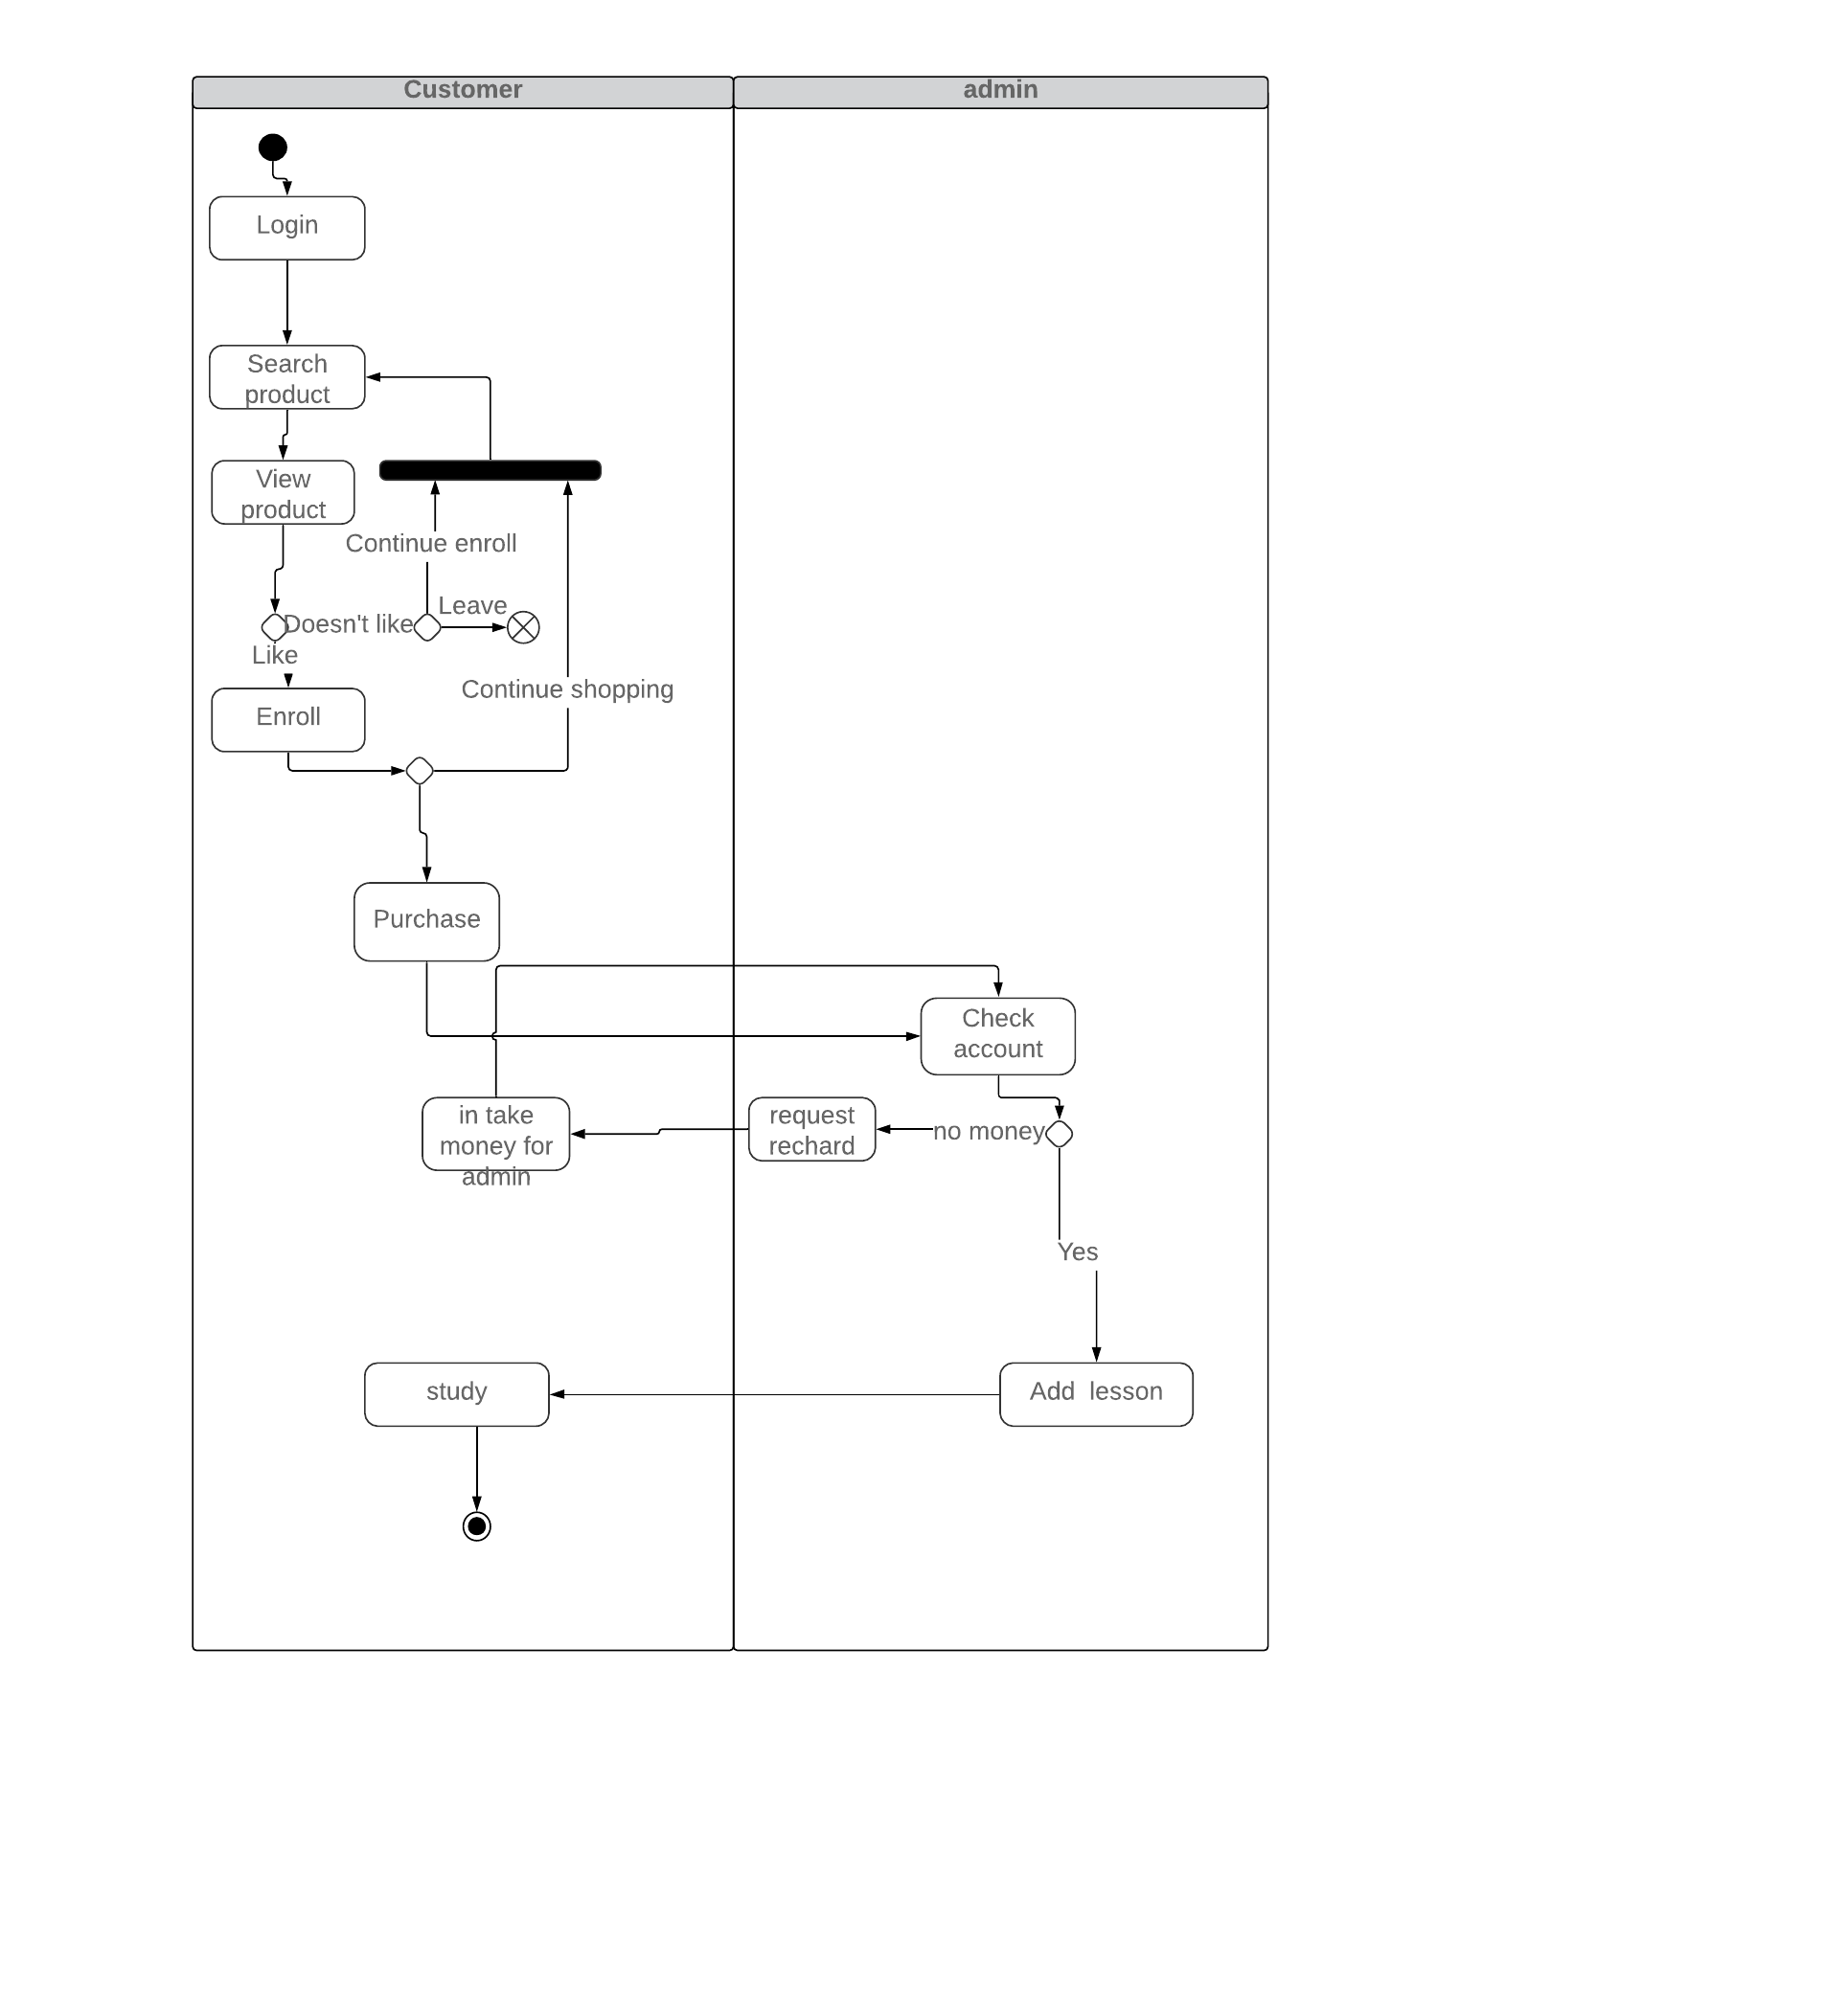
### Activity diagram of system :

Slide 11
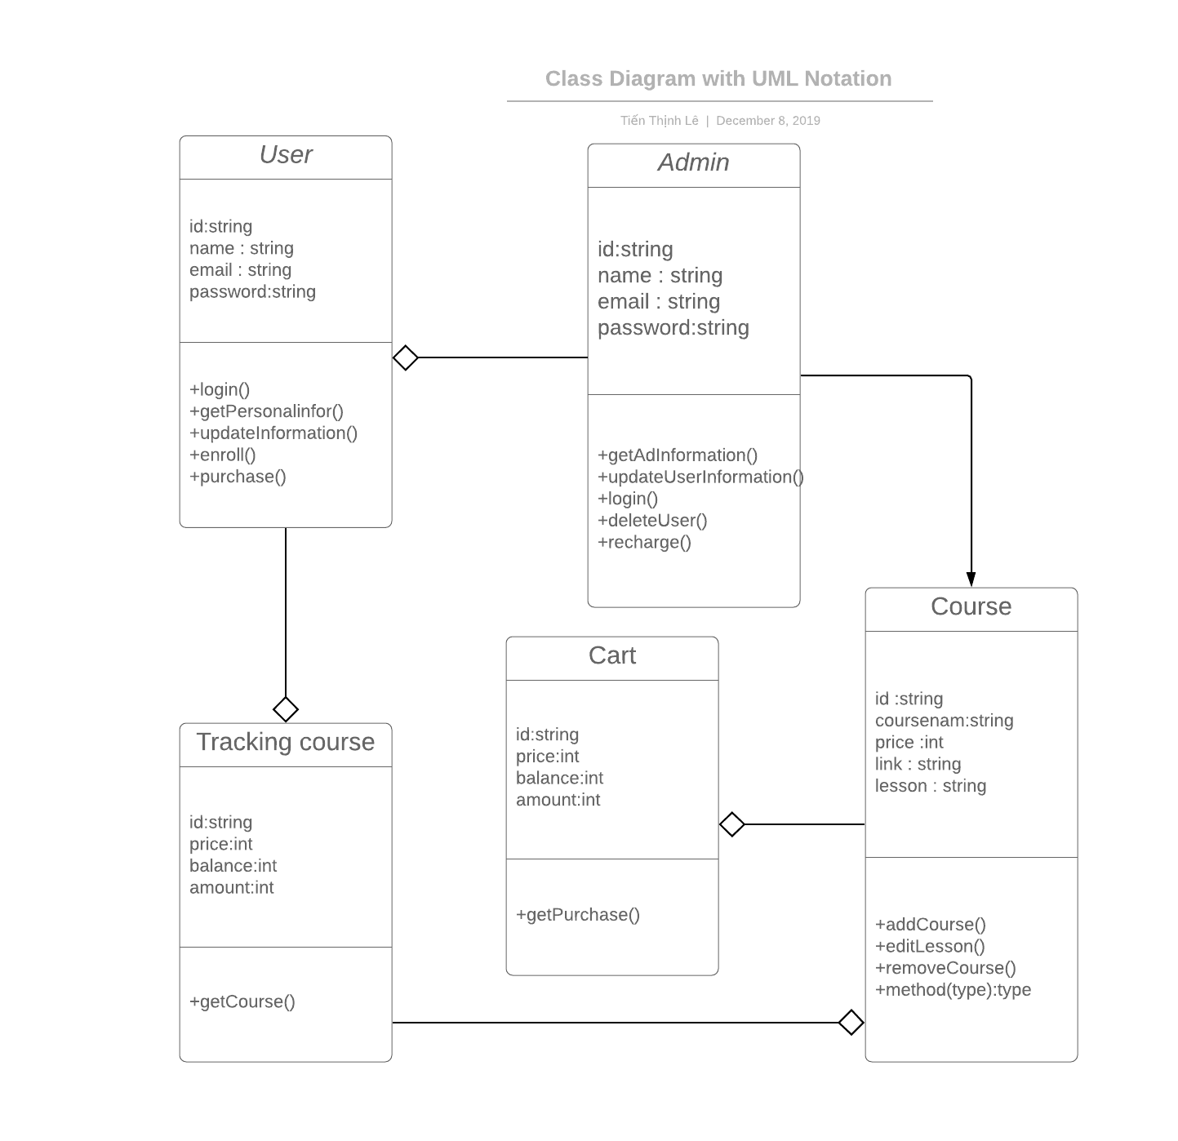
###Class Diagram :

Slide 12
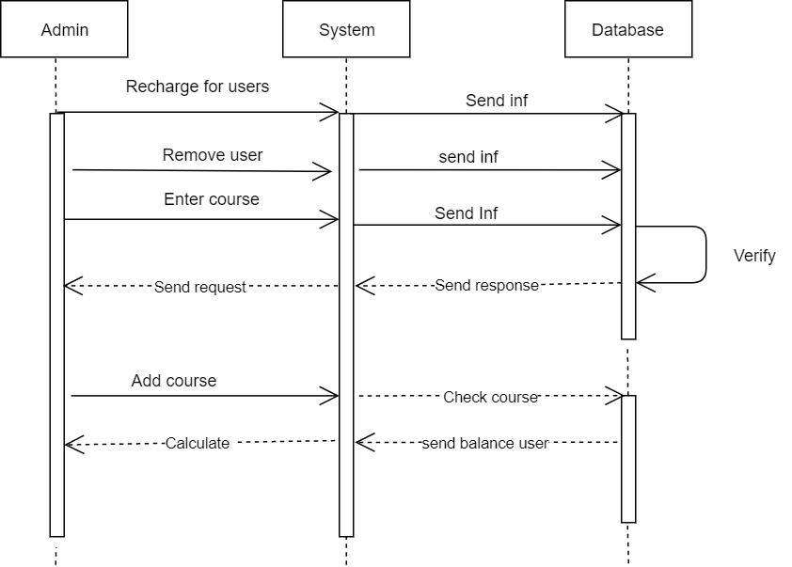
### Sequence diagram of system :

Slide 13
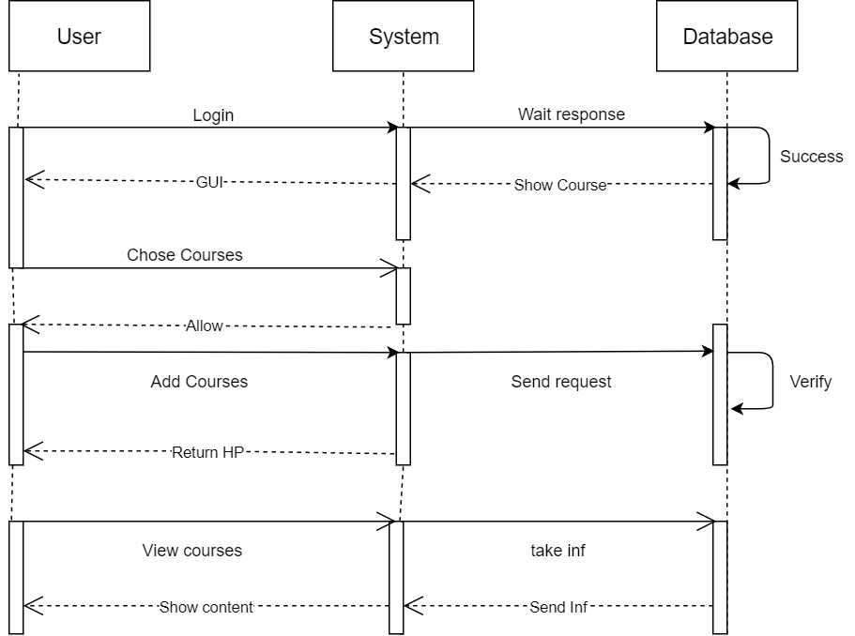
### Sequence diagram of system :

Slide 14
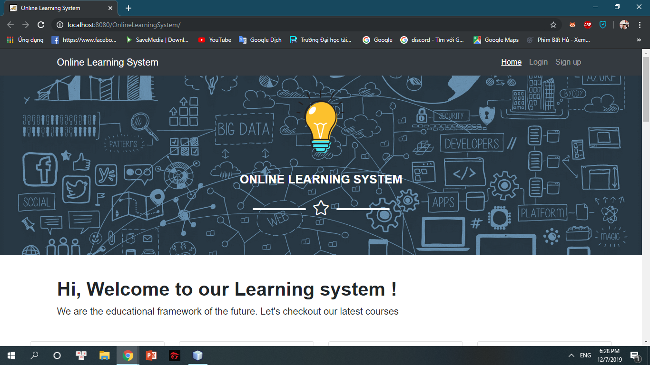
Demo
Inteface

Slide 15
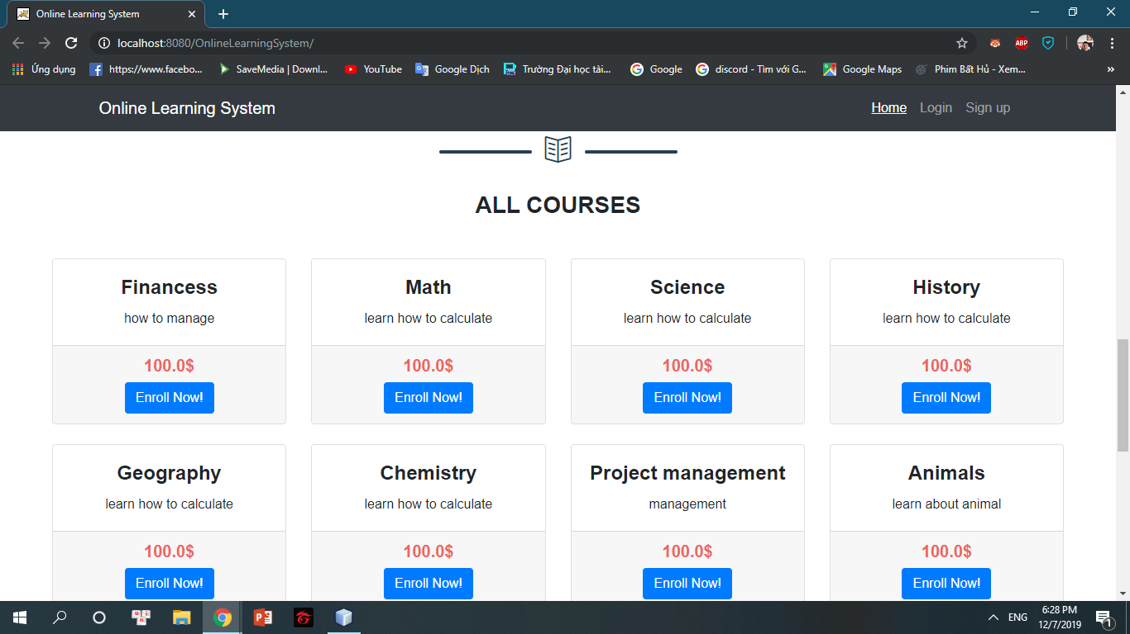
Demo

Slide 16
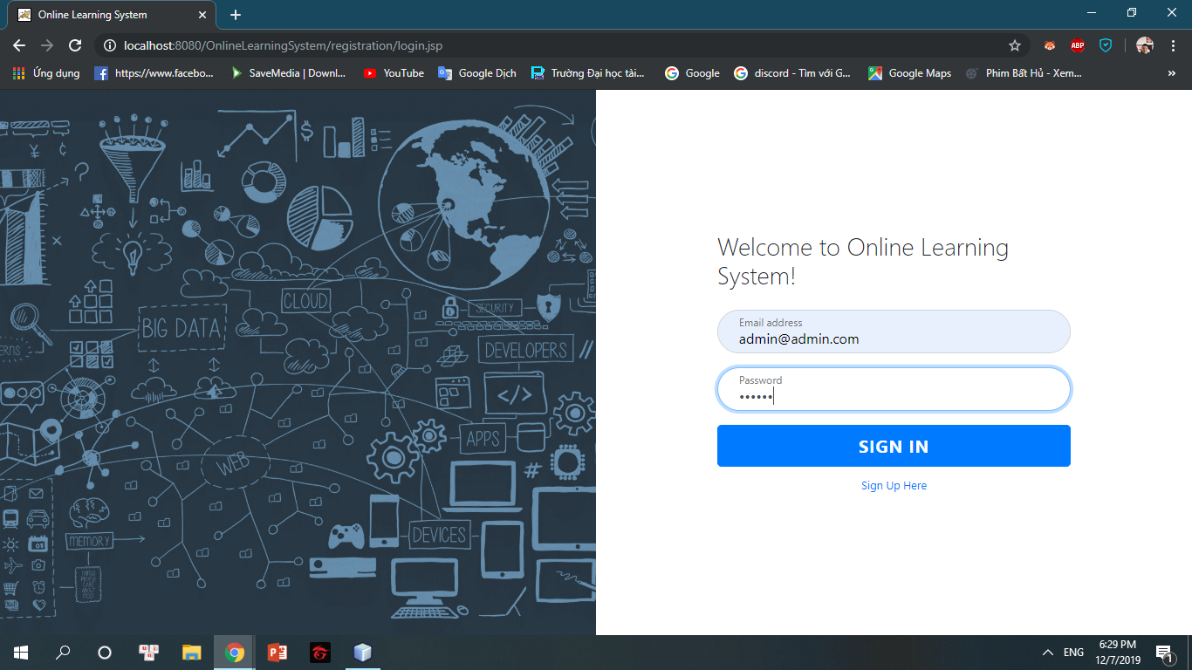
Demo
Log in

Slide 17
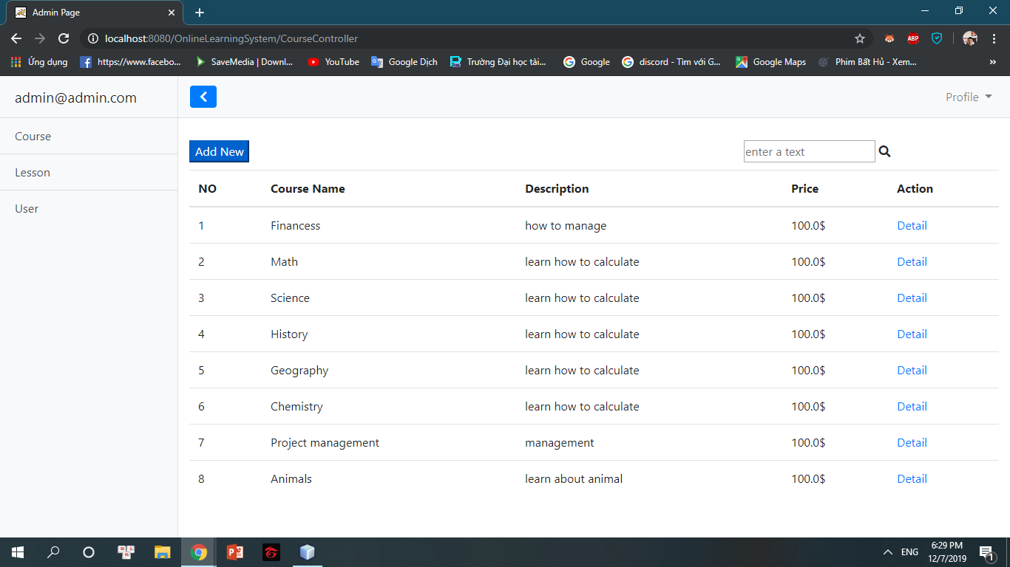
Demo

Slide 18
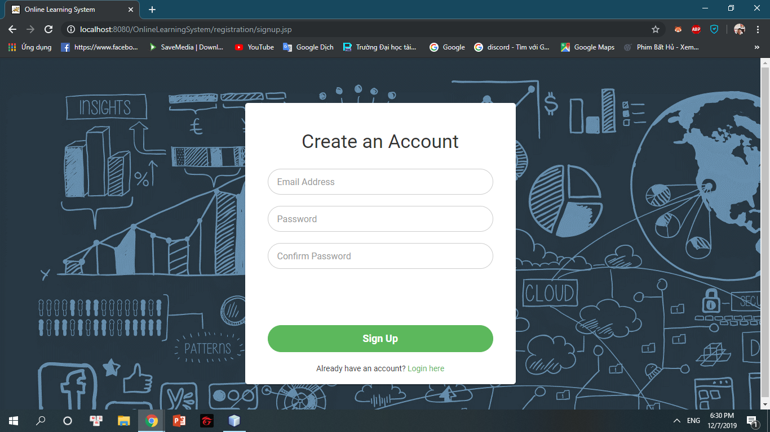
Demo
Sign up

Slide 19
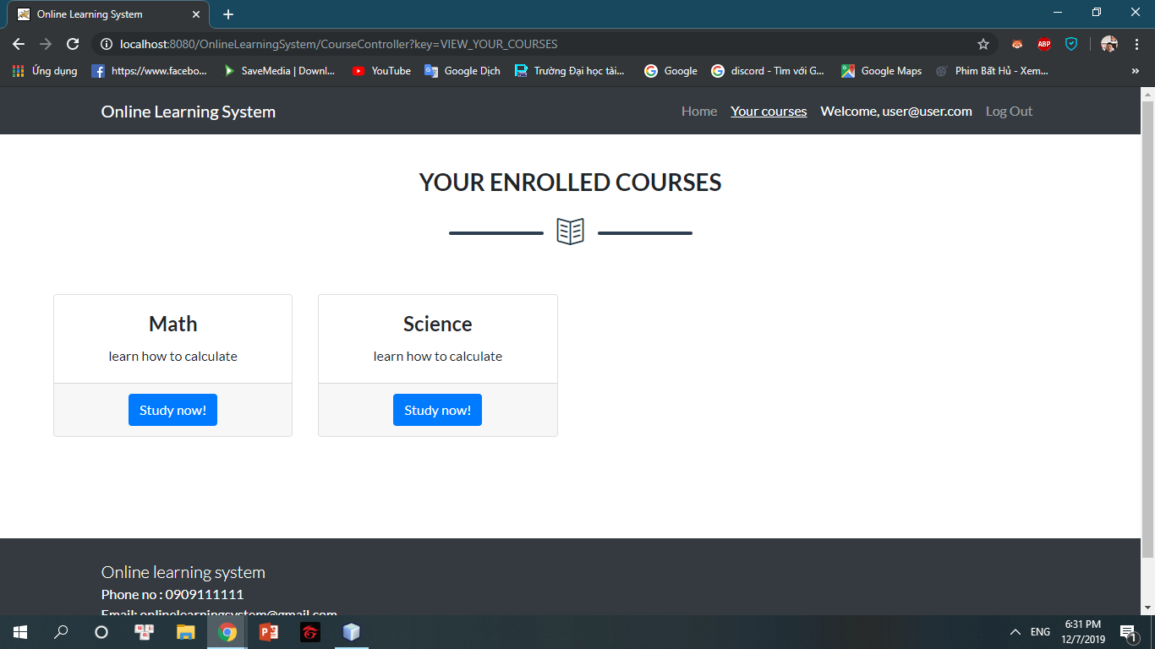
Demo
Course card

Slide 20
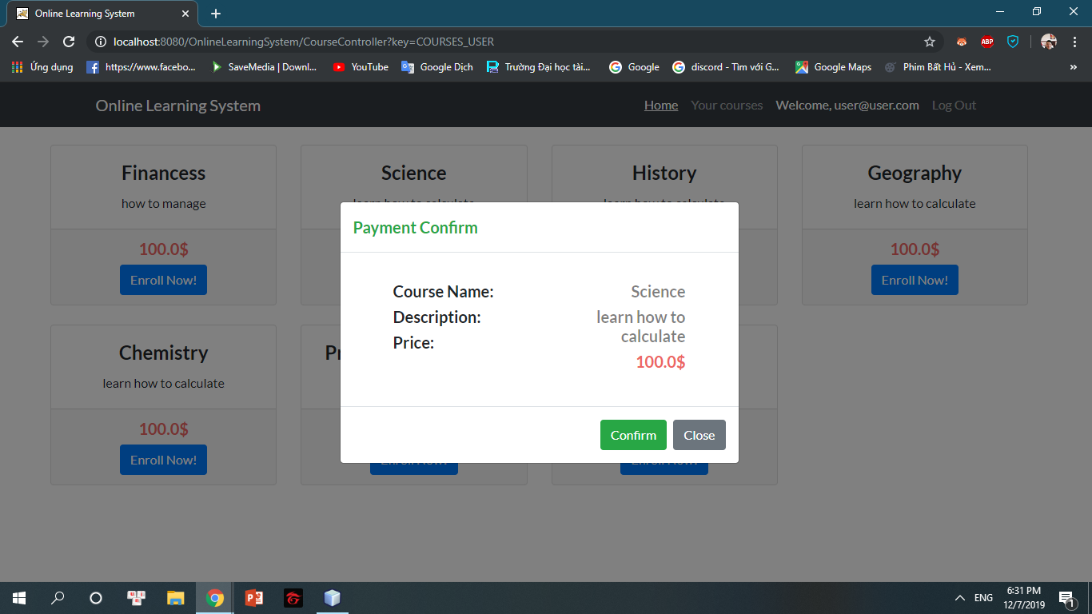
Demo
Purchase

