Slide 2
Version to download
Chọn bản web edition

Slide 3
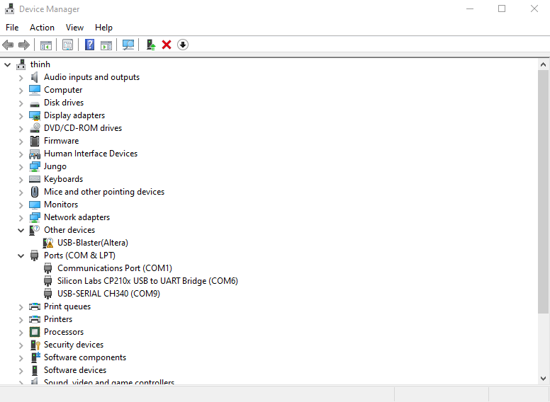
Install driver
Driver error!

Slide 4
Install driver
Driver error!

Slide 5
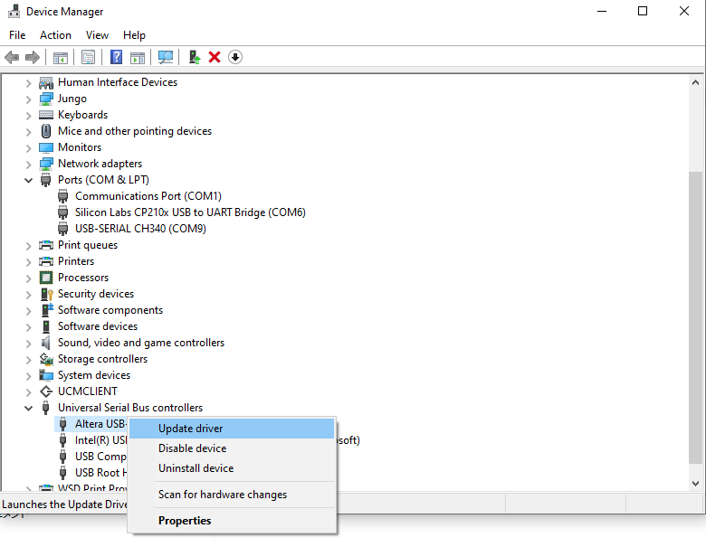
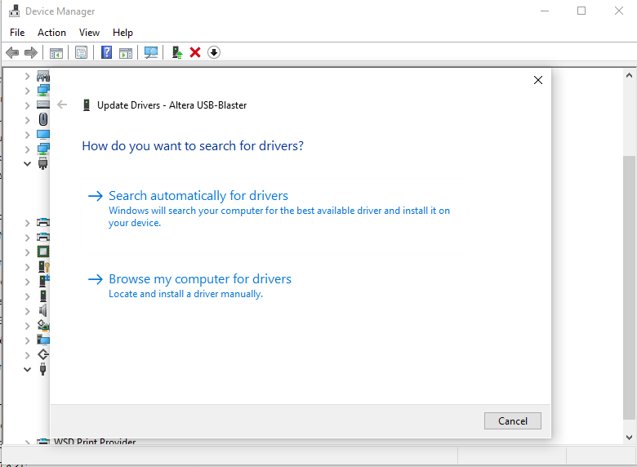
Update driver
Step 1: Left click to Driver error, then click to Update driver
Step 2: select to here

Slide 6
Update driver
Step 1: Left click to Driver error, then click to Update driver
Step 2: select to here

Slide 7
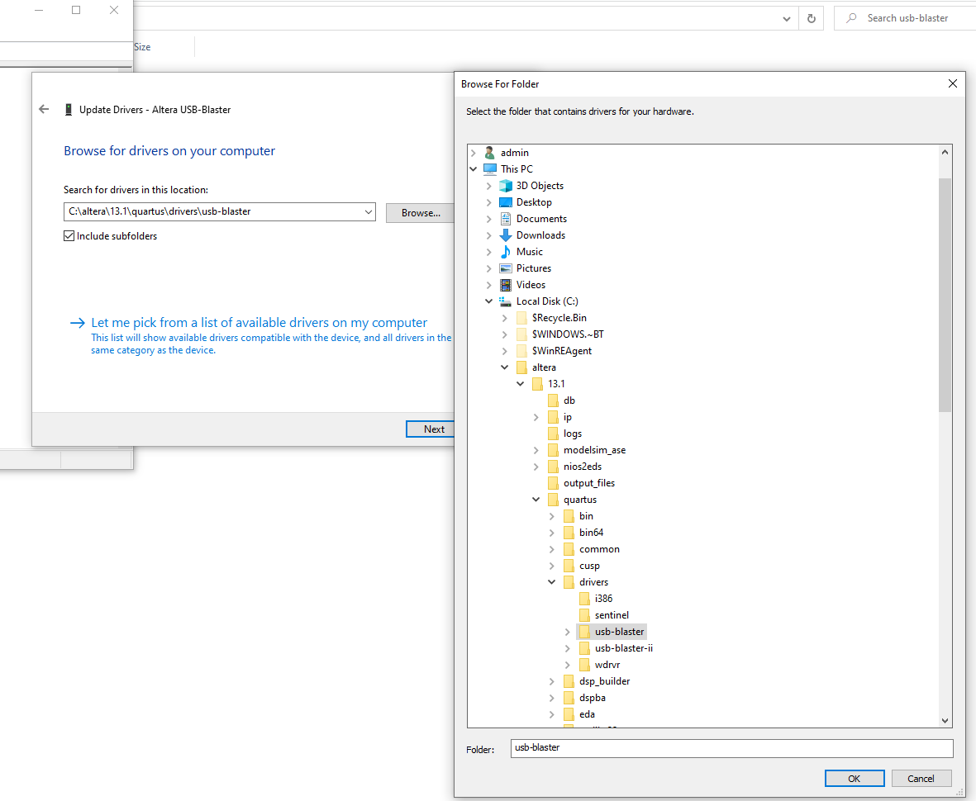
Update driver
Step 4: Find the install folder project -> click to USB-blaster Folder
Step 3: Click to “Browse”
Step 5: Click OK

Slide 8
Ref
https://community.intel.com/t5/Programmable-Devices/Windows-10-driver-support-for-USB-Blaster/m-p/1276720

Slide 9
Create first project

Slide 11
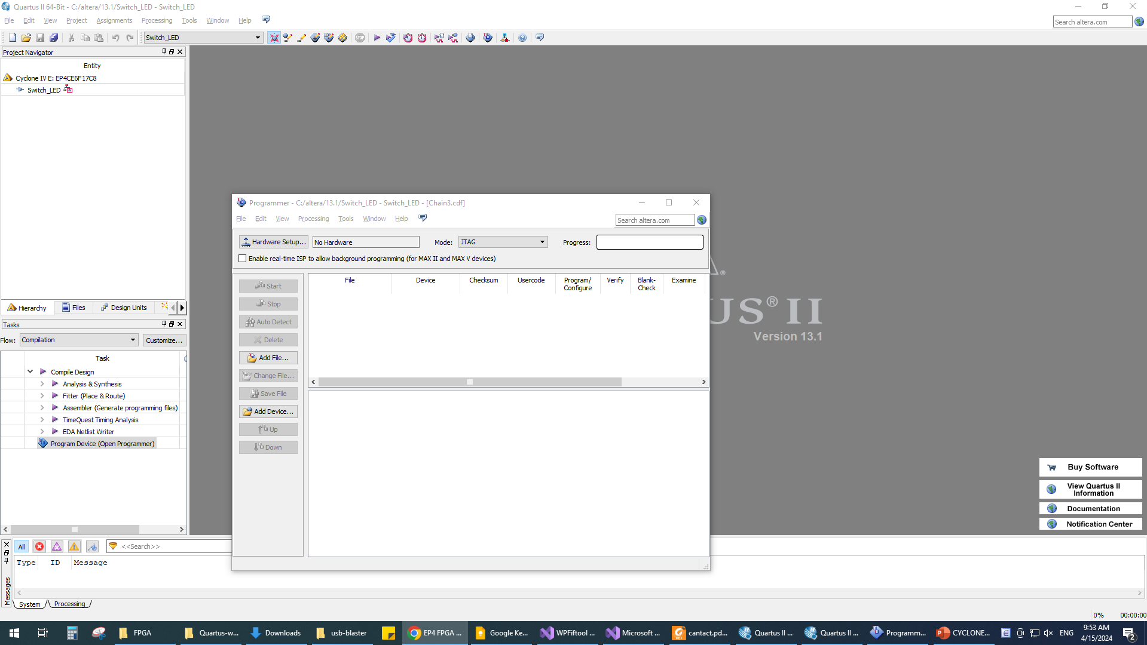

Slide 12
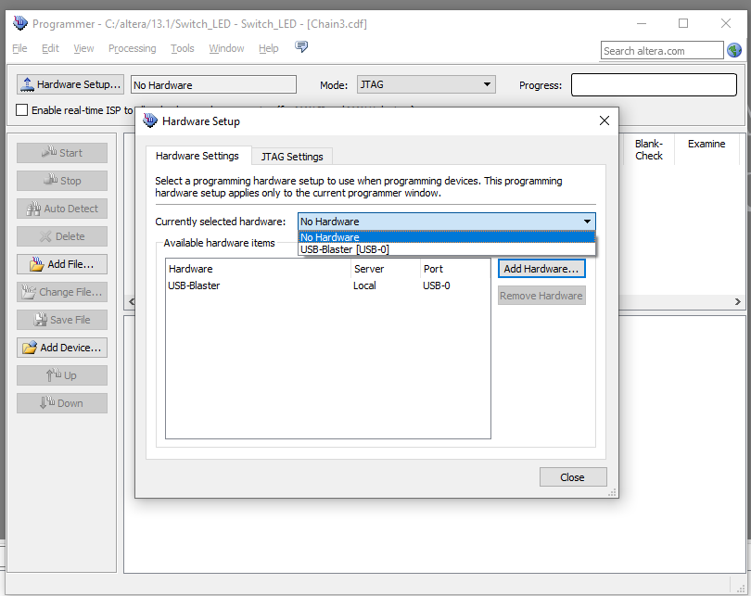

Slide 13
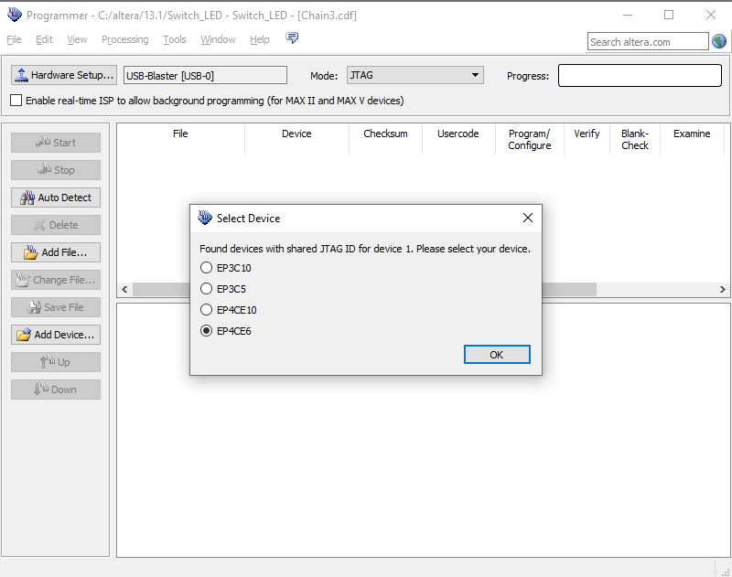

Slide 14
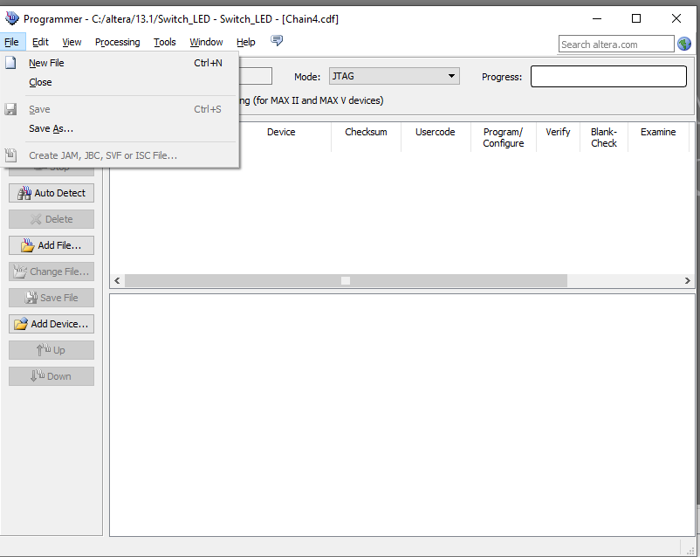

Slide 15
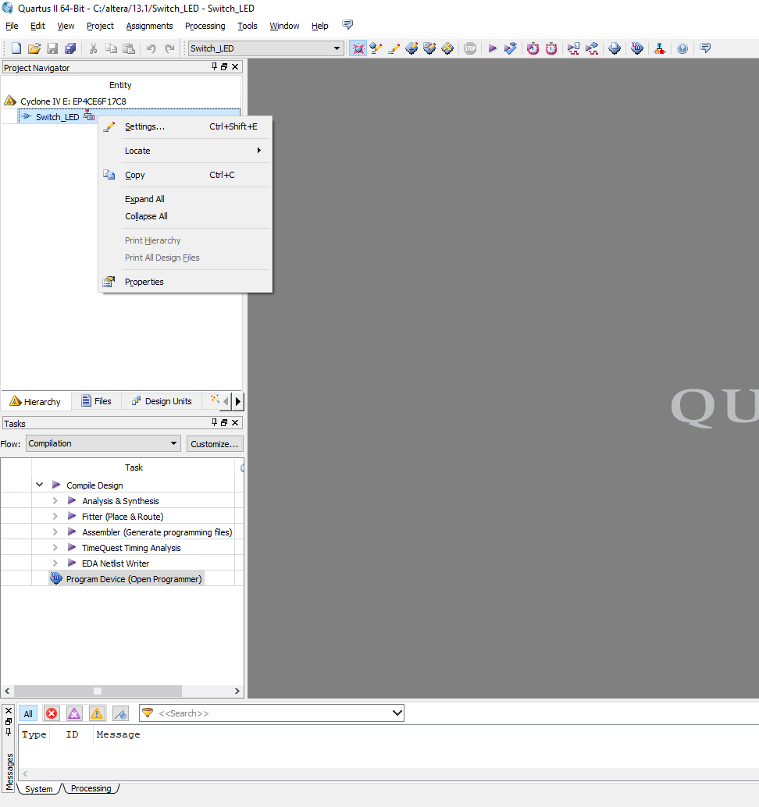
Left click!
Select Setting

Slide 16
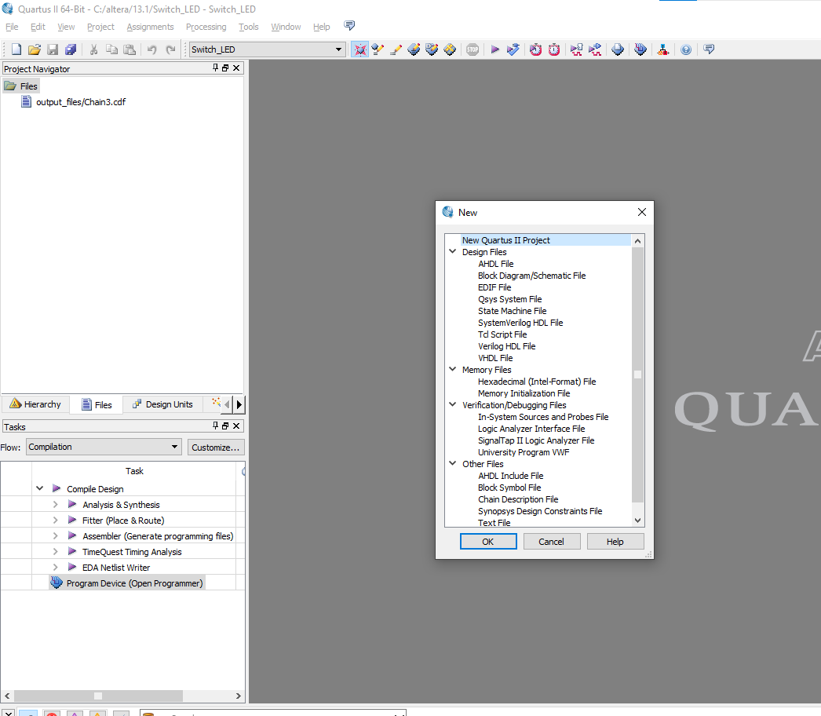

Slide 17
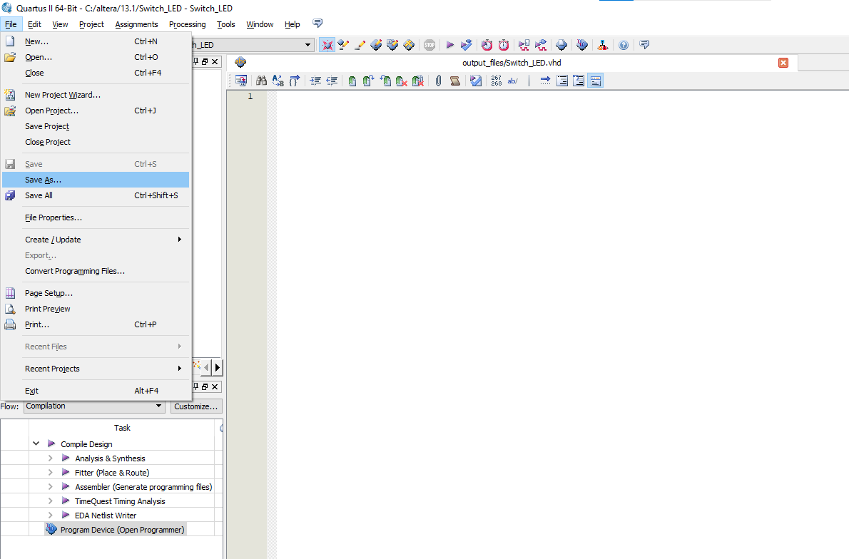

Slide 18
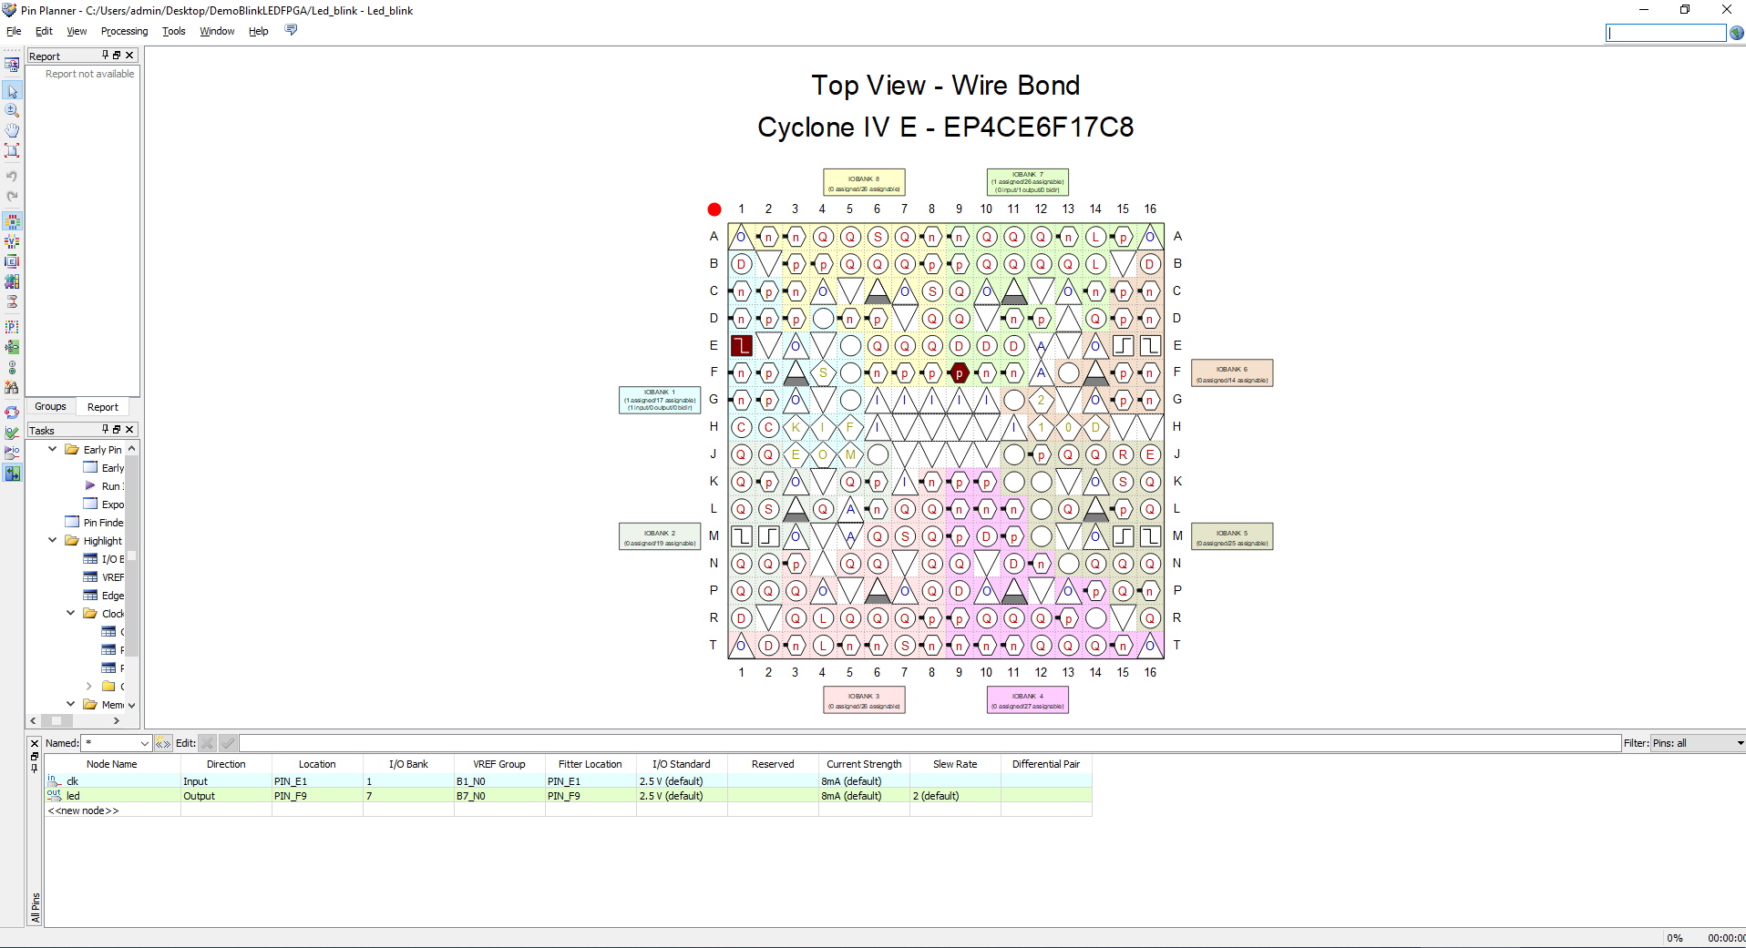
This pin is input clock

Slide 19
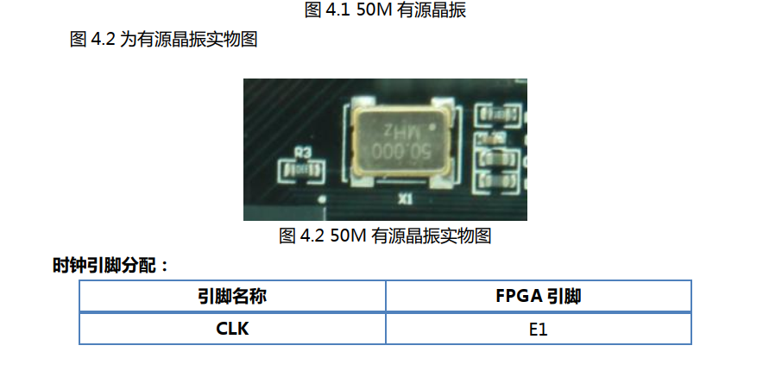
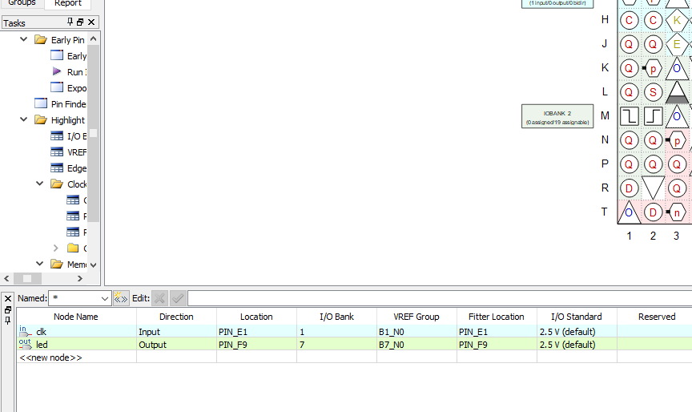
Blink LED
REF: https://www.youtube.com/watch?v=JJ3XkNcLdx8
Note:

