Slide 1
CHUYỂN ĐỔI SỐ HỆ 2 SANG HỆ 10

Slide 2





Yêu cầu
$$10011101$$
$$(2)$$
$$=$$
$$?$$
$$(10)$$

Slide 3

























Quy tắc 1: Lập bảng chia khoảng 2^{i}
$$2048$$
$$1024$$
$$512$$
$$256$$
$$128$$
$$64$$
$$…$$
$$2^{11}$$
$$2^{10}$$
$$2^{9}$$
$$2^{8}$$
$$2^{7}$$
$$2^{6}$$
$$32$$
$$16$$
$$2^{5}$$
$$2^{4}$$
$$2^{3}$$
$$2^{2}$$
$$2^{1}$$
$$2^{0}$$
$$8$$
$$4$$
$$2$$
$$1$$

Slide 4

































Quy tắc 1: Lập bảng chia khoảng 2^{i}
$$1$$
$$0$$
$$0$$
$$1$$
$$1$$
$$1$$
$$0$$
$$1$$
$$(2)$$
$$…$$
$$2^{11}$$
$$2^{10}$$
$$2^{9}$$
$$2^{8}$$
$$2^{7}$$
$$2^{6}$$
$$2^{5}$$
$$2^{4}$$
$$2^{3}$$
$$2^{2}$$
$$2^{1}$$
$$2^{0}$$
$$0$$
$$0$$
$$0$$
$$0$$
$$1$$
$$0$$
$$0$$
$$1$$
$$1$$
$$1$$
$$0$$
$$1$$

Slide 5

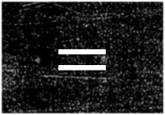

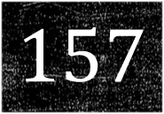


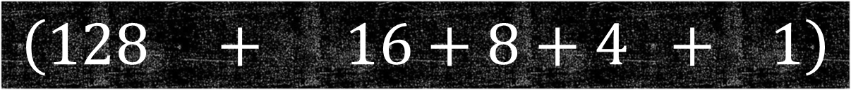




Quy tắc 2: Cộng các giá trị 2^{i}(khác bit 0)
$$157$$
$$=$$
$$\left(128 + 16+8+4 + 1\right)$$
$$128$$
$$16$$
$$8$$
$$4$$
$$1$$
$$…$$
$$2^{11}$$
$$2^{10}$$
$$2^{9}$$
$$2^{8}$$
$$2^{7}$$
$$2^{6}$$
$$2^{5}$$
$$2^{4}$$
$$2^{3}$$
$$2^{2}$$
$$2^{1}$$
$$2^{0}$$
$$0$$
$$0$$
$$0$$
$$0$$
$$1$$
$$0$$
$$0$$
$$1$$
$$1$$
$$1$$
$$0$$
$$1$$

Slide 6




Kết quả
$$10011101$$
$$(2)$$
$$157$$
$$(10)$$

