Slide 1
CHUYỂN ĐỔI SỐ HỆ 10 SANG HỆ 2
ĐỐI VỚI DẠNG SỐ NGUYÊN KHÔNG DẤU
1 3 8 258 517 ….

Slide 2

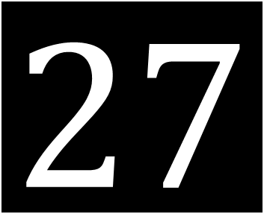
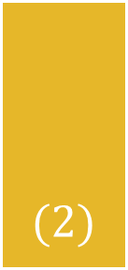


Yêu cầu
$$27$$
$$(10)$$
$$=$$
$$?$$
$$(2)$$

Slide 3













Quy tắc 1: Lập bảng chia khoảng 2^{i}
$$2^{0}=1$$
$$2^{1}=2$$
$$2^{2}=4$$
$$2^{3}=8$$
$$2^{4}=16$$
$$2^{5}=32$$
$$2^{6}=64$$
$$2^{7}=128$$
$$2^{8}=256$$
$$2^{9}=512$$
$$2^{10}=1024$$
$$2^{11}=2048$$
$$…$$

Slide 4

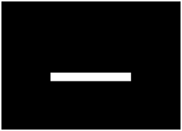






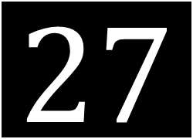
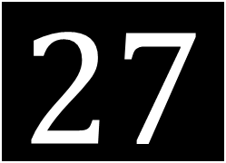

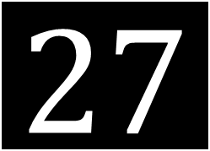

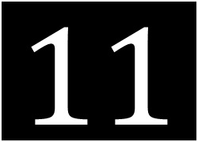

















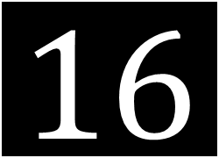




Quy tắc 2: Giảm dần số hệ 10 với 2^{i}
$$1024$$
$$27$$
$$−$$
$$128$$
$$=$$
$$!@\#$$
$$!@\#$$
$$!@\#$$
$$!@\#$$
$$27$$
$$!@\#$$
$$27$$
$$−$$
$$−$$
$$1024$$
$$512$$
$$=$$
$$27$$
$$=$$
$$27$$
$$−$$
$$−$$
$$32$$
$$64$$
$$=$$
$$=$$
$$512$$
$$128$$
$$64$$
$$32$$
$$16$$
$$27$$
$$−$$
$$16$$
$$=$$
$$11$$
$$8$$
$$4$$
$$2$$
$$1$$

Slide 5

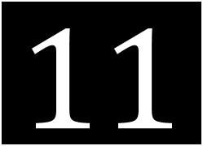
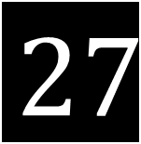




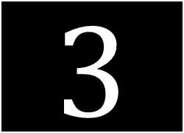


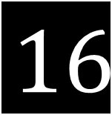



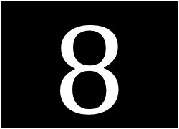





Quy tắc 2: Giảm dần số hệ 10 với 2^{i}
$$1024$$
$$27$$
$$−$$
$$16$$
=
$$11$$
$$11$$
$$512$$
$$128$$
$$64$$
$$32$$
$$16$$
$$11$$
$$−$$
$$8$$
$$=$$
$$3$$
$$8$$
$$4$$
$$2$$
$$1$$

Slide 6


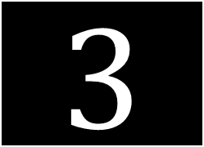
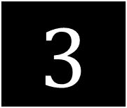




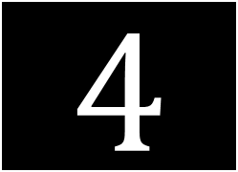

Quy tắc 2: Giảm dần số hệ 10 với 2^{i}
$$1024$$
$$27$$
$$−$$
$$16$$
=
$$11$$
$$512$$
$$11$$
$$−$$
$$8$$
=
$$3$$
$$128$$
$$3$$
$$64$$
$$32$$
$$16$$
$$8$$
$$3$$
$$−$$
$$4$$
$$=$$
$$!@\#$$
$$4$$
$$2$$
$$1$$

Slide 7



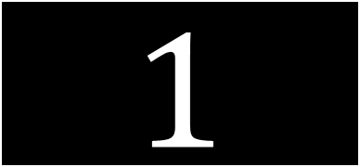

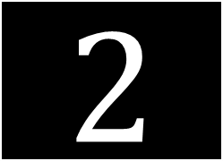
Quy tắc 2: Giảm dần số hệ 10 với 2^{i}
$$1024$$
$$27$$
$$−$$
$$16$$
=
$$11$$
$$512$$
$$11$$
$$−$$
$$8$$
=
$$3$$
$$128$$
$$3$$
$$64$$
$$32$$
$$16$$
$$8$$
$$4$$
$$3$$
$$−$$
$$2$$
$$=$$
$$1$$
$$2$$
$$1$$

Slide 8


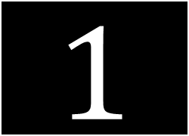
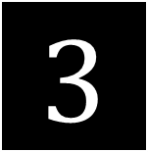

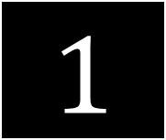

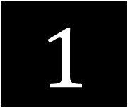


Quy tắc 2: Giảm dần số hệ 10 với 2^{i}
$$1024$$
$$27$$
$$−$$
$$16$$
=
$$11$$
$$512$$
$$128$$
$$11$$
$$−$$
$$8$$
=
$$3$$
$$64$$
$$3$$
$$−$$
$$2$$
=
$$1$$
$$1$$
$$32$$
$$16$$
$$8$$
$$4$$
$$2$$
$$1$$
$$−$$
$$1$$
$$=$$
$$0$$
$$1$$

Slide 9
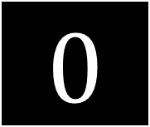

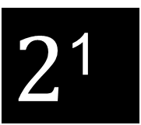

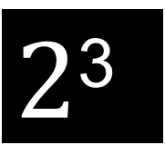
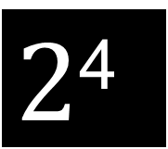
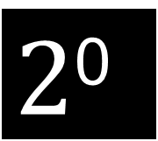
Quy tắc 2: Giảm dần số hệ 10 với 2^{i}
$$1024$$
$$27$$
$$−$$
$$16$$
=
$$11$$
$2$⁴
$$512$$
$$128$$
$$11$$
$$−$$
$$8$$
=
$$3$$
$2$³
$$64$$
$$3$$
$$−$$
$$2$$
=
$$1$$
$2$¹
$$32$$
$$16$$
$$1$$
$$−$$
$$1$$
=
$$0$$
$2$⁰
$$8$$
$$4$$
$$2$$
$$1$$

Slide 10
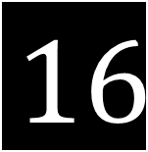
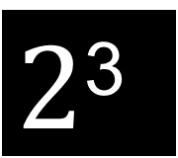

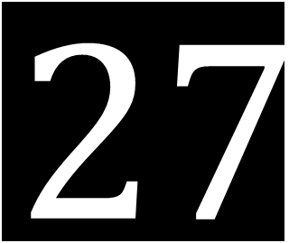

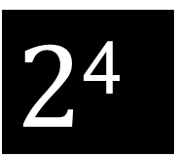


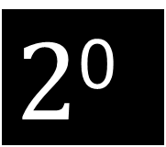



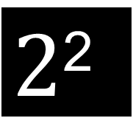
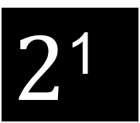


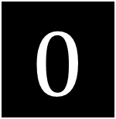
Quy tắc 2: Giảm dần số hệ 10 với 2^{i}
$$1024$$
$$27$$
$$(10)$$
$$=$$
$$16$$
+
$$8$$
+
$$2$$
+
$$1$$
$$512$$
$$128$$
$$64$$
$$32$$
$2$⁴
$2$³
$2$²
$2$¹
$2$⁰
$$16$$
$$8$$
Thứ tự bit
4 | 3 | 2 | 1 | 0
$$4$$
$$1$$
$$1$$
$$0$$
$$1$$
$$1$$
$$2$$
$$1$$

Slide 11


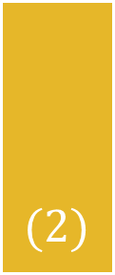
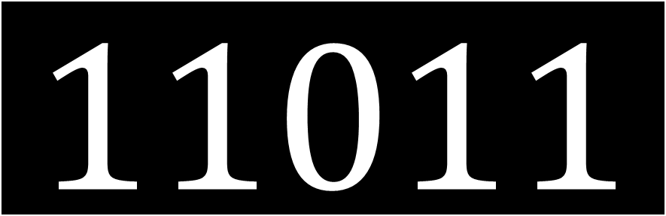

Kết quả
$$27$$
$$(10)$$
$$=$$
$$11011$$
$$(2)$$
Bit cuối (2⁰) = 1, mang ý nghĩa số thập phân cần đổi là số lẻ

