Slide 1
WEBGIS SYSTEM BASED ON JAVASCRIPT AND ARCGIS SERVER
HỘI THẢO KHOA HỌC
BỘ MÔN KỸ THUẬT PHẦN MỀM
Nha Trang, 08/2020

Slide 2
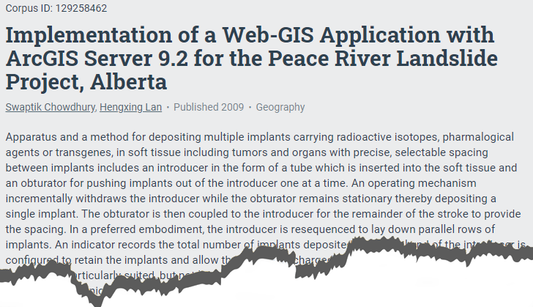


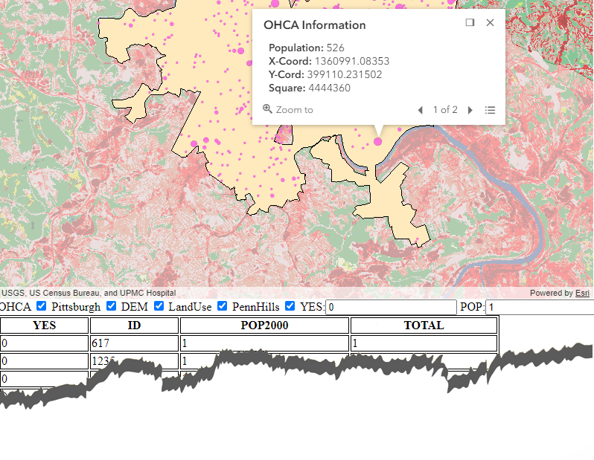
overview
A WebGIS is designed with tools and features that are common on Web
WebGIS are rapidly applied in Tourism, Biodiversity, Space Programing(NASA)
Using ArcGIS Desktop and Server, HTML, JavaScripts API for ArcGIS Server
Data set was collected from GIS workbook (Esri, Press 2011), spatial data of 4 layers (OHCA, DEM, Pittsburgh, and LandUse).
Simple functions such as Navigate, Zoom, Widget, Popups also impement

Slide 3
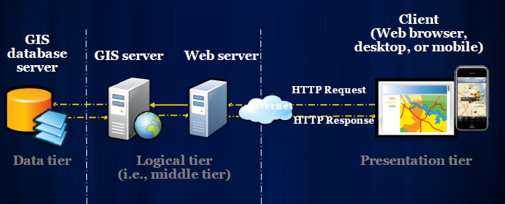
INTRODUCTION
A GIS is a computer-based system for managing, storing, querying, analysing, model-ling and displaying map database information. When GIS data and functionality are avail-able on the Internet, the system is referred to as WebGIS.
First, generate the data to be published.
Then, upload the data into a map server.
Finally, build the web interface to display the data for users.
Fu, P. (2011). Web GIS: Principle and Applications. US: ESRI Express

Slide 4
INTRODUCTION
Within the Esri platform you will need to use JavaScript to create stunning web mapping applications in the ArcGIS API for JavaScript
Asynchronuos Module Definition (AMD);
Maps, layers, and views;
Accessors; Collections; Promises;
Widgets and the UI;
Web scenes and local scenses

Slide 5
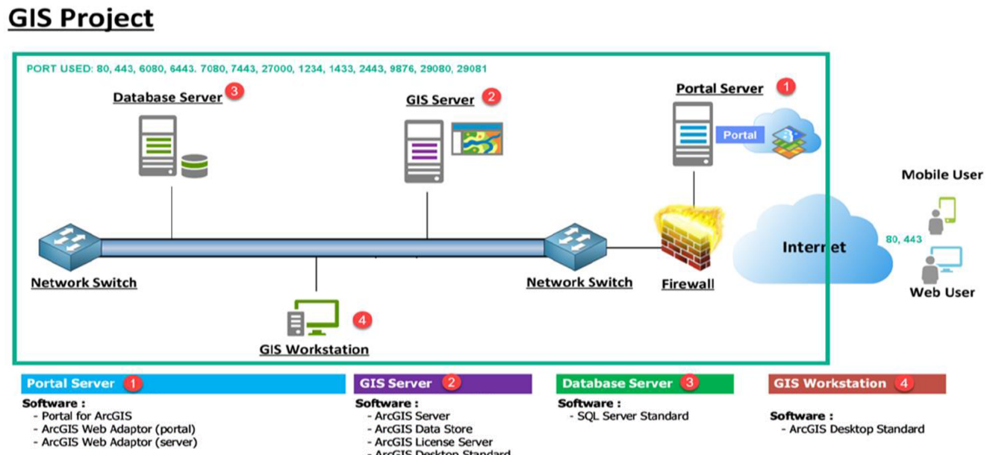
MATERIALS AND METHODS Computer system requirements
The base GIS software used in this project are the Esri ArcGIS desktop suite, and ArcGIS server product.
The ArcGIS JS API development
The data layer foundation of the software utilizes Postgre SQL
The project IDE is provided by Microsoft Visual Studio Code

Slide 6
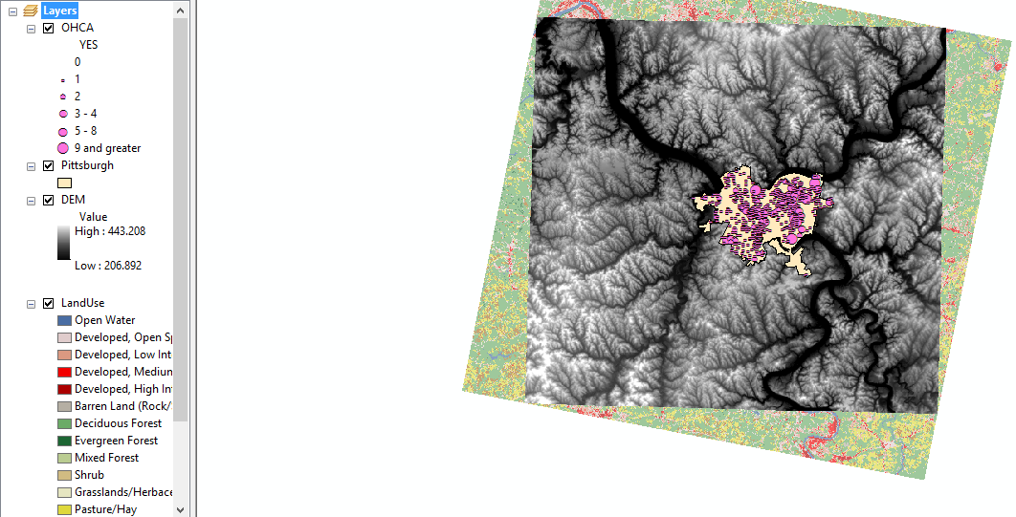
MATERIALS AND METHODS Spatial databases designs
The spatial data is vector graphics format, includes images, data types and genetic information: Point, line and polygon.
Data Layer | Format
OHCA | Point
DEM | Graphics
Pittsburgh | Polygon

Slide 7
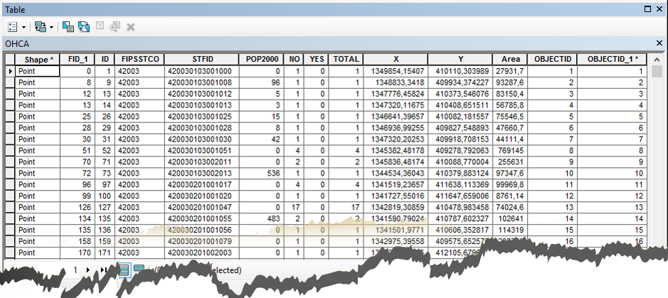
MATERIALS AND METHODS Attribute database design
Base on the foundation map, additional attribute information were added in the attribute table by ArcCatalog - a tool of ArcGIS Desktop

Slide 8
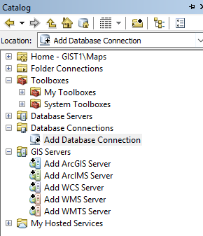
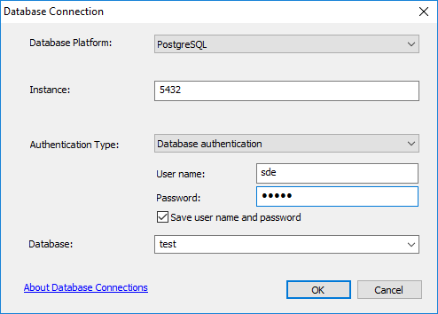
MATERIALS AND METHODS Create Enterprise Geodatabase PostgreSQL
Using Create Enterprise GeoDatabase function in Geodatabase Administrator (Catalog - ToolBoxes - System ToolBoxes - Data Management Tools) to create geodatabase. This data will be stored in Postgre SQL.

Slide 9
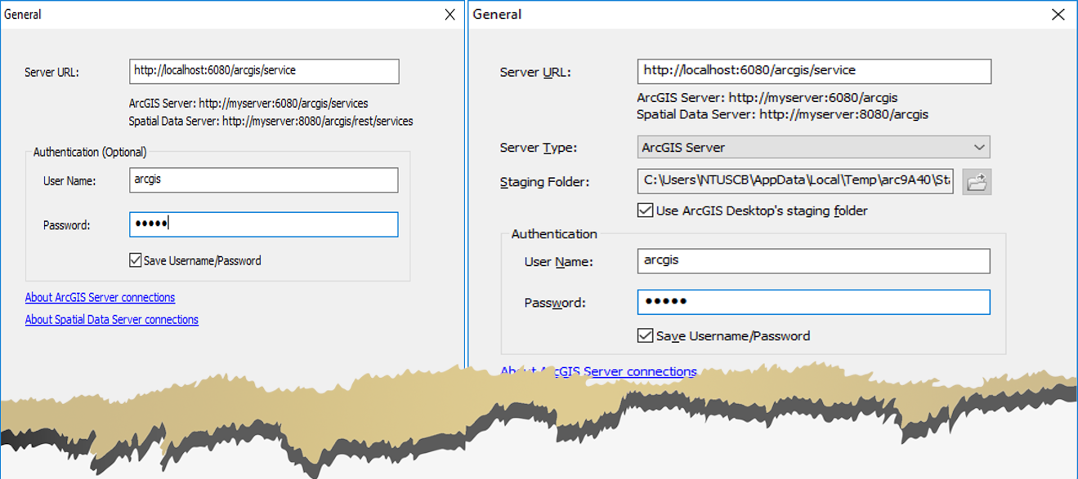
MATERIALS AND METHODS Publish to WebGIS
There are two-way to pushlish map to ArcGIS Server: Use GIS service (Figure, left), and Publish to ArcGIS server (Figure, right).

Slide 10
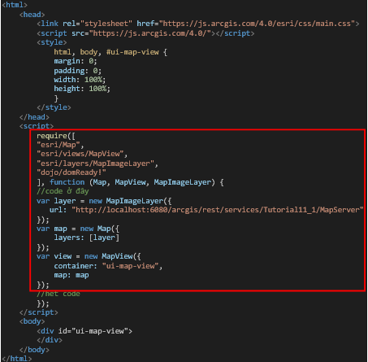
MATERIALS AND METHODS Display map on a web
At the beginning, load all necessary module un-der require block.
Then, create layer’s map via variant name – layer and path to layers on ArcGIS Server.
Finally, use MapView (for 2D maps) or SceneView (3D maps) in order to display all layers and features.

Slide 11
MATERIALS AND METHODS On Off layers
//Kiểm soát sự kiện change checkbox
view.then(function () {
on(dom.byId("chkLayer0"), "change", function (ev) {
layer.sublayers[0].visible = ev.target.checked;
});
on(dom.byId("chkLayer1"), "change", function (ev) {
layer.sublayers[1].visible = ev.target.checked;
});
});
At first, adding on and dom modules.
Next, adding check boxes in body block.
Finally, adding check change functions for check boxes event.
This promise occurs after activating view function.

Slide 12
MATERIALS AND METHODS Pop-ups identify
require([
"esri/Map",
"esri/views/MapView",
"esri/layers/MapImageLayer",
//module IdentifyTask,IdentifyParameters,arrayUtils,SimpleFillSymbol,Graphic
"esri/request",
"esri/tasks/IdentifyTask",
"esri/tasks/support/IdentifyParameters",
"esri/symbols/SimpleFillSymbol",
"esri/Graphic",
"dojo/_base/array",
"dojo/dom",
"dojo/on",
"dojo/domReady!"
], function (Map, MapView, MapImageLayer, esriRequest, IdentifyTask, IdentifyParameters,SimpleFillSymbol,Graphic,
arrayUtils, dom, on) {
IdentifyTask, IdentifyParameters use for configuration Identify parameters.
ArrayUtils is an extent object for ArcGIS Javascript API – use to list objects in an array by FOR com-mand.
SimpleFillSymbol, Graphic create polygon and add view graphic to highlight ojects

Slide 13
MATERIALS AND METHODS Search by query task
//Thêm nút tìm kiếm
on(dom.byId("btnSearch"), "click", function () {
var queryTask = new QueryTask({
url: "http://localhost:6080/arcgis/rest/services/Tutorial11_1/MapServer/0"
});
adding esri/tasks/QueryTask
adding esri/tasks/support/Query
adding search button and query task in to click function via SQL command line.
var query = new Query();
query.returnGeometry = true;
query.outFields = ["*"];
query.where = "YES=" + dom.byId("txtYES").value;
// Return all YES by 1 and Pop2000 by 6
query.where += " AND POP2000="+dom.byId("txtPOP2000").value

Slide 14
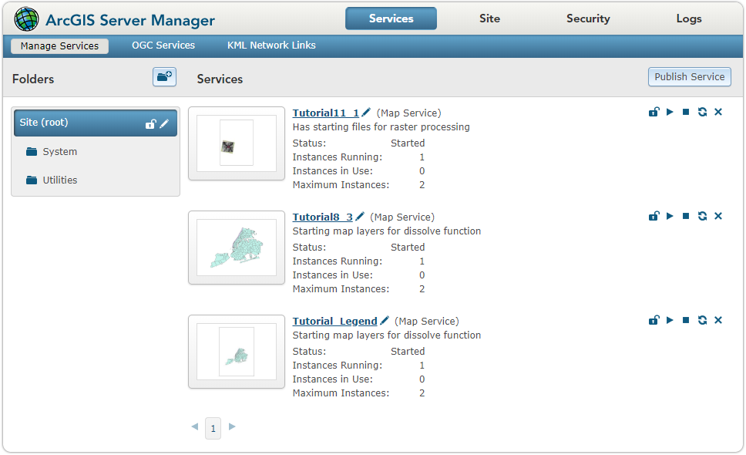
RESUTS Publish a WebGIS

Slide 15
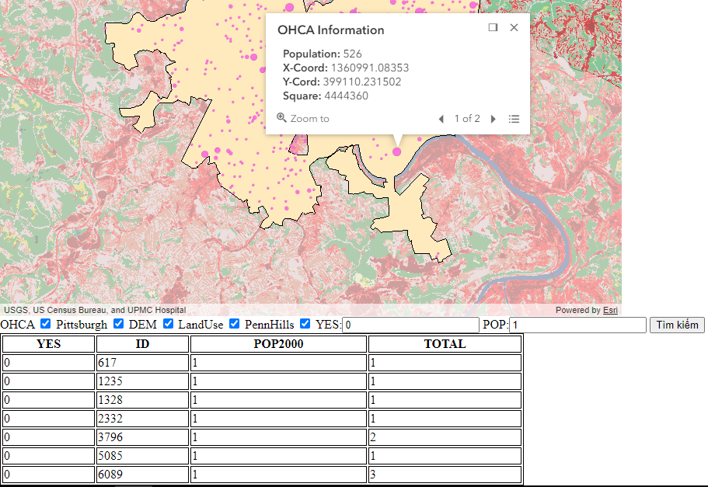
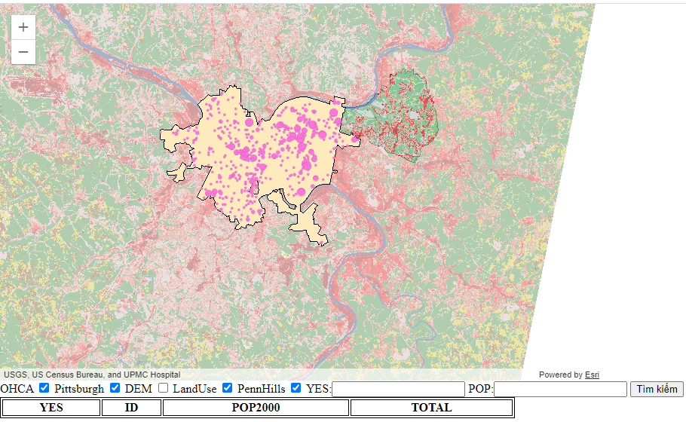
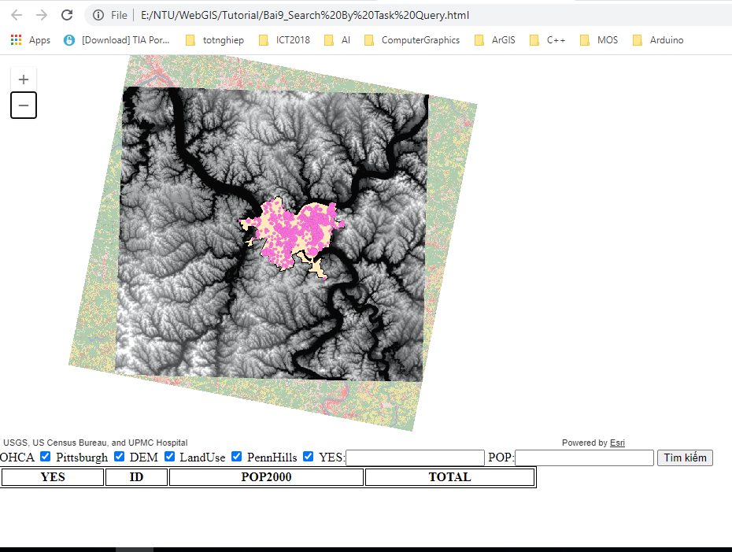
RESUTS Display map on a web

Slide 16
DISCUSSIONS
WebGIS application has the potential to share data, provide easy access for users with limited GIS knowledge.
Query the data in the database
Query the survey data of each fish species
View the image, and find genetic data of each species
Can apply supported GIS tools to clearly realize the spatial distribution of each species

Slide 17


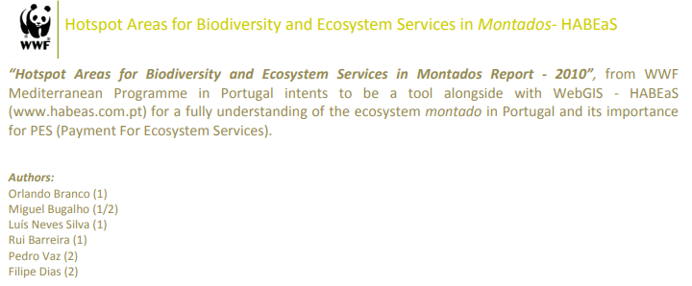
DISCUSSIONS
WebGIS technology has been applied in environmental management
Telecommunications infrastructure
Biodiversity assessment: Perceptions, tasks, trip attributes
Network of natural resources and ecological data
Biodiversity inventory in the Geneva cross-border area
Freshwater fish in Mekong Delta, Vietnam

