Slide 1

Note: The data and information in this document is reflective of a hypothetical situation and client. This document is to be used for KPMG Virtual Internship purposes only.
Sprocket Central Pty Ltd
Data analytics approach
[Analytics Team] - Thinh Ho

Slide 2
Note: The data and information in this document is reflective of a hypothetical situation and client. This document is to be used for KPMG Virtual Internship purposes only.
Agenda
Data Exploration
Model Development
Interpretation

Slide 3
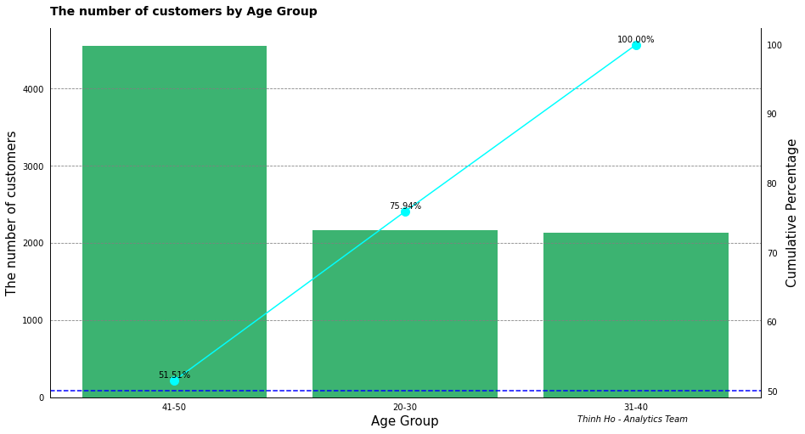
Note: The data and information in this document is reflective of a hypothetical situation and client. This document is to be used for KPMG Virtual Internship purposes only.
Data Exploration
Age Group
Our customer falls into three age group: 20-30, 31-40, and 41-50
The age group from 41 to 50 years old accounts for more than 50% of total customers

Slide 4
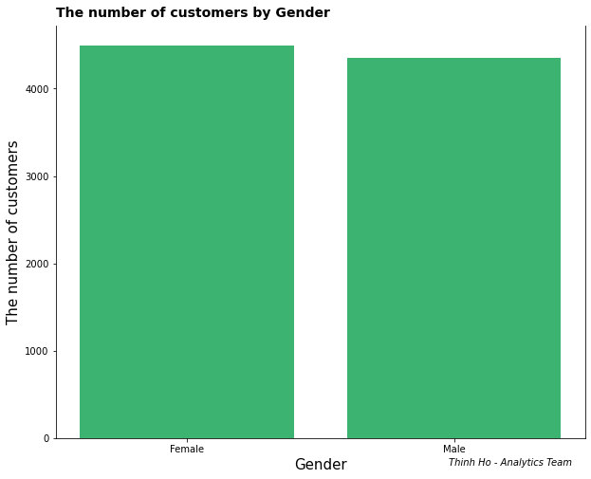
Note: The data and information in this document is reflective of a hypothetical situation and client. This document is to be used for KPMG Virtual Internship purposes only.
Data Exploration
Gender
There is no significant different between Male and Female in purchasing bicycles

Slide 5
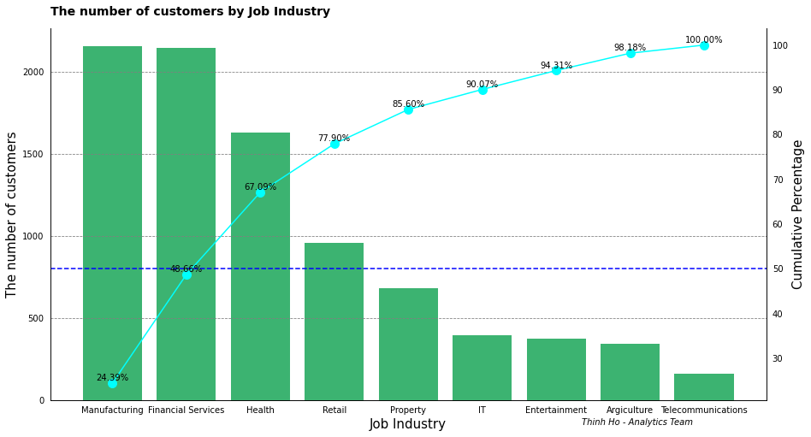
Note: The data and information in this document is reflective of a hypothetical situation and client. This document is to be used for KPMG Virtual Internship purposes only.
Data Exploration
Job Industry
Job Industry is a huge factor on purchasing bicycles
Manufacturing, Financial Services, and Health takes almost 70% of the customers

Slide 6
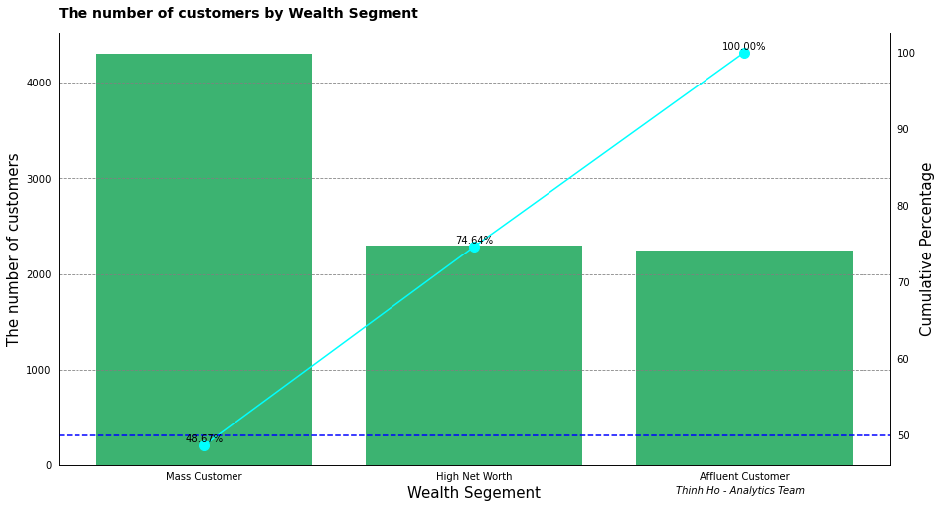
Note: The data and information in this document is reflective of a hypothetical situation and client. This document is to be used for KPMG Virtual Internship purposes only.
Data Exploration
Wealth Segment
Our segment is mainly Mass Customer which is almost 50% of all customers
Following are High Net Worth and Affluent Customer

Slide 7
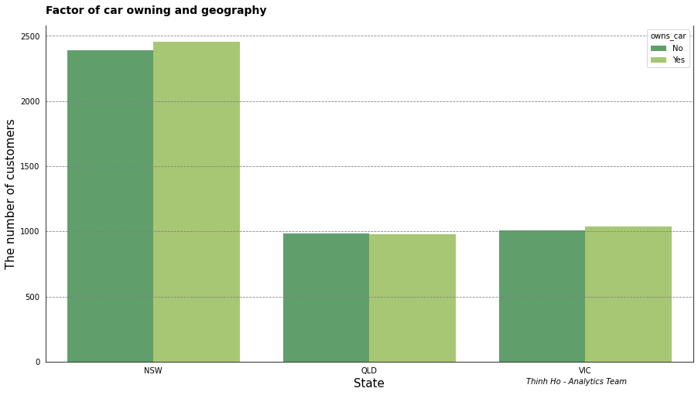
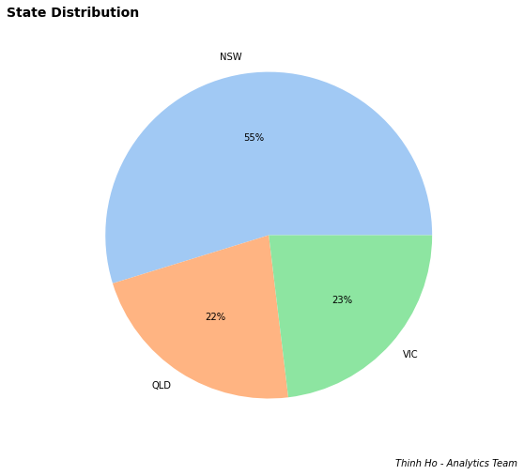
Note: The data and information in this document is reflective of a hypothetical situation and client. This document is to be used for KPMG Virtual Internship purposes only.
Data Exploration
Geography and Car Owning
New South Wales is our high potential target
Car owning definitely does not affect customer’s bicycle purchase

Slide 8
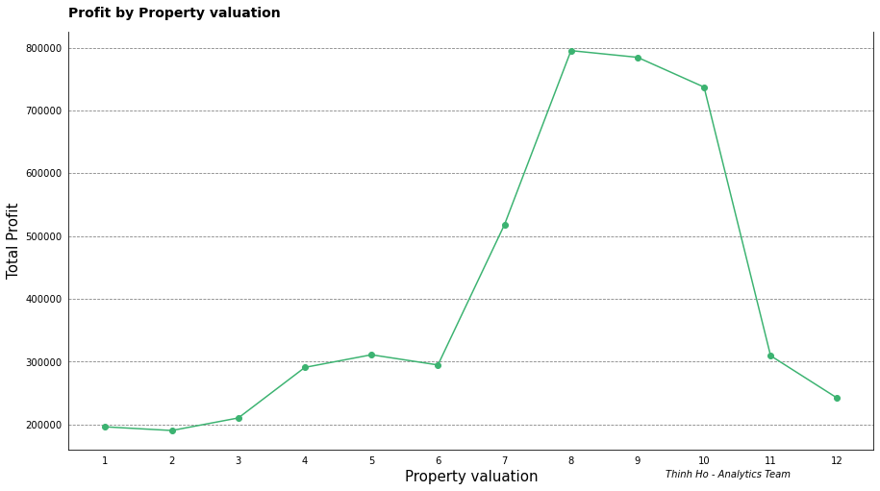
Note: The data and information in this document is reflective of a hypothetical situation and client. This document is to be used for KPMG Virtual Internship purposes only.
Data Exploration
Property Value
The customer with property valuation from 8 to 10 brings the most profit to the company

Slide 9
Note: The data and information in this document is reflective of a hypothetical situation and client. This document is to be used for KPMG Virtual Internship purposes only.
Model Development
Our target group of customer will have following traits:
Age from 40 to 50
Living location in New South Wales
Working in these industry: Manufacturing, Financial Services, and Health
Be a Mass Customer
Property value is either 8,9 or 10

Slide 10

Note: The data and information in this document is reflective of a hypothetical situation and client. This document is to be used for KPMG Virtual Internship purposes only.
Interpretation
From 1000 new customers, extract based on the criteria, we have these 15 customers which have high potential :

