Slide 1





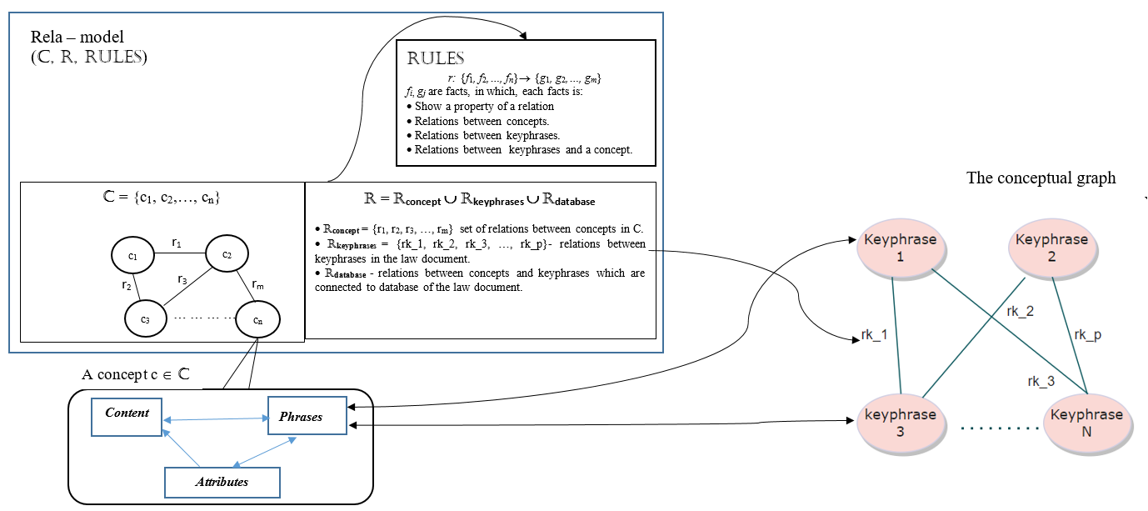
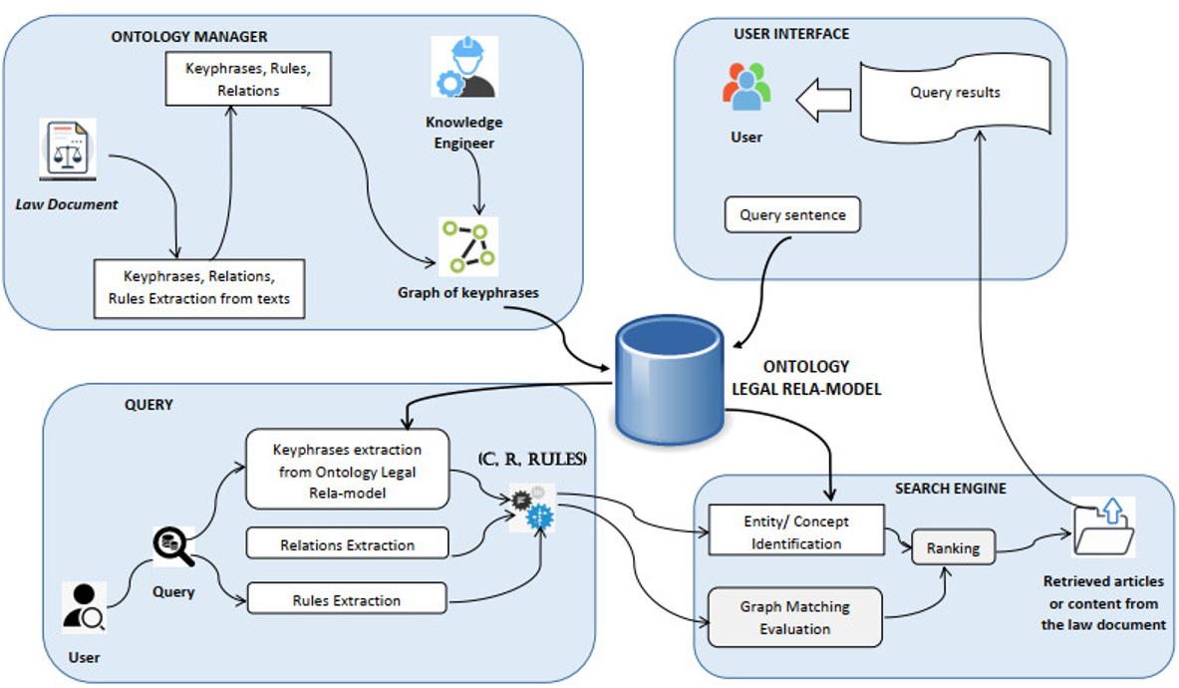
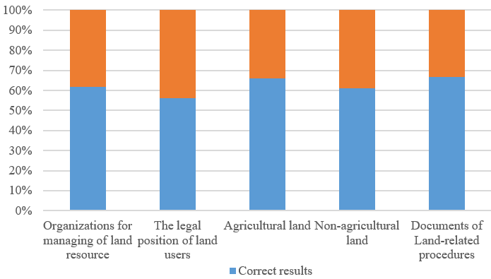
Legal-Onto: An Ontology-based model for Representing the Knowledge of a Legal Document
Thinh H. Nguyen^{1,2}, Hien D. Nguyen^{1,2}, Vuong T. Pham³, Dung A. Tran^{1,2}, Ali Selamat^{4,5}
¹ University of Information Technology (UIT), Ho Chi Minh City, Vietnam
² Vietnam National University, Ho Chi Minh City, Vietnam
³ Sai Gon University (SGU), Ho Chi Minh City, Vietnam
⁴Malaysia-Japan International Institute of Technology (MJIIT), Universiti Teknologi Malaysia, Kuala Lumpur, Malaysia
⁵ Center for Basic and Applied Research, Faculty of Informatics and Management, University of Hradec Kralove, Czech Republic
Abstract
In this paper, an integration ontology for representing the knowledge of a law document is proposed. This model is integrated of ontology about relational knowledge and the graph of keyphrases as a conceptual graph. It can represent semantic of contents in the law document. Based on this integrated model, the searching engine is studied to extract some main key phrases and compare with the structure of the knowledge model’s components through relations between key phrases leading to corresponding concepts. The proposed method is applied to construct an intelligent support system for knowledge querying on Vietnam Land Law. It can help users to query some meaning of terminology in land law and some land-related administrative procedures
Result
Class | Meaning | Training queries | Tested queries
Concept | Require to determine definition or attributes of a concept | 211 | 54
Procedure | Require to determine list of documents for a procedure in the land law. | 93 | 24
Related knowledge | Require knowledge related to obtained results | 107 | 32
Out of scope | Queries related to real-estate but they do not use the knowledge of land law. | 83 | 21
Total |  | 494 | 131
The structure of Legal Rela-model.
Table 2: Classification of queries.
Content | Queries | Number of correct results |  |  |  | Proportion (%)
 |  | Concept | Procedure | Related knowledge | Total
Organize to manage land resource | 42 | 11 | 9 | 6 | 26 | 62%
legal position of land users. | 48 | 10 | 10 | 7 | 27 | 56%
Agricultural land | 59 | 19 | 15 | 5 | 39 | 66%
Non-Agricultural land | 36 | 9 | 8 | 5 | 22 | 61%
Documents of Land-related procedures | 24 | 5 | 7 | 4 | 16 | 67%
Total | 209 | 54 | 49 | 27 | 130 | 62%
Knowledge model of relations for law domain
K = (C, R, Rules) + (Key, Rel, weight)
(C, R, RULES) is a structure of Rela-model, where, C is a set of concepts; R is a set of relations, those relations are between concepts, key phrases and database storing the content of the law document; RULES is a set of inference rules.
(Key, Rel, weight) is a conceptual graph representing the relations between key phrases of legal documents, where, Key is a set of key phrases of the law document, Rel is the set of arcs, and weight is a map from Key to binary similarly vector.
Table 3: Results of Querying on Vietnam Land Law.
Knowledge querying on legal document
(1) Problem 1: Classifying the inputted query.
From the query inputted as Vietnamese text, this problem extracts the main key phrases of the query to determine the meaning of the query and classify it.
(2) Problem 2: Retrieving suitable articles in the document and searching the content of concepts based on matching the key phrases.
Based on extracted key phrases, a method to compare the similarity between the meaning of the key phrases and the content in the knowledge base is proposed.
The architecture of the querying system on land law.
References
[1] Do, N., Nguyen, H., Selamat, A. 2018. Knowledge-Based model of Expert Systems using Rela-model. International Journal of Software Engineering and Knowledge Engineering 28(8), 1047 - 1090.
[2] Szostek, D., Zatucki, M. 2022. Legal Tech. Nomos Verlagsgesellschaft, Waldseestraße, Germany.
[3] Tieu, T., Chau, C., Bui, N., et al. 2021. Apply Bert-based models and Domain knowledge for Automated Legal Question Answering tasks at ALQAC 2021. In KSE 2021, 13th International Conference on Knowledge and Systems Engineering, Nov. 2021. IEEE.
The precision of the querying system on each content of Vietnamese Land Law.

