Slide 1





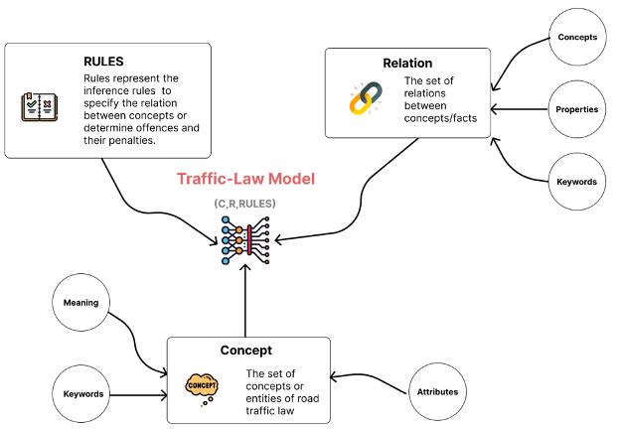
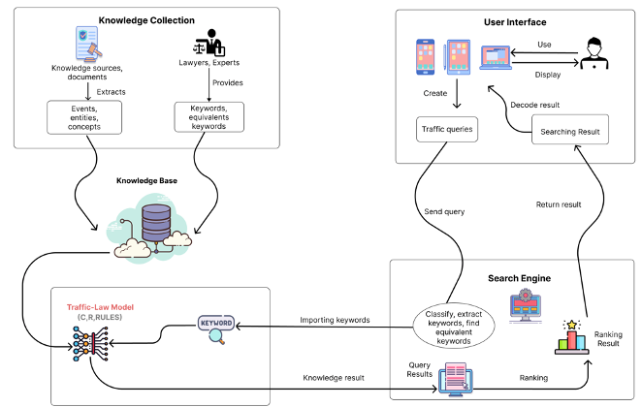
Ontology-based Solution for Building an Intelligent Searching System on Traffic Law Documents
Vuong T. Pham^{1,2,4}, Hien D. Nguyen^{3,4}, Thinh Le^{3,4}, Binh Nguyen^{,4}, Hung Q.Ngo⁵
¹ Faculty of Information Technology, Sai Gon University, Ho Chi Minh City, Vietnam
² Faculty of Mathematics and computer Science, University of Science, Ho Chi Minh City, Vietnam
³ University of Information and Technology, Ho Chi Minh City, Vietnam
⁴Vietnam National University, Ho Chi Minh city, Vietnam
⁵ Technological University Dublin, Dublin, Ireland
Abstract
In this paper, an ontology-based approach is used to organize the knowledge base of legal documents in road traffic law. This knowledge model is built by the improvement of ontology Rela-model. In addition, several searching problems on traffic law are proposed and solved based on the legal knowledge base. The intelligent search system on Vietnam road traffic law is constructed by applying the method. The searching system can help users to find concepts and definitions in road traffic law. Moreover, it can also determine penalties and fines for violations in the traffic. The experiment results show that the system is efficient for users' typical searching and is emerging for usage in the real-world.
Dataset
Class | Meaning | Quantity
Concept | Require identifying the meaning of a concept | 54
Penalties | Require identifying the fine of an offence | 83
Out of scope | Queries that do not belong to the two above kinds | 23
Total |  | 160
The structure of Traffic-Law model.
Table 1: Dataset of traffic regulation
Knowledge model for road traffic law
K = (C, R, Rules)
In which, C is the set of concepts or entities of road traffic law, R is the set of relations between concepts/facts, Rules represent the inference rules to specify the relation between concepts or determine offences and their penalties.
The Rules-set is classified two kinds of rules:
Rules = Rule_{infer} ∪ Rule_{offence}
In which, Rule_{infer} is the set of rules inferring the relation between concepts, and Rule_{offence} is the set of rules determining offences and penalties.
Result
Kind | Meaning | Correct | Rate
Queries about concepts/defintions | 54 | 42 | 78%
Queries about penalties and fines | 83 | 61 | 73%
Total | 137 | 103 | 75%
Table 2: Results of Querying on Vietnam Land Law.
Knowledge querying on legal document
(1) Problem 1: Extracting the keywords from the inputted query
This problem aim to extract keywords from the Vietnamese inputted query to search for the concepts and relations in the legal knowledge base related to those. Steps included in this problems are: classifying the queries, extracting keywords, collect similar keywords from legal document sources
(2) Problem 2: Retrieve the knowledge from the knowledge base matching extracted concepts and relations.
Based on the concepts and relations, the article of legal documents that states the offence is found by using collected rules. Then, the information, penalties, and fines of them are retrieved through the specified content of law in the knowledge base.
Conclusion
The architecture of an intelligent searching system on the Vietnam road traffic.
This paper proposed an ontology-based model for representing legal knowledge in the Vietnam road traffic codes improved based on ontology Rela-model in the structure of concepts, relations, and inference rules. This system can do several common search queries, such as finding concepts/definitions in the law and determining penalties for violations in the road traffic.
In the future, the system can be involved other legal aspects such as commercial law, civil law, etc. Further, the system can be used to provide an e-learning system for legal aspects. The abilities to use AI to identify entities and concepts from an image or use voice recognition to identify searching input are also features considered to add more to the system.
References
[1] Do, N., Nguyen, H., Selamat, A. 2018. Knowledge-Based model of Expert Systems using Rela-model. International Journal of Software Engineering and Knowledge Engineering 28(8), 1047 – 1090.
[2] Ngo, H., Nguyen, T., Nguyen, D., Pham, M. 2021. AimeLaw at ALQAC 2021: Enriching Neural Network Models with Legal-Domain Knowledge. In KSE 2021, 13th International Conference on Knowledge and Systems Engineering, Nov. 2021. IEEE.
[3] Nguyen, H.D., et al. 2015. A Mathematical Approach for Representation Knowledge about Relations and Its Application. In KSE 2015, 7th IEEE International Conference on Knowledge and Systems Engineering, Oct. 2015. IEEE.
[4] Nguyen, H., Tran, D., Pham, H., Pham, V. 2020a. Design an intelligent system to automatically tutor the method for solving problems. International Journal of Integrated Engineering 12(7), 211 – 223.

