Slide 1

MACHINE LEARNING
«HEART DISEASE PREDICTION»
Student: Nguyen Phuoc Thinh
Mentor: D.Sc. Nguyen Si Thin

Slide 2
1. DATA DESCRIPTION
This data set dates from 1988 and consists of 4 databases: Cleveland, Hungary, Switzerland, and Long Beach V. It contains 76 attributes, including the predicted attribute, but all published experiments refer to using a subset of 14 of them. The "target" field refers to the presence of heart disease in the patient. It is integer valued 0 = no disease and 1 = disease.
Dataset: 13 attributes, 1 predicted atrribute, 303 data rows.
ID | Attribute Name | Attribute Desc | Notes
1 | target | Cardiovascular disease status (0 - no disease, 1 - disease) | Predicted attribute
2 | age | Age
3 | sex | Gender (0-female, 1-male)
4 | cp | Chest pain type (0-typical angina, 1-atypical angina, 2-non-anginal pain, 3-asymptomatic)
5 | trestbps | resting blood pressure

Slide 3
1. DATA DESCRIPTION
ID | Attribute Name | Attribute Desc | Notes
6 | chol | serum cholestoral in mg/dl
7 | fbs | fasting blood sugar (0-normal: <120mg/dl, 1-high: >=120mg/dl)
8 | restecg | resting electrocardiographic results (0-normal, 1-heart muscle, 2-enlargement of the heart's left ventricle)
9 | thalach | maximum heart rate achieved
10 | exang | exercise induced angina (0-no, 1-yes)
11 | oldpeak | ST depression induced by exercise relative to rest | Float
12 | slope | the slope of the peak exercise ST segment (0-upsloping, 1-flat, 2-downsloping)
13 | ca | number of major vessels (0-3) colored by flourosopy
14 | thal | Thalassemia (0-normal, 1-fixed defect, 2-reversable defect)

Slide 4
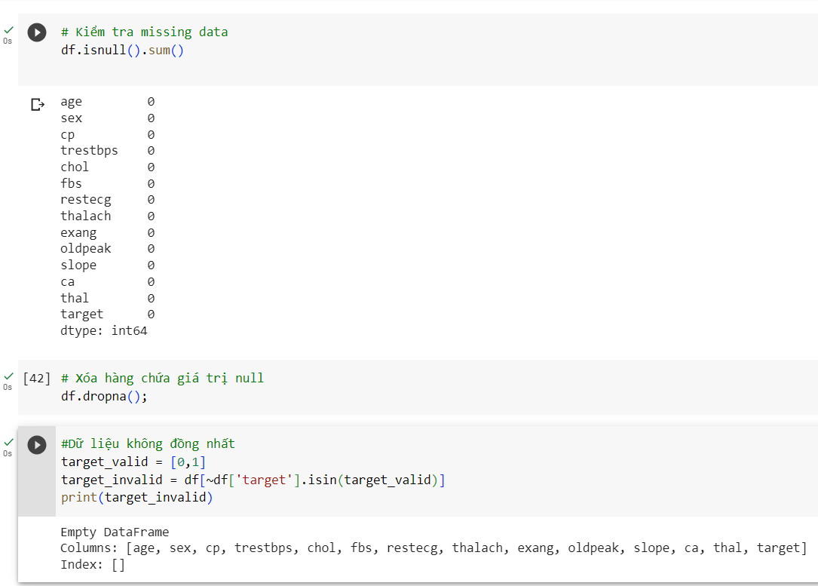
2. DATA PREPROCESSING

Slide 5
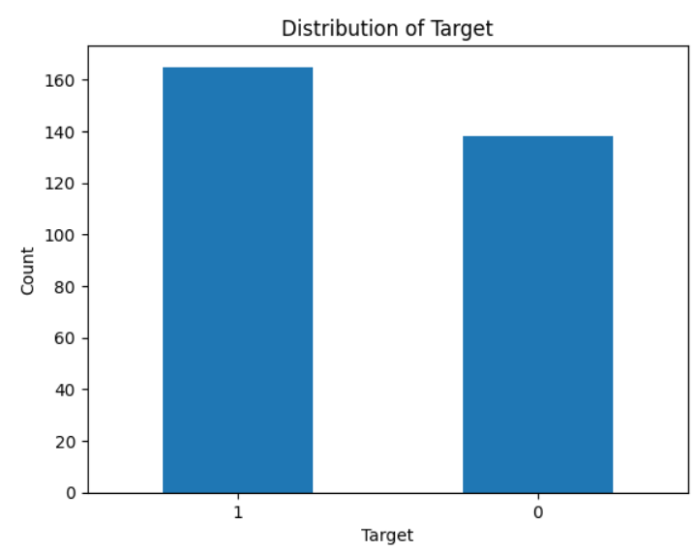
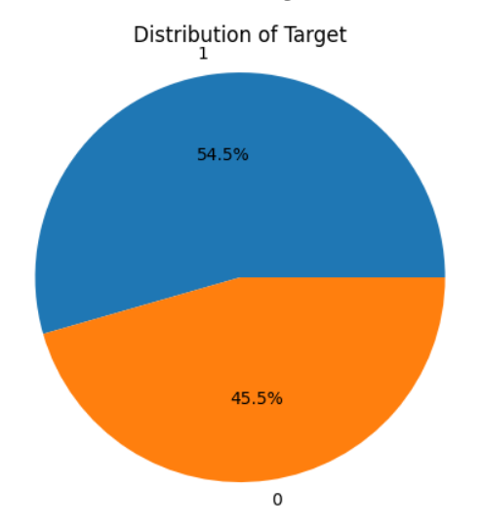
3. QUALITATIVE ANALYSIS OF DATA

Slide 6
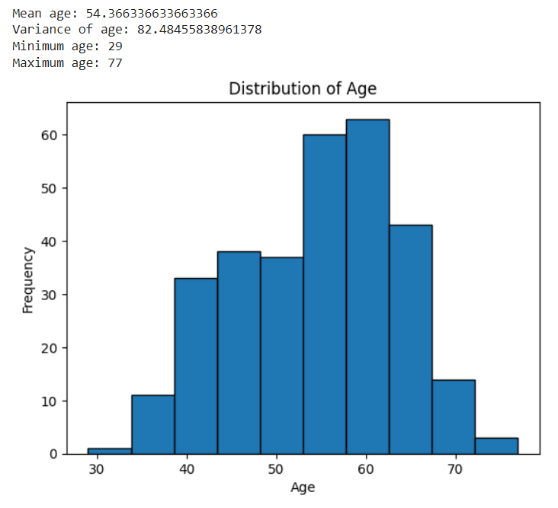
4. QUANTITATIVE ANALYSIS OF DATA

Slide 7
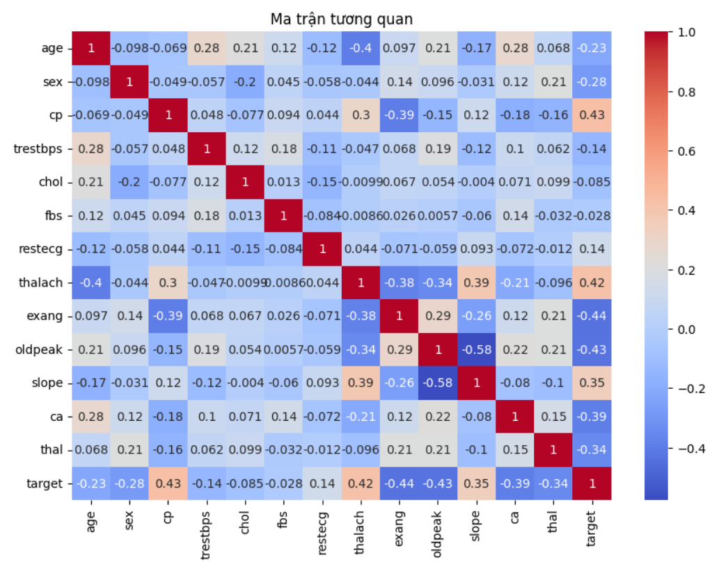
5. RELATIONSHIP BETWEEN THE ATTRIBUTES

Slide 8
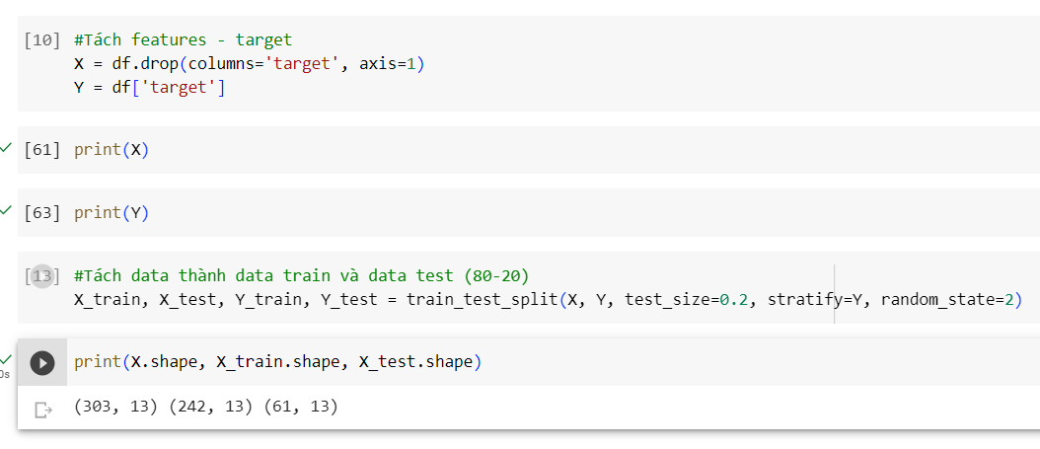
6. PREPARATION OF DATA SETS: TRAIN - TEST

Slide 9
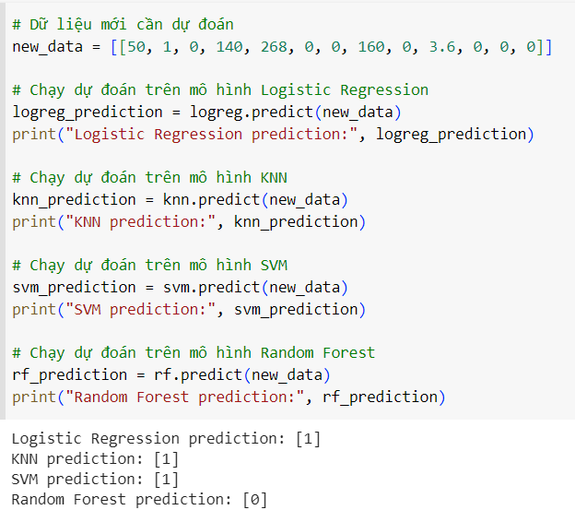
7. USING MACHINE LEARNING TO DATA PREDICTION

Slide 10
8. COMPARISON AND CONCLUSION
Model | Time Train | Accuracy Train | Accuracy Test
Logistic Regresstion | 0.03 seconds | 85.12% | 81.97%
KNN | 0.01 seconds | 78.10% | 62.30%
SVM | 0.01 seconds | 69.42% | 62.30%
Random Forest | 0.17 seconds | 100.00% | 78.69%
Based on the above results, Logistic Regression model is the best choice for this problem. Since it has high accuracy on both training and test sets, the training time is fast and simpler than other models.

Slide 11
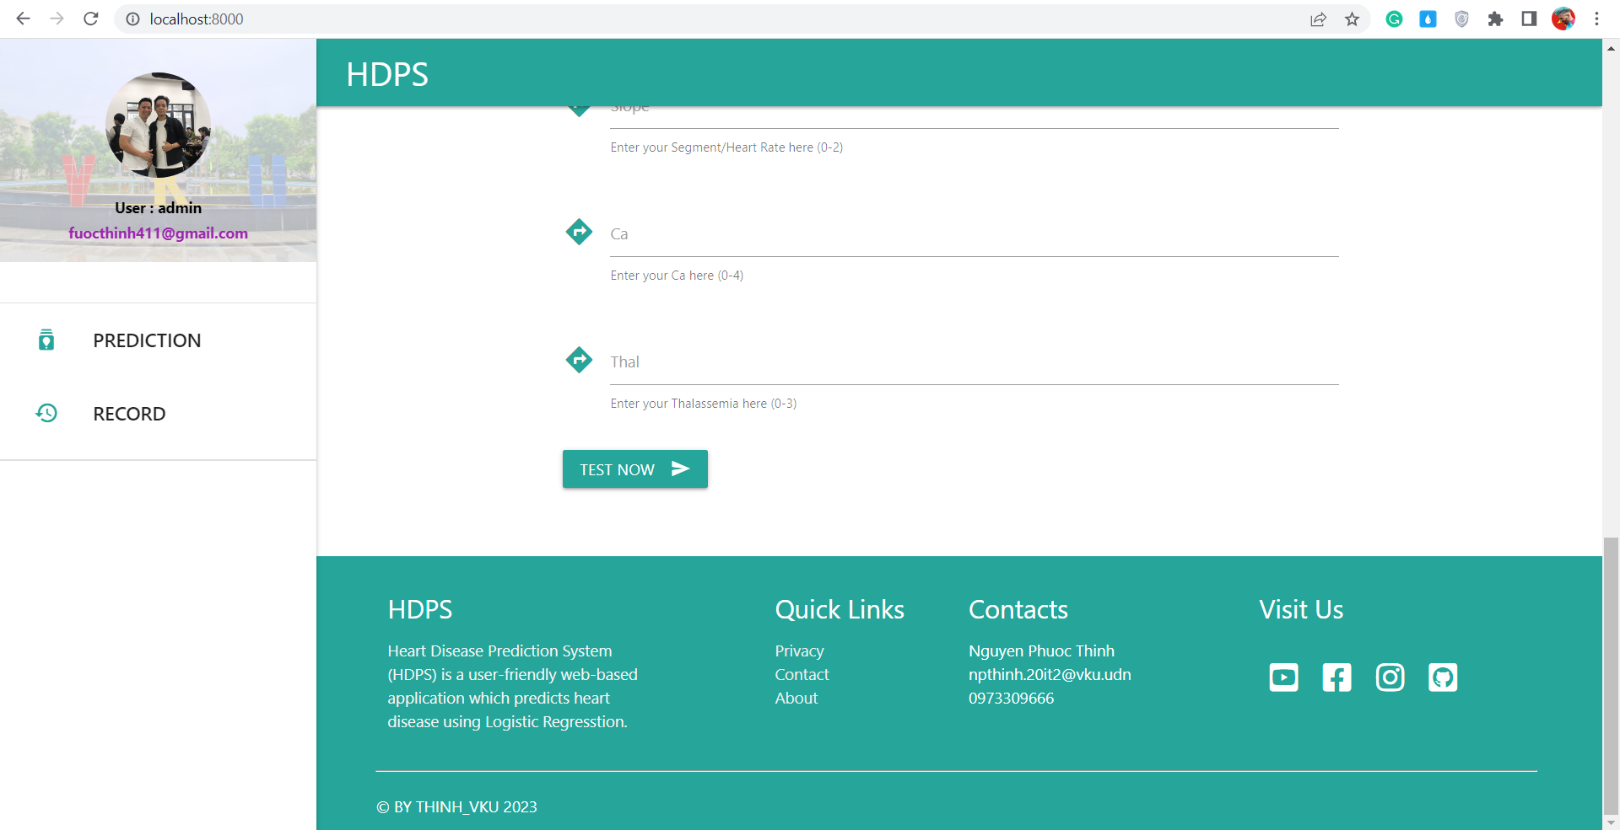
9. DEMO ON WEBSITE

Slide 12

Do Have You Any Question?

Slide 13
Thanks For Watching!

