Slide 1
Ch 10 Image Segmentation
Ideally, partition an image into regions corresponding to real world objects.

Slide 2
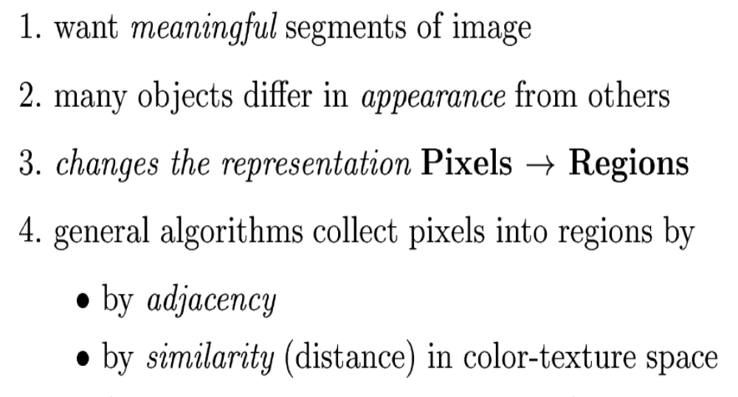
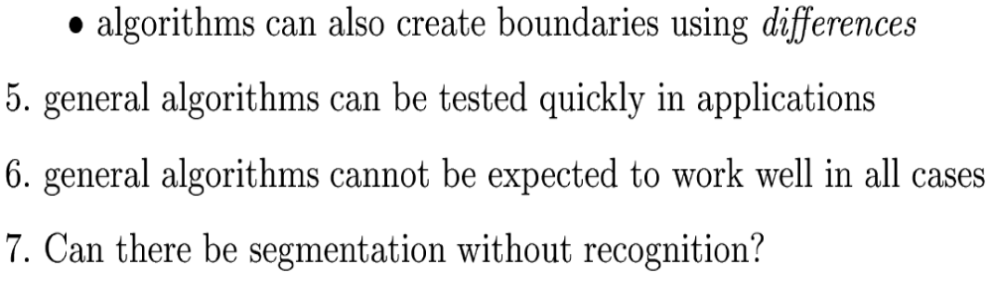
Goals of segmentation

Slide 3
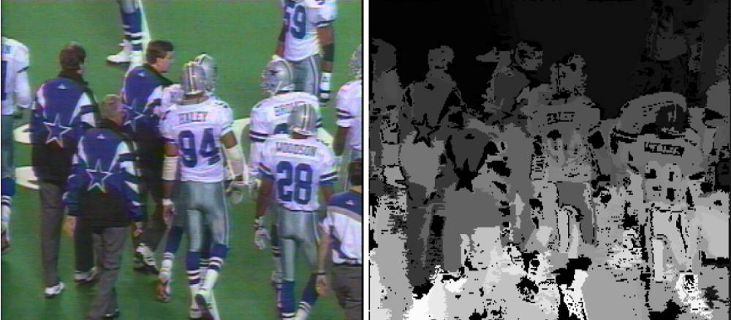
Segments formed by K-means

Slide 4
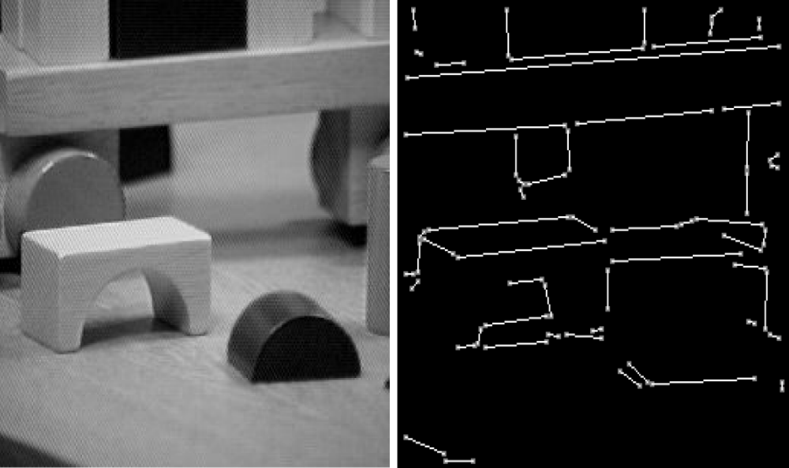
Segmentation attempted via contour/boundary detection

Slide 5
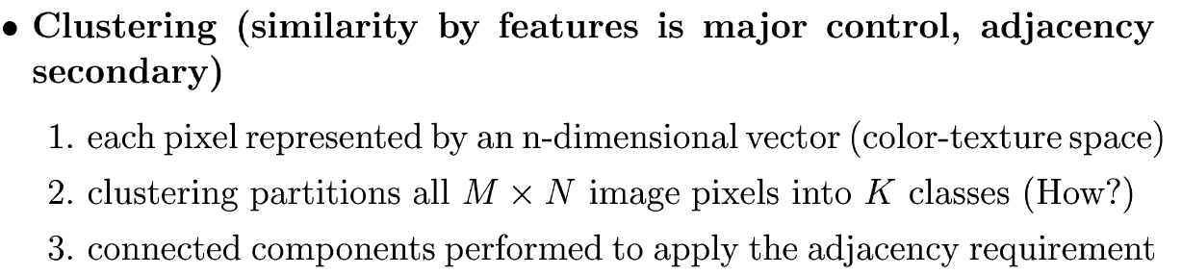
Clustering versus region-growing

Slide 6
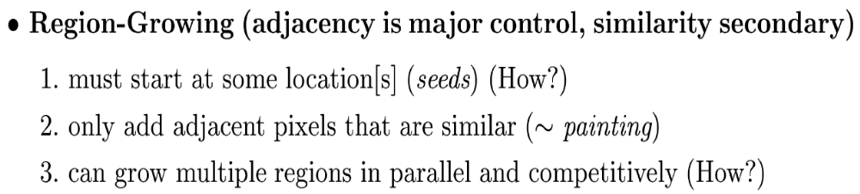
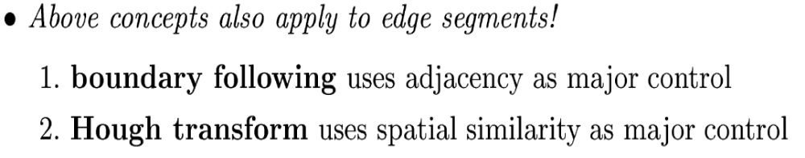
Clustering versus region-growing

Slide 7
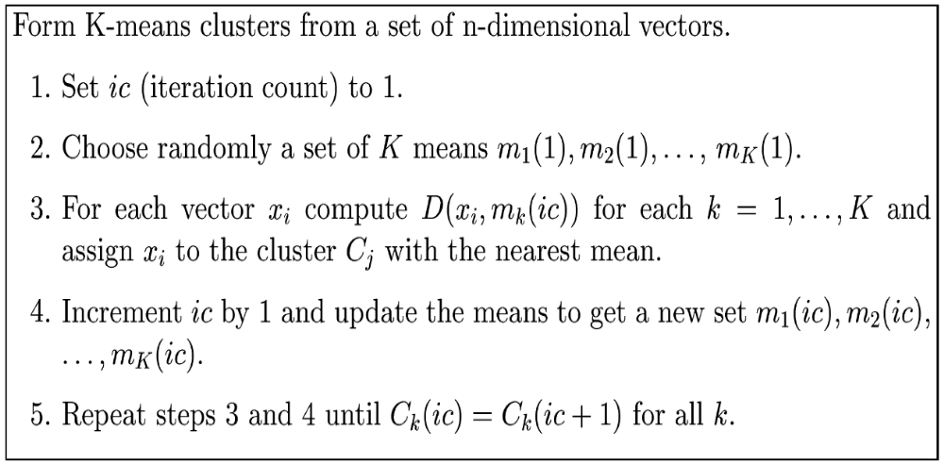
K-means clustering as before: vectors can contain color+texture

Slide 8
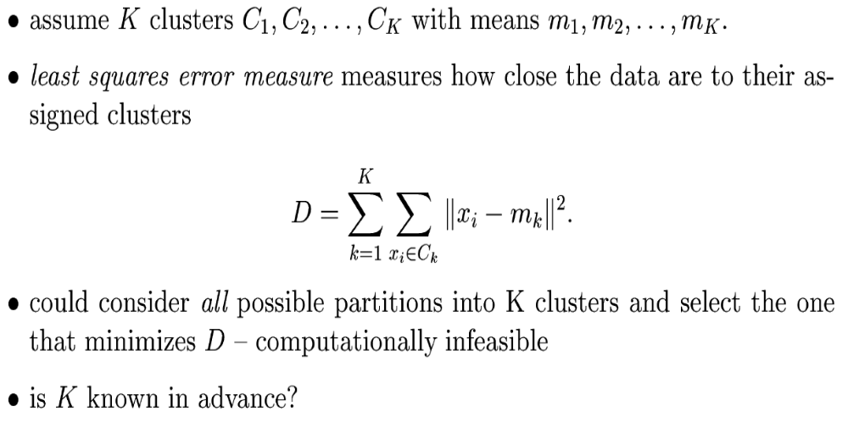
K-means

Slide 9
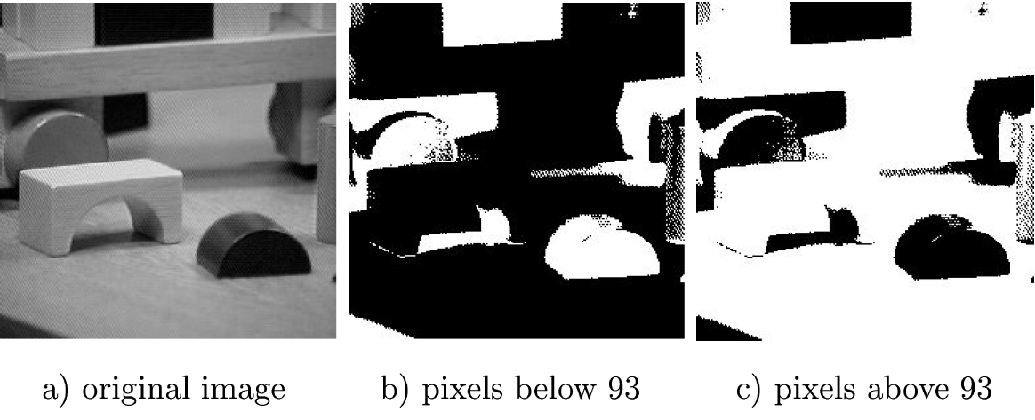
Histograms can show modes

Slide 10
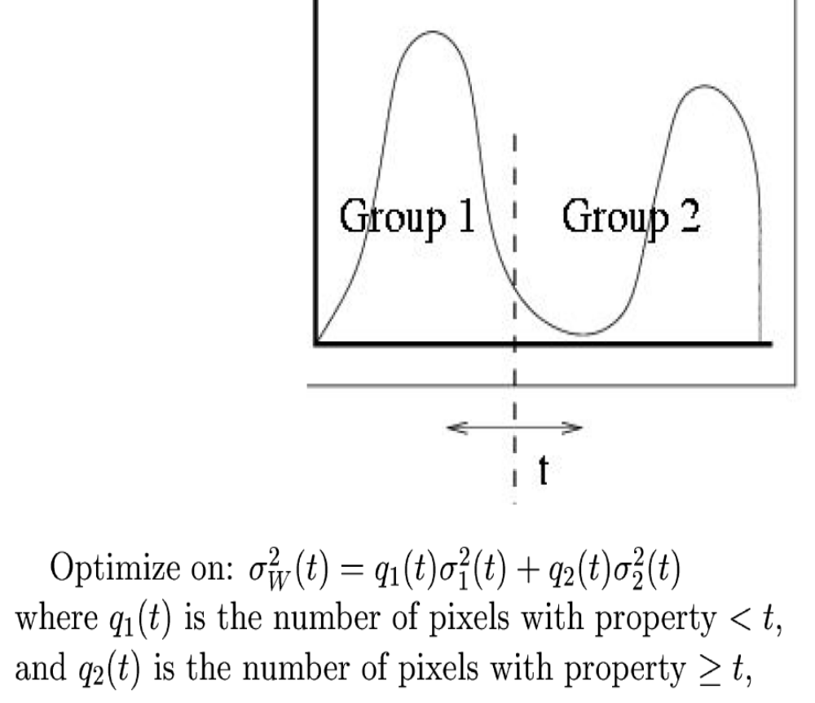
Otsu’s method assumes K=2. It searches for the threshold t that optimizes the intra class variance.

Slide 11
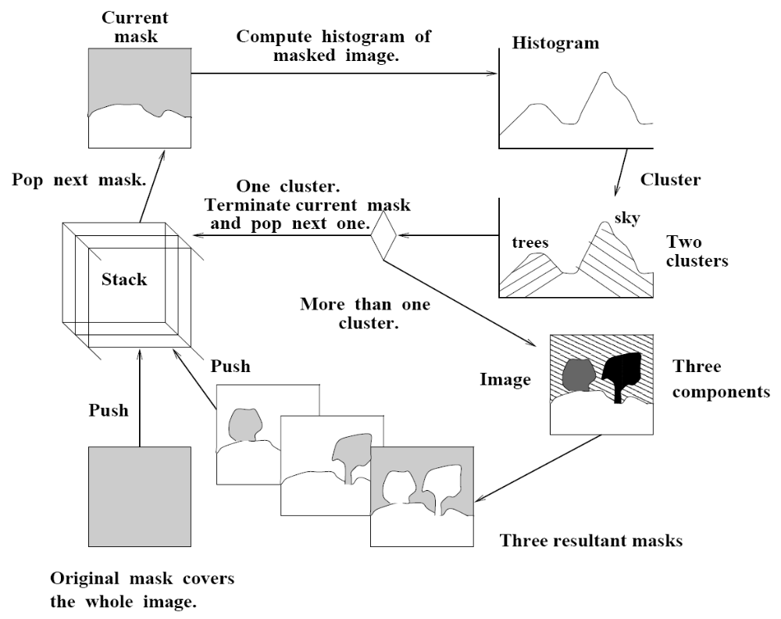
Ohlander bifurcated the histogram recursively

Slide 12
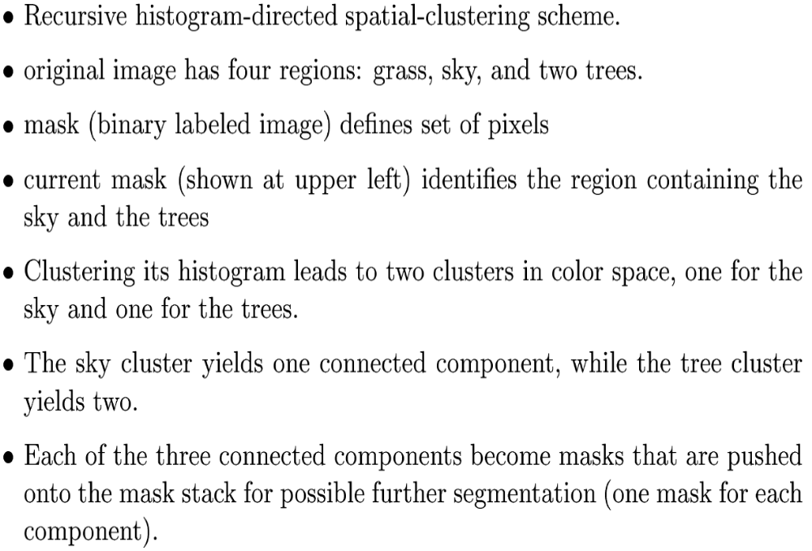
Recursive histogram-controlled segmentation

Slide 13
URL’s of other work
Segmentation lecture http://robots.stanford.edu/cs223b/index.html
Tutorial on graph cut method and assessment of segmentation http://www.cis.upenn.edu/~jshi/GraphTutorial/

Slide 14
Segmentation via region-growing (aggregation)
Pixels, or patches, at the lowest level are combined when similar in a hierarchical fashion

Slide 15
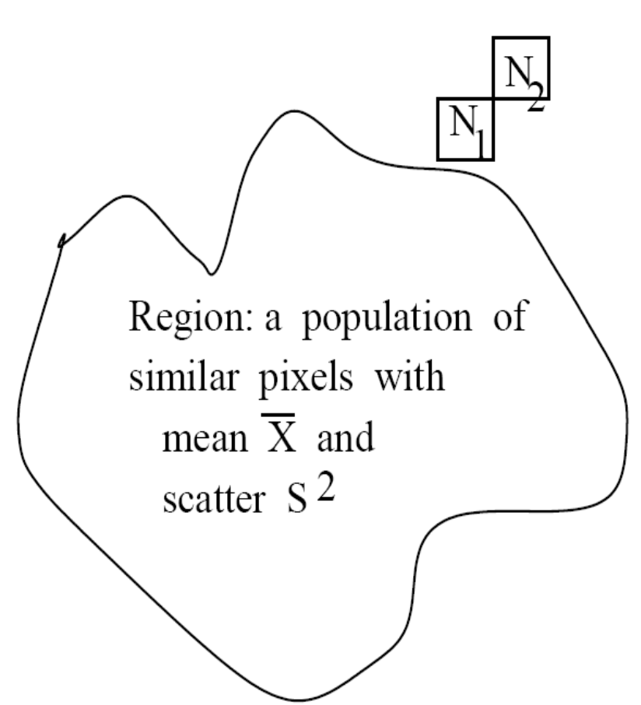
Decision: combine neighbors?
Neighboring pixel or region

Slide 16
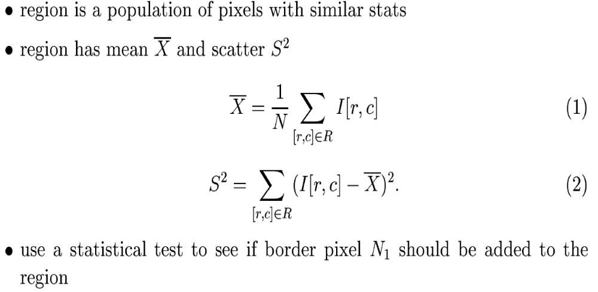
Aggregation decision

Slide 17
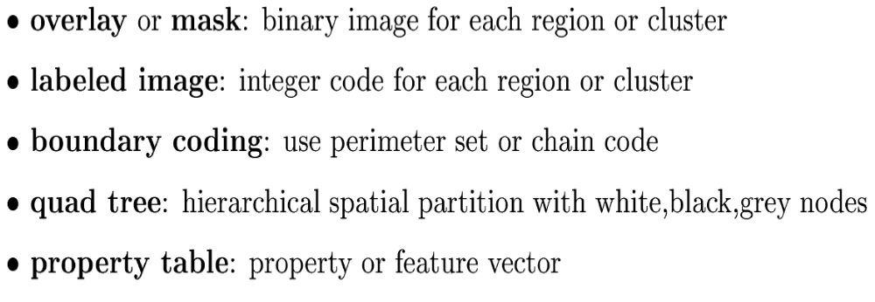
Representation of regions

Slide 18
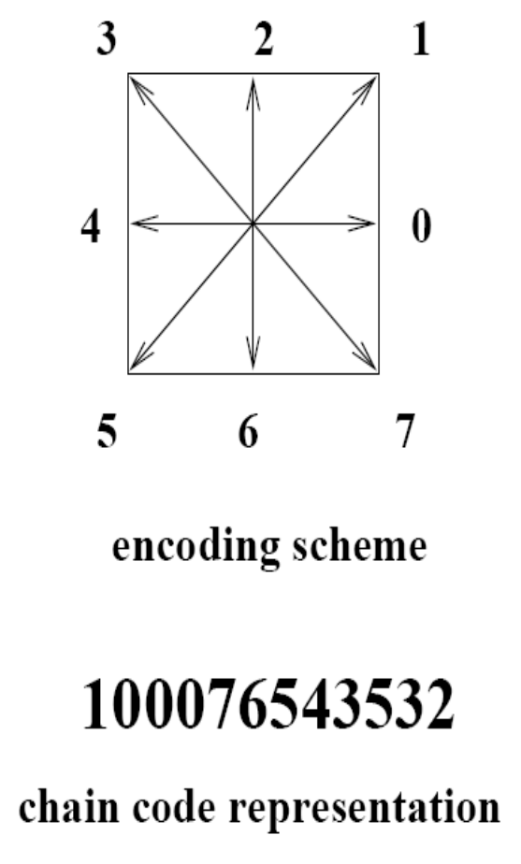
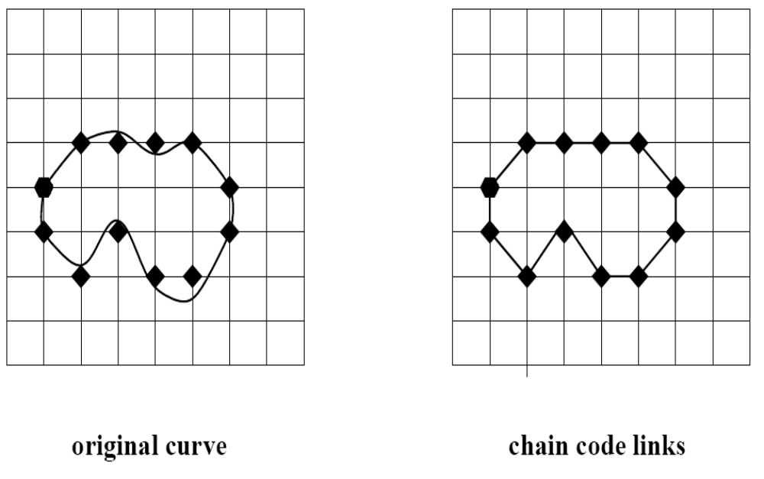
Chain codes for boundaries

Slide 19
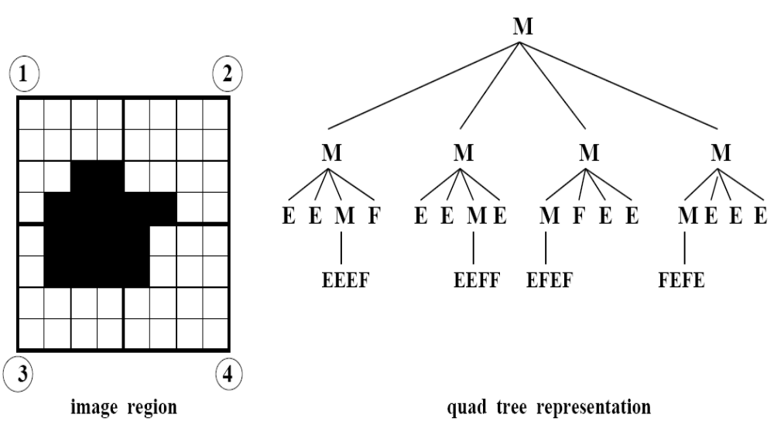
Quad trees divide into quadrants
M=mixed; E=empty; F=full

Slide 20
Can segment 3D images also
Oct trees subdivide into 8 octants
Same coding: M, E, F used
Software available for doing 3D image processing and differential equations using octree representation.
Can achieve large compression factor.

Slide 21
More URLs of other work
Mean shift description http://cmp.felk.cvut.cz/cmp/courses/ZS1/slidy/meanShiftSeg.pdf

