Slide 1


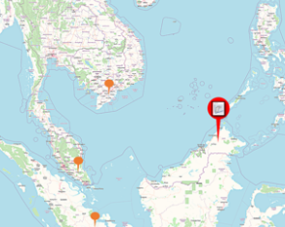

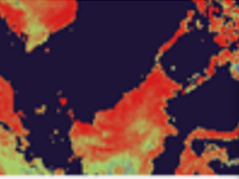
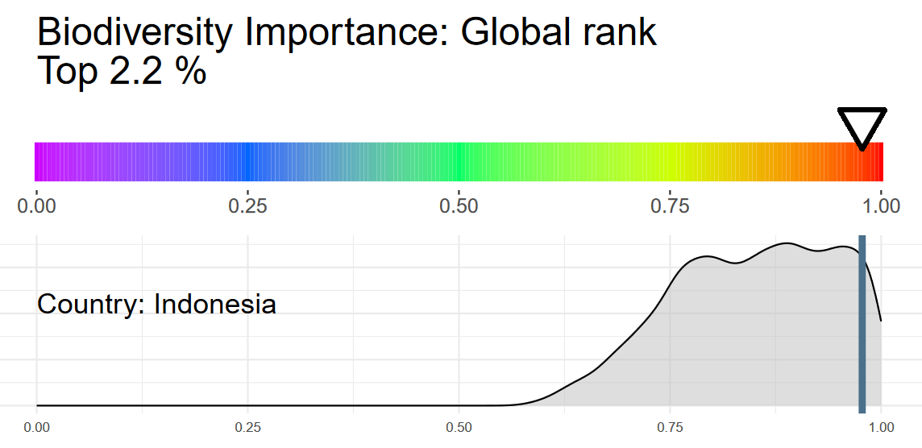
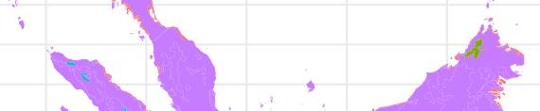
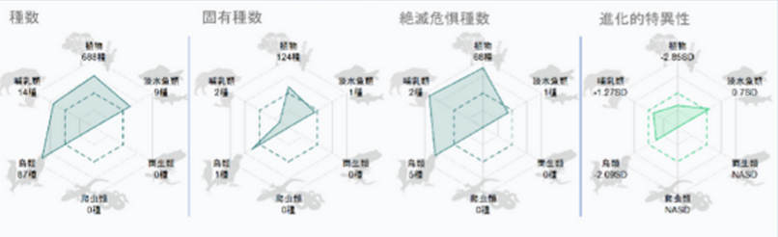
Site #23
Activity: Electronics and hardware production
Overview
Biodiversity
Dependency
Impact
Around map
Site #3
Activity: Electronics and hardware production
Overview
Biodiversity
Dependency
Impact
Biodiversity Importance
Priority: High
Ecoregion & Biome
Intactness: Intermediate
Notable taxonomic group: Trees
Species Richness

Slide 2


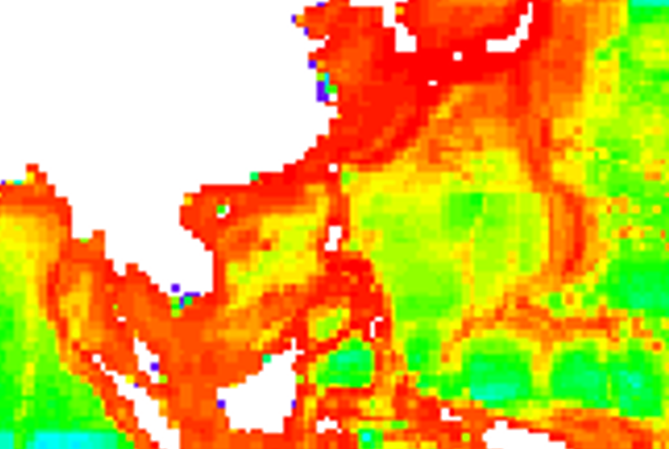
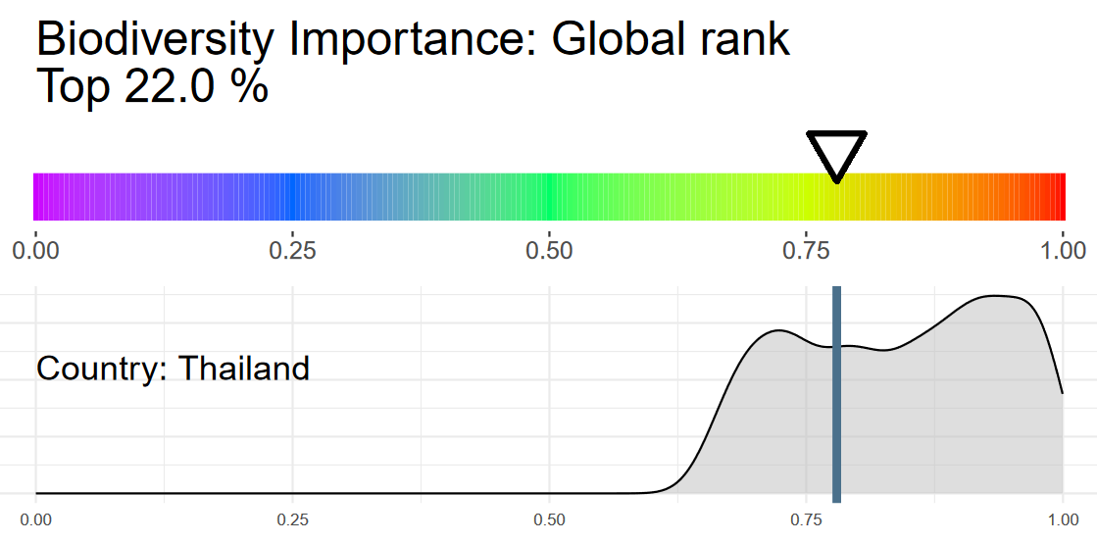



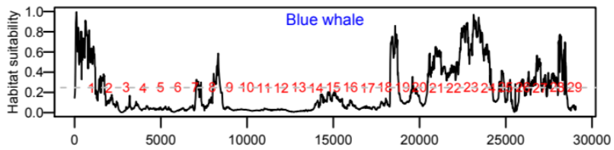

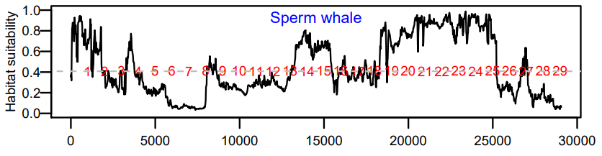
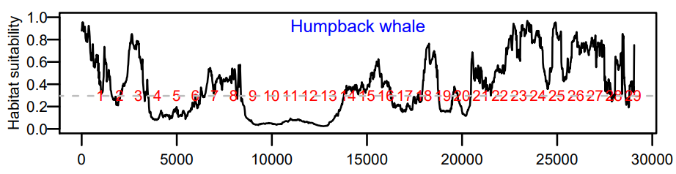
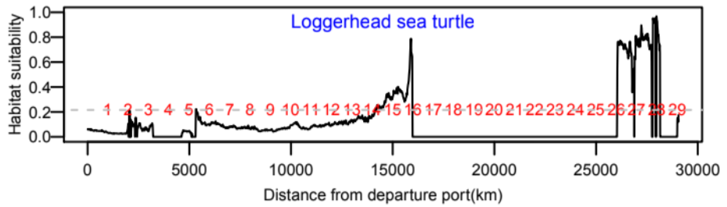
Site #10
Activity: Shipping
Overview
Biodiversity
Dependency
Impact
Biodiversity Importance
Site #10
Priority: High
Marine Footprint: Low
Activity: Shipping
Notable taxonomic group: Coral
Overview
Biodiversity
Dependency
Impact
Species Richness
Species Distribution

