Slide 1
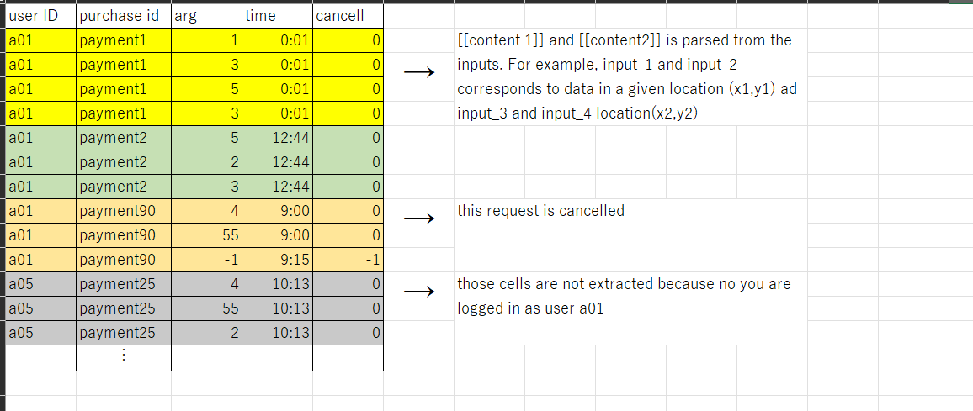
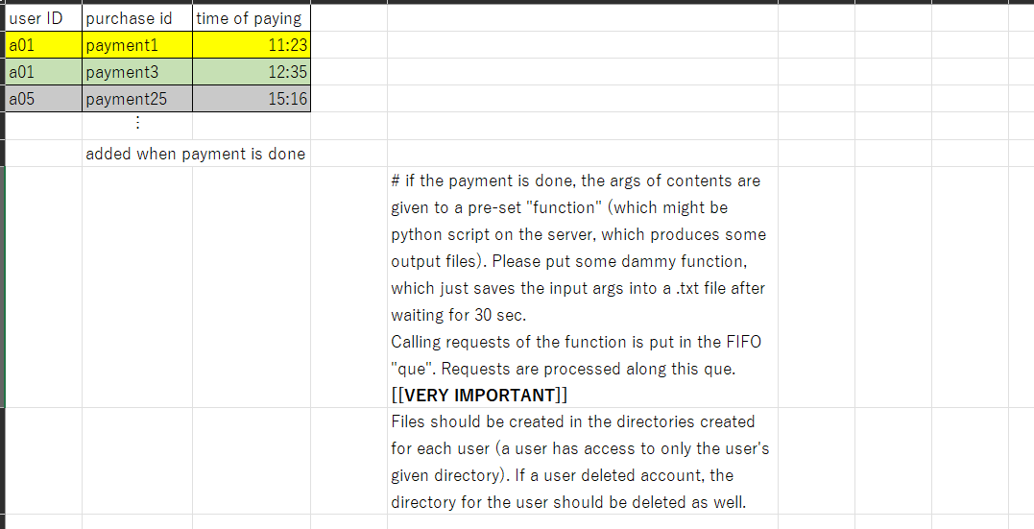
Dashboard page
Read
Return a list of contents and their name
Give the purchase id of each content
Return the payment status for each content

