Slide 1
Tutorial 1
Introduction

Slide 2
About me
Juan Carlos Fuentes Carranza
Contact info:
juan.fuentescarranza@ucalgary.ca
Tutorial website:
http://pages.cpsc.ucalgary.ca/~juan.fuentescarranza/CPSC526/

Slide 3
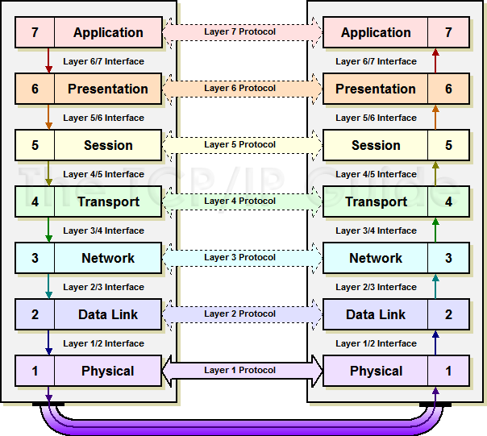
OSI (Open System Interconnection) Model
Seven layer conceptual model
Developed by ISO (International Organization for Standardization)
Describes Standards for communication between computers
Image from [2]

Slide 4
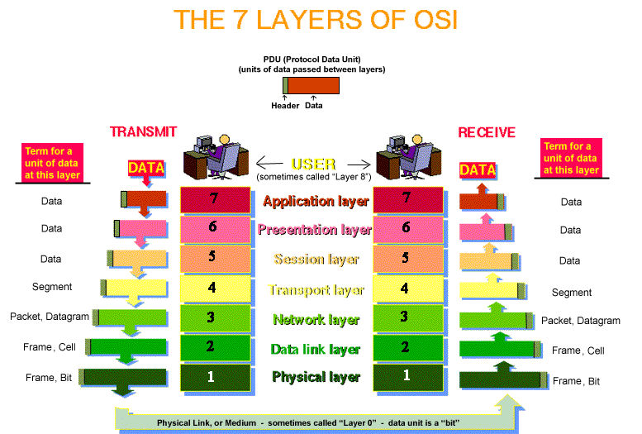
The Seven Layers (High-Level Protocols)
Application (Layer 7) | Network Specific Applications: Mail Web Remote connection File Transfer
Presentation (Layer 6) | Provides a context for communication between layers (Formats the data so that the receiving application can understand it) Encryption/Decryption Compression
Session (Layer 5) | Start & Stop Sessions (Connections) between devices
Image from [2]

Slide 5
The Seven Layers (Medium-Level Protocols)
Transport (Layer 4) | This layer provides transparent transfer of data between end systems, or hosts, and is responsible for end-to-end error recovery and flow control. It ensures complete data transfer. Usually TCP or UDP (Port Numbers are added).
Network (Layer 3) | Provides connections between hosts in different networks (IPv4, IPv6) Routing of Packets Source IP and destination IP are added to the data
Image from [2]

Slide 6
The Seven Layers (Low-Level Protocols)
Data Link (Layer 2) | Provides connections between hosts in the same network (Ethernet, MAC Addresses) Source and destination MAC Addresses are added
Physical (Layer 1) | Describes electrical and physical specifications for devices Cable, connectors, hubs, repeaters, etc.
Image from [2]

Slide 7
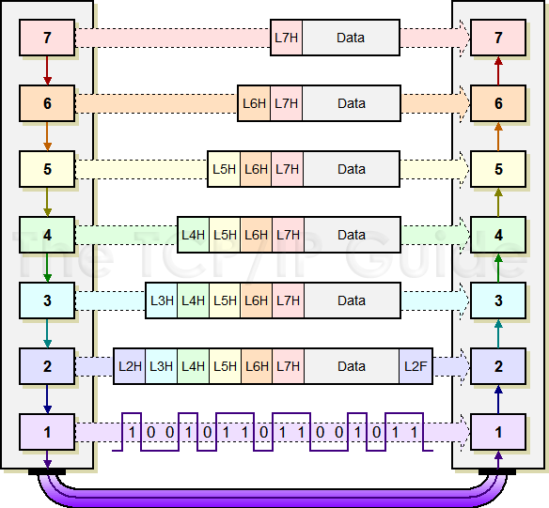
How it works?

Slide 8
Some protocols per Layer
L# | Layer Name | Protocols
7 | Application | Telnet, SMTP, HTTP, FTP, IMAP, POP3, SNMP
6 | Presentation | MPEG, ASCII, TLS, SSL
5 | Session | NetBIOS, SAP
4 | Transport | TCP, UDP
3 | Network | IPv4, IPv6, ICMP, IPSec, ARP, MPLS
2 | Data Link | MPLS, RARP, Ethernet, 802.11.x, PPP, Frame Relay, ATM, FDDI, Fibre Channel
1 | Physical | RS232, DSL, 10BaseT, 100BaseTX, ISDN, T1

Slide 9
Never Forget!
Please Do Not Throw Sausage Pizza Away!
QUESTIONS?

Slide 10
Sources and References
[1] https://www.youtube.com/watch?v=sVDwG2RdJho
[2] http://www.infocellar.com/networks/osi-model.htm

