Slide 1
Tutorial 2
Linux commands and sockets

Slide 2
About me
Juan Carlos Fuentes Carranza
Contact info:
juan.fuentescarranza@ucalgary.ca
Tutorial website:
http://pages.cpsc.ucalgary.ca/~juan.fuentescarranza/CPSC526/

Slide 3
Useful Linux Commands
ssh
Login to remote host
ssh username@remotehost
ssh jcarlos@linux.cpsc.ucalgary.ca
Send a command to a remote host
ssh username@remotehost “remote command”
ssh jcarlos@linux.cpsc.ucalgary.ca
Copy a local file to a remote host
scp localfile_path username@remotehost:destination
scp myTestFile.txt jcarlos@linux.cpsc.ucalgary.ca:myCopyTextFile.txt
Copy a remote file
scp username@remotehost:remotefile destination
scp jcarlos@linux.cpsc.ucalgary.ca:remoteDir/remoteFile.txt localDir/myCopy.txt

Slide 4
Useful Unix Commands
find
Find files by name in a given directory
find directory –name filename
find . –name myFile.txt
Find file by name ignoring case
find directory –iname filename
find . –iname myfile.txt
Find files with specific permissions
find directory –perm XXX
find / -perm 777
Execute a command based on the results of a search
find directory … -exec <command> \; // {} should be used as the name of the files found!
find -perm 777 –exec chmod 644 {} \;

Slide 5
Useful Unix Commands
grep
Find one line that includes a specific pattern (regular expression) in one file (filename may be a regular expression also)
grep pattern filename
grep find-me textfile.txt
Get the name of the files that whose content includes a specific pattern
grep –l pattern filename
tail
Monitor one file
tail –f filename
man

Slide 6
Netcat
Netcat is a computer networking service for reading from and writing network connections using TCP or UDP. Netcat is designed to be a dependable "back-end" device that can be used directly or easily driven by other programs and scripts. At the same time, it is a feature-rich network debugging and investigation tool, since it can produce almost any kind of correlation you would need and has a number of built-in capabilities.
Simple client
$ nc -v google.com 80
GET index.html HTTP/1.1

Slide 7
Netcat
Simple server
$ nc –l -v 5555
Port scanning
$ nc –z –v host 1-1000
Simple echo server
$ nc -v -l -p 5555 -c 'while true; do read i && echo [echo] $i; done'

Slide 8
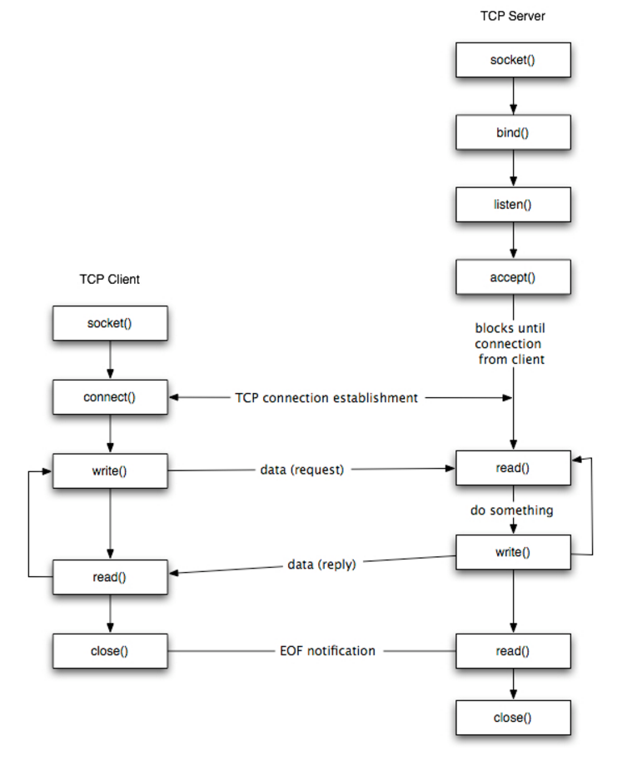
Sockets
Sockets are one end of an interprocess communication channel
The steps involved in establishing a socket on the client side are as follows:
Create a socket with the socket() system call
Connect the socket to the address of the server using the connect() system call
Send and receive data. There are a number of ways to do this, but the simplest is to use the read() and write() system calls.
The steps involved in establishing a socket on the server side are as follows:
Create a socket with the socket() system call
Bind the socket to an address using the bind() system call. For a server socket on the Internet, an address consists of a port number on the host machine.
Listen for connections with the listen() system call
Accept a connection with the accept() system call. This call typically blocks until a client connects with the server.
Send and receive data

Slide 9
References
http://www.programminglogic.com/example-of-client-server-program-in-c-using-sockets-and-tcp/
http://www.cs.dartmouth.edu/~campbell/cs60/socketprogramming.html
http://www.cs.rpi.edu/~moorthy/Courses/os98/Pgms/socket.html

