Slide 1
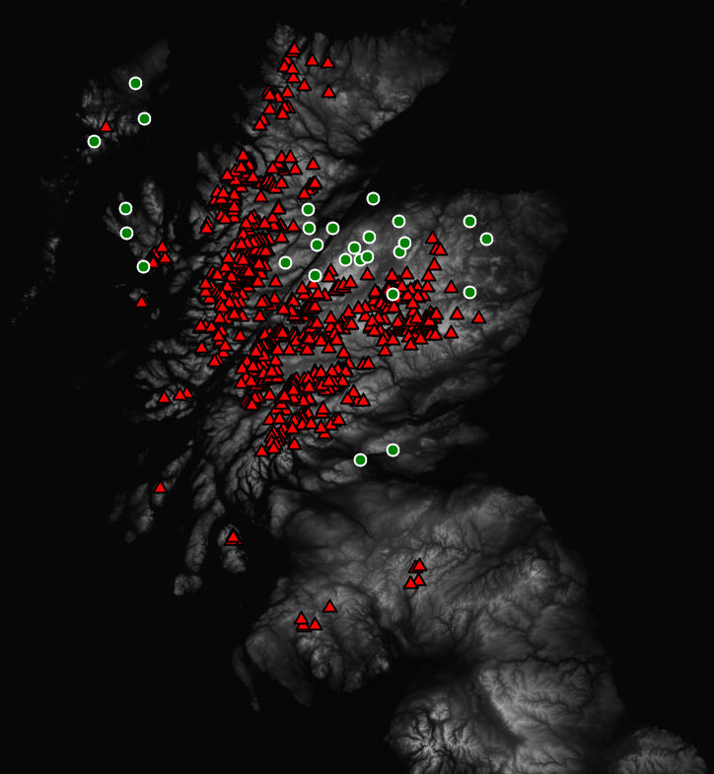

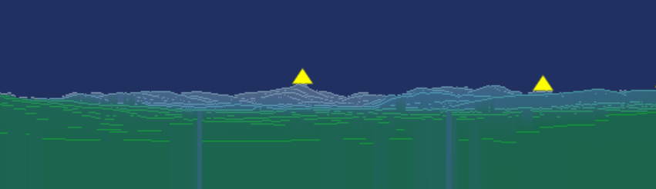
Rendering the Horizon in Real Time
with Open Terrain Data and Serverless AWS
Iain Hunter & Alastair Carson
FOSS4G, September 2019

Slide 2
What we’re building
Horizon Render App
Python Application
Renders a 360⁰ view of the horizon from a user provided location
Height Data from OS Terrain 50 Dataset
Geoserver 2.15 publishes user location dataset to a web client
Outputs a png with colour representing distance
Png can be integrated into an Open Layers web app
AWS Serverless Environment to host the app
Infrastructure as Code - Terraform to spin up our serverless environment in minutes
Docker - We’ll show you how the app can be wrapped in a docker container
Serverless - We’ll use AWS Fargate to host the app, and show you how you can set up a scheduler so you only pay for what you need

Slide 3

Outputs
A deeper understanding of how to run serverless GIS workloads in the cloud, for fun and profit. 3 core elements:
How to host an app in a Docker container so it can be scheduled in AWS
How to create a serverless AWS environment using Infrastructure as Code with Terraform. Including how to structure your IAC code
How to deploy and schedule an app on a serverless stack using AWS Fargate
Hopefully you’re inspired to try it yourself ☺

Slide 4

Introduction to all elements of the project:
Terraform
Docker,
AWS Serverless Stack
Python render app
No obligation to follow along
There should be time to get everyone running at the end
If we run out of time we’ll be happy to follow up after the workshop, or raise questions/issues on the github repo
All code is Open Sourced in thinkWhere’s github repo
Please ask questions as we go ☺
Check familiarity

Slide 5

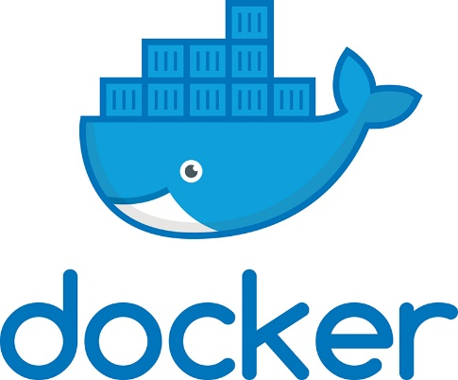

Pre-requisites
Admin access to an AWS Account
Strongly recommend setting up a separate account
Docker installed
Git client
Wifi gods on our side
Containers are all reasonably large, so it may be difficult to upload/download containers if bandwidth is limited.
If you don’t have the above you’re most welcome to stay and watch the workshop, and try to get things running later.

Slide 6

Workshop Overview
Part 1 – Iain Hunter
Intro to thinkWhere
A whistle-stop tour of serverless
Deploying a Serverless HelloWorld
Deploying our production environment
Virtual Private Cloud, eg a network to run our app on
Postgres (not serverless)
Serverless Geoserver
Part 2 – Alastair Carson
Overview of the Horizon App
Configuring the Production Environment
Demo

Slide 7
Git the code: https://github.com/thinkWhere
Github - Clone the workshop repos:
https://github.com/thinkWhere/foss4g-serverless-ops
https://github.com/thinkWhere/foss4g-horizon-render-app
https://github.com/thinkWhere/foss4g-horizon-web-app
Docker:
Run the foss4g-ops container and build geoserver :
docker-compose run foss4g-ops
docker pull thinkwhere/geoserver:2.15

Slide 8

Intro to
GIS Consultancy in Codebase Stirling
20 years working with Public and Private Sector Clients
Focus is on Open Source GIS tech
PostGIS, Geoserver, Mapproxy, Python, OpenLayers, Angular
Specialising in big data projects, web apps, training and consultancy
The thinkWhere mapCloud manages over 8Tb of data for various clients in handling over 20 million requests per month.
Clients include
British Library, Galbraith, Humanitarian Openstreetmap Team, Scottish Government, Harper Collins
OS Partner – Check out www.maptrunk.com to download data
Please get in touch info@thinkwhere.com www.thinkwhere.com

Slide 9
The Serverless Sales Pitch
What is serverless?
Serverless allows you to build and run applications and services without thinking about servers.
Why Serverless
It eliminates infrastructure management tasks such as server or cluster provisioning, patching, operating system maintenance, and capacity provisioning.
Everything required to run and scale your application with high availability is handled for you.
Serverless Benefits
No Server Management
Flexible Scaling
Pay as you go (don’t pay for servers running 24x7)
High Availability (Amazon’s engineers keep the underlying infrastructure running, not you)
https://aws.amazon.com/serverless/

Slide 10

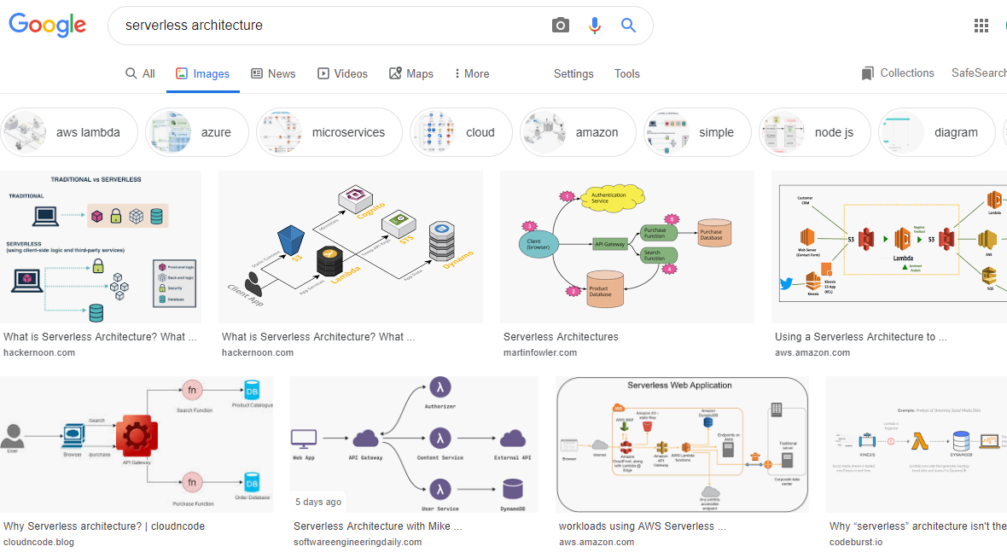
Sounds brilliant…. but where to start

Slide 11
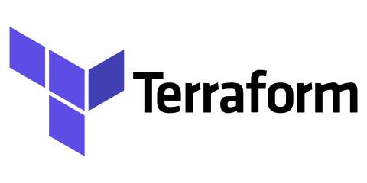


The Three Pillars of Serverless
The Cloud
IAC

Slide 12
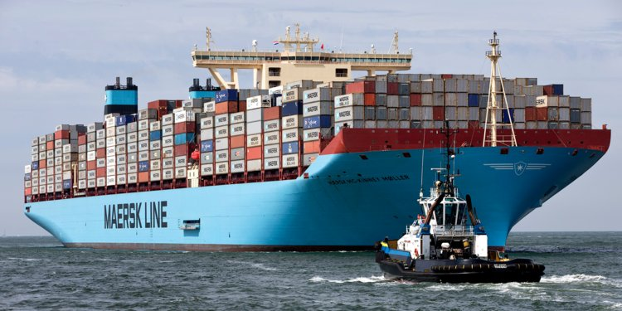
Package Software into Standardized Units for Development, Shipment and Deployment
Once you have your app packaged in a docker container it opens the door to all the serverless tooling and gives you the ability to deploy on any cloud platform – Google Cloud, Azure etc
We’ll show you how
Find out more
https://www.docker.com/resources/what-container

Slide 13
Infrastructure as Code (IAC)
IAC enables you to safely and predictably create, change, and improve infrastructure
No “click ops”
Gets rid of the “too scared to touch this” feeling
Collaborate and Share
Configuration can be stored in version control, shared, and collaborated on by teams
Evolve your infrastructure
Track the complete history of infrastructure versions
Automation Friendly
Today we’re going to be using Hashicorp Terraform (many alternatives)
Find out more
https://www.terraform.io/

Slide 14

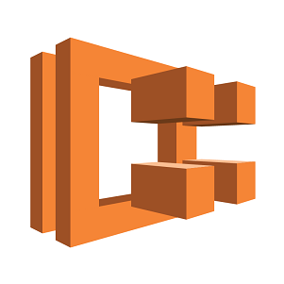
Part 3 - A HelloWorld AWS serverless architecture
VPC
AWS CloudWatch event fires every 5 minutes to run the app
HelloWorld App running inside a docker container on AWS Fargate

Slide 15
First Run Config
Before we can get Terraform to create infrastructure on our behalf we need to configure 4 items:
TODO diagram of how terraform works
An IAM user Terraform can run as
A S3 bucket for Terraform to hold it’s state
Terraform writes the current state of your infrastructure to a file. So when you make a change to your local config it detects this and compares your change to the stored state. It can then decide what changes need to be made.
An AWS region you’re going to create your infrastructure in (we’re using us-east-1 – Virginia)
App specific secrets we’ll put in the env_vars.ini file (more on this later)
Wiki Page
https://github.com/thinkWhere/foss4g-serverless-ops/wiki/First-Run-Config

Slide 16
Setting up our Global environment
There are some elements of our AWS environment that we want many apps to share, for our HelloWorld app these are:
Virtual Private Cloud VPC
IAM Credentials that our Serverless App will use
Wiki Page
https://github.com/thinkWhere/foss4g-serverless-ops/wiki/HelloWorld-Serverless

Slide 17
A small note on network topology
Our app needs to sit on a network so it can communicate with the internet
On AWS the typical way to set this up is to create a VPC split into 3 subnets:
Public subnet for communication to the internet
Private subnet for applications to sit in with no direct internet connection
Database subnet (basically another private subnet) where databases live
This allows us to control incoming traffic and ensure our apps and databases live in a space where it’s harder for malicious users to access.
There are a bunch of gateways, and routing tables that are required also but luckily Terraform simplifies the configuration and setup of these.
See diagram…

Slide 18
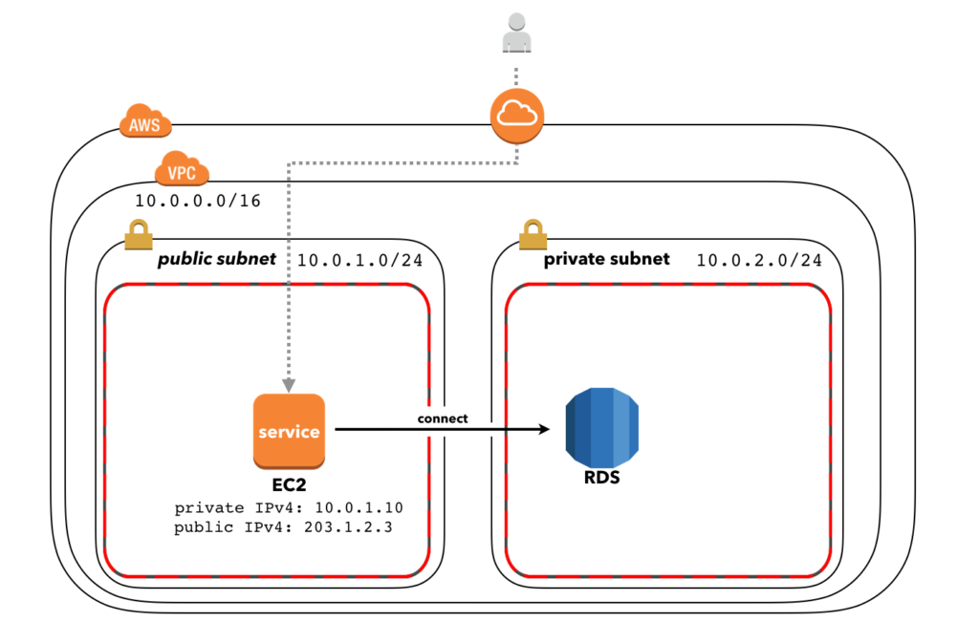
A basic AWS VPC

Slide 19
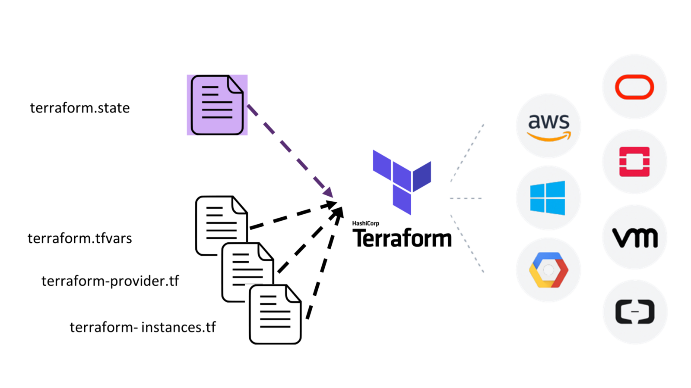
Terraform Overview

Slide 20
Terraform - Creating our global VPC & IAM Creds
Run commands from the wiki
Structure of a Terraform “component”
config.tf – Where you specify the provider and where to store the state
variables.tf – Where you supply variables like instance size, region etc
main.tf – One or more files where we actually define and compose our infrastructure
outputs.tf – Where we can specify the outputs of the component, so they can be shared with other components
Terraform module registry is a huge timesaver, where you can get pre-baked modules for common infrastructure like a VPC ☺
https://registry.terraform.io/
Take a look at the AWS Console to see what we’ve created

Slide 21
Terraform – HelloWorld App
No need to follow along with this as we’ll be doing the same thing for the bigger horizon app
Create a ECR docker repo to host our app
Create a ECS Fargate Serverless service
Check task definition
Check the CloudWatch event scheduler
Check cloudwatch logs
A quick look at our helloWorld app
Manually deploy our container
Code Pipeline can be constructed (exercise for the reader)

Slide 22
Terraform – Destroy HelloWorld
We can simply tidy up our environment by destroying the infrastructure we just created.
This is the power of IAC, simply and reliably tear down and recreate infrastructure in seconds.

Slide 23

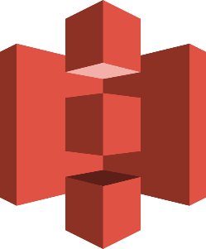
Part 4 – A production environment for our GIS workload
VPC
AWS CloudWatch event fires every 5 minutes to run the app
Postgres RDS DB with workload data
Horizon App running inside a docker container on AWS Fargate
Horizon render saved in S3

Slide 24
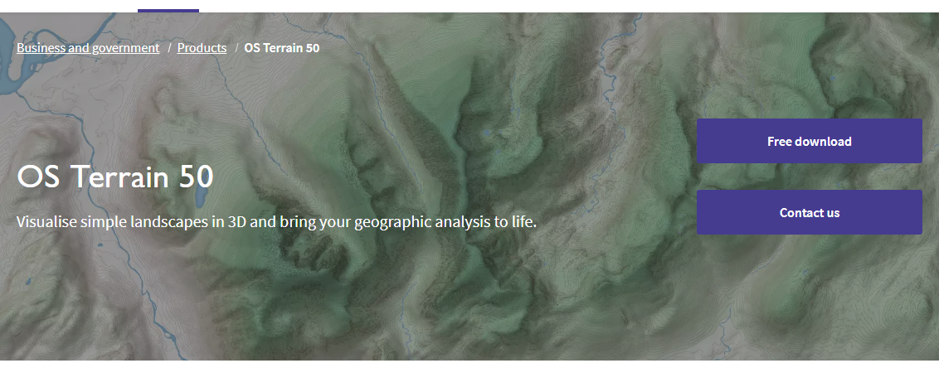
Horizon App
Started as a personal project
Born out of wanting to: -
Try out OS Open Data
Try out AWS
Generates an image of the horizon from Terrain 50 DTM data
Samples up to 50km away around 360° (Total of 6,400,000 points)
Finds peaks along each bearing, which are rendered on to the image
A JSON file of peaks (Munro’s & Corbett’s) which should be visible
Calculated using the same peak map
Mixed Success
50m grid can lead to blocky outputs
Looks fine from the right viewpoint, or at least in some directions!
Revived to provide a good example of a server-less workload for this workshop

Slide 25
Terrain 50 DTM Data
Downloadable from OS as Open Data
50m resolution DTM
10 x 10 km tiles with 200 x 200 values
Pre-processed for use here
ASCII files processed into binary files for quicker access
Script is included in the application repository
Uploaded to an AWS S3 bucket on our account
We have set our copy as publically accessible to save everyone else doing it today

Slide 26
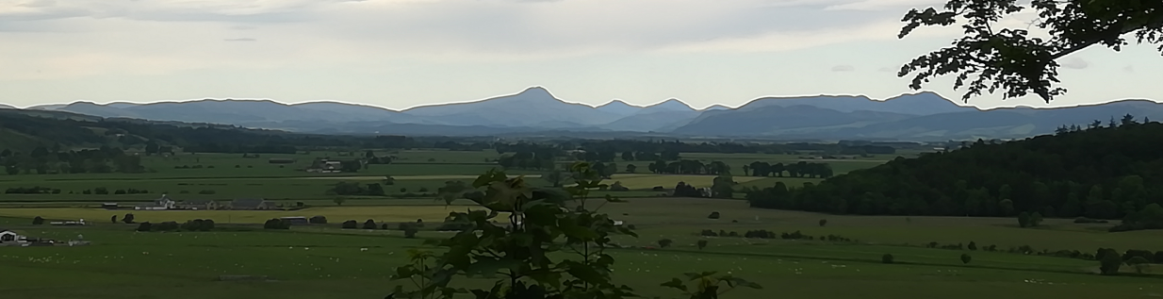
Example – Lunch time walk in Stirling

Slide 27
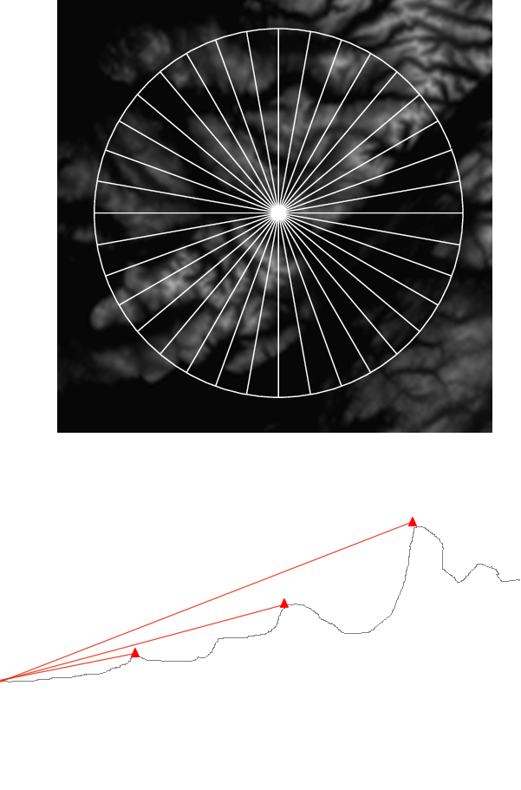
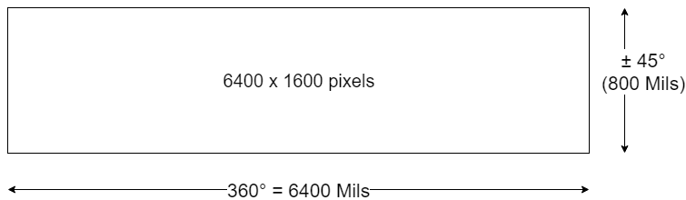
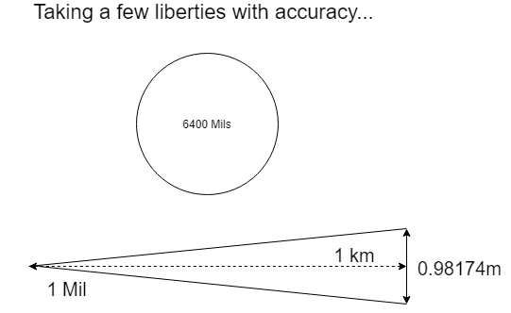
Terrain Map

Slide 28
Preparing the application for running on ECS/Fargate
FROM python:3.7 RUN apt-get update RUN apt-get upgrade -y # App code will be deployed into /app within docker container WORKDIR /src ADD . /src # Add and install Python modules. RUN pip install --upgrade pip RUN pip install -r requirements.txt CMD python app/location.py
Started as a Python script
Run via command line
Local resources on hard drive
Hard-coded location
Updated to: -
Read/write files from/to AWS S3
Source DTM data and output files
Read/write workload from/to database table
Simple point data table
Added Dockerfile for use as a Container
Checks for records to process, processes any, then exits
Added web application for display
OpenLayers map
HTML Canvas to show image with superimposed peaks

Slide 29
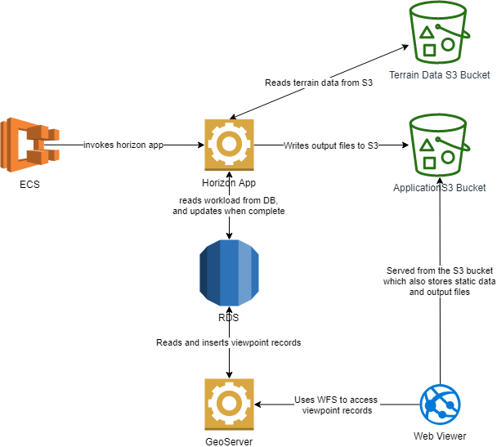
Overall Process
Dependencies of App are
Data in S3
Database table
Outputs of App are
Data in S3
Updated records in database

Slide 30
Part 4 – Production Environment
So building on what we learned in Part 3, we’ll use Terraform to setup the following elements
Global – VPC, IAM (already built)
Horizon App:
RDS Postgres Database Instance
Serverless Geoserver
Serverless App
Wiki Page
https://github.com/thinkWhere/foss4g-serverless-ops/wiki/Horizon-App

Slide 31
Here’s one we made earlier
http://horizon-viewer-test1.s3.amazonaws.com/map.html

Slide 32

Wrap Up
Hopefully you’ve been inspired to look at containers and serverless as an option for distributing your GIS workloads
Data exports, PDF generation, data loading, reprojection, data caching are all good candidates for this approach.
Simplistically if you can run your app in a local container you can deploy it to the cloud.
Workflows can rapidly become complex. However, IAC can help manage the complexity
Devil is in the detail. Productionising is time consuming, build pipelines, secret management, logging and alerting will take time to get right.
Containers are undoubtedly the way the world is moving to deploy apps. Great for managing dependencies. Exciting time in the DevOps space with lots of innovation.

Slide 33

Get in touch
info@thinkWhere.com https://github.com/thinkWhere

