Slide 1


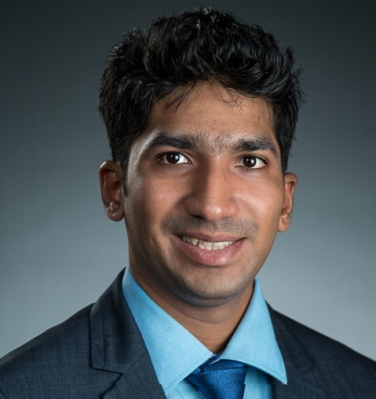

The Man Who Solved The Market and can you?
Aniket Shirsat
Data Scientist @ American Express

Slide 2
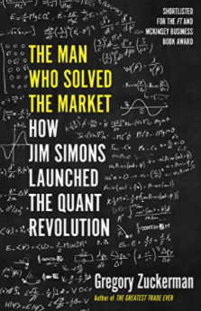
The Man who solved the Market
Who is Jim Simons?
Mathematician / Statistician
Math Professor (MIT/ Harvard)
Code breaking for the US Intelligence
Chair of the mathematics department at Stony Brook University.
Founded Renaissance/ Medallion Fund
Known as the “Greatest Investor on Wall St.”

Slide 3
Can we solve the market?
What we need?
Strategy
Data
Feature Modelling
ML Model
Model Validation / Back Testing
Production (Super Risky $$$)
Notes:
Make it proportion wise

Slide 4
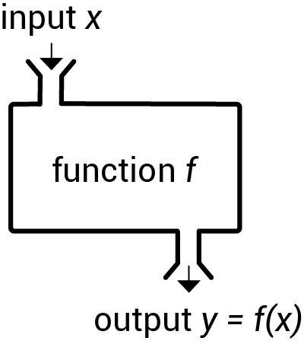
Strategy
What is our GOAL?
Swing trading.
Find stocks that have a high confidence to go up in next 10 days.
Use Machine Learning Model?
What is X and what is Y?

Slide 5


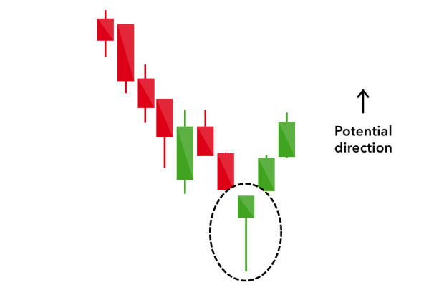
DATA
Notes:
Code?

Slide 6
Feature Modelling
X : TECHNICAL INDICATORS
What are they?
Why they work?
Y : Buy Indicator
Did the stock went up __% in the next __ days.
Without going down by __%.

Slide 7

ML Model
Classification
2 classes
Imbalance: Yes

Slide 8
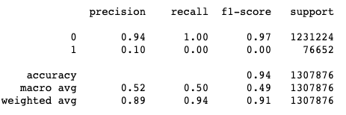
Model Validation / Back testing
What is Important ?
Precision
Recall
The precision is intuitively the ability of the classifier not to label as positive a sample that is negative.

Slide 9
DISCLAIMER
Do your Own Research
The content is intended to be used and must be used for informational purposes only. It is very important to do your own analysis before making any investment based on your own personal circumstances. You should take independent financial advice from a professional in connection with, or independently research and verify, any information that you find here and wish to rely upon, whether for the purpose of making an investment decision or otherwise.

Slide 10
Final Though!
yourself.
The best investment you can make is in

Slide 11



Let’s Connect!
www.linkedin.com/aniketshirsat
www.twitter.com/an1ke7
www.phxdataconference.com
www.github.com/an1ke7

