Slide 1
Java Table of contents
Java installation and configuration
Eclipse installation
Writing first program in Eclipse
Object oriented Programming
Oops feature - inheritance
Oops feature - Abstraction
Oops feature – Encapsulation
Oops feature – Polymorphism
Oops feature – Platform independent
Class Members – Data and Methods
Variable scopes
Operators
Control flows
Constructors
Interface and Sub class

Slide 2
Abstract classes
Access privileges
Overload methods and compiletime polymorphism
Override methods and Runtime polymorphism
Data Transfer Object
Static and Final keyword.
Arrays
Exception handling
Try/catch/finally
User Defined Exception
Threads
String class
Collections
List
Set
Map
File IO operations
Package Jar and Configuring Classpath
Class loaders

Slide 3
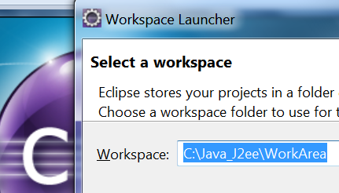
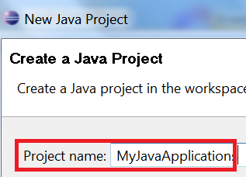
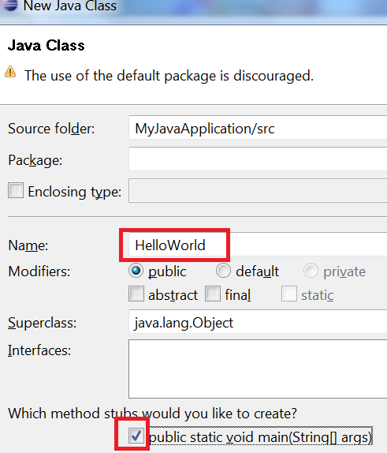
Eclipse – Configure Workspace and Application
Create folder
C:\Tutorial\java
double click the eclipse shortcut
on desktop.
Enter the workspace path as
C:\Tutorial\java
Press ok
Click File -> New -> Java Project
Enter “tutorials_workspace” as
“project Name”
And press “Finish” button
Click Window -> Show view -> Project Explorer
Double click on tutorials_workspace in left window
Right Click on src->New->Class
Enter Class name as HelloWorld
Select option

Slide 4
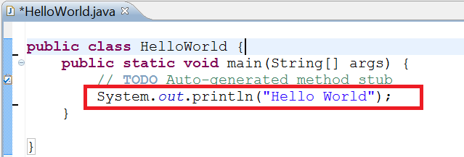
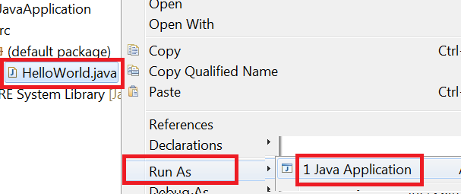
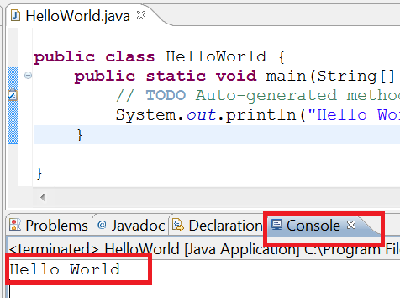
First Java program in eclipse
Continuing from previous step.
Type in below line
System.out.println("Hello World");
Eclipse compiles java code automatically.
To execute this program
In left window under
JavaApplication->src->(default package)
Right click on class name HelloWorld.java
-> Run as -> Java Application
Program output can be seen in the
console window

Slide 5
Java commands
Code : source code files are stored with extension “.java”
Package name : the very first line of java program. Helps in organizing code structure and avoids conflicts with same class names.
Java program name and file name : Java program name is mentioned in the program followed by public class. ( if a file name is Helloworld.java – the code in the program contains “public class Helloworld” )
Compile :
javac command is used to compile .java files into .class files . The .class file contains byte code which can be interpreted by any JVM thus making java platform independent.
Execution :
java command is used to execute java programs. Executing java program requires the complete path (dot separated) starting with package name and class name. The java program being executed must contain main method with a signature public static void main(String args[])
Note : refer Java classpath and path setup steps for Java environment.
In directory c:/ , there is a file Hello1.java. The file contains class name Hello1 and no package name.
Open command prompt.
Compile : Go to the the directory location c:/ and execute command “javac Hello1.java”
Execute : Go to the the directory location c:/ and execute command “java Hello1”
In directory c:/ , there is a file Hello2.java. The file contains class name Hello2 and package name as com.tutorial.
Create a folder c:/com/tutorial. Copy Hello2.java in c:/com/tutorial
Compile : Go to the the directory location c:/com/tutorial and execute command “javac Hello2.java”
Execute : Go to the the directory location c:/ .Then execute the program with command “java com.tutorial.Hello2”

Slide 6
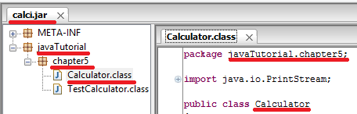
Packaging jar and configuring classpath
Jar is an archived folder ( like zip) which contains group of class files. Files in jar are stored as per the fully qualified class name structure. If a Calculator.class file has package javaTutorial.chapter5. The fully qualified class name is javaTutorial.chapter5 .Calculator
To create jar file for this class, we need to create folders similar to package name.
Exampe : In c:/ folder, Create a folder javaTutorial with a sub folder chapter5 and store the file Calculator.class in it.
Go to parent folder of package structure and execute jar command.
cd c:/
Classpath : Environment variable contains group of jar file (complete path), separated by semicolon in windows.
Location : Mycomputer -> right click -> properties -> advanced -> environment variables -> system variable -> CLASSPATH
Value:To add calci.jar in classpath .;d:/abc.jar;e:/work/xyz.jar;c:/calci.jar
jar –cvf calci.jar javaTutorial/chapter5/*.class

Slide 7
Class Loaders
Java com.tutorial.Hello
Bootstrap classloader : <JDK_HOME>/JRE/lib/rt.jar . search rt.jar for com/tutorial/Hello.class.
Extension classloader
The folder <JDK_HOME>/JRE/lib/ext has several jar files. searches into each of these jar files for for com/tutorial/Hello.class.
Classpath classloader
Environment variable CLASSPATH has semi colon separated jar file location. Searches into each of these jar files for com/tutorial/Hello.class
Error: Could not find or load main class

Slide 8
Object Oriented Programming
Object oriented Programming : OOP allows us to represent any entity in the form of an Object or data structure (that contains data and method). All real world examples such as person/profession/organization are made up of properties/attributes and perform some behaviors. These real world examples can be represented in terms of Objects.
Java : Java is an Object oriented programming developed by Sun Microsystems which is now oracle.
Class is a blue print used to define “state/attributes” & “behavior” of an entity.
Objects are real or runtime instances /version/copy of class. Objects contains state and behavior. Objects are usually live implementation of a blue print that is class. new operator is used to create an object.
Class Dog defines state and behavior of animal Dog – Dog should have a name and should run.
Object myDog contains state and behavior for the Dog blue print – Dog object has a name Milo and is running.

Slide 9
OOP features Inheritance
This feature represents “is-a” relationship. It allows children entities to acquire all the features from parent entity without rewriting entire existing feature. In terms of OOP/Java a sub class acquires or can access all the data and method of parent class. This feature helps to organize, generalize , reuse features.
Example : Animals, car, building,phone etc
“Phone” -> “Mobile” -> “Iphone” -> “Iphone4”
Mobile is a Phone , Iphone is a Mobile, Iphone4 is a Iphone
As in above example , While launching IPhone4 Apple company did not had to develop the product from the scratch. They reused the previous model and added just a new voice command feature Siri.
IT example/Work experience : Electricity company like Reliant has different set of customers (Residential and Business). Registration project requires to collect information from both customers. The common information in either residential or business would be userid/pwd/secret que/secret ans, which can be written in parent class Customer. Sub class ResidentialCustomer and BusinessCustomer can reuse parents generic code and just work on customer specific info later.

Slide 10
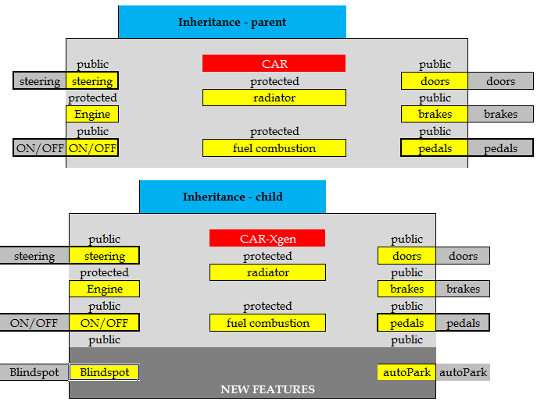
OOP features Inheritance

Slide 11
OOP features - Encapsulation
Encapsulation
Encapsulation is a way of organizing data and methods. Encapsulation uses different access privileges on data and methods to hide/protect/organize data and methods. This feature allows enterprise application to maintain confidential information.
Real life example : When person pays his/her bill to a service provider like reliant electricity , they need not know how you arranged payment or how much funds you have. A Person’s funds/bank balance is personal and needs to be protected from outside world. So a person organizes or manges his funds/data privately and only ensures the required functionality like “pay my bill” options is visible to outside world.
IT example/Work experience : Authentication team and payment team get their respective job done as “authentication status complete” or “payment completed” without compromising confidential information , without disclosing customer’s information to outside world. Customer’s userid/pwd is secret/private for authentication team, customer’s creditcard information is private/secret to payment team.

Slide 12
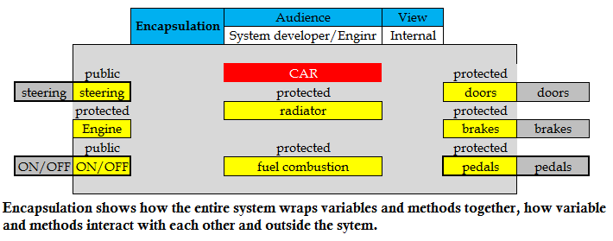
OOP features - Encapsulation

Slide 13
OOP features Abstraction
Abstraction allows us to hide the internal complex implementation details and allows end user to use the interface without being concerned about internal complexity.
Real life example : When a customer buys a car, he/she is only concerned about using the interfaces like steer the vehicle, start, stop etc. Customer is not burdened with knowing how the car mechanics or engine works internally.
IT example/ Work experience : Teams are divided in several components GUI developers, Business logic developers, backend database developers. All the team understands what interface to be used to integrate the entire system. Each individual team (ex : business logic team) concentrate on implementing their role/requirement without needing to know the complexity involved in other teams requirement implementation (GUI development or DB integration). GUI team invokes Business logic team interface such as register,Login,Order,Pay api’s without needing to know what is the internal complexity of registering , authentication, processing order.
Abstraction is more generic concept which provides features like reusability, generalization, Hide complexity etc..

Slide 14
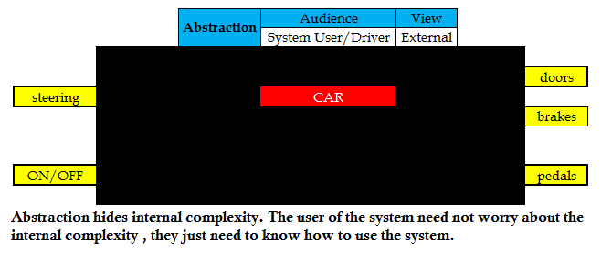
OOP features Abstraction

Slide 15
OOP features Polymorphism
Polymorphism means many forms. This feature allows us to define same functionality in multiple ways based on the input provided. In short Same functionality different input gives different output.
Real life example : We come across polymorphism every day. Dressing or eating are functionality , we chance the way we dress based on what occasion we attend to. Dressing functionality for occasion Office is professional dress Dressing functionality for occasion sleep is night dress. Eating functionality has food items that changes based on morning, afternoon, night.
IT example/ Work experience : Companies like “reliant” electricity provider has many services. Each service is billed differently based on the kind of service. Same functionlity Calculate Billl varies based on services.
A CalBill functionality for internet service is calculated on download/upload speed A CalBill functionality for cable is calculated based on channels subscribed A CalBill functionality for Wireless phone service is calculated based on data speed and talk time.

Slide 16
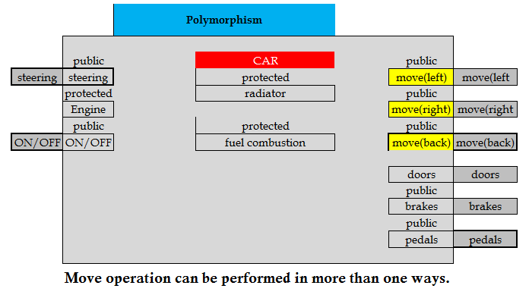
OOP features Polymorphism

Slide 17
OOP features – Platform Independent
Platform Independent: One of the features of Java is WORA (Write Once Run Anywhere). Developers need not write different code for different operating systems. JVM ( Java virtual machine) makes the code translation to underlying machine. Java has a compiler and interpreter, both together make the language platform independent
Java compiler : (javac commands ) the java source code (.java files) is compiled into intermediate form called ByteCode (.class files). Byte code remains same across all platforms. Byte codes are non machine readable ,JVM readable format.
Java interpreter : The java Interpreter are specific to underlying machine. They interpret the intermediate bytecode and convert to underlying machine’s readable format.

Slide 18
Chapter 2- Class Members - Data
Data – Data in a class is represented by its type (Data type) and name ( variable ).
Data type : each attributes/data of a class should be assigned a type. Example : dog class has “name” attribute of type String and legs attribute of type int.
Primitive data type : byte,short,int,long,float,double,char,boolean.
Object data type : User defined or Java provided objects ( String, File class etc ) .
Variable : is a container or reference that holds/points value of the data. Variable name can contain letter,digit,$,_ variable name should start with letter,$,_
instance variable – non static variable
Class variable – static variable
Local variables – variables declared inside the method.
Parameters – variables passed in methods
Default values of declared data types are
Primitive data type : byte=0 , short=0 , int =0 , long =0L , float =0.0f , double =0.0d , char ='\u0000' , boolean =false
Object : (example String) = null
Accessing data : data accessed by using dot operator on class name or object(variable name )

Slide 19
Chapter 3- Class Members - method
Method : methods represents the functions/ behavior of a class. It has two sections declaration and definition.
Declaration : method declaration consist of
Access privileges : defines visibility scope of a method ( covered in chapter)
Return type : this part of the method declaration represents the output or response from the method call. This is usually a data type.
Example : if dog class has method getName. The response or return type from this method call is expected in String type.
Void : if no results are to be returned from the method define as void.
If results are expected from the method return type can be defined as one of the Primitive data type or object data type.
Method name : Java naming convention suggests camelcase. Same rules as naming variable applies to method name as well.
Method parameters : this part of the method declaration defines input to the method. parameters to a method are not mandatory and can contain 0-N number of parameters.
Example : If dog class has method eat. User requires to pass input as String food as the parameter.
Exception :
Definition : method definition contains the logic/instruction to complete the task.
Accessing Method : Methods are accessed by using dot operator on class name or object(variable name )

Slide 20
Assignment-1
Below keywords cannot be used as variable or methods :
abstract,continue,for,new,switch,assert***,default,goto*,package,synchronized,boolean,do,if,private,this,break,double,implements,protected,throw,byte,else,import,public,throws,case,enum****,instanceof,return,transient,catch,extends,int,short,try,char,final,interface,static,void,class,finally,long,strictfp**,volatile,const*,float,native,super,while
Write java class for below example.
List following. FYI : Has refers to variable/fields/data of a class, Does refers to methods of the class.
1) Product
Has/instance variable : name, price, quantity
Does/methods : buy, sell, negotiate
2) Car
Has/instance variable :
Does/methods :
3) Bank
Has/instance variable :
Does/methods :
4) Television
Has/instance variable :
Does/methods :
5) Fan
Has/instance variable :
Does/methods :
6) Tree
Has/instance variable :
Does/methods :

Slide 21
Assignment
Create Methods for following
Cacluclator program
Method for calculating area of triangle
Method for calculating area of circle
Method for calculating area of rectnagle
Method for calculating (a+b)2
Bank Program
Method for calculting simple interest
Method for withdraw
Method for deposit
Ecommerce program
Method for login
Method for registration
Method of add to cart
Method for payment
Mail Program
Method for sending email
Method for deleting email
Method for read email

Slide 22
Interactive native apps Assignment
Make All the programs from previous assignment interactive.

Slide 23
Java program structure
Package
package com.tutorial;
import
import java.lang.String;
Class name
public class Person {
Data/variables
String item;
Local variable declaration
assignments
Blocks
method invocation
Public void eat(String food){
methods
boolean hungry=false;
Item=food;
While(hungry)
{
System.out.print(“eating “+item);
}
}
}
The compiled Java program should be stored in a folder structure similar to package name. For above example, Person.java is a java source code file, the compiled file Person.class must be stored under folder com followed by sub folder tutorial ( as package name com.tutorial)

Slide 24
Chapter 4 - Variable scope
Class variable : static variable declared outside the method with global scope.
Instance variable : non static variable declared outside the method with global scope.
Local variable : local variable are declared within the methods. If there is a variable name conflict between in local and global variable, local variable takes precedence within the method.
Method parameters : These variables have a local scope just as local variable. If there is a method parameter name conflict and global variable name, method parameter variable takes precedence within the method.
Assignment : Create appropriate variables in a program
Car program has Vin and transportation type
Product program has quantity , name , price
Bank program does withdraw functionality that takes withdraw amount as input
Calculating sum of 3 numbers
Calculating simple interest with P T R
Chase Bank Account program has bank name, customer names, balance.
Amazon program has method changePassword that takes userid and new password and confirms if change was success or failure

Slide 25
Chapter 5 - Operators, Statements and blocks
Statements consists of variable , method invocation, assignement
Blocks : Blocks consists of group of statements within braces.
Simple Assignment Operator
= Simple assignment operator
Arithmetic Operators
+ Add operator
- Subtraction operator
* Multiplication operator
/ Division operator
% Remainder operator

Slide 26
Chapter 5 - Operators
Equality and Relational Operators
== Equal to
!= Not equal to
> Greater than , >= Greater than or equal to
< Less than , <= Less than or equal to
Unary Operators
+ Unary plus operator; indicates positive value (numbers are positive without this, however)
- Unary minus operator; negates an expression
++ Increment operator; increments a value by 1
-- Decrement operator; decrements a value by 1
! Logical complement operator; inverts the value of a boolean
Conditional Operators
&& Conditional-AND
|| Conditional-OR
?: Ternary (shorthand for if-then-else statement)
String name = “uppercase”.equals("uppercase") ? "JOHN" : "john";
Type Comparison Operator
instanceof Compares an object to a specified type
Bitwise Operators
& : 3 & 6 = 011 & 110 = 10 = 2 ( both bits are 1)
| : 3 | 6 = 011 | 110 = 111 = 7 ( both or either bit are 1 )
^: 3^6 = 011 ^ 110 = 101 = 5 ( both bits cannot be 0 or 1 )
Reference : https://docs.oracle.com/javase/tutorial/java/nutsandbolts/

Slide 27
Operator Precedence
Operators | Precedence
bracket | (),[]
postfix | expr++ expr--
unary | ++expr --expr +expr -expr ~ !
multiplicative | * / %
additive | + -
shift | << >> >>>
relational | < > <= >= instanceof
equality | == !=
bitwise AND | &
bitwise exclusive OR | ^
bitwise inclusive OR | |
logical AND | &&
logical OR | ||
ternary | ? :
assignment | = += -= *= /= %= &= ^= |= <<= >>= >>>=
Reference - https://docs.oracle.com/javase/tutorial/java/nutsandbolts/operators.html

Slide 28
Chapter 6 - Control Flows
Java program consist of several lines/statements of codes. Programs requires to decide if a block of code is to be executed or not. Control Flows provides conditional decision making criteria to allow execution of block of statements.
If : execute line of code inside the if block on condition being satisfied. Used when there is only 1 option.
if(debitCardPin == “pin I entered”)
{ // allow customer to enter amount and withdraw money }
If else :
If block is executed if condition is satisfied.
else block is executed if condition is not satisfied
Used when only 2 options are available (either/or)
if(debitCardPin == “pin I entered”)
{ // allow customer to enter amount , withdraw money }
else
{ // error xshow error “invalid pin” }
if elseif else
Execute block on whichever condition satisfies. If all fails final else block is executed
If ( want to witdraw money)
{ // withdraw money }
else if ( want to check balance)
{ // show balance }
else
{ // quit }

Slide 29
Control Flows
For loop has 3 parts. Initialization , conditional check and increment
For(int i=0;i<10;i++)
int i=0; // initialize the loop with 0;
i<10; // keep looping until I value is less than 10
i++; // increment I value after every loop.
While : Unlike for loop, while loop has just conditional check. Initalization and conditional check has to be done outside/inside of the loop.
int i=0;
while(i<10)
{
// do the job
i++;
}
Do While loop ensures atleast 1 execution of the loop before validating next check.
do{
// execute these lines
}while(i<10 )
Switch case is similar to “if else if” loop ,except it takes primitive data type input.
Switch(i)
Case 1 : // if input passed is “1” do something
break;
Case 2 :// if input passed is “2” do something
break;
Default
break;

Slide 30
Assignment-2
Write a Class Calculations
Write a method to calculate interest rate.
Write a method to convert $ to rupees.
Write a method to print 1 to 10 using increment operator.
Write a method to see if a number is greater than 50.
Write a method to print multiples of 5 (1-10) using for loop
Write a method to print multiples of 6 (1-10) using while loop
Write a method to print “customer care” if input to method is 1 else print “other help” using ternary operator.
Write a method to print menu items (use Switch case)
1 – Pizza
2 – Pasta
Default – salad

Slide 31
Chapter 7 - Constructors
Constructors are invoked when a new instance/object is created using operator “new”. Constructors are used to initialize instance variables of an object . Constructor is the very first class member invoked.
Constructors name should be same as Class name.
Constructors should not have any return type.
There are no limits to number of constructor in a class.
If no constructors are defined, Compiler provides a default constructer with no parameters and no code.
BankAcct ragSav=new BankAcct(name);
BankAcct ragSav -> create a reference variable ragSav which can hold the memory address of an object BankAcct
new BankAcct -> new operator create an object in memory of type BankAcct and return the memory location address which is then stored in ref variable ragSav.
(name) -> invoke the constructor of BankAcct which takes one string parameter.

Slide 32
Program View
Memory View
The images in orange are reference variable
The images in yellow are address to the object memory location.
The images in blue are actual object in the memory
x
“Andy”
name
S
T
R
I
N
G
x
“Andy”
name
S
T
R
I
N
G
public class test
{
public static void main(String[] args)
{
String name=new String(“Andy”);
BankAcct ragSav;
ragSav=new BankAcct(1);
//BankAcct ragSav=new BankAcct(x);
}
}
ragSav
x
“Andy”
name
S
T
R
I
N
G
public class BankAcct
{
int acctId;
int bal;
public BankAcct(int CusId)
{ acctId= CusId; }
public BankAcct(String act,int money)
{ acctId=act;
bal=money; }
}
}
ragSav
y
B
A
N
K
A
C
C
O
U
N
T
acctId
p
0
bal
q
0
x
“Andy”
name
S
T
R
I
N
G
ragSav
y
B
A
N
K
A
C
C
O
U
N
T
acctId
p
1
bal
q
0

Slide 33
Program View
Memory View
The images in orange are reference variable
The images in yellow are address to the object memory location.
The images in blue are actual object in the memory
x
“Andy”
name
S
T
R
I
N
G
ragSav
y
B
A
N
K
A
C
C
O
U
N
T
acctId
p
1
ragChk
bal
q
0
public class test
{
public static void main(String[] args)
{
String name=new String(“Andy”);
BankAcct ragSav=new BankAcct(1);
// y is like a key to the bankacct object locker.
// below line RHS ragSav holds value y, the same value is copied to another ref variable. Now 2 reference variables access to same memory location.
BankAcct ragChk=ragSav;
// if changes are done by 2nd variable ragChk the change will reflect in the same memory location
ragChk.bal=100;
ragSav.bal=1000;
ragChk = new BankAccount(2);
}
“Andy”
x
S
T
R
I
N
G
name
ragSav
B
A
N
K
A
C
C
O
U
N
T
y
acctId
p
1
ragChk
bal
q
100
x
“Andy”
name
S
T
R
I
N
G
ragSav
y
B
A
N
K
A
C
C
O
U
N
T
acctId
p
1
bal
q
1000
z
B
A
N
K
A
C
C
O
U
N
T
acctId
r
2
ragChk
bal
s
0

Slide 34
Chapter 8 - Interface and Sub class
Sub class is an inheritance implementation. This feature allows Java programs with reusability features. Sub class is implemented by keyword extends. Which allows Sub class to inherit all the data and methods from parent class.
Sub class cannot inherit from more than 1 parent.
Child class cannot exist without creating parent object first. Sub class constructors internally calls default super constructor.
Runtime polymorphism :
You can pass sub class object to a Method that takes parent class as parameter.
Assignment : Parent class on the left hand side and sub class object on the right hand side .
Type casting : type casting can be done among the same class heirarchy else results in runtime ClassCastException. Instanceof operator can be used to identify the real child object.
Method can be hidden from sub class if private or sometime even package – (Access privilege chapter )
Final Keyword :
Methods : cannot be overridden
Class : cannot be extended
Super keyword :
Sub class constructor can call parent constructor explicitly by keyword super. Super should be the first statement in sub class constructor.
Super keyword can also be used to access overridden parent class method
Interfaces provides pre-defined contract/agreement/specification for accessing the system. Interface specifies the outer view of a system. Interface provides a high level view on how the systems will/should interact with each other.
Interface is defined with keyword “interface” instead of class. An implementing class should implement all the methods in an interface, or else the implementing class will become abstract. An interface has method definition only , no implementation is provided. Implementing class provides implementation for the interface.

Slide 35
Default methods : introduced in Java 8 , default methods allows java frameworks and application with backward compatibility features.
Multiple inheritance issue: conflicting default methods from multiple inheritance causes compiler error.
Implementing class need to override the default method. Implementing class can call one of the parent methods implementation as <interfacename>.super.<default_method_name>
Default method can also be overridden, converted to abstract again.
An interface “SmartPhone” provides an agreement/standards defined to all phone companies to provide keypads and makeCall features. If a phone company fails to provide these features ; it is an incomplete(Abstract) SmartPhone.
When to use Interface : Designer /Architect of a project providing guidelines to developers and tester on 1) how the system is expected to behave/react when being used 2) what the system is suppose to deliver.
IT experience example : Authentication Interface. BusinessAuthentication class and ConsumerAuthentication class both requires to validate username and password as mandatory steps in authentication process.
Assignment-3
Give 5 examples of inheritance in real world.
Write a class Father
Write a Sub class Son
Write a Class for Company –
data companyName, companyService, CompanyLocation
Write a constructor to initialize companyName
Write a constructor to initialize companyName, companyService
Write a constructor to initialize companyName , companyService, companyLocation

Slide 36
Chapter 9 - Abstract Classes
Abstract classes are non-concrete or incomplete classes. Since these classes are incomplete they cannot be instantiated or created object. Abstract class may or may not have abstract methods. A class implements an interface , if the class does not implement few or all of the interface methods it has to be declared “abstract”.
“nokiaBetaPhone” class does not adhere to all the conditions/agreement of interface “SmartPhone”. “nokiaBetaPhone” can allow you to make and recieve call, but cannot allow you to browse, which makes it an incomplete(abstract) SmartPhone.
When to use Abstract : If the developer want to implement methods which are common to all the future/category of classes.
IT work experience : Registration class is an abstract class. This class has the common api’s implemented required by ConsumerRegistration and BusinessRegistration class.

Slide 37
Chapter 10 - Access privileges
Access privileges : compare below table across . John finger prints compared with john / john’s family member / john children / Others.
 | Private | Package | Protected | Public
Same Class | Y | Y | Y | Y
Different class but in same package | N | Y | Y | Y
Sub class in same package | N | Y | Y | Y
sub class in different package | N | N | Y | Y
Different Class in Different package | N | N | N | Y
 | John finger prints | Meet John daily | john money | internet
John | Y | Y | Y | Y
john's family members | N | Y | Y | Y
John's children - in same family. ex : Son | N | Y | Y | Y
john's children - in other family, ex : Daughter | N | N | Y | Y
others | N | N | N | Y

Slide 38
Assignment-4
Write a Interface for SuperSonicPlane
Method : fly(), goWithSoundSpeed()
Write abstact class Plane,
Write Concrete class Mach3
Access privileges
Write a class audience
Method
checkPrice – call car methods price
Write a class driver
Method
Drive - Call Car methods
Write a class Car
Method
Price ( accessible to all )
Steering ( accessible within same package )
fuelInjector ( not accessible )
Motor ( not accessible )
engineCombustion ( not accessible )
Brakes ( accessible within same package )
Accelerator ( accessible within same package )
onOff ( accessible within same package )

Slide 39
Chapter 10b - Data Transfer Objects
Java methods can accept zero or more parameters.
Java methods has a limitation of just 1 return item.
Data Transfer Objects are used very often in all online applications. When information exchanged between 2 parties requires to send or receive more than one info or complex information.
Complex input : accept customer information for registration
public boolean register( String firstName, String lastName, String address, String city, String state, String zipCode, int mobile, String userid, String password)
public boolean register( Customer cust)
Complex output : accept userid and pull customer information.
public String,String,String,String getInfo(String userid)
public Customer getInfo(String userid)
Solution :
Create a DTO Class Customer which has/instance variables String firstName, String lastName, String address, String city, String state, String zipCode, int mobile, String userid, String password.
Set the values in each of these instance variable and exchange data

Slide 40
DTO- Data Transfer Objects
public class CalcDTO
{
public int sum,sub;
}
x
Calculator
myCal
public class Calculator
{
public CalcDTO doItAll(int a,int b)
{
CalcDTO result=new CalcDTO();
result.sum=a+b;
result.sub=a-b;
return result;
}
}
x
Calculator
a
4
myCal
result
b
3
y
CalcuDTO
sum
sub
0
0
x
Calculator
a
4
myCal
result
b
3
y
CalcuDTO
sum
sub
7
public class Student
{
public static void main(String args[])
{
Calculator myCal=new Calculator();
CalcDTO myResult= myCal.doItAll(4,3);
}
}
1
myCal
x
Calculator
y
CalcuDTO
sum
sub
7
myResult
1

Slide 41
Chapter 11 – Polymorphism type
Polymorphism means many forms. Java has compile time and run time polymorphism.
Compile time polymorphism refers to a method which can perform different task with same interface name. overloading methods are an example of compile time polymorphism.
Dinner restaurant purpose is serveFood. The same feature serveFood comes in Indian and American food form.
public Class MyRestaurant
{ public void serveFood(AmericanFood food) {}
public void serveFood(IndianFood food) {}
}
Run time polymorphism : Inheritance refers to runtime polymorphism. JRE resolves the object in runtime.. OverRiding and inheritance objects are example of runtime polymorphism.
Iphone is a Iphone3 and Iphone is a Iphone4
A company orders 1000 iphone as a generic order for there 1000 employee.
Verision can be resolved only when all the 1000 Iphones are delivered. The seller can send 300 Iphone3, 300 Iphone4, 400 Iphone5

Slide 42
Chapter 12- Static and Final
static variable : These variables are called class variables. These variables are shared by all the objects of its class.
These variables can be accessed without creating an object, provided these variables have proper access privileges.
Non static and static method can access static variables.
Static Methods : These methods are shared by all objects of its class
These methods can be accessed without creating an object as well, provided these variables have proper access privileges.
Non static and static methods can access static methods.
static methods can access only static methods and variable. (cannot access non static variable and methods.)
Final keyword in java is used to ensure no modifications are performed to a variable/method/class.
Final variables are variable whose values cannot be changed.
Final methods cannot be overridden.
Final class cannot be extended.

Slide 43
Static variable
public class Car
{
public static int sales;
public int vin;
public Car(int newVin)
{
vin=newVin;
Sales++;
}
public void drive()
{
System.out.print(“driving”);
}
}
nissan1
x
Car
vin
1
nissan2
y
Car
vin
2
Sales
nissan3
z
Car
vin
3
0
nissan1
x
Car
public class CarCustomer
{
public static void main(String args[])
{
Car nissan1=new Car(1);
Car nissan2=new Car(2);
Car nissan3=new Car(3);
nissan1.sales=100;
nissan1.sales=101;
nissan1.sales=102;
}
}
vin
1
nissan2
y
Car
vin
2
Sales
nissan3
z
Car
vin
3
102

Slide 44
Accessing Methods
 | Static Member | Non Static member
Same class Static member | Can access directly just by method name | Can access directly just by method name
Same Class Non Static Member | Need to create an object of the same class and access the method using object. | Can access directly just by method name
Other class Static member | Can access with Classname followed by dot and method name | Can access with Classname followed by dot and method name
Other class Non Static member | Need to create an object of the other class and access the method using object. | Need to create an object of the other class and access the method using object.

Slide 45
Assignment-5
Write a class Father
Method : occupation
Write a class Son , sub class of Father
Override method : occupation
Write a class Earth
Int Variable – oxygen and value as 21. nobody should be able to change the value
Write a class Car
Write a variable “sales” which Counts number of times the car object is created.
Write a class Calculator
Method add takes 2 number
Method add takes 2 names

Slide 46
Chapter 13 - Arrays
An array is used to hold group of similar objects or primitive data types.
The length of an array is fixed and has to be defined when initialized.
Array index starts with zero.
If an array length is defined as 3, the items are at position 0,1,2
Arrays can also be multi dimensional. A table with row and columns is 2 dimensional array.
System.arraycopy can be used to copy 1 array into another
Java provides a simple for loop to navigate item by item in array which can be used without the conditional check and incremental assignment.
public class College
{
public static void main(String[] args)
{
String[] students; // null
students=new String[3];
// all items has null value
students[0]=“john”;
}
}
students
students
a
String-
Arr
Students[0]
Students[1]
Students[2]
String-5
Arr
b
String
students
a
Students[0]
john
Students[1]
Students[2]

Slide 47
Arrays
public class Product
{
public String name;
public int quantity;
public int price;
public Product(String a,int b,int c)
{ name=a; quantity=b; price=c;
}
}
public class Shopping
{
public static void main(String[] args)
{
Product[] cart;
cart=new Product[2];
Product prod1=new Product(“iphone”,1,500);
cart[0]=prod1;
prod1.quantity=2;
System.out.print(cart[0].quatity);
System.out.print(cart[1].quatity);
}
}
cart
cart
a
Product
Array
cart[0]
cart[1]
cart
a
Product
Array
cart[0]
cart[1]
prod1
b
P
R
O
D
U
C
T
String
name
c
iphone
quantity
1
price
500
cart
a
Product
Array
cart[0]
cart[1]
prod1
b
P
R
O
D
U
C
T
String
name
c
iphone
quantity
1
price
500

Slide 48
Chapter 14 - Exception handling
Exception handling is an important part of programming. All the programmed systems can fail anytime due to known or unknown reasons. The program should be equipped to handle such situations. Exception can occur due to human error, hardware/software constraint.
Practical example : If a bank customer is trying to withdraw more money than his balance ; the bank application should throw an exception due to insufficient funds. Bank should not give money to Customer and customer should know why the transaction failed.
Exception handling involves 3 aspects try, catch and finally. Try block should be followed by “1 or more catch block“ or “finally” or both.
Try: This block contains code that may or may not throw exception.
Catch : this block provides programmer with options to take action in case of exception
Finally : This block will be executed whether any exception is thrown or not.
User defined exceptions are custom exceptions. These exceptions are thrown based on failed/invalid business logic. These exceptions allows us to throw custom error message and exception action plan to the end user.

Slide 49
Exception Category
Throwable
Exception
Error
Checked Exception
Runtime Exception
Throwable : Throwable is the parent class of all the exceptions and errors in Java.
Exception : This is the parent class of all exceptions
Checked Exception : checked exception are compile time exceptions. Developers need to handle these exceptions explicitly with try catch blocks. Exception such as IOException, FileNotFoundException and User defined exceptions that extend Exception class need be explicitly handled by caller.
Runtime Exception : Runtime exceptions are unchecked and are checked at runtime only. The most common runtime exception is NullPointerException.
Errors : Errors are irrecoverable , severe and should not be caught in catch blocks. OutOfMemoryError is one of the popular Errors category type.
Multiple Catch blocks : when handling multiple exceptions for your code block, ensure the exception hierarchy is maintained. If a try code block is expected to throw FileNotFoundException and IOException, the sub class FileNotFoundException is required to be in first catch block followed by IOException catch block.

Slide 50
Assignment-6
Write a class Calci
Method : divide ( handle all possible exceptions )
Write
New Exception class FundsNotEnough
New class BankOfIrving
Variable name balance has value as 100;
Method name withdraw takes int amount as input – throw FundsNotEnough exception if amount > balance
Write a class School
Instance variable – string array students
Method – enrollStudent takes name as parameter. Add this name to students array.

Slide 51
Chapter 15 - Threads
Threads provide multitasking capabilities in java. Java thread is a single path of execution in a program. All the Threads share the available CPU’s to perform tasks in parallel providing the multitasking capabilities.
Thread class can be created by either “implement Runnable” or “extend Thread”.
1) Runnable interface has abstract method public void run(); method for mandatory implementation.
2) Extending or sub classing “Thread” class and to override run method.
Threads are initiated by calling start() on the thread object.
Thread Priority : setPriority allows us to assign priorities to thread. Windows has 1 to 10, Linux has -5 to 5 range as the value for this method.
A machine has physical and logical cores.
Physical core : Physical cores are just that, physical cores within the CPU..
Logical core : The ability of single physical core to do more than 1 thing ( usually 2 logical core per physical core)
Example : Quad core intel I7 has 4 physical cores and 8 logical cores. On this machine a maximum of 8 parallel threads can run on each logical core independently without competing for CPU time.
CPU allotment to each threads are controlled by OS. On I7 , If a java program is running more than 8 parallel threads , these threads need to share the CPU time to run in parallel.

Slide 52
Threads lifecycle
Threads can be in one of the below stages
New : This stage involves in initializing the thread object with new operator.
Runnable : This stage starts with start() method call on the Thread object. At this stage te Thread executes the task ( executes line of code in run method.) control can come back to this stage from waiting by below method calls.
notify(): A thread can gain execution from wait stage if notify is invoked.
Waiting : Java provides a way to put an execution of task onhold by below methods.
wait() : A thread goes in waiting stage when this method is invoked.
join(): this method keeps the current thread on hold until the join thread completes its execution.
Timed Waiting : This stage of thread life cycle goes in waiting stage for predefined time.
sleep(ms): this method allows the current thread to sleep for given milli seconds
wait(ms) : A thread goes in waiting stage for given milli seconds.thread can awake before the time set if notify is invoked
join(ms): this method keeps the current thread on hold until the join thread
Terminated : Threads reaches the stage either when thread completes the execution or when stop() method is invoked.
Post 1000 ms
New
Start()
Runnable
Timed Waiting
MyThread obj=new MyThread();
Sleep (1000)
Join(1000)
Notify()
Stop()
Execution
completes
Wait()
Terminated
Join()
Waiting
When the other thread completes execution

Slide 53
Synchronization
Apple and Users need to share and synchronize on Iphone Stock object, also notify each other to maintain proper stock. Apple cannot over manufacture and User cannot order more than stock.
Apple :will be in RED stop produce, if it has enough stock and has invoked supply.wait()
will be in GREEN indicating produce, if Users invoke demand.notify(). Indicating low stock
Users: will be in RED stop shop,if Out of stock to place order and is invoked by demand.wait()
will be in GREEN indicating shop,if Apple invoke supply.notify(). Indicating new stock added
//consumer needs 6 iphones
while(demand.quantity < 6) {
// producer thread will be notified
demand.notify();
// consumer waits until new stock is added by producer thread
demand.wait();
}
Apple
IPhone
Users
b
a
c
Producer
supply
Stock
demand
Consumer
quantity=0
// Producer added 10 Iphones
supply.updateStock(10);
// notify consumer thread for new stocks
supply.notify();
// wait until all products are sold
supply.wait();
Apple
IPhone
Users
b
a
c
Producer
supply
Stock
demand
Consumer
quantity=10
//consumer needs 6 iphones
while(demand.quantity < 10) {
………..
}
// reduces the total quantity in stock to 4
demand.updateStock(-deductStock);
Apple
IPhone
Users
b
a
c
Producer
supply
Stock
demand
Consumer
Quantity=4

Slide 54
Chapter 16- String Class
Java Strings are group of characters. String is immutable object, meaning assigned values cannot be changed in the MEMORY. Due to memory/performance constraints if a program has too many String manipulation requirement it is advised to use StringBuffer(synchronized) or StringBuilder class(not synchronized).
public class Test {
public static void main(String args[])
{
// string new operator object
String s1=new String("john");
String s2=new String("john");
// string literal
s1="jane";
s2="jane";
StringBuffer sb1=new StringBuffer("sri"); s2=s2+" doe";
sb1.append("ram");
}
}
s1
s2
b
String
a
String
john
john
String Pool
john
s1
b
john
a
String
String
john
jane
s2
sb1
c
sri
String Pool
StrBuf
john
s1
b
john
a
String
String
john
String Pool
jane
doe
s2
sb1
c
sri
john
Jane doe
StrBuf
s1
b
john
a
String
String
john
String Pool
jane
doe
s2
sb1
c
sriram
john
Jane doe
StrBuf

Slide 55
Assignment-7
thread
Write a class restaurant
Write a class food
Static Method
takeOrders : takes input order_item , can accept pizza,pasta,noodles .
Write a thread class customer . Initialize customer class with variable order_item (set random values pizza,pasta,noodles ). Run method call restaurant takeOrders method.
simulate 10 parallel customers thread.
Write a class Profile
Method
fullName – take firstName and secondName parameter and join both
Search – take address parameter , find if the address contains “irving” in it.
changeCity – take address parameter , find if the address contains “irving” in it, and replace with “dallas”

Slide 56
Chapter 17 - Collections
Collections is a java framework to store and manipulate group of objects. Unlike Arrays; Collections can grow or shrink dynamically.
Collection categories are List, Set, Map.
List : ArrayList, Vector ,LinkedList
ArrayList : designed as an array implementation of List. Items are indexed in this collection.
Vector : similar to ArrayList but provides synchronized access to objects. ( thread safe)
LinkedList : designed as double linked list.
When to use :
ArrayList : if requirement is for frequent reads and if memory is a constraint.
Vector : if requirement is for synchronized frequent reads and if memory is a constraint. Doubles size.
LinkedList : if requirement is for frequent insertion and deletion.
List methods :
add() : to add objects in the collection
remove() : to remove objects from the collection. Accepts item index # or the object itself as parameter.
Reading List items :
Iterator are used to navigate through the collection objects. Iterator has methods like hasNext(),next() methods are used to check elements and move to next elements.

Slide 57
Collections-Set
Set : This collection type consists of unique items only. Items are not indexed in this collection.
HashSet : elements in this collection are not ordered in the sequence of insertion.
LinkedHashSet: elements are ordered in the sequence of insertion.
TreeSet : elements in the collection are sorted.
Like List, Set also uses Iterator to navigate through the items.
HashSet set=new HashSet(); //LinkedHashSet set=new LinkedHashSet ();
// or Treeset set=new Treeset ();
set.add(1);
set.add(2);
set.add(2);
System.out.println(set); // displays just 2 items, since 2nd and 3rd item are duplicates. Also elements // can be any order of insertion 1,2 or 2,1
If used LinkedhashSet
System.out.println(set); // displays just 2 items, since 2nd and 3rd item are duplicates. Elements are in // order of insertion 1,2
If used TreeSet
System.out.println(set); // displays just 2 items, since 2nd and 3rd item are duplicates. Elements are in // sorted 1,2,3

Slide 58
String Items (John,Jane,Ram,Ram,Raj) when added in array and collection in memory
Arrays have fixed size
If an item is deleted it does not require realign.
Array
0-John
1-Jane
2-Ram
3-Ram
4-Raj
List size grows/shrinks dynamically and allows duplicates.
Deleting an item realigns indices. If item 2 is deleted, 3 becomes 2 , 4 becomes 3 so on.
Vector is synchronized or thread safe.
ArrayList
0-John
1-Jane
2-Ram
3-Ram
4-Raj
Vector
0-John
1-Jane
2-Ram
3-Ram
4-Raj
LinkedList
0-John
1-Jane
2-Ram
3-Ram
4-Raj
Set is similar to list except does not allow duplicates
Treeset : sorts the items as well.
Hashset
0-John
1-Ram
2-jane
3-Raj
4
LinkedHashset
0-John
1-Jane
2-Ram
3-Raj
4
Treeset
0-Jane
1-John
2-Raj
3-Ram
4

Slide 59
Collections-Map
Map : This collection type allows to store a key and value pair. The key/value items are unique.
HashMap : key/value elements in this collection are not ordered in the sequence of insertion. Allows null key/value. Provides Set to read the items.
HashTable : similar to HashMap but are synchronized to keep thread safe. Does not allow null as key/values. Provides Enumeration to read the items.
TreeMap : key/value elements in this collection are ordered in the sequence of insertion. Does not allow null as values. Provides Set to read the items.
LinkedHashMap : sub class of HashMap. The insert ordering drawback of hashMap is fixed in this class.
Provides Set to read the items.
HashMap hm=new HashMap(); // or TreeMap ht=new TreeMap (); or LinkedHashMap hm=new // LinkedHashMap (); or HashTable hm=new HashTable();
hm.put("Andy", "s");
hm.put("Andyav", "s");
hm.put("Andyav", "s");
System.out.println(hm); // shows 2 items, duplicates are removed
Set items=hm.keySet(); // hashmap returns all the keys in the form of set. Use set to iterate
Iterator iterator=items.iterator();
while(iterator.hasNext())
{
String key=(String)iterator.next();
String values=(String)hm.get(key); // hashmap has get method which returned // values for the key
System.out.println(key+ “:” + values);
}

Slide 60
Non null key/value
Very slow performance
MultiThread Safe
Hashtable
Array
Synchronized
Sorted
Non null value
slow modify performance
TreeMap
Pair
Size Known
Order
Fast performance
LinkedHashMap
Unordered
Null key/value allowed
Fast performance
HashMap
Collections
Good read performance
Less memory
ArrayList
Duplicates
Very slow performance
Multithread safe
Vector
Good modify performance
More memory
LinkedList
Single
Sorted
TreeSet
Unique
Order
LinkedHashSet
Unordered
HashSet

Slide 61
Assignment-8
Which collections to be used
Requirement : In a restaurant take the orders of each customer (name, food item). On display board display the orders arranged alphabetically ( customer name )
Requirement : Train booking application. Give tickets to all the passengers. On display board display the customer ticket number in the order “first come first serve”.
Write 2 classes
Requirement : Airline Class.
Variable – collection to hold passangerName
Method – book()
Make sure the same passenger does not book the ticket twice.
Requirement : MovieTheatre class
Variable – collection to hold ticketNumbers
Method – bookTicket. - Make sure 2 customers do not book the ticket in parallel at the same time.
Treeset and TreeMap does sort and order items/objects in the collection. Sorting requires comparing 2 objects and deciding if the object goes up or down the collection order. If the objects stored in these collections are user defined, these objects need to implement comparable interface and define method compareTo. For set and map unique check implement equals and hashcode method

Slide 62
Design Patterns
Factory Pattern : This is a creational design pattern. Factory pattern is based on runtime
polymorphism using inheritance concept in OOP. This design pattern allows users
to create different type of object in runtime based on the input.
Example : Used in projects where we need to create different instance of same type based
on the input.
Registration -> ResidentialReg, BusinessReg. If a business customer type is the input return
BusinessReg else return ResidentialReg.
Singleton : This is a creational design pattern. This design patterns provides controlled
access to object creation process. This design pattern limits all the user to create only
single object of a class. Any subsequent Request to create object will be returned with the
same object.
Example : Used for logging. With millions of customer accessing the website we still need
to maintain single file to log all user activities.
Adapter : This is a structural design pattern. The design pattern allows interfacing to systems
that are incompatible.
Example : Order updates notification. The event notification has to be interpreted by
different systems in different ways such as notification to different endpoints such as Text to
Mobile , email, Voicemail to telephones etc.
Composite : this is a structural design patterns. This design pattern allows to package
Different heterogeneous object into a single object. This represents has-a relationship.
Example : All the DTO/bean objects in an application represents this design pattern.
Façade : this is a structural design pattern. This design pattern helps us hide the internal complexity
Presenting the end users with much easier and simpler interface to use. This design pattern helps
Implement Abstraction OOP concept.
Example : Payment system provides the ordering system a simpler interface for transaction.

Slide 63
Decorator design pattern
Java does not allow to inherit from more than 1 classes(multiple inheritance).
Inheritance : Inheritance allows us to extend/reuse/inherit from 1 parent.
Decorator design : This design pattern provides the flexibility to assign different features at runtime. This design pattern allows us to indirectly achieve multiple inheritance using a combination of has-a relationship and inheritance. Example : Each website has front end and back end. Front end such as the technology JSP,ASP,PHP and the backend such as RDBMS Oracel,MSSQL etc.
If a Website design Company would like to support all possible combination of front end (ex : 5) and backend (ex : 10) using inheritance they would need M x N (50) employees.
JSPWebsite
ASPWebsite
PHPWebsite
CFMLWebsite
JSPOracle
JSPOracle
JSPOracle
JSPOracle
Similarly if the company decides to use decorator pattern instead they would need (M + N ) 15 employees. The DecoratorWS class is abstract and has a type Website. In runtime if DecoratorWS has a JSPWebsite it provides JSP+Oracle website behaviour, if it has a ASPWebsite it provides ASP+Oracle website behaviour.
Website
DecoratorWS
JSPWebsite
ASPWebsite
PHPWebsite
CFMLWebsite
Oracle
MySQL
MSSQL
DB2
Sybase

Slide 64
Chapter 18 –Data Streaming and File IO
Files on a system can contain data of type text or Binary (multi media, dll, exe etc ) format. Java provides api to perform all the IO operation related to File system including creating/reading/updating/deleting/copying files and folders. Most common method in these classes include createNewFile(), delete,
Stream : Streaming data involves exchange of data between source and destination. Source can be either taking real time inputs or files. Destination can be File or real time console. Most common streaming are Reading and writing content of file. This process requires opening a file , performing required operations and closing file. Streaming also involves take
Character Stream : These api’s allow us to read and write data to/from file in the form of Character sequence or strings. (BufferedReader and File Writer)
Byte Stream : These api’s allow us to read and write data to/from file in the form of bytes. Not all file content type are textual in nature. We have dll, binary files etc whose content are in an unreadable or machine code format. Which can be read/written/copied in byte formats. Most common operations since these contents are non textual unreadable format is to delete or copy these files from A to B location.
Serialization : Used to write the object from the memory into byte streams. Used to store the object on a persistence storage. Transient variable in an object cannot be saved.

Slide 65
Streaming can be divided in 2 broader categories textual and non-textual ( character and bytes).
WhatsApp : text -> Live Stream -> Char -> Buffer -> Char -> Live Stream ->Text
Twitter : text -> Live Stream -> Char -> Non Buffer -> Char -> Live Stream ->Text
Youtube : Media -> Live Stream -> Byte -> Buffer -> Byte -> Live Stream ->Media
NonText
NonText
Text
Text
Java
App
Media
Live
Stream
Byte
Buffer
Buffer
Byte
Live
Stream
Media
Media
Static
File
Char
Non
Buffer
Non
Buffer
Char
Static
File
Media
Text
Text
NonText
NonText

Slide 66
File : File as source or destination.
Object :Object as source or destination.
ByteArray : Byte array as in memory chunk.
Piped : Used for communication between threads.
SequentialInputStream : Used for joining 2 or more input stream.
StringBufferInputStream: Used to convert a string as a input stream.
ByteArrayInputStream
BufferedInputStream
FileInputStream
DataInputStream
FilterInputStream
LineNumberInputStream
InputStream
ObjectInputStream
PipedInputStream
PushBankInputStream
SequentialInputStream
StringBufferInputStream
ByteArrayOutputStream
FileOutputStream
BufferedOutputStream
OutputStream
FilterOutputStream
DataOutputStream
ObjectOutputStream
PrintStream
PipedOutputStream

Slide 67
Java exercise
Project to design a Calculator : The requirements/guidelines to design a calculator is, it should allow the user to add,mul,div,sub.
Create New Project Calculator
Interface : Create an interface Calculator. with below methods.
addition : takes 2 numbers and returns result in number format
subtract : takes 2 numbers and returns result in number format
multiply : takes 2 numbers and returns result in number format
divide: takes 2 decimal and returns result in decimal format
Class :
Class Casio - implements Calculator interface.
Class TestCasio - has main method. This class will test the Casio services/methods ( add, sub,mul,div)
implementation in main method : create an object of Casio class
Variables and access privilege :
Create instance variable sum,div,mul,sub
sum : can be accessed by everyone
mul and sub : can be accessed by class members only
div : can be accessed by sub classes and class in same package
Methods and If loop : Create method addition
declaration : takes 2 numbers and returns result in number format
implementation :
if any of the input provided are less than 0 , print “negative values entered”
add input numbers and assign to instance variable sum. return sum variable

Slide 68
Java exercise
if-else : Create method divide
declaration : takes 2 decimal and returns result in decimal number format
implementation :
if the second number is zero return value 0.0
else divide numbers using / operator
for loop : Create method multiply
declaration : take 2 number and return result in number format
implementation :
multiply number using for loop ( hint : 2 * 4 = adding 2 , 4 times in a loop)
switch case : create method subtract
declaration : take 2 number and return result in number format
implementation : use switch case loop for validation.
case -1 : first input number is zero return -1
default : subtract second number from first number
Constructor and Inheritance : Accountant needs an api to calculate average of 2 number. This requires the mathematical operation add and divide. So instead of rewriting all the code Accountant can inherit from Calculator.
Create Class Accountant – sub class of Calculator
Create instance variable : name
Create constructor : each accountant has name. initialize name
Create method average
Declaration : takes 2 numbers and returns result in decimal format
Implementation : Use inherited method add and divide.

