Slide 1

Docker

Slide 2
In This Section
What is Docker
Virtual Machines v/s Containers
Architecture of Docker
Installing Docker
Development Workflow

Slide 3


What is Docker?
It’s a platform for building and running applications.

Slide 4


Slide 5
Reasons:
One or more files missing.
Software version mismatch.
Different Configuration setting.

Slide 6
Package:
Node
Mongo DB
Application

Slide 7
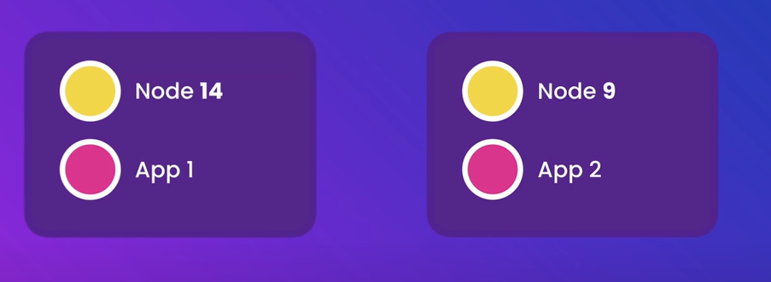
Containers:

Slide 8
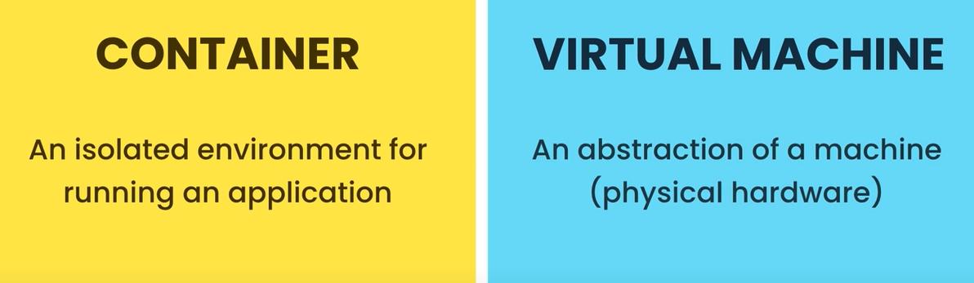
Containers v/s Virtual machine

Slide 9
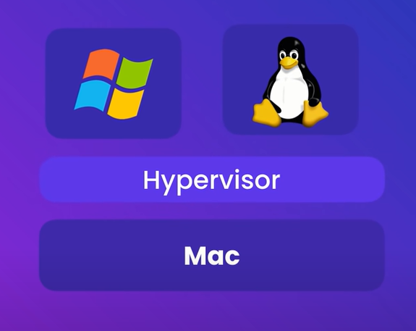
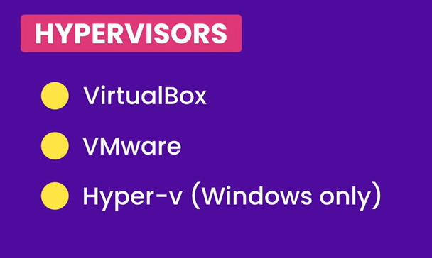
Virtual Machine

Slide 10
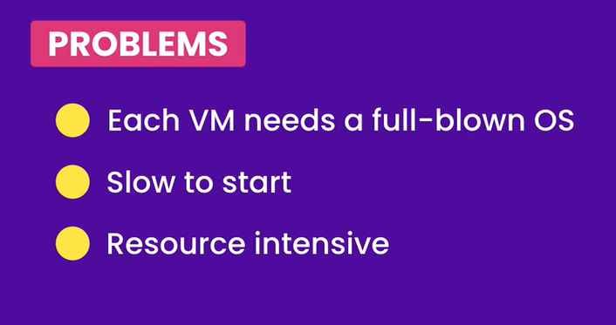

Slide 11
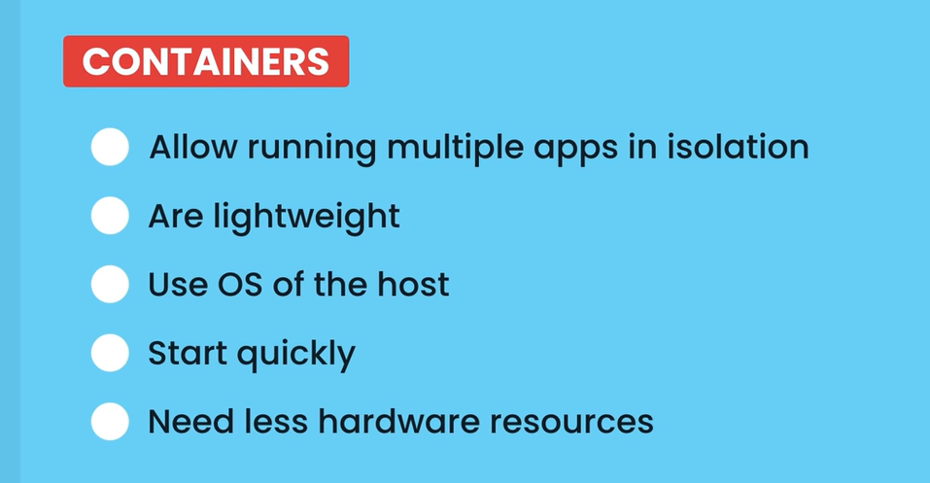

Slide 12
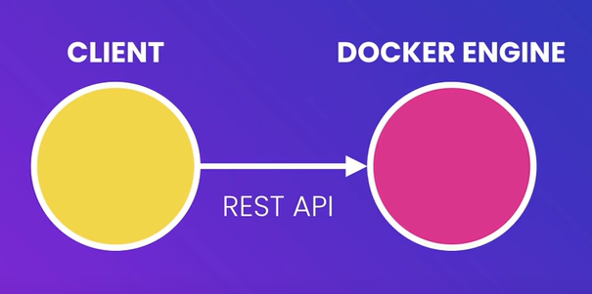
Architecture

Slide 13
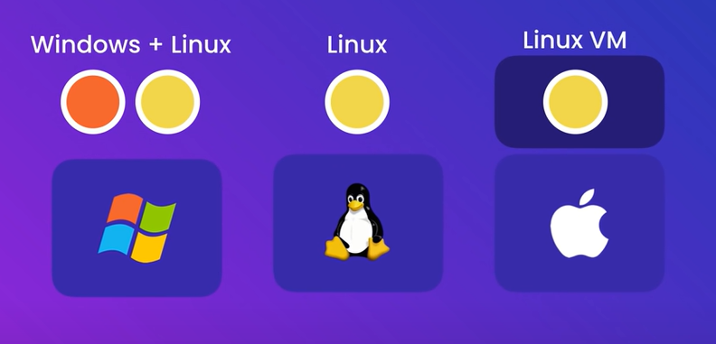
Kernel of OS

Slide 14
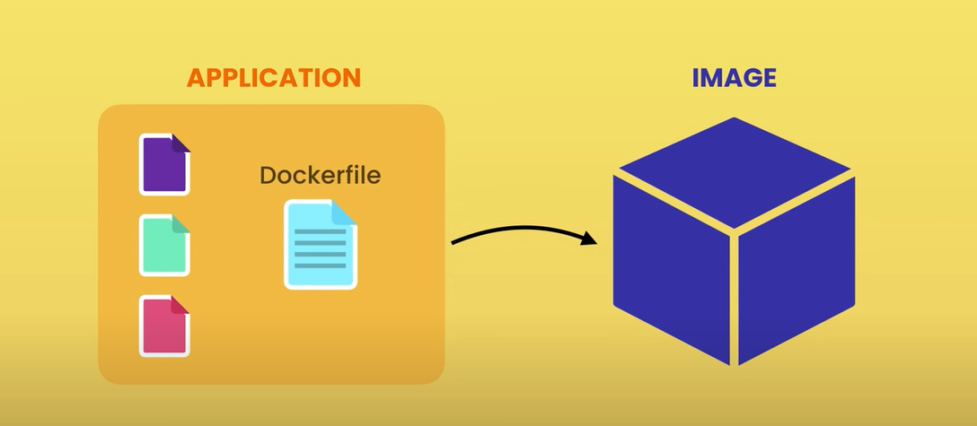
Development Workflow

Slide 15
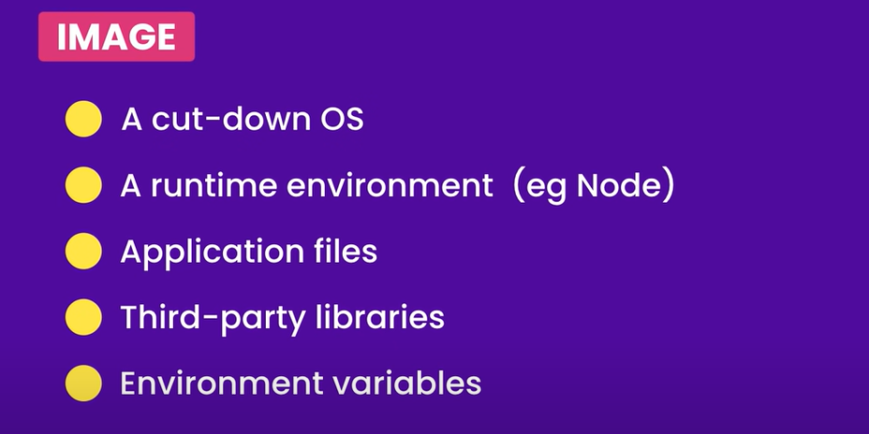

Slide 16
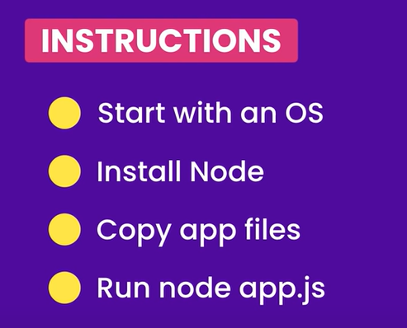

Docker in Action

Slide 17
