Slide 1

Jenkins

Slide 2

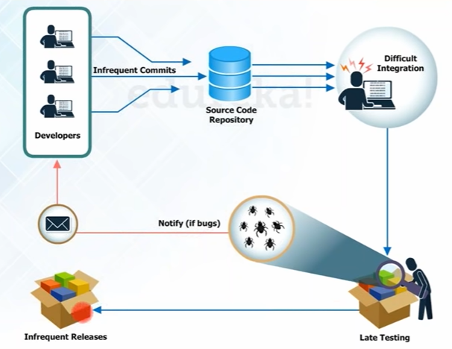
Before Continuous Integration

Slide 3
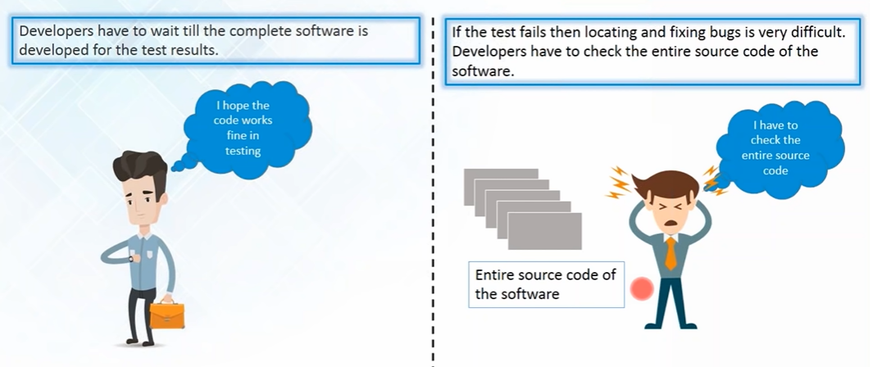
Problems

Slide 4
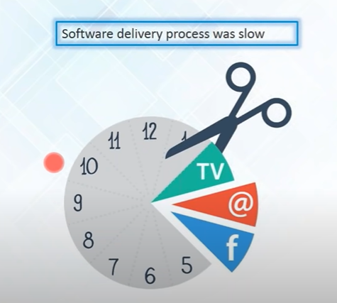

Slide 5
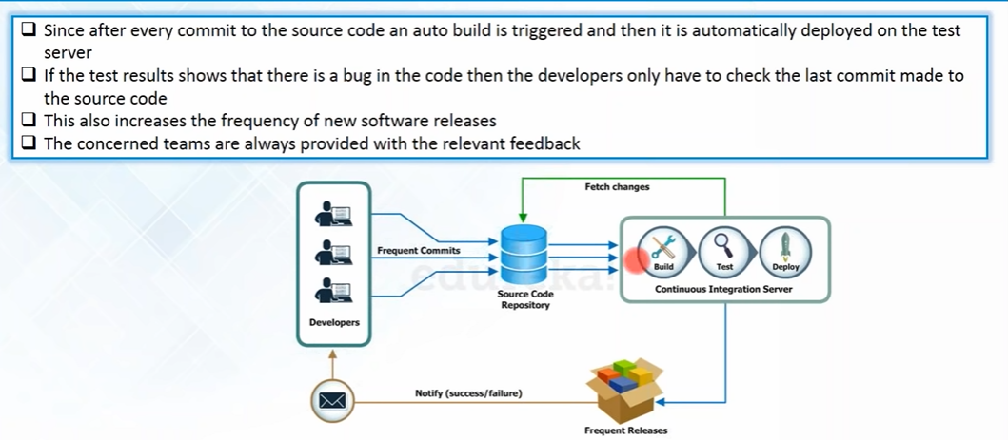
After Continuous Integration

Slide 6
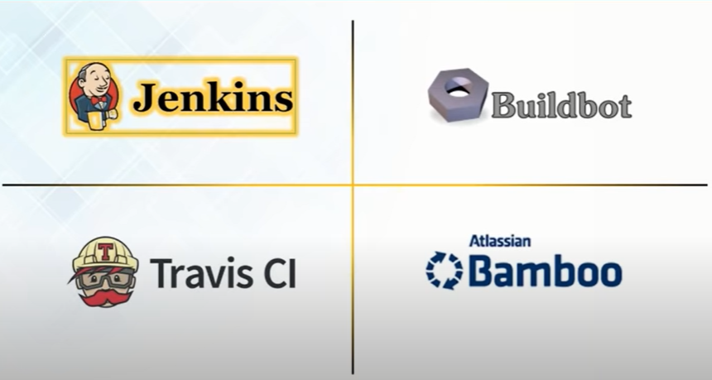
Continuous Integration Tools

Slide 7
