Slide 1
Apache Kafka

Slide 2
Apache Kafka Terminology
Producer
Consumer
Broker
Cluster
Topic
Partitions
Offset
Consumer groups

Slide 3
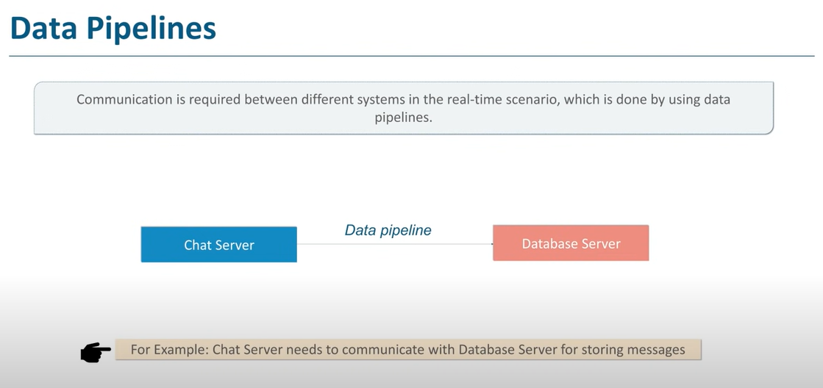

Slide 4
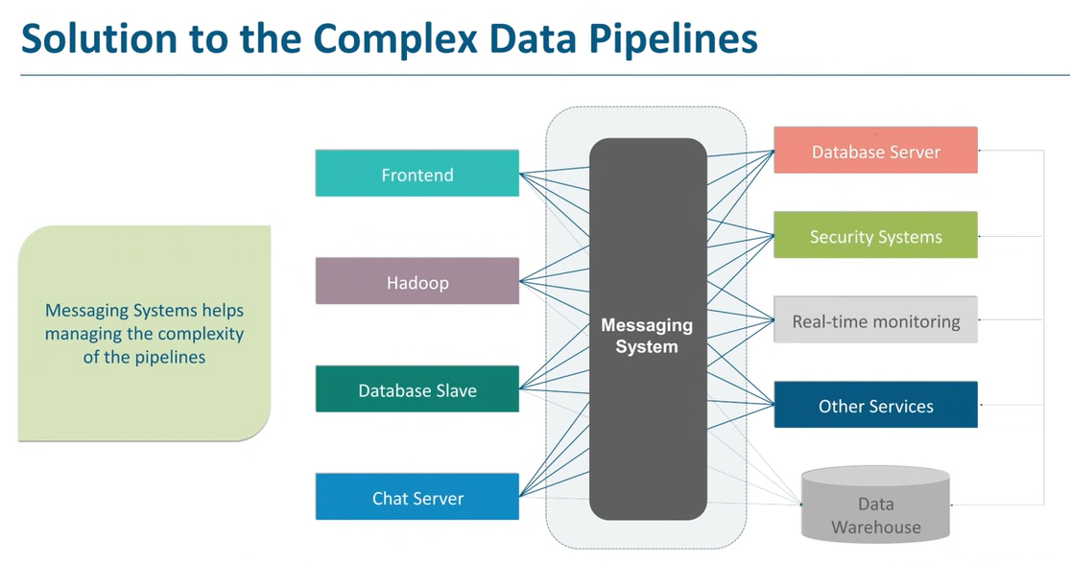

Slide 5
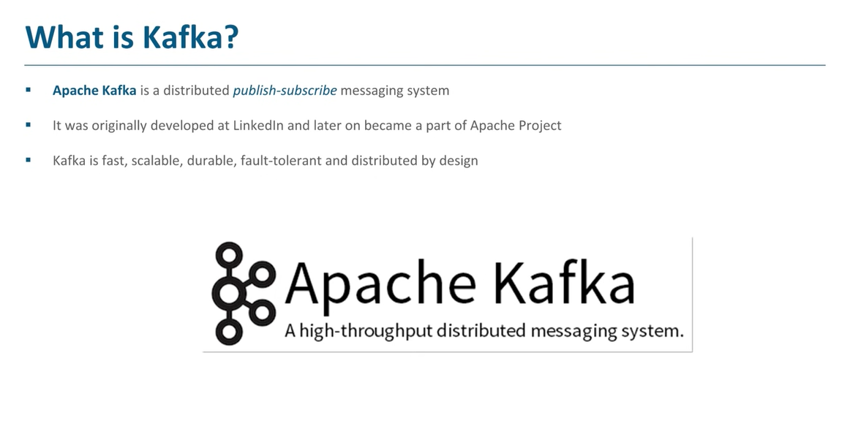

Slide 6
What is Producer?
An Application that sends a message to Kafka Server.

Slide 7
What is Message?
Small to medium size piece of data.
For Kafka, its an array of bytes.

Slide 8
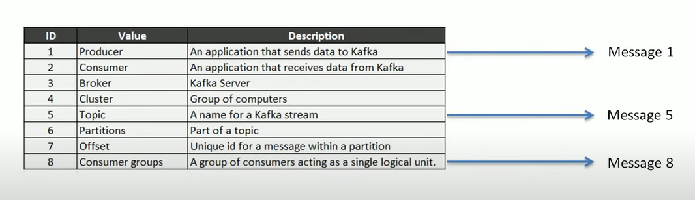
Example:

Slide 9
What is Consumer?
An Application that reads a message from Kafka Server.

Slide 10
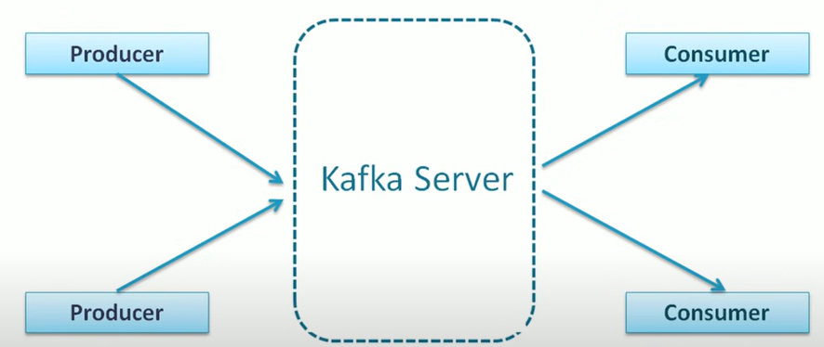

Slide 11
What is Kafka Broker?
Kafka Server is a Broker between Producer and Consumer.
It helps in exchanging messages between Producer and Consumer.

Slide 12
What is Cluster?
Cluster is a group of Brokers, where each broker is an instance of Kafka Broker.

Slide 13
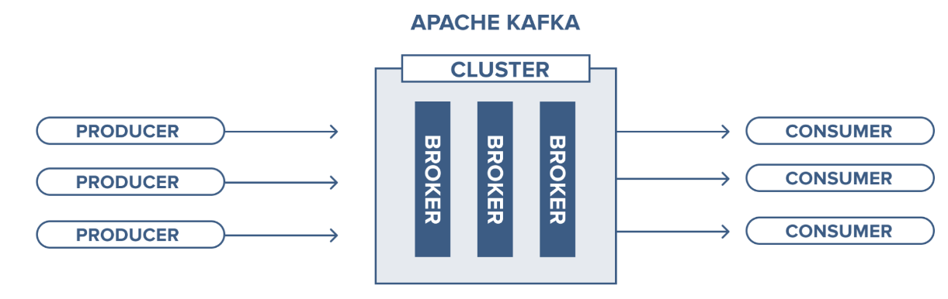

Slide 14
What is Topic?
It’s a unique name given to Kafka Stream.
Through this, Producer and Consumer exchange messages.

Slide 15
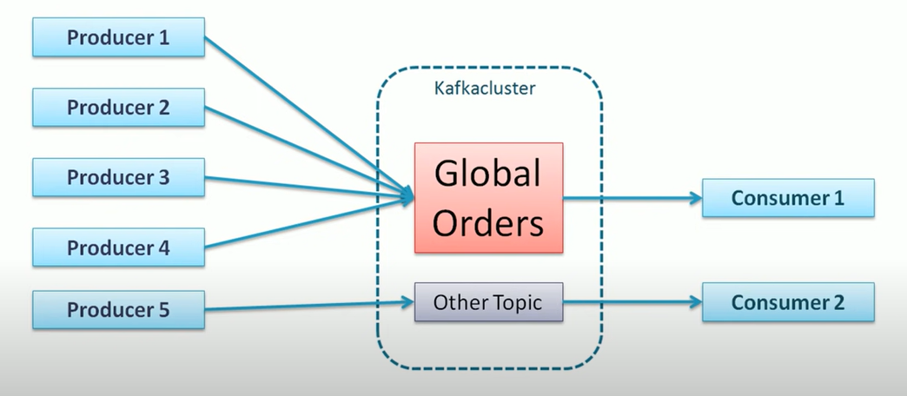
Topic Example

Slide 16
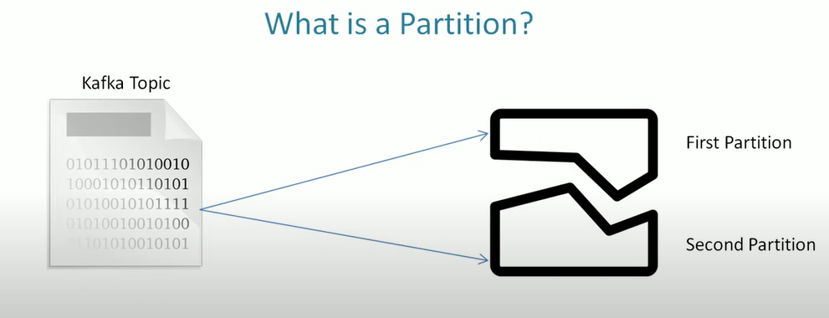

Slide 17
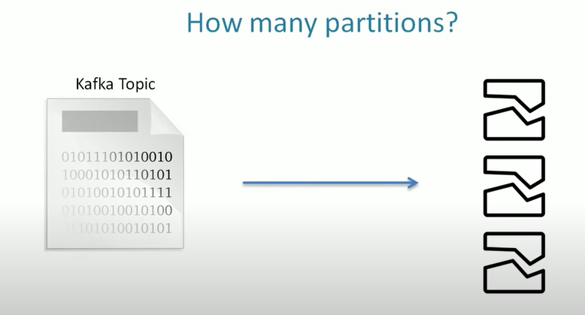

Slide 18
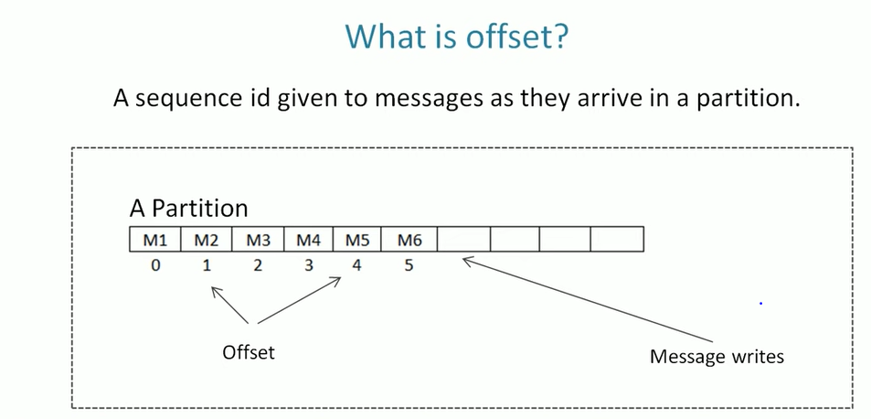

Slide 19
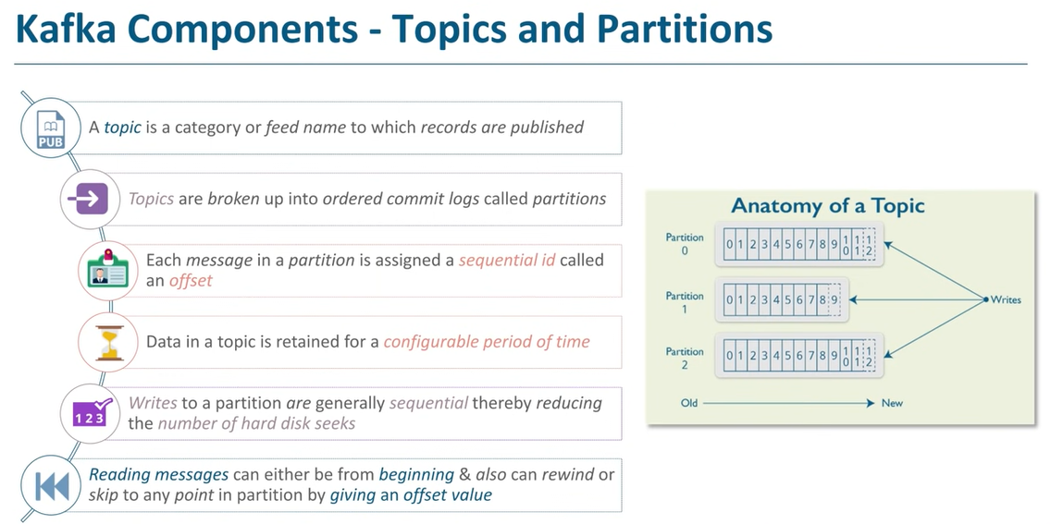

Slide 20
What is Consumer Group?
A group of consumers acts as a single logical unit.

Slide 21
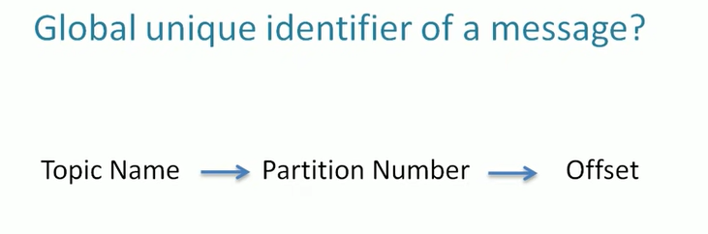

Slide 22
