Slide 1
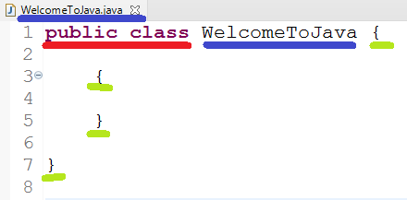
Class
Start the program with “public class”. public and class are Keywords. Keywords are words in purple color and should be typed in lowercase.
Class name should match file name(without extension). Class name can contain alphabets, numbers , $ and _ symbol (no space)
Number of closing and opening brackets should match. Below there are 2 open and 2 close brackets

Slide 2
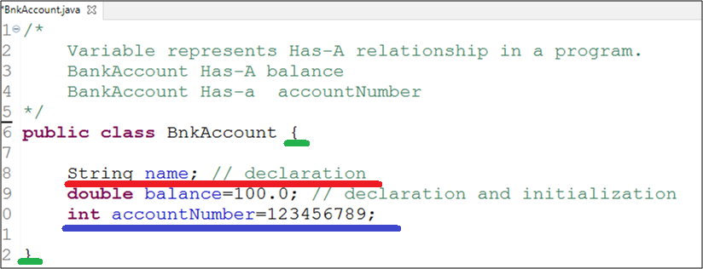
Variables = HAS-A connections to the program
Variable Should be written inside open and close curly bracket “{ }” .
Below is how we write code for variables.
LHS (code on left of equal sign) = RHS (code on right sideof equal sign)
DATA_TYPE VARIABLE_NAME = VALUE ; (variable declaration and initialization)
DATA_TYPE VARIABLE_NAME ; (variable declaration)
DATA_TYPE describes the type of information you wish to store in the software.
Data type can be
Numeric : byte, int, short, long
Decimal : float, double
Yes/No : boolean
Single Character : char
Complex :
group of Character : String
contains sub-information : create another program to hold the sub information

Slide 3
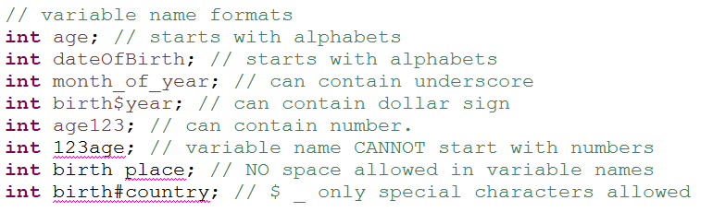
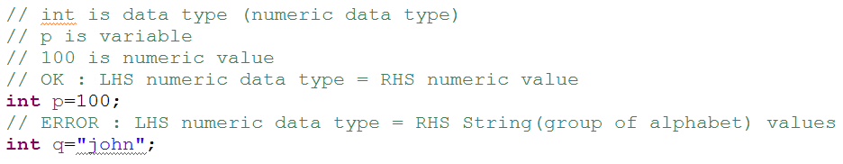
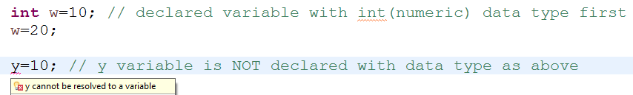
Variable’s naming rules
Variable’s Data type should match Values
Variable means something that changes, so variable value can also be changed.
Variable has to be declared before using it.

Slide 4
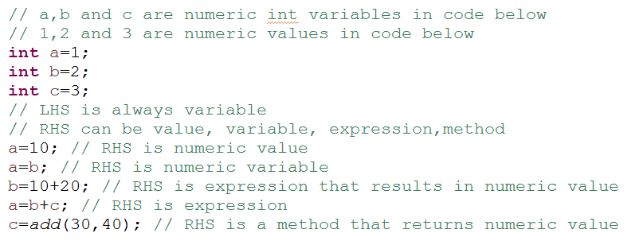
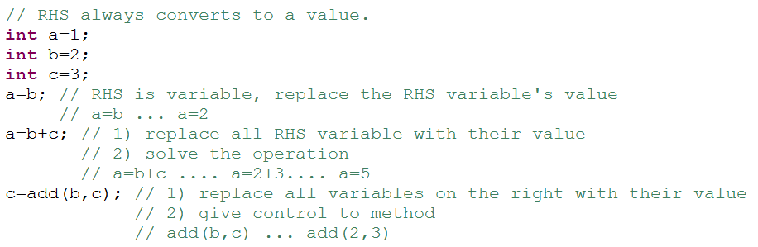

Slide 5

Methods DECLARATION
how to recognize methods : Does-A exercise
Calculator Does addition
how to code methods :
What to name this activity ??? addition
how many inputs are required ??? what are the data type of each inputs ???
If 0 input leave it blank
If 1 input write data type and input name(parameter)
If more than 1 input write pair of data type and input name(parameter) comma separated
2 inputs, int number1 , int number2
how many returns/outputs are required ??? what is the data type of each output ???
If 0 output write void
If 1 input write data type
If more than 1 output, create complex class and write class name
1 output.. Int

Slide 6
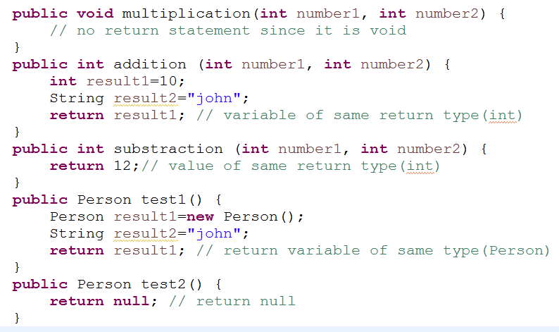
Methods - RETURN STATEMENT
If the output/return type is void.
No return statement needed
if the output/return type is primitive or simple
any variable of same type or any value of same data type can be returned
if the output/return type is complex/object/reference data type
any variable of same type or null value can be returned.

Slide 7
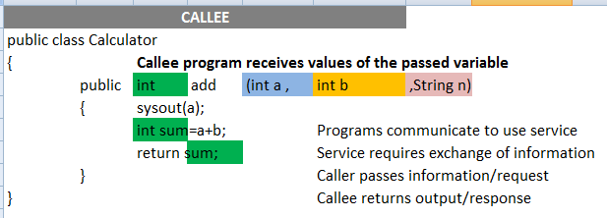
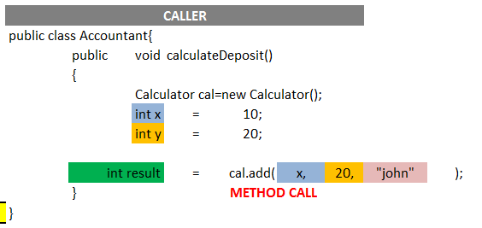
Methods - CALL
Method calls are a way for programs to communicate
number of input should match
data type of input should match
order of input should match
Return type from other program should match LHS variable

