Slide 1
Java installation

Slide 2
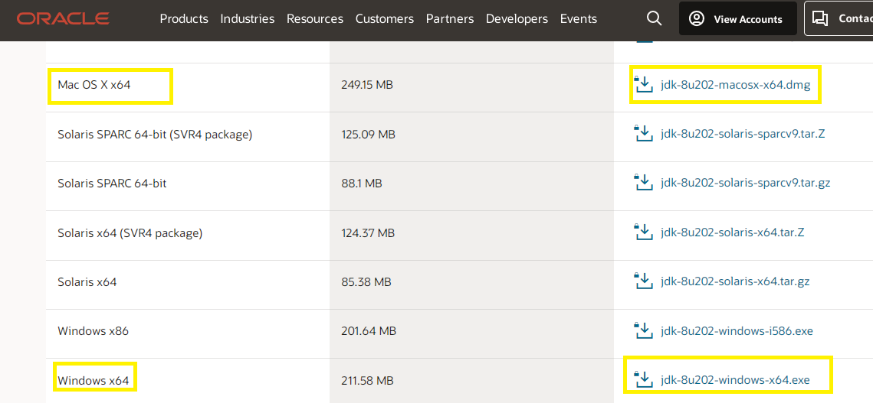
Java Installation Guide:
Steps:
Download Java 1.8 Version from below Path
https://www.oracle.com/in/java/technologies/javase/javase8-archive-downloads.html
Click on Java Version downloaded to Install ( choose windows or mac accordingly)

Slide 3
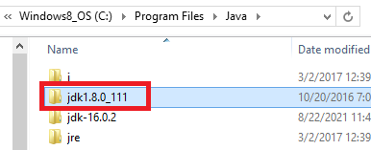
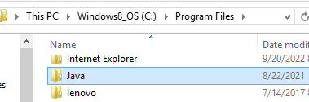
If prompted for registration. Complete oracle registration and start from previous slide again.
Download the jdk after repeating steps from previous slide
Go to download folders on your laptop and double click the jdk installer file
Install java (use default values from java installer and complete installation (click next next… finish)
Check in Program Files for folder C:\Program Files\Java
Ensure the java folder contains “JDK”
(OPTIONAL) Setup System Environment Variables
Path: C:\Program Files\Java\jdk-18.0.1.1\bin
JAVA_HOME: C:\Program Files\Java\jdk-18.0.1.1
(OPTIONAL) Check Java installation in CMD Prompt
java -version
javac -version

Slide 4
Spring tool suite installation

Slide 5
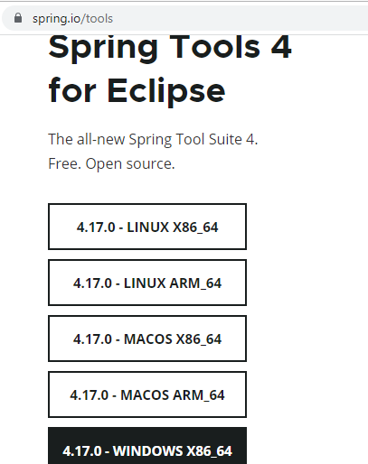
Download Spring Tool IDE from below Path (choose windows or mac accordingly)
https://spring.io/tools

Slide 6
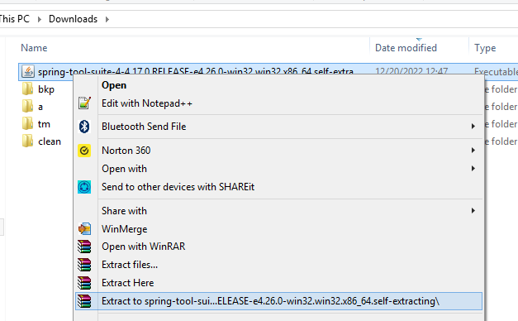
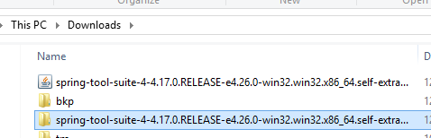
Right click on downloads/spring-tool… file and extract
Open spring folder

Slide 7
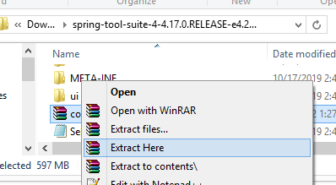
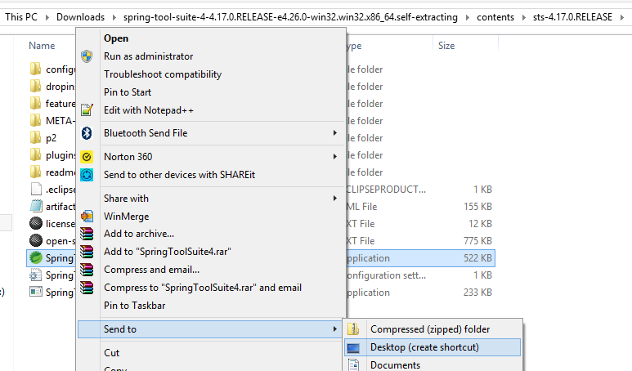
Right click on content… extract
Open sts folder
Right click on green spring icon. Send to… desktop shortcut

Slide 8
Github desktop install

Slide 9
Go to https://desktop.github.com/
Download and install github desktop

Slide 10
Java project Configuration

Slide 11
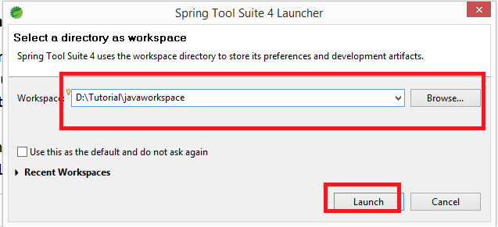
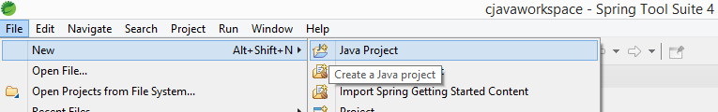
Double click spring green icon from desktop
Enter location where you would like to keep java projects
Click file in left top corner
Select new > java project

Slide 12
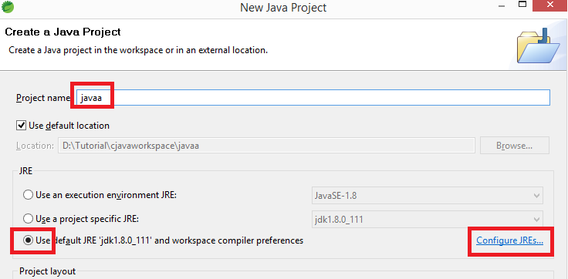
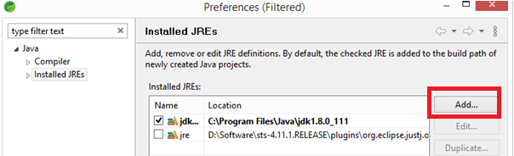
Enter project name
Select default jre
Click configure jre
Click add

Slide 13
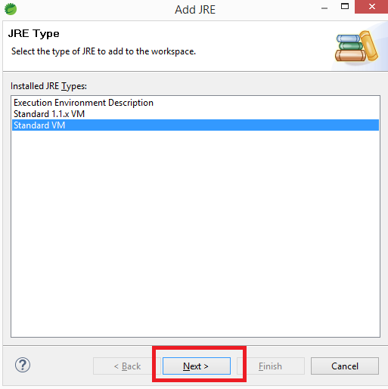
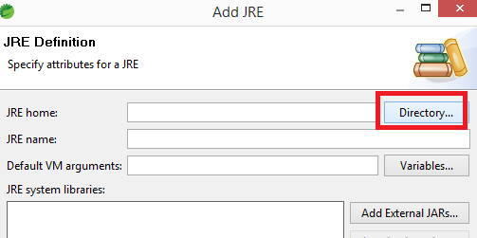
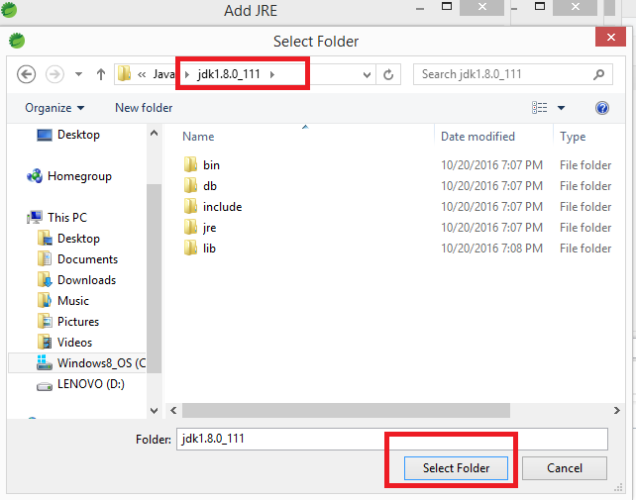
Click next
Click directory
Browse to c:/programfile/java/jdk
Click select folder

Slide 14
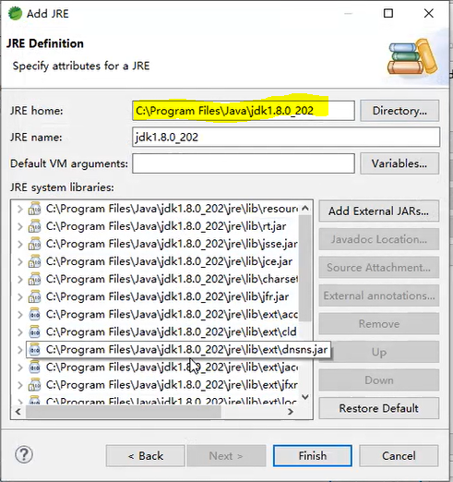
Click finish

Slide 15
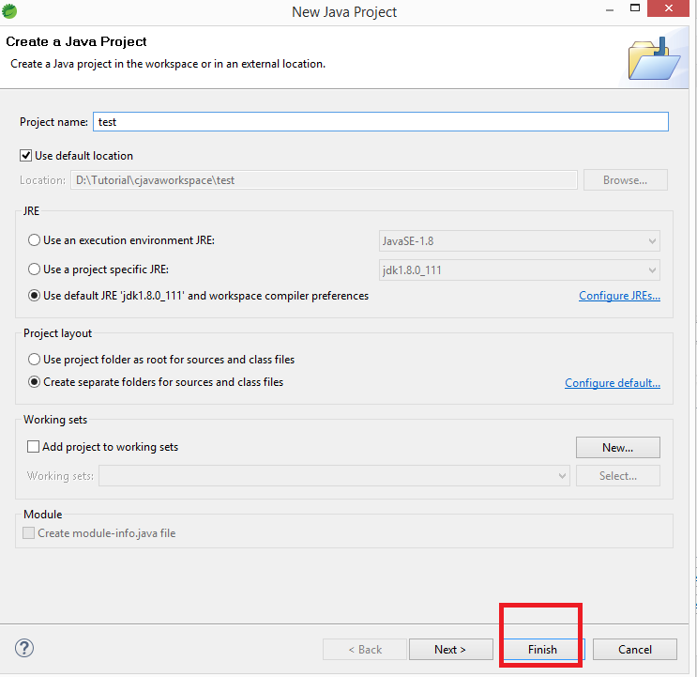
Click finish

Slide 16
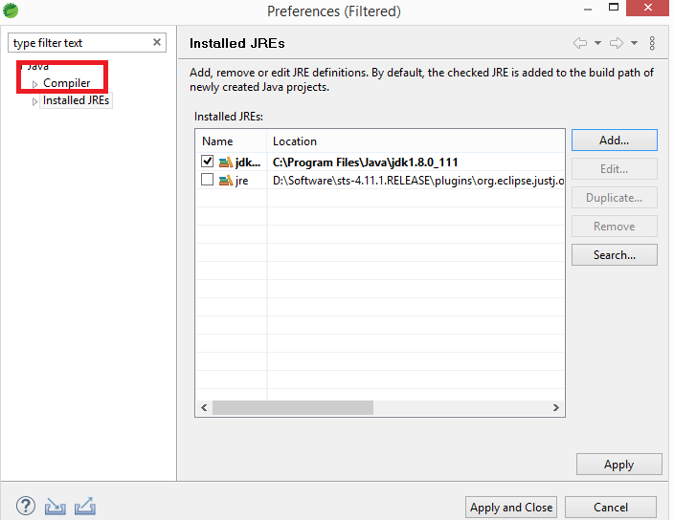
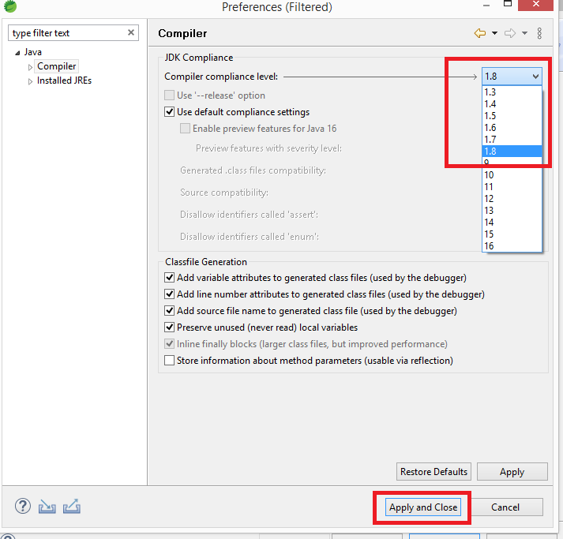
Click compiler on the left
Select 1.8 in drop down
Click apply and close

Slide 17
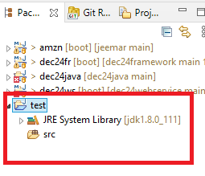
New Java project is created

Slide 18
Git Project training material configuration

Slide 19
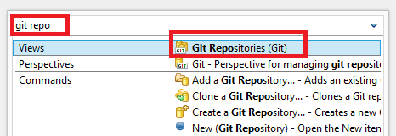
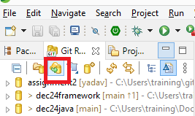
Click search icon on the right
Type git repo > select git repositories
Click green git icon
(Clone git repository)

Slide 20
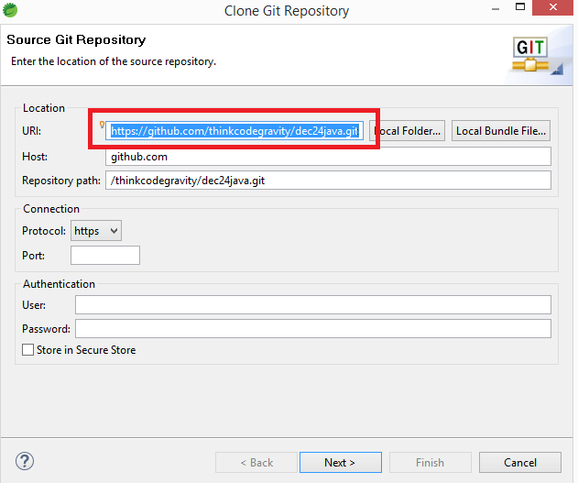
In URI enter https://github.com/thinkcodegravity/dec24java.git
Click next

Slide 21
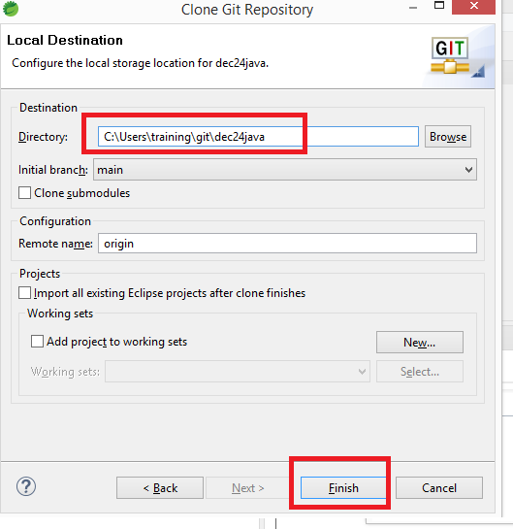
Click next… next…
REMEMBER THIS LOCATION SHOWN BELOW IN RED.. WE WILL NEED THIS IN SLIDE #22 LATER
Click finish

Slide 22
training project import

Slide 23
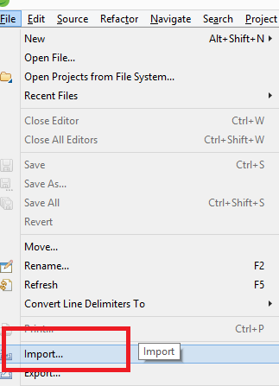
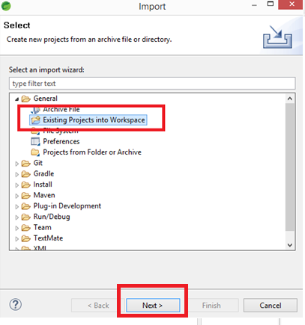
Click file
Click import
Click general
Click existing projects into workspace
Click next

Slide 24
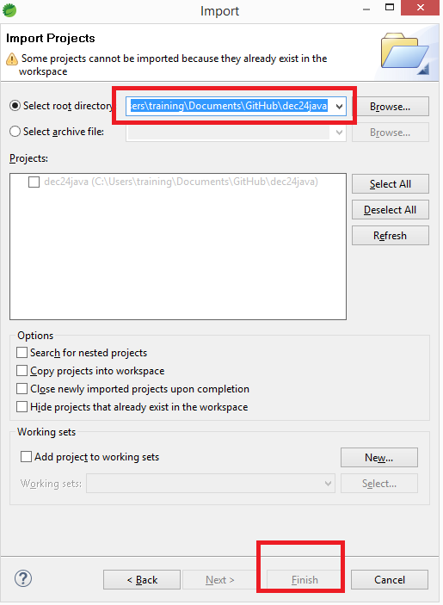
Enter the location from slide 19
Click finish

Slide 25
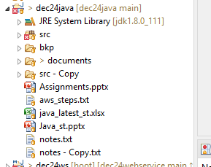
Training material and training session java projects is now setup

Slide 26
Git Project Assignment configuration

