Slide 1
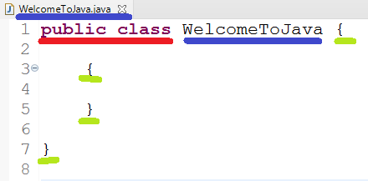
Class
Start the program with “public class”. public and class are Keywords. Keywords are words in purple color and should be typed in lowercase.
Class/variable/method name should match file name(without extension). Class name can contain alphabets, numbers , $ and _ symbol (no space)
Number of closing and opening brackets should match. Below there are 2 open and 2 close brackets

Slide 2
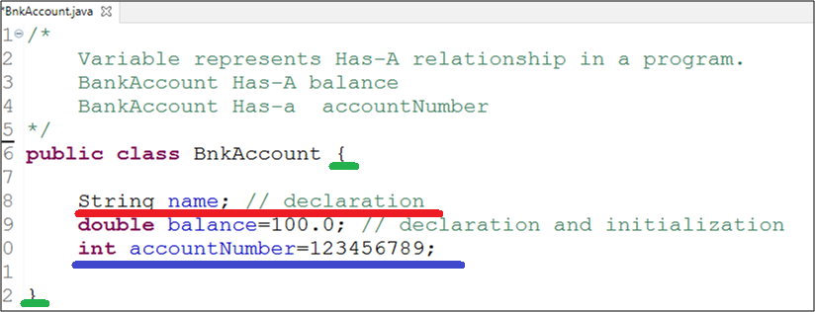
Variables = HAS-A connections to the program
Variable Should be written inside open and close curly bracket “{ }” .
Below is how we write code for variables.
LHS (code on left of equal sign) = RHS (code on right sideof equal sign)
DATA_TYPE VARIABLE_NAME = VALUE ; (variable declaration and initialization)
DATA_TYPE VARIABLE_NAME ; (variable declaration)
DATA_TYPE describes the type of information you wish to store in the software.
Data type can be
Numeric : byte, int, short, long
Decimal : float, double
Yes/No : boolean
Single Character : char
Complex :
group of Character : String ( group of alphaet, number, special character)
contains sub-information : create another program to hold the sub information

Slide 3
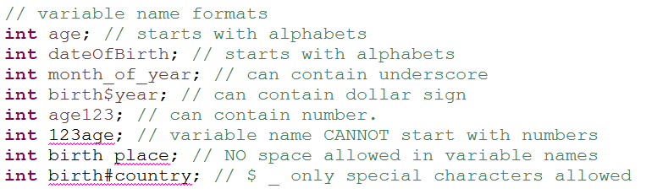
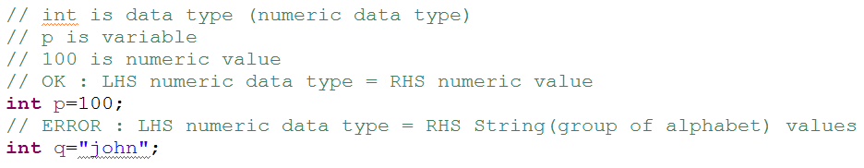
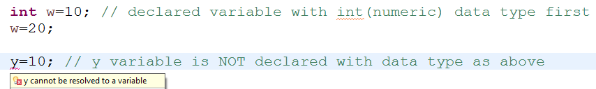
Variable’s naming rules
Variable’s Data type should match Values
Variable means something that changes, so variable value can also be changed.
Variable has to be declared before using it.

Slide 4
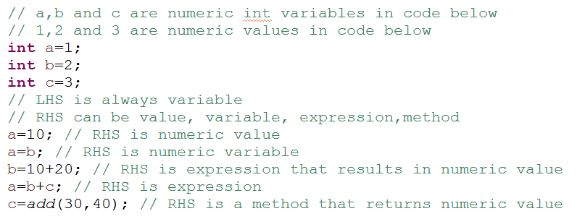
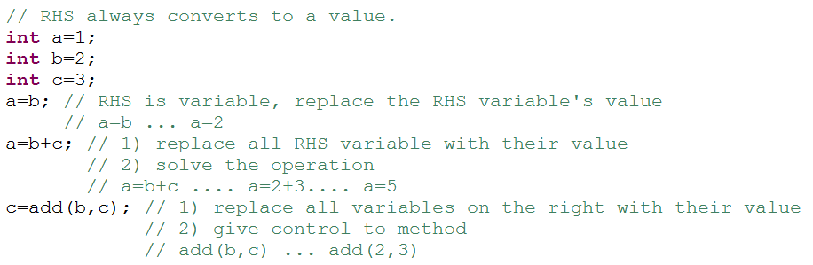

Slide 5

Methods DECLARATION
how to recognize methods : Does-A exercise
Calculator Does addition
how to code methods :
What to name this activity ??? addition
how many inputs are required ??? what are the data type of each inputs ???
If 0 input leave it blank
If 1 input write data type and input name(parameter)
If more than 1 input write pair of data type and input name(parameter) comma separated
2 inputs, int number1 , int number2
how many returns/outputs are required ??? what is the data type of each output ???
If 0 output write void
If 1 input write data type
If more than 1 output, create complex class and write class name
1 output.. Int

Slide 6
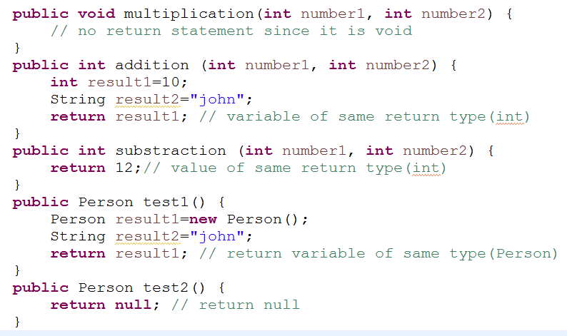
Methods - RETURN STATEMENT
If the output/return type is void.
No return statement needed
if the output/return type is primitive or simple
any variable of same type or any value of same data type can be returned
if the output/return type is complex/object/reference data type
any variable of same type or null value can be returned.

Slide 7
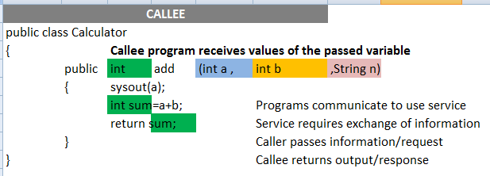
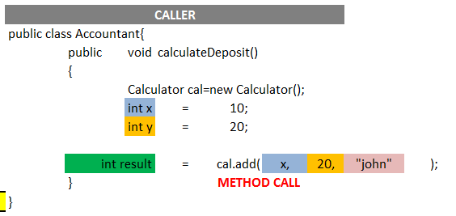
Methods - CALL
Method calls are a way for programs to communicate
number of input should match
data type of input should match
order of input should match
Return type from other program should match LHS variable

