Slide 1


A New Approach to E-Prescribing: Semantic Medical Prescriptions
Ali Khalili
Bita Sedaghati

Slide 2
Agenda
E-Prescriptions
Linked Open (Drug) Data
Semantic Documents
Semantic E-Prescriptions
Advantages of Semantic E-Prescriptions
Pharmer: Writing Semantic E-Prescriptions
Pharmer: Ecosystem
Pharmer: Evaluation
Conclusion

Slide 3
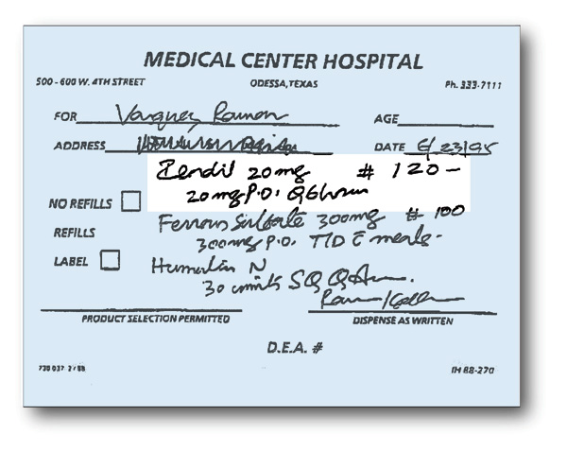

E-Prescriptions
✓

Slide 4
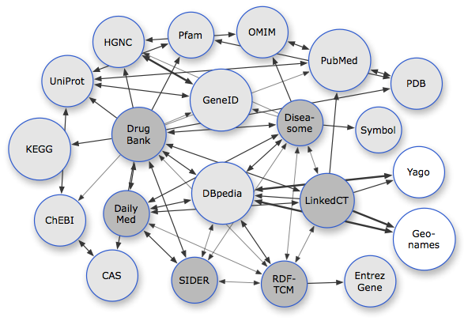
Linked Open (Drug) Data

Slide 5





Semantic Documents

Slide 6
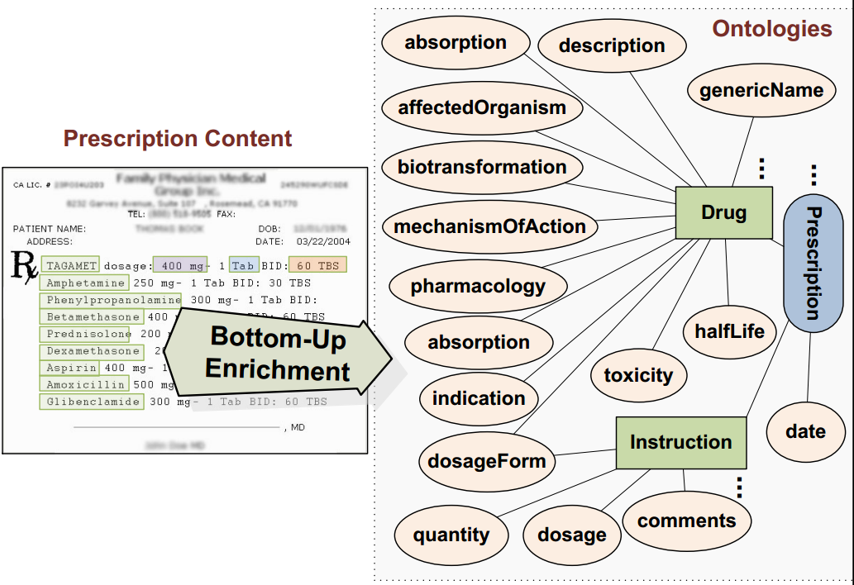
Semantic E-Prescription

Slide 7
Advantages of Semantic Prescriptions
Persistent connection to up-to-date drug information coming from multiple dynamic data sources.
Drug interactions prevention→ Error free prescriptions.
Machine understandable prescription.
Patient awareness.
Connection of physicians, pharmacists, patients, pharmaceutical researchers and drug companies.

Slide 8
Pharmer: Writing Semantic Prescriptions
An application created as a proof of concept for the authoring of semantic prescriptions.
Open-source: http://code.google.com/p/pharmer/
Features
- Providing Different Semantic Views
- Real-time Drug Tagging
- Drug Suggestion
- Automatic Drug Annotation

Slide 9
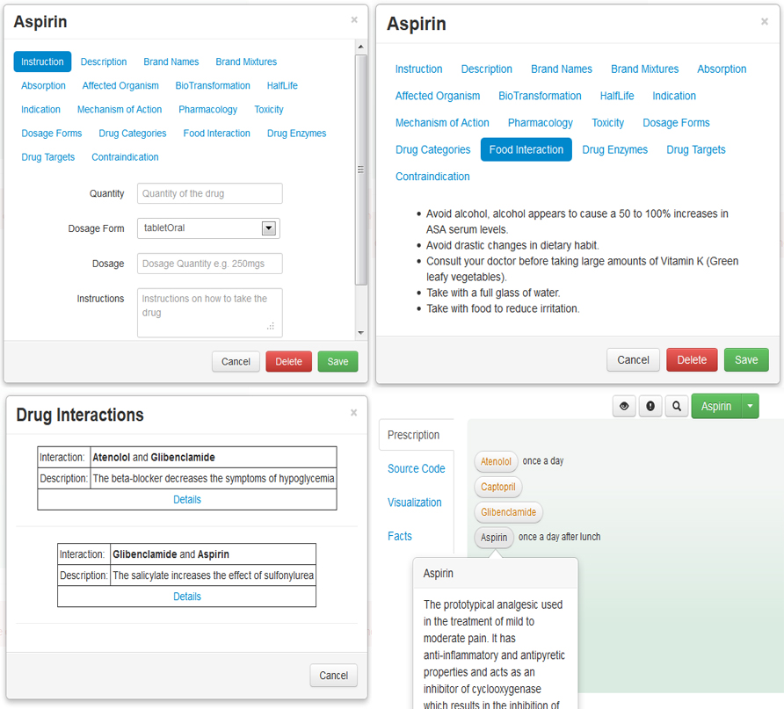
Pharmer: Demo
http://bitili.com/pharmer

Slide 10
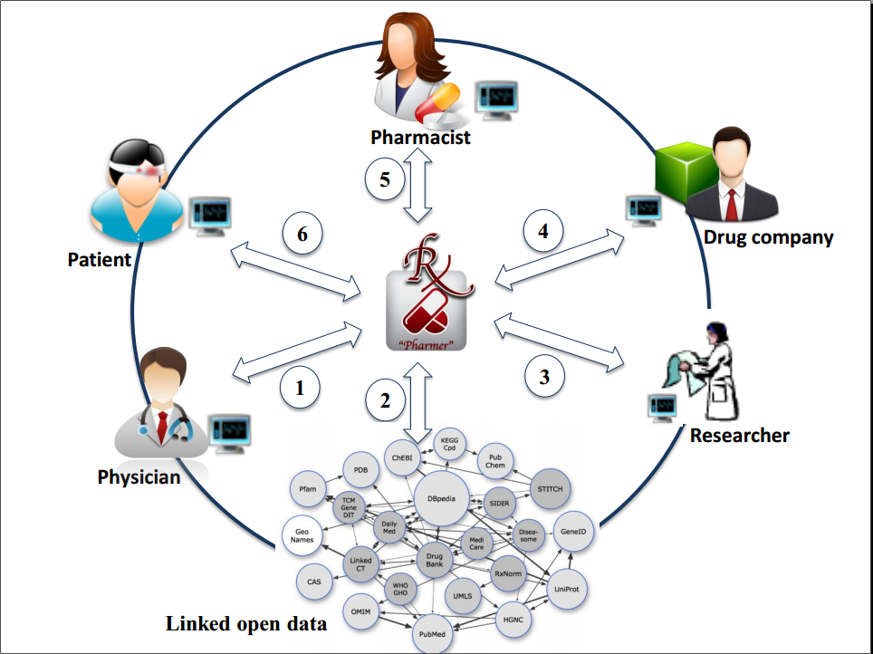
Pharmer: Ecosystem A Real Example

Slide 11
Pharmer: Evaluation
A usability user study with 12 subjects
3 physicians, 3 pharmacist, 3 pharmaceutical researchers and 3 students
Steps
A tutorial video of using different features of Pharmer
Participants were asked to create a prescription with Pharmer
A questionnaire addressing feature usage questions and usability experience questions.
Results
Usability score of 75 (System Usability Scale )

Slide 12
Conclusion
Providing a consistent connection between patients, physicians, pharmacists, pharmaceutical researchers and drug companies is a crucial step towards enhancing the quality of knowledge management and thereby e-health services in the pharmaceutical domain.
We introduced Pharmer as an approach for implementation of Semantic Prescriptions as intelligent medical prescriptions to improve the integration and interoperability of e-prescribing systems with other e-health services.

Slide 13

Questions
?

