Slide 1
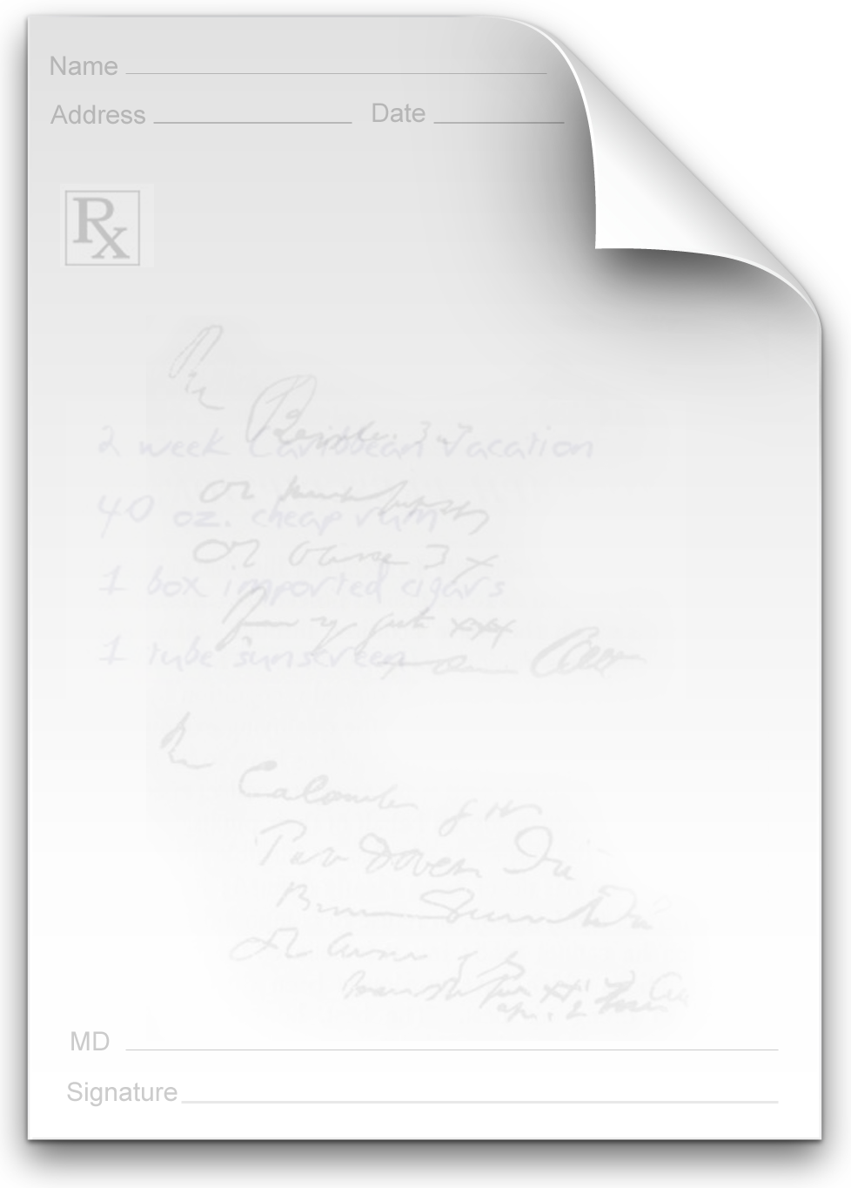


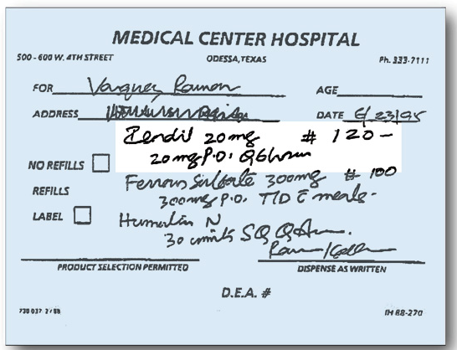
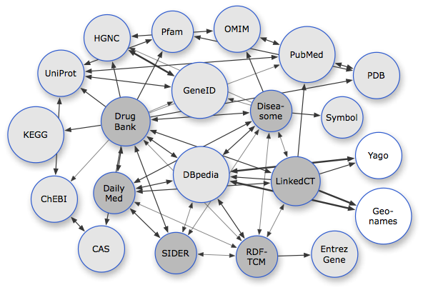
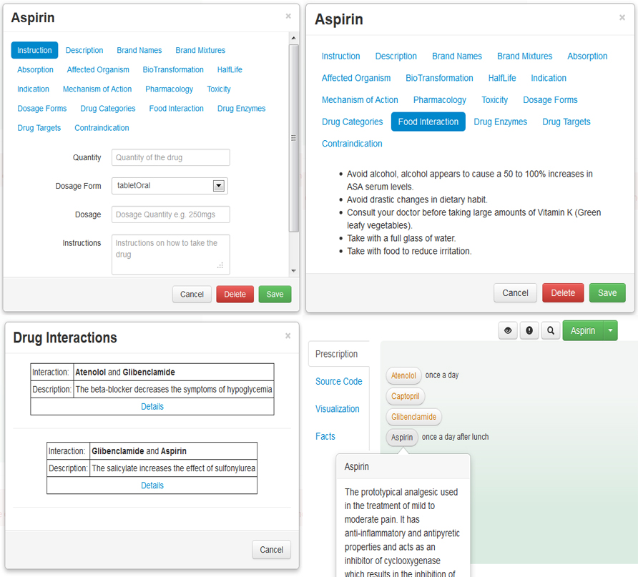
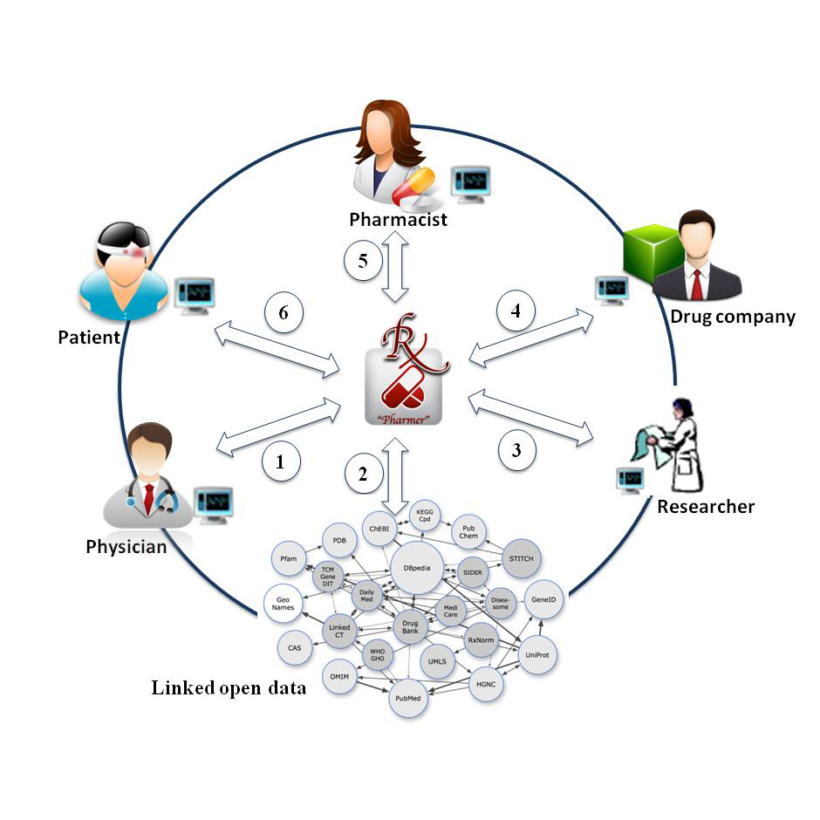




E-Prescriptions
Pharmer
✓
X
Semantic Medical Prescriptions
Semantic Prescriptions are intelligent e-prescription documents enriched by drug-related meta-data thereby know about their content and the possible interactions. They provide:
Linked Open Drug Data
Persistent connection to up-to-date drug information
coming from multiple dynamic data sources.
Drug interactions prevention→ Error free prescriptions.
Connection of physicians, pharmacists, patients,
pharmaceutical researchers and drug companies
Machine understandable prescription.
Patient awareness.
Pharmer Prescription Writer
Providing Different Semantic Views.
Real-time Drug Tagging.
Drug Suggestion.
Automatic Drug Annotation.
Ali Khalili
AKSW Research group
Institute of Informatics
khalili@informatik.uni-leipzig.de
Bita Sedaghati
Pharmaceutical Technology Research Group
Institute of Pharmacy
bita.sedaghati@uni-leipzig.de
http://www.aksw.org

