Slide 1


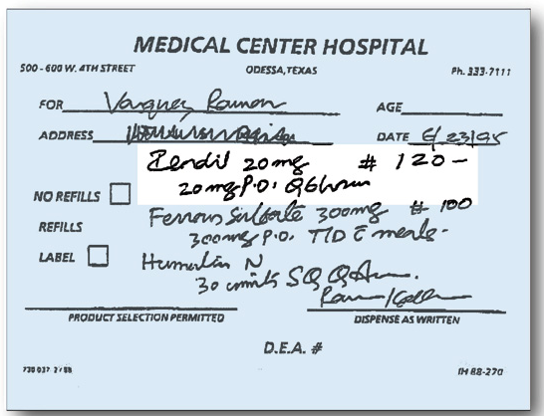

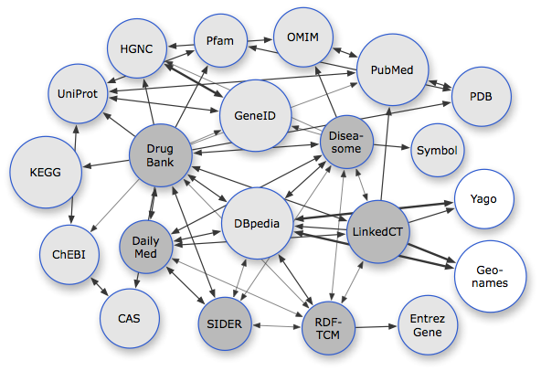
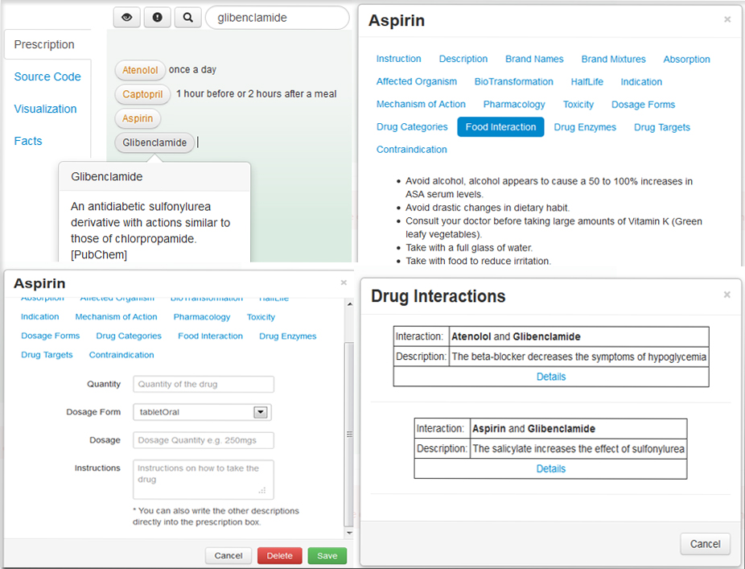
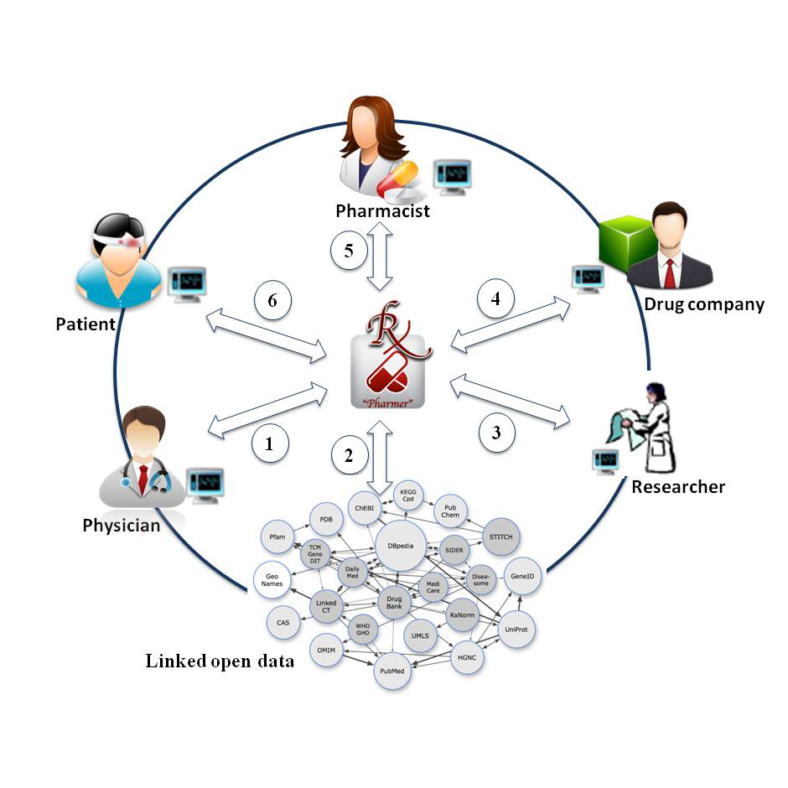


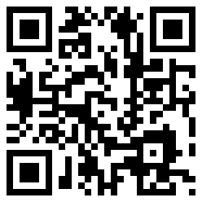

E-Prescriptions
Pharmer
✓
X
Semantic Medical Prescriptions
Semantic Prescriptions are intelligent e-prescription documents enriched by drug-related meta-data thereby know about their content and the possible interactions. They provide:
Linked Open Drug Data
Persistent connection to up-to-date drug information
coming from multiple dynamic data sources.
Drug interactions prevention→ Error free prescriptions.
http://bitili.com/pharmer
Connection of physicians, pharmacists, patients,
pharmaceutical researchers and drug companies
Machine understandable prescription.
Patient awareness.
Pharmer Prescription Writer
Providing Different Semantic Views.
Real-time Drug Tagging.
Drug Suggestion.
Automatic Drug Annotation.
The physician diagnoses the disease and writes the corresponding semantic prescription using the Pharmer. The patient's medication history is available to the physician as well.
Pharmer utilizes the Linked Open Data as its integrated information source.
The researcher can analyze the stored semantic prescriptions data.
Drug companies utilize the Pharmer data store in order to balance their production and distribution according to the market taste and demand.
The pharmacist verifies the prescription and hands in the medication to the patient.
The patient inquires drug information and can contact the related physician and pharmacist.
Ali Khalili
AKSW Research group
Institute of Informatics
khalili@informatik.uni-leipzig.de
Bita Sedaghati
Pharmaceutical Technology Research Group
Institute of Pharmacy
bita.sedaghati@uni-leipzig.de
Printed by Universitätsrechenzentrum Leipzig
http://www.aksw.org

