Slide 1





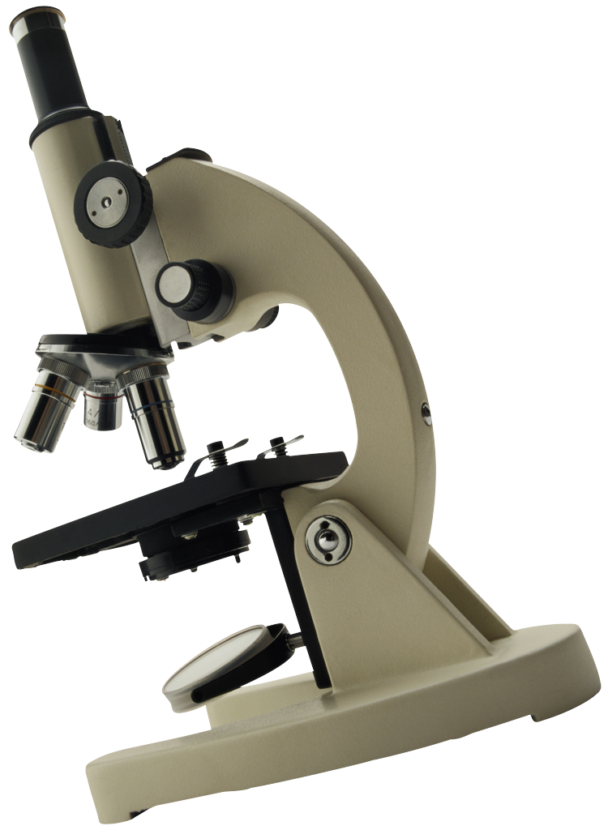
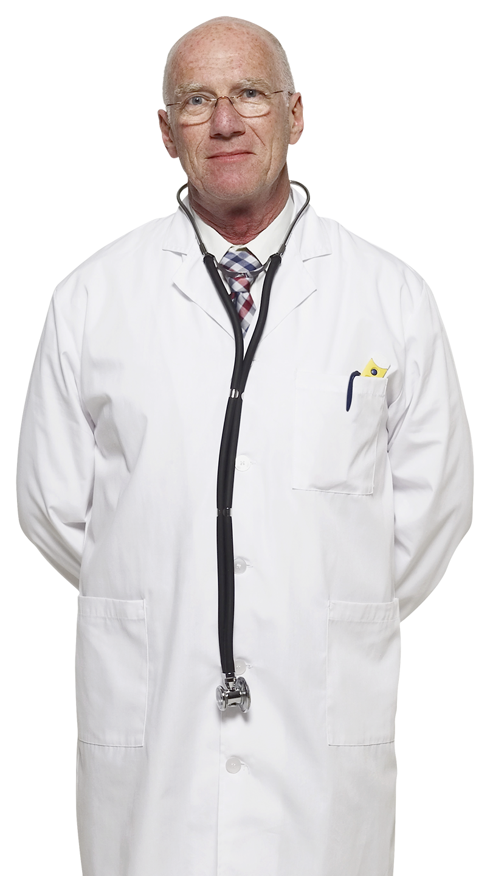
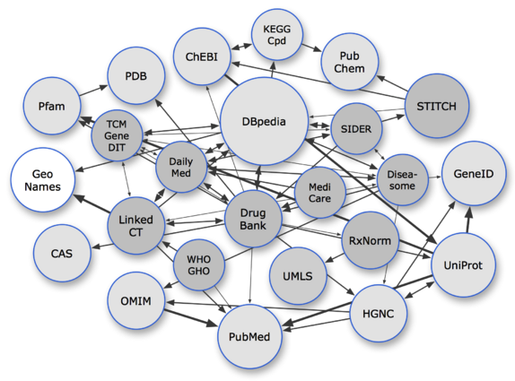
Pharmacist
Drug company
Patient
Pharmer
Reasercher
Physician
Linked open data

Slide 2
1→Patient contact physician in order to treat his disease. By that he automatically enters To the online system.
2→Physician based on his diagnosis writes an E-Rx in the system.
3→E-Rx immediately is sent to the patient’s chosen pharmacy and pharmacist verify the E-Rx and gives the medication to the patient.
4→Patient recieves the drugd from pharmacist and inquire about drugs.

